Slide 1
CHATBOT
A HEALTH CARE APPLICATION

Slide 2
CONTENTS
Team Info
Introduction
Flow chart
Architecture
Techniques
Plan for project execution

Slide 3
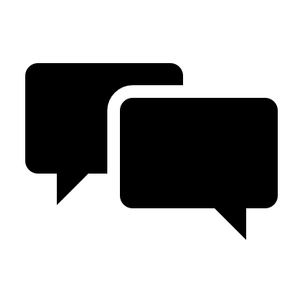
DEEPMIND
Mahnoor Rana
Jayalakshmi Basetty
Mohamed Suhail
Sagnik Bhattacherjee
Muaaz Ahmad Saeed
Gundarapu Narsimha Reddy

Slide 4
Introduction
A chatbot originally chatterbot is a software application that aims to mimic human conversation through text or voice interactions.
A chatbot is an automated tool designed to simulate an intelligent conversation with human users.
Healthcare chatbots are the next frontier in virtual customer service as well as planning and management in healthcare businesses.

Slide 5
FLOW CHART
DATA PREPROCESSING
DATA COLLECTION
DATA CLEANING
DATA TRANSFORMATION
MODEL BUILDING
INTENT RECOGNITION
&
ENTITY EXTRACTION
USER INPUT
OUTPUT

Slide 6
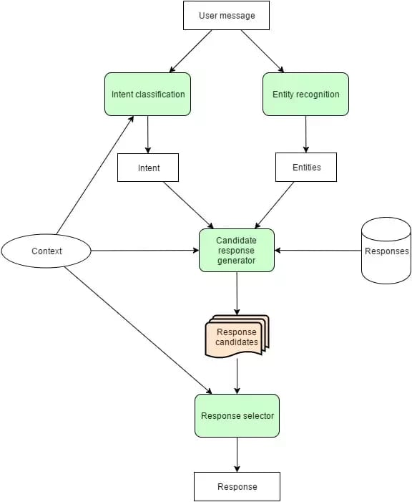
ARCHITECTURE

Slide 7
TECHNIQUES
Natural Language Processing(NLP)
RASA Framework
Intent recognition
Entity Extraction
Dialog management

Slide 8
PLAN
Data Collection
Dataset Preparation
Model building
NLP and Dialog management
CHATBOT Development
Testing and Evaluation
Deployment
Documentation

Slide 9
Model building
Text Pre-Processing
Creating YAML files
Training dataset
RASA Installation & Setup
Training the RASA model

Slide 10
evaluation
Testing the RASA ChatBot
Improvements and Iteration
Expansion and Evaluation
Deployment
Future scope

Slide 11
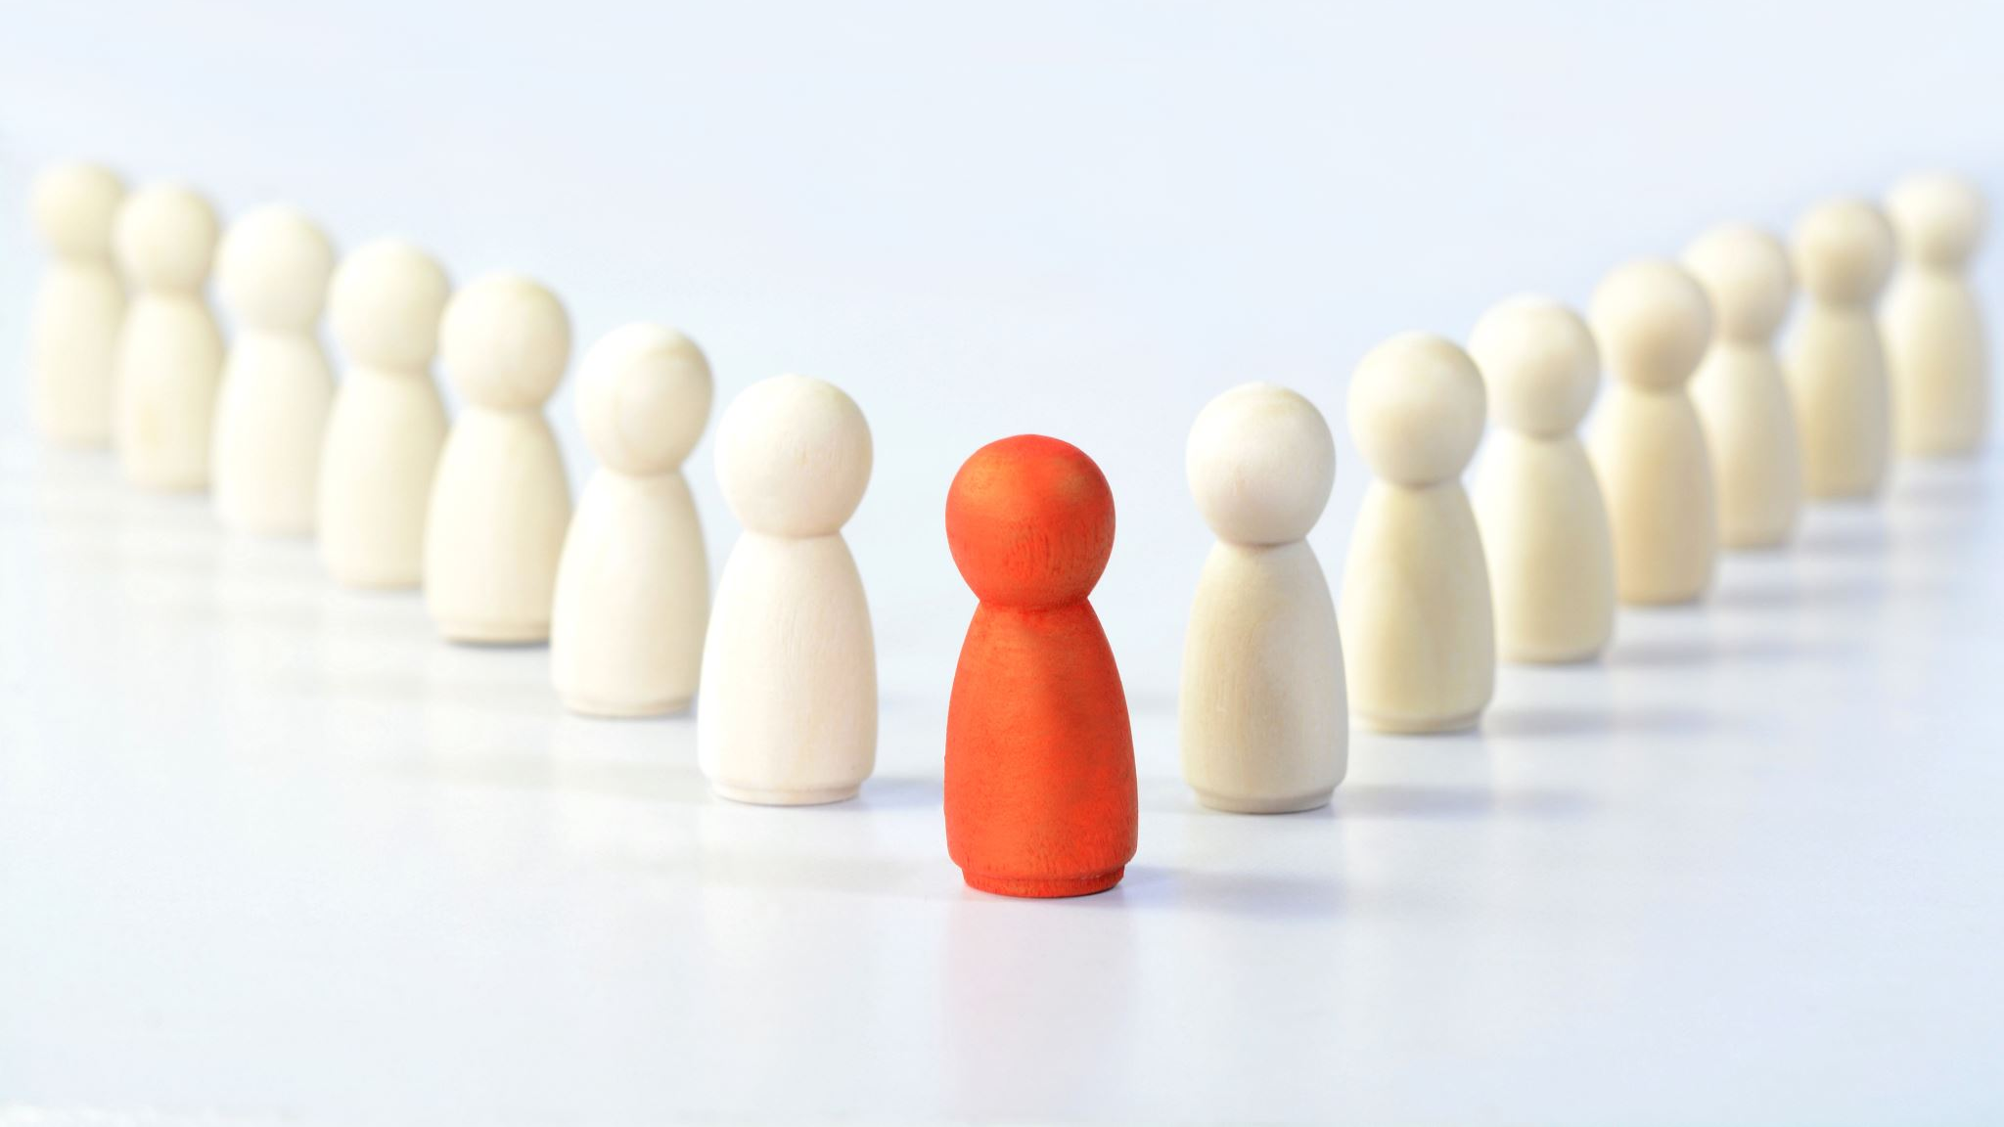

ACKNOWLEDGEMENTS

Slide 12
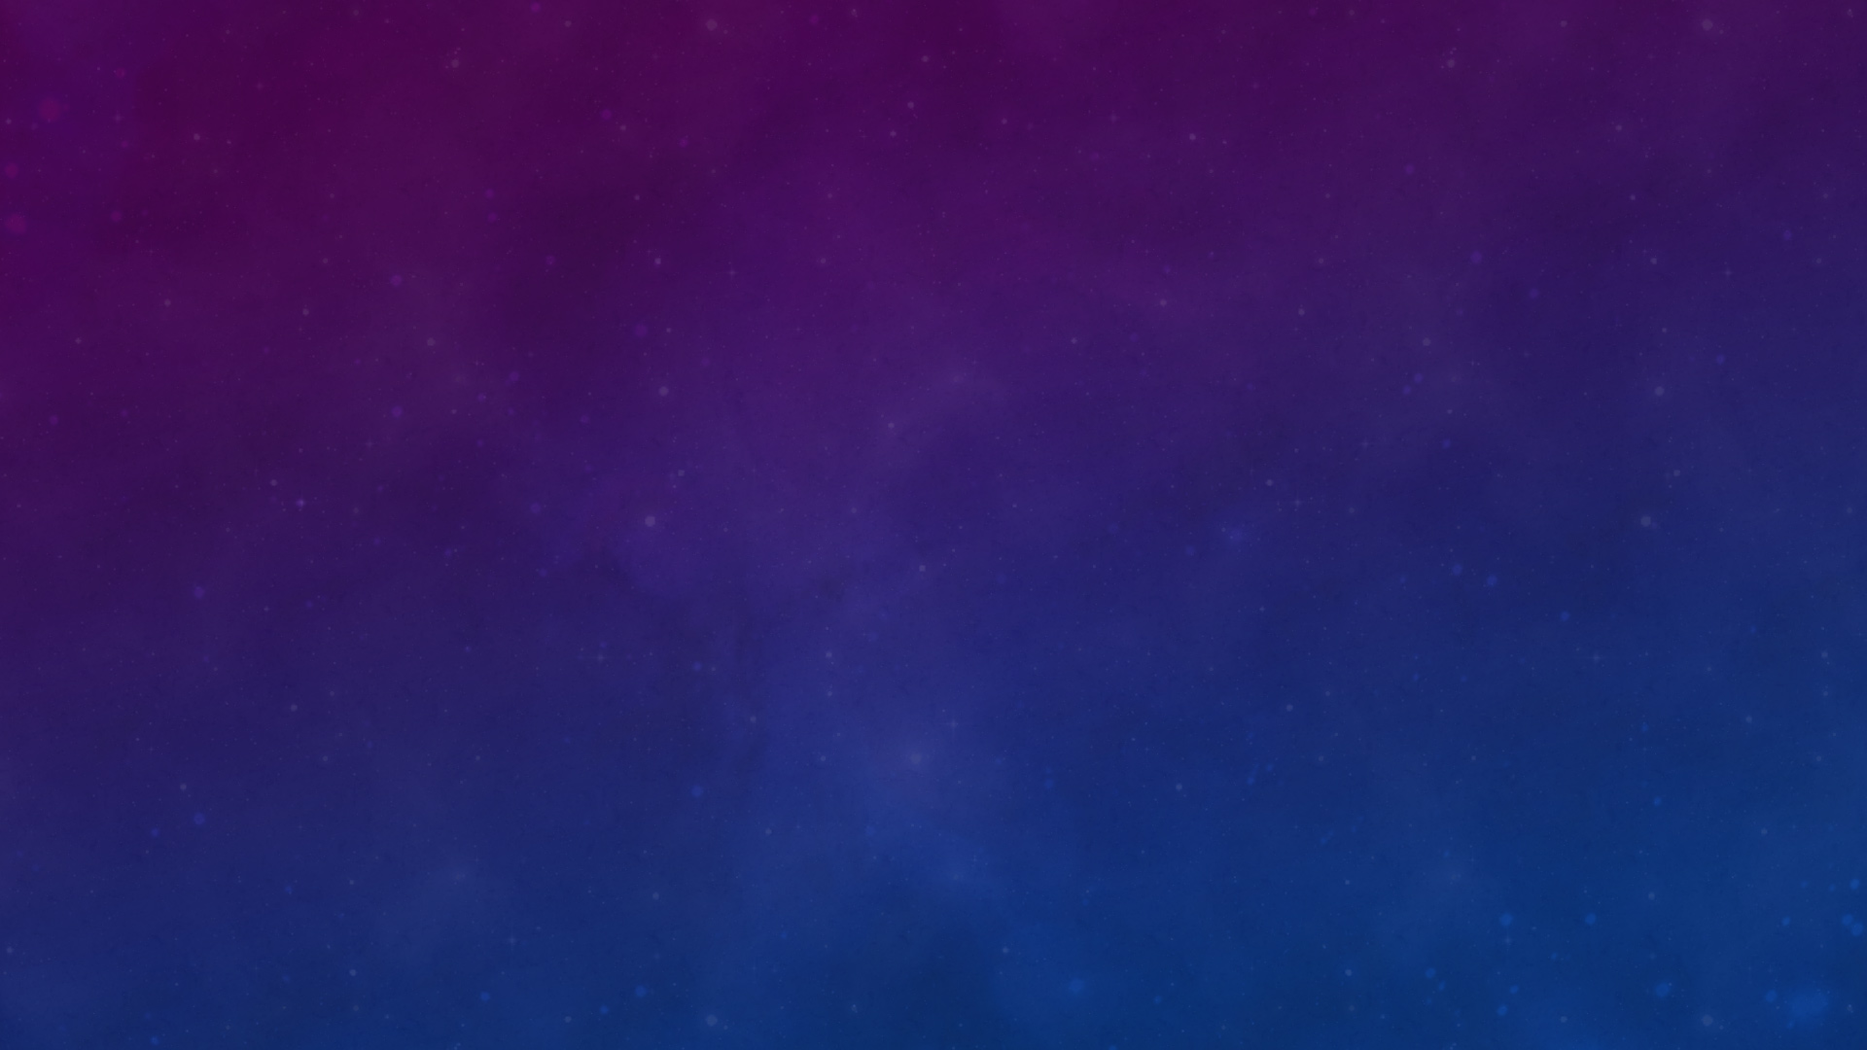

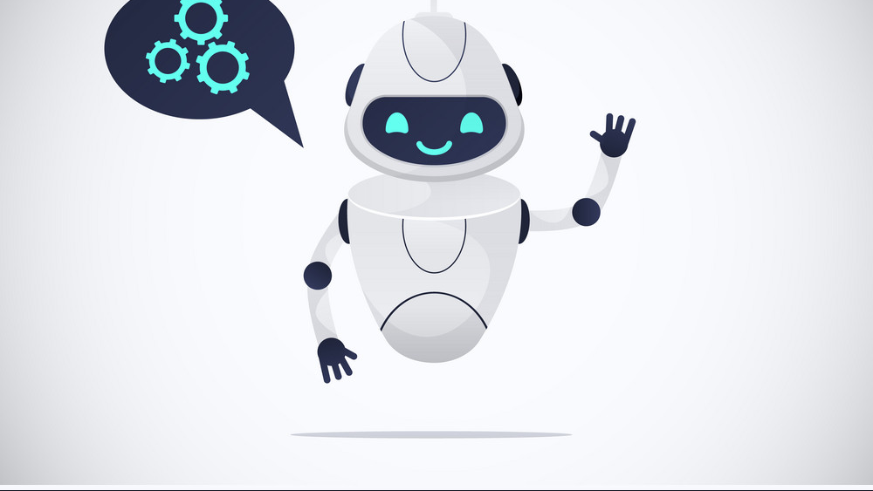
THANK YOU

