Slide 1

SMART CROP CARE
PRESENTING BY -
Keerthan –B.SC III rd. year
Bhavagnya- B.SC III rd. year
Narsimha- B.SC III rd. year

Slide 2
MISSION
Our mission is to bring awareness among the farmers on digital technology. That helps the farmers to detect plant diseases, accessing farming news, weather forecast, consult experts, and buy products.
Traditional methods of disease detection takes time and can lead to heavy loses, where in our SMART CROP CARE aims to bridge the gap between farmers and technology by offering instant solutions.

Slide 3
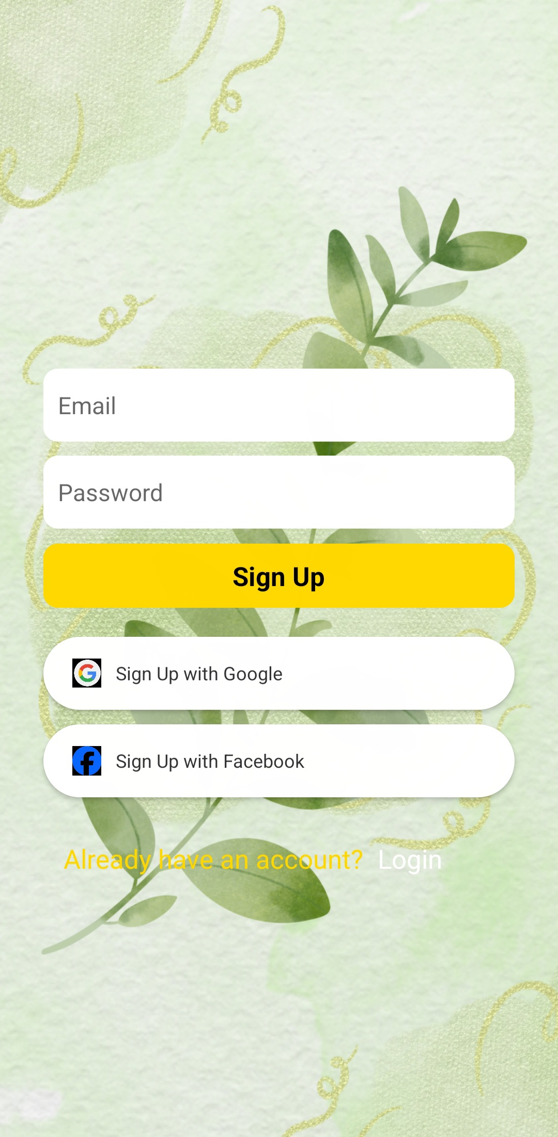
Sign Up!!!
Get access with google, face book.
Connected to firebase as a backend!

Slide 4
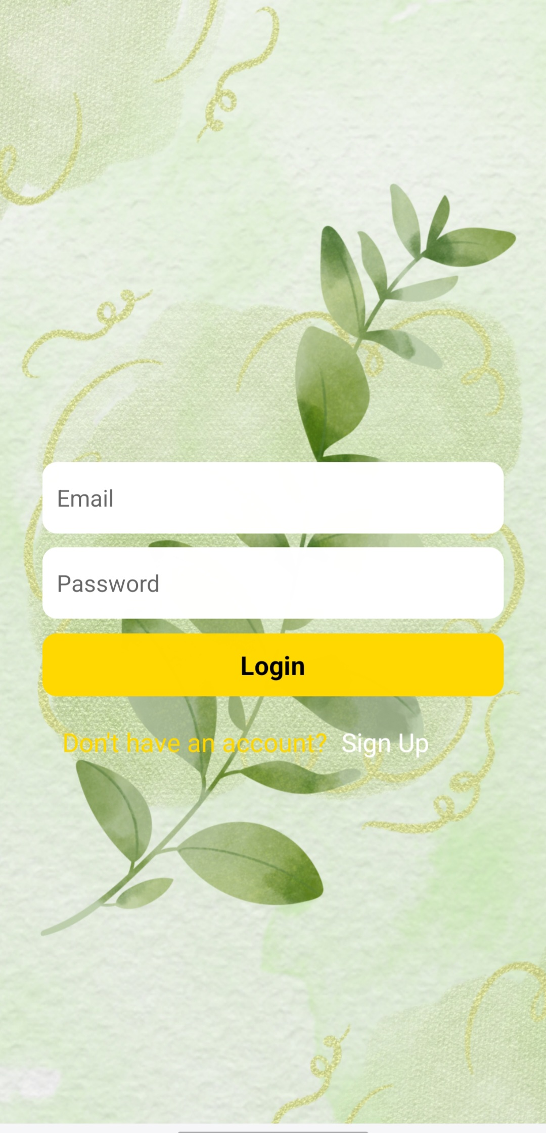
Login!!
Already have an account
Just Login with your Gmail and Password.
It takes the data from firebase for authentication to verify user details.
The login and signup information are stored in firebase. Safe and Secure.

Slide 5
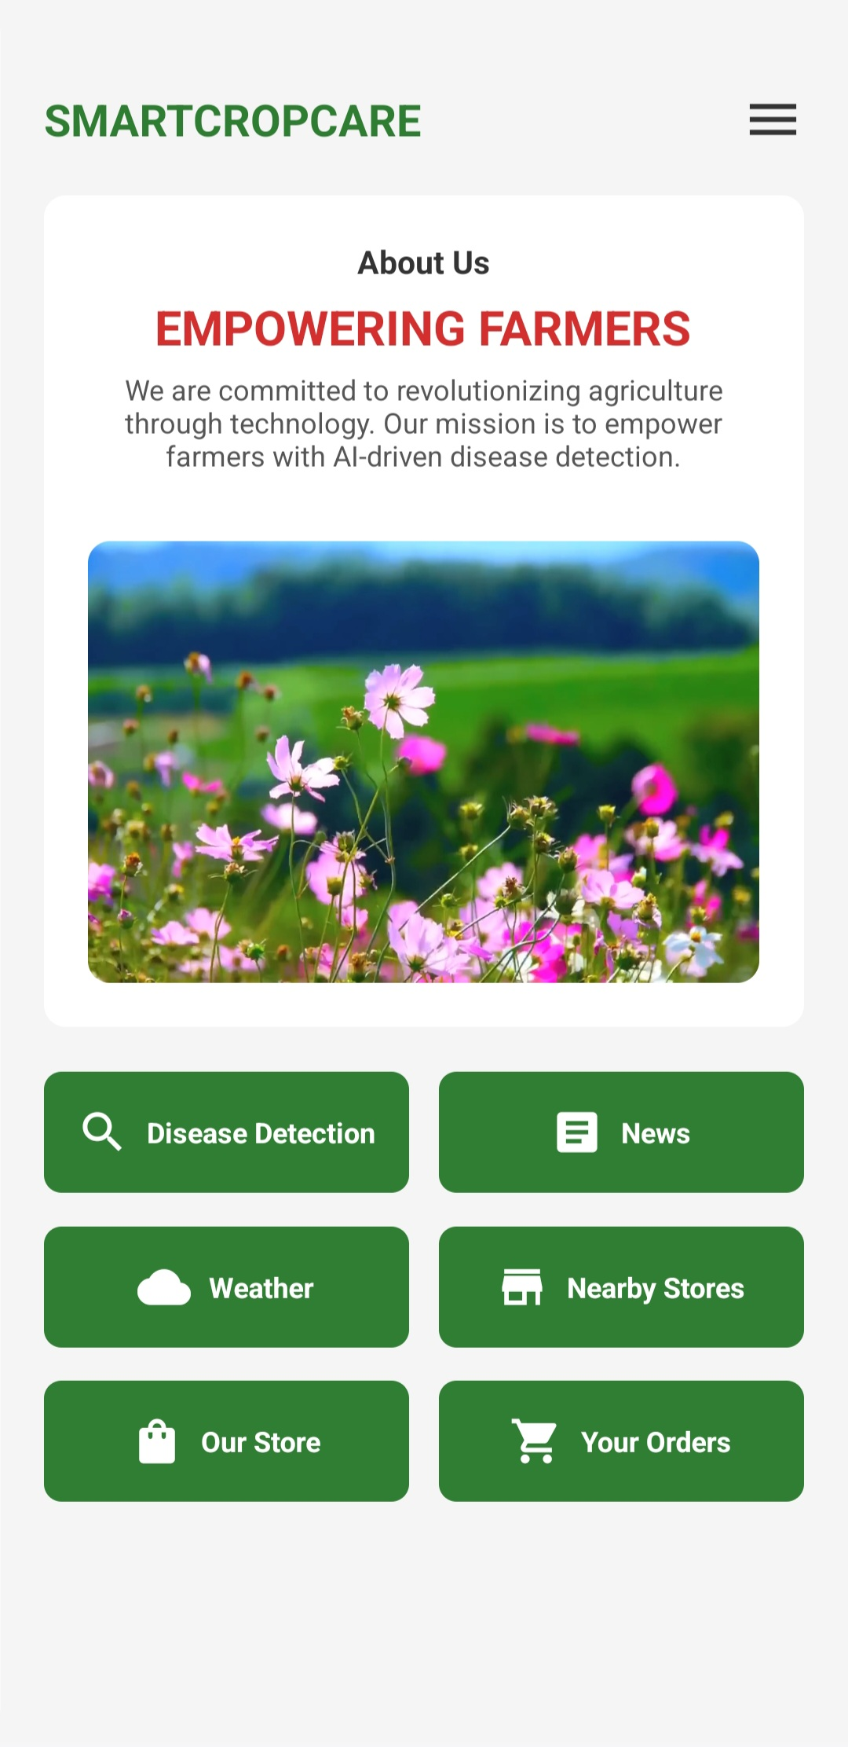
Empowering Farmers with AI-driven Solutions
Key Features-
Disease Detection
News Updates
Weather Forecast
Nearby Stores
Online Store
Orders and Our store.

Slide 6
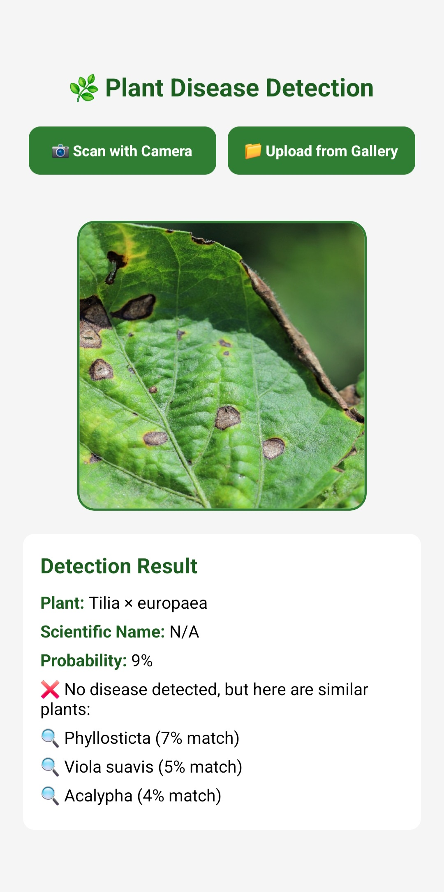
🌿 Plant Disease Detection
📸 How It Works?
Scan with Camera 📷 or Upload from Gallery 📂 to analyze plant health.
AI detects potential diseases and suggests similar plant conditions
AI-driven plant health analysis.
Used PlantAPI.ai for API key.
Helps farmers take preventive actions
.

Slide 7
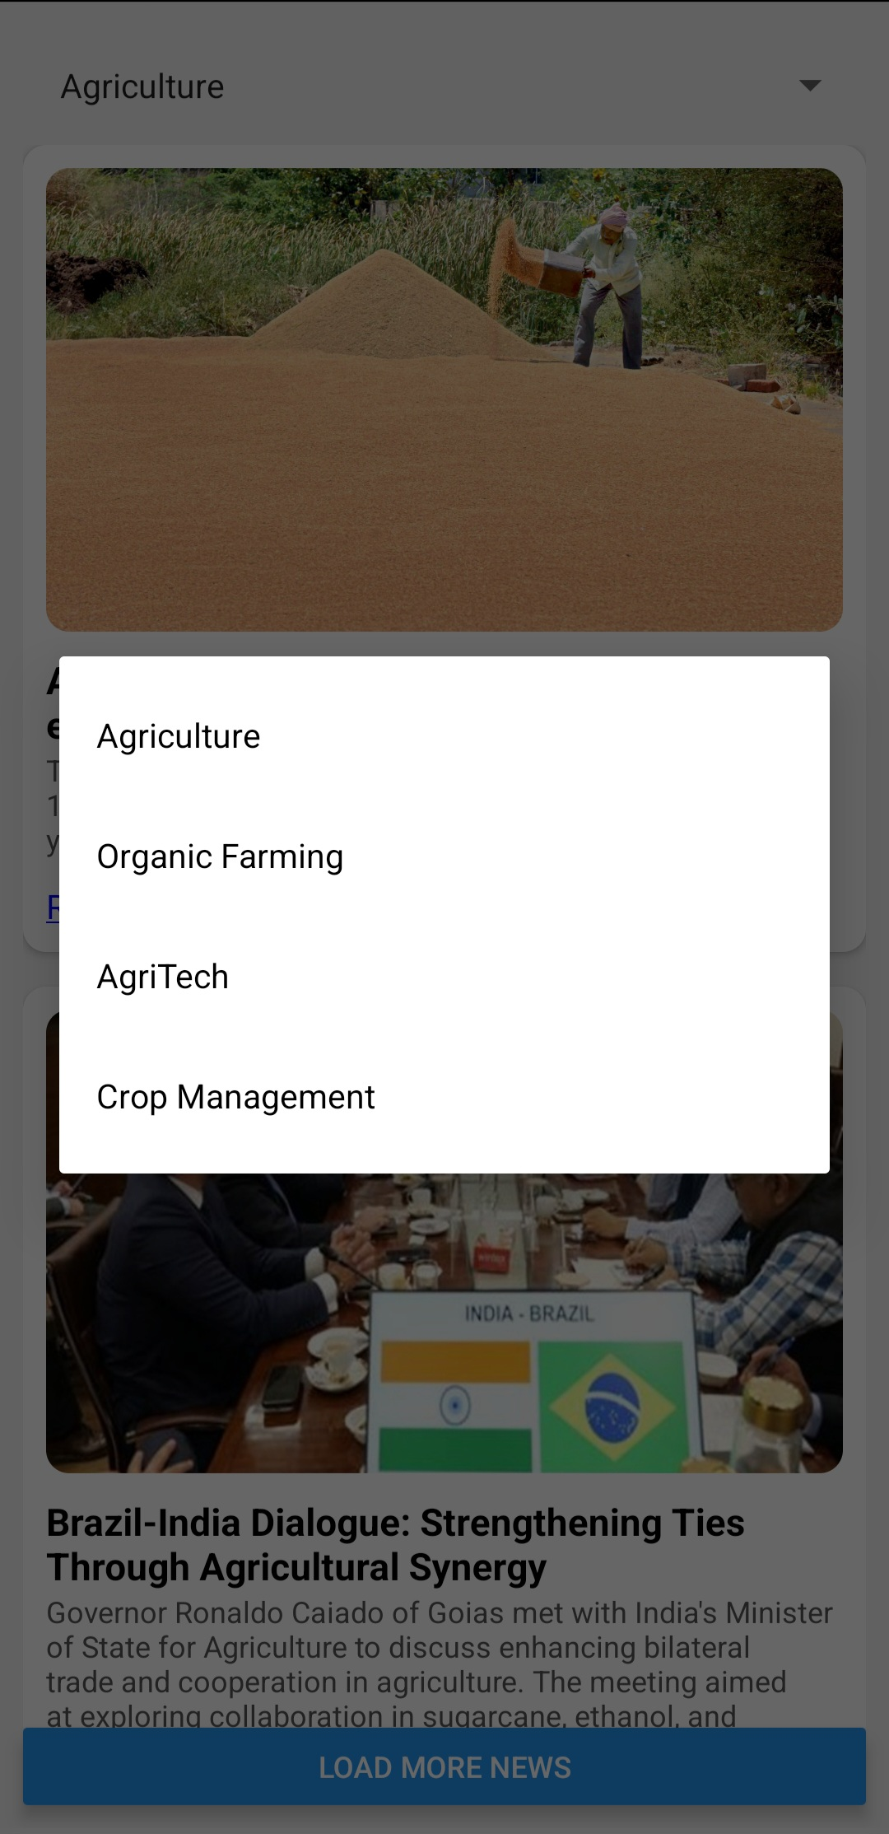
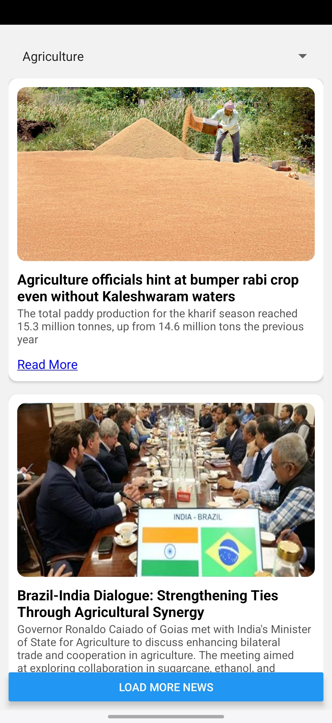
Agriculture News
Stay Updated with the Latest Developments in Agriculture
Content:
Users can select different agricultural categories for News like: -Agriculture -Organic Farming -AgriTech -Crop Management
We used Gnews API KEY to fetch the news day to day.
Educates farmers about new techniques and innovations.

Slide 8
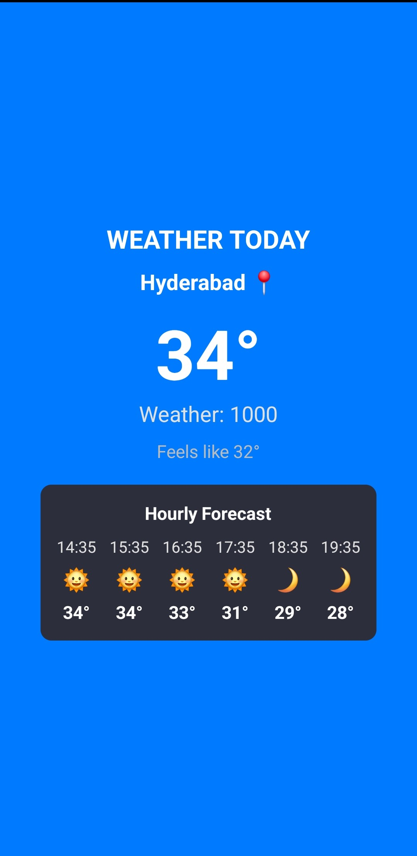
Agriculture News & Weather Insights
Stay Informed with the Latest Weather Updates
Weather Forecast for Hyderabad
Title: Today's Weather – Hyderabad 🌍
Temperature: 34°C 🌡️
Feels Like: 32°C
Weather Condition: Clear ☀️
Hourly Forecast.
Integrated with tomorrow.io API key to get fetch the weather news.

Slide 9
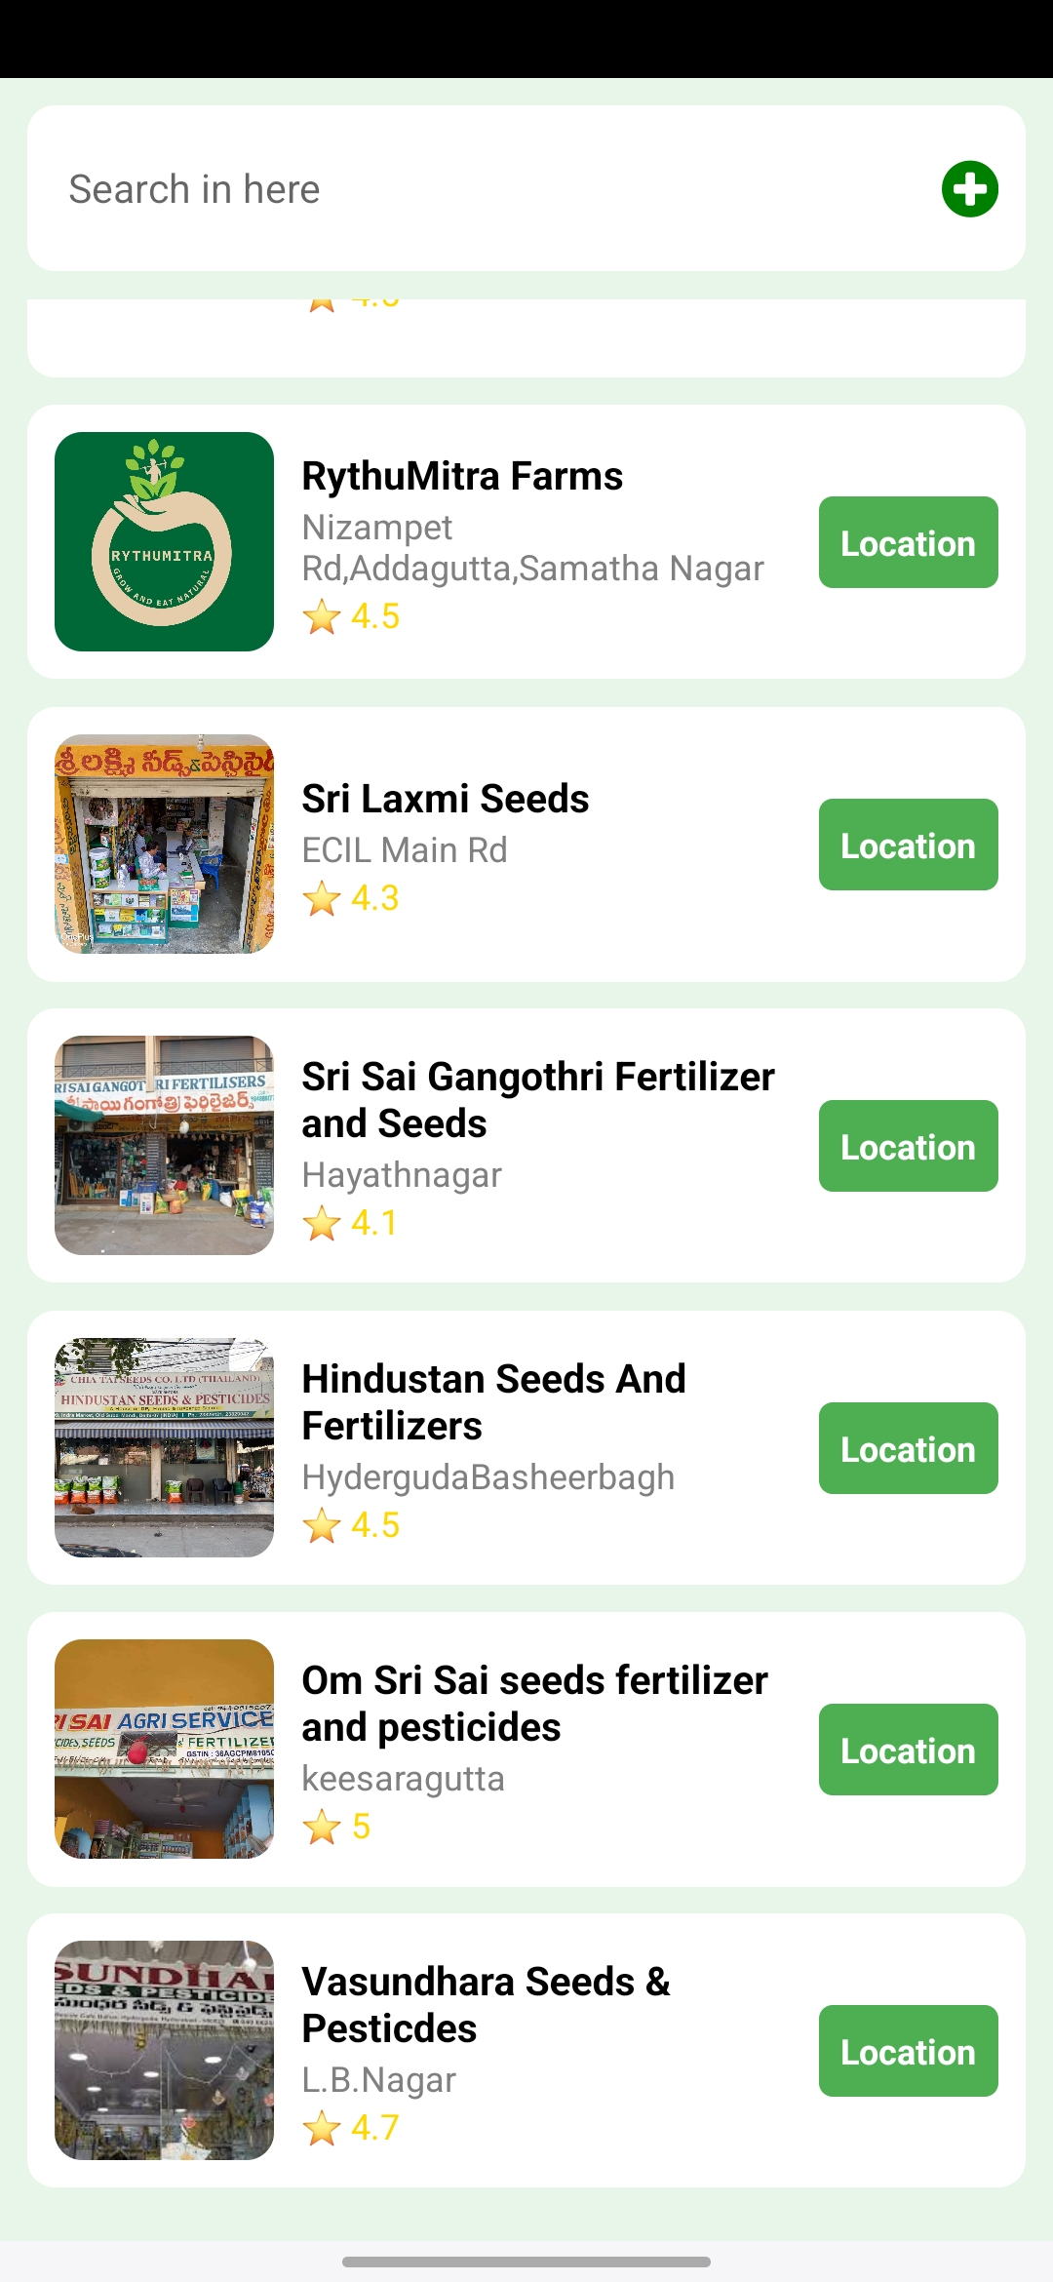
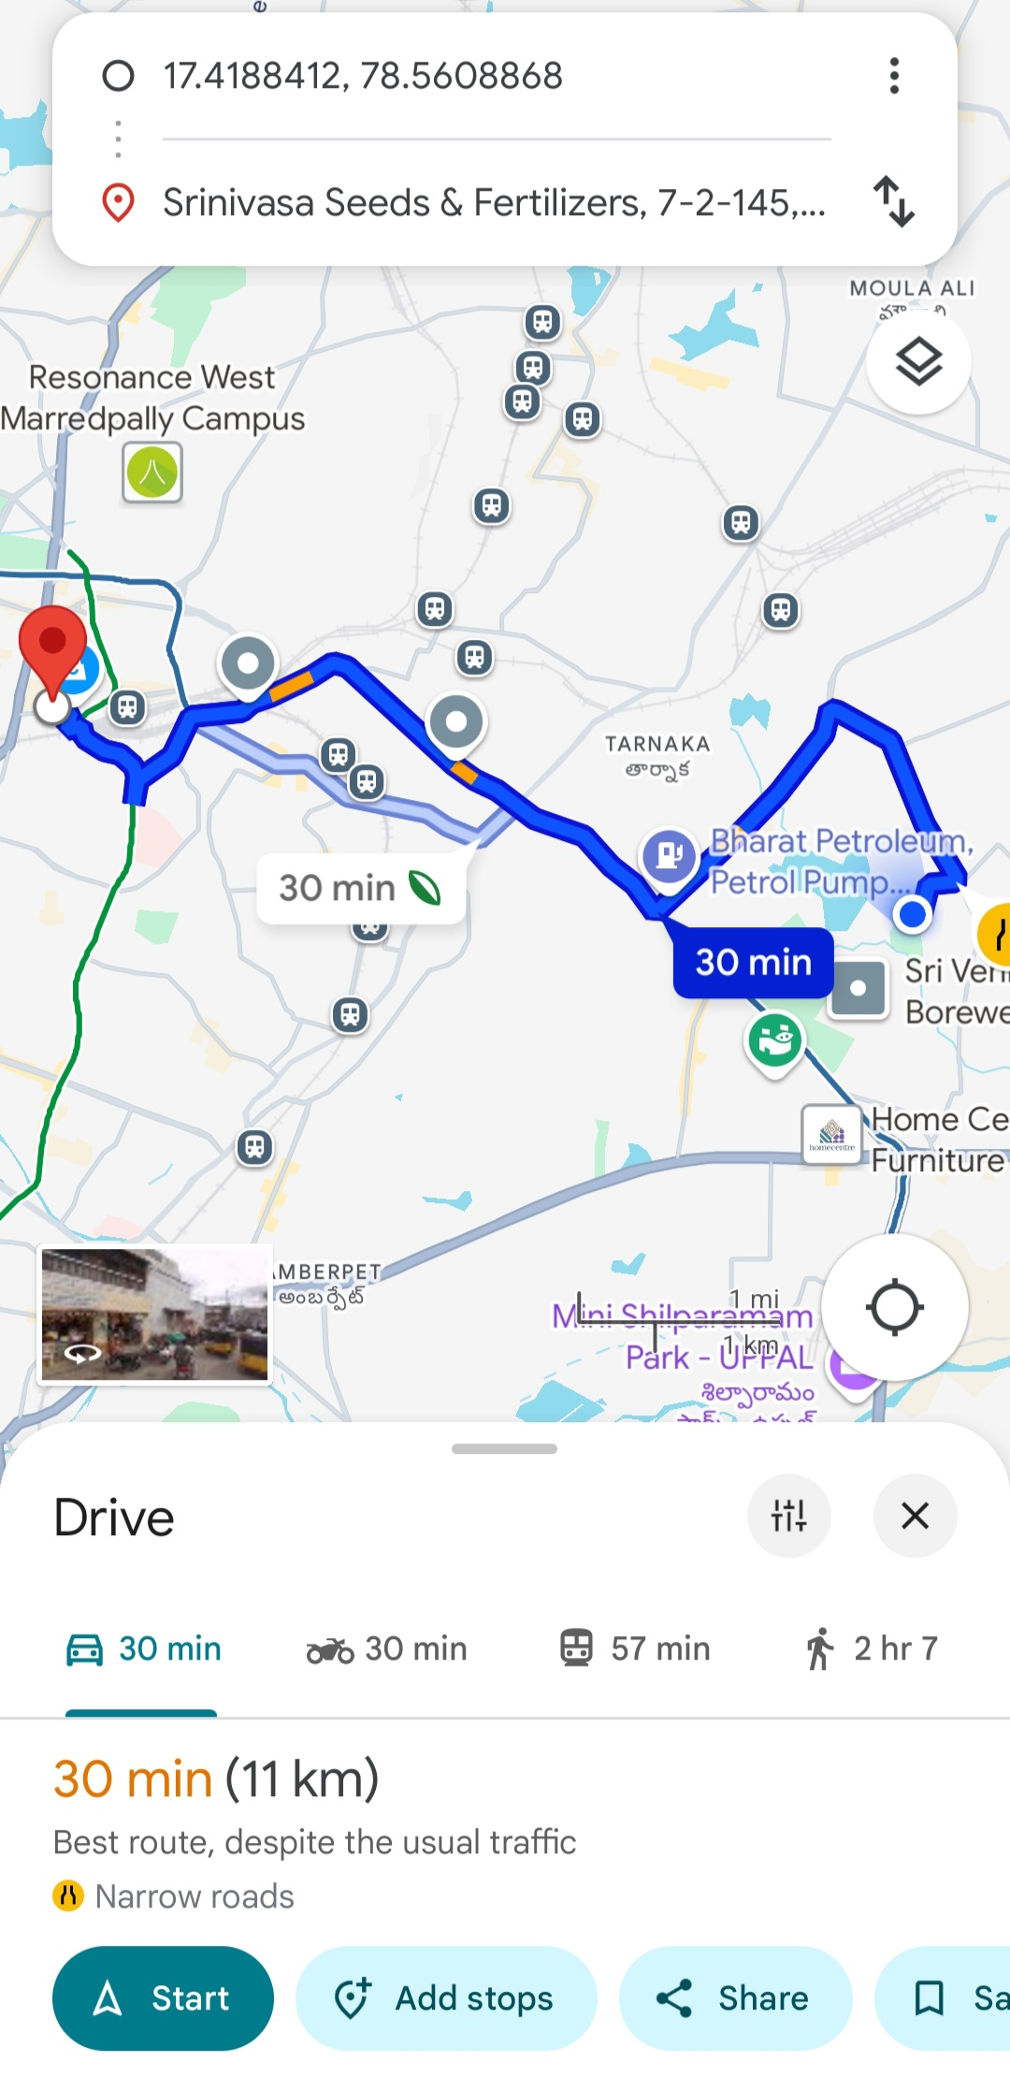
Nearby Agriculture Stores
Find the Best Agriculture Stores Near You 🌱
Fertilizers & Pesticides – Recommendations & online store
Click “Location” to navigate to the store 📍

Slide 10
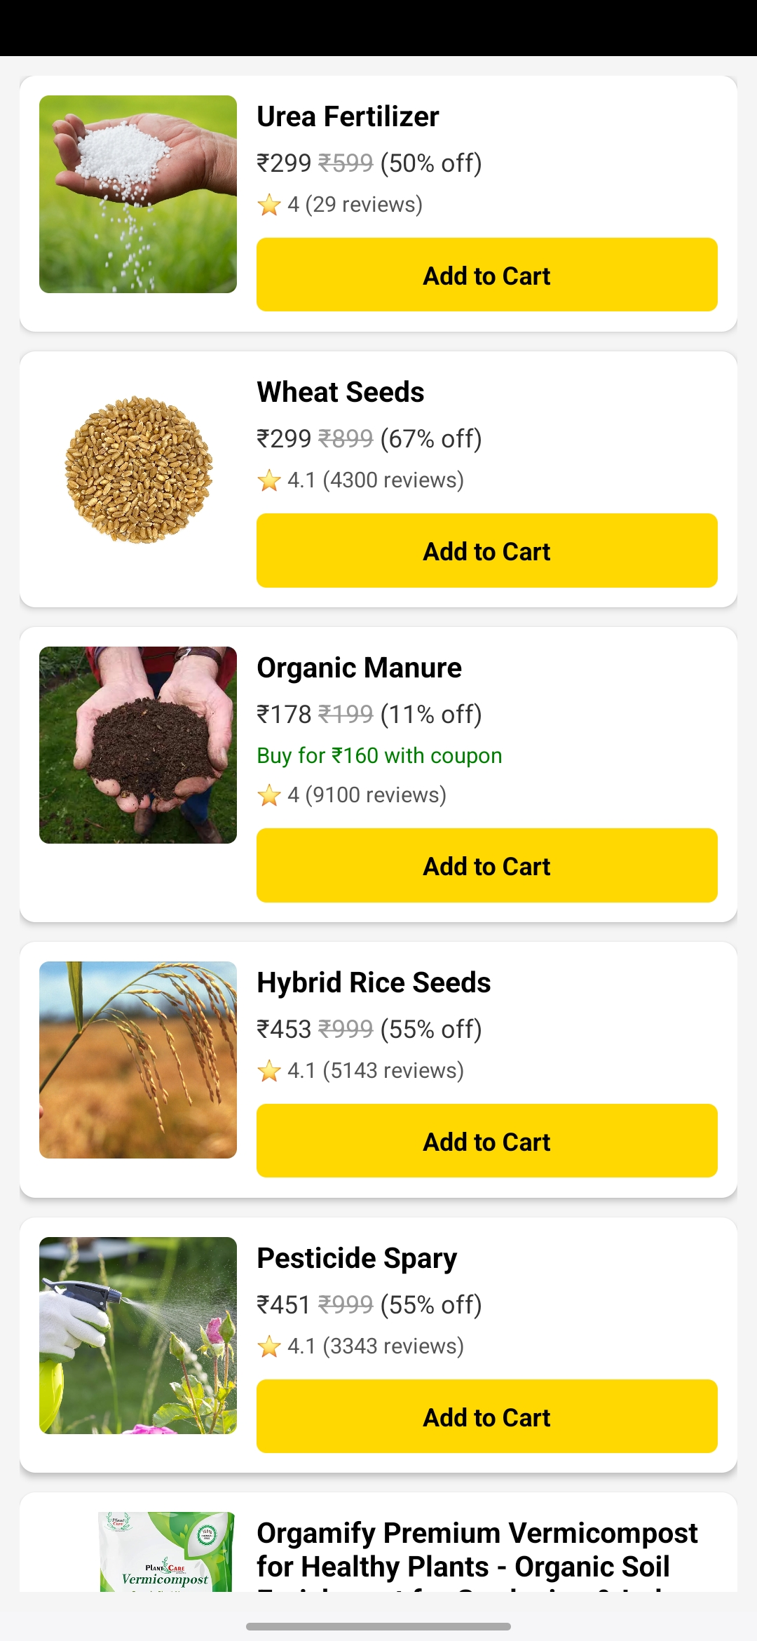
Our Store Delivers:
Convenient Shopping
Shop for fertilizers and tools with ease.
Best Deals on Farming Essentials 🌾
Add to cart and boost your farm's productivity! 🛒

Slide 11
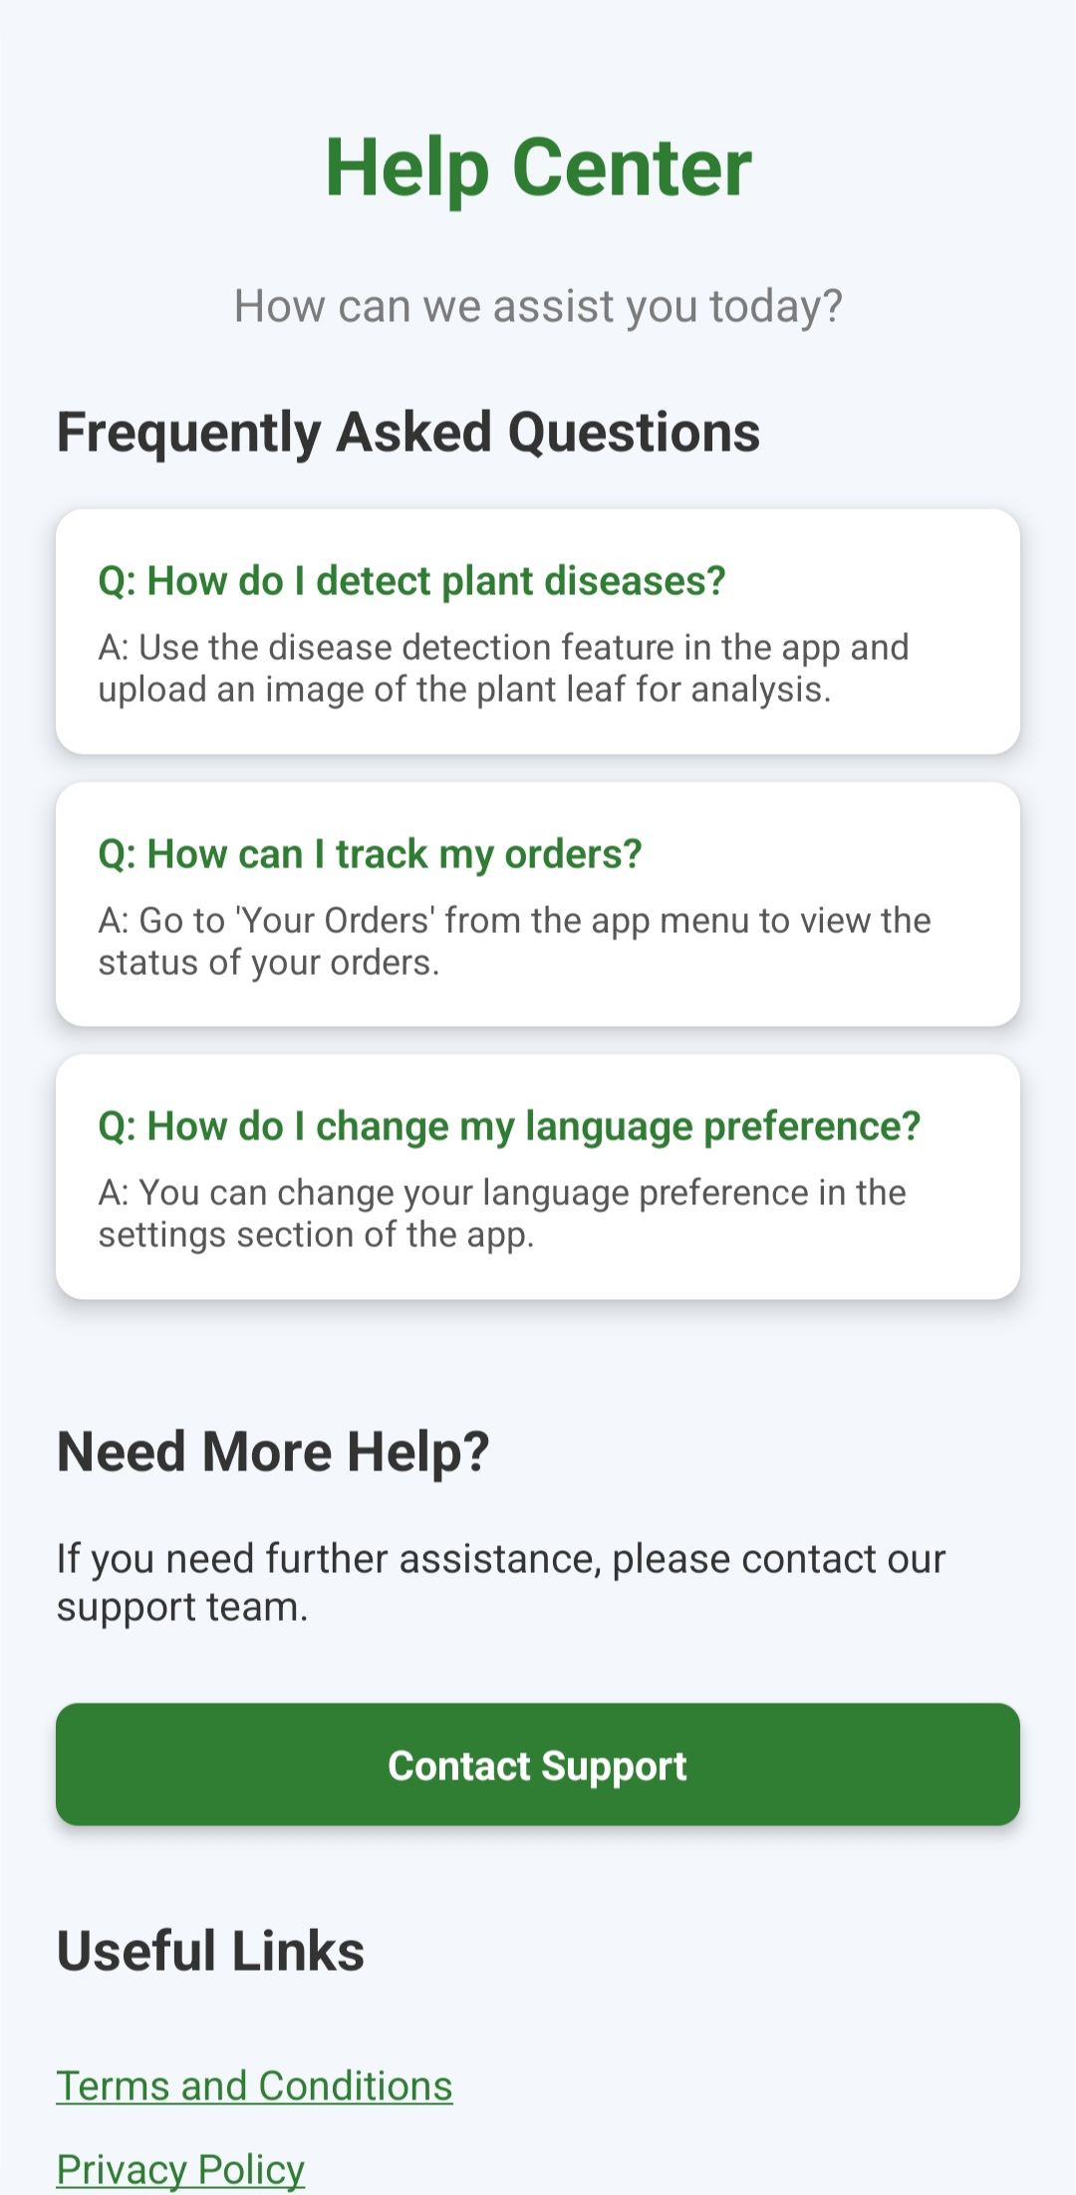
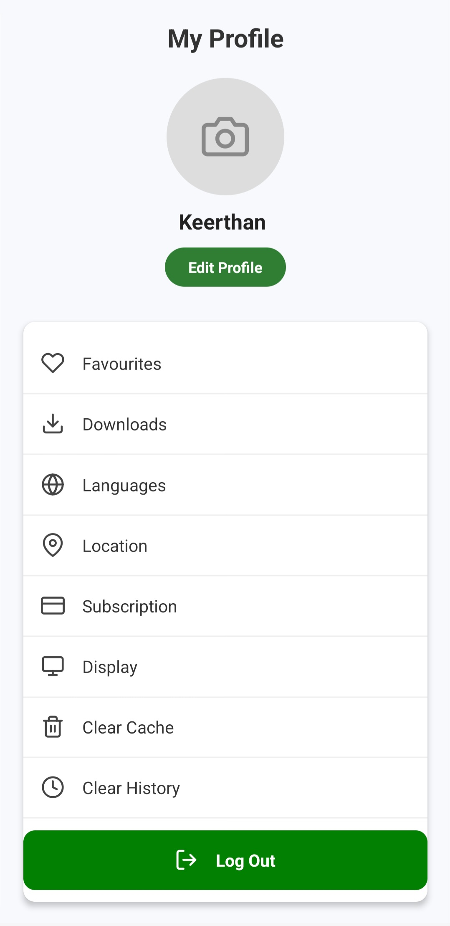
Help Center & Support
Title: Need Assistance? We're Here to Help! 💬
User Profile & Settings
Title: Manage Your Profile Easily! 🛠️
🔐 Log Out Securely

Slide 12
Conclusion
This app serves a valuable resource about disease detection & real-time insights. Optimal use of fertilizers and pesticides. Easy ordering ,tracking and personalized settings. Supporting eco-friendly & high yield agriculture.
Thank You!

Slide 13
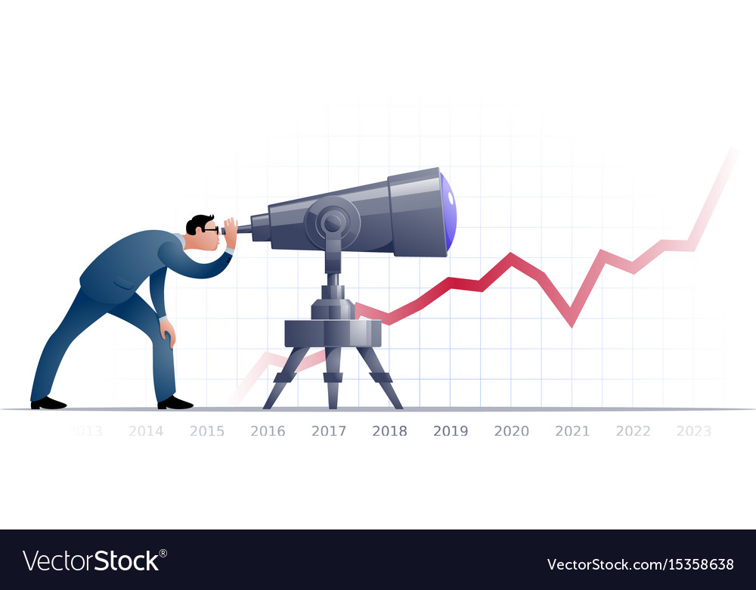
Future Scope
Language modulations.
Agriculture rentals.
Crop selling section.
Drone technology.
Empowering farmers with AI chatbots.

