Slide 1
TEST YOUR CODING SKILLS (TYCS)
Under The Guidance Of
M. Tarakeshwar Rao TEAM: B. Narsimhulu (16911A0509) J. Siddharth (16911A0523)
M. Abhinav Reddy (16911A0534)

Slide 2
ABSTRACT:
In the present situation the competitive programming knowledge is necessary requirement for engineering students.
Nowadays the technical recruiters are asking the students to solve the complex programming challenges to test the candidates on their specific programming skills and better understand their qualification for a certain role.
TYCS is a tool to facilitate the students with the competitive coding challenges in different languages like C, C++, Java, and Python.
TYCS helps students to build and develop their programming skills in different programming languages

Slide 3
SOFTWARE REQUIREMENTS:
Software Requirements Specification plays an important role in creating quality software solutions.
Software Requirements:
Front-End : React JS, CSS
Backend : Node JS, Express.JS
Database: Mongo dB
Hardware Requirements:
Ram: 512 mb or above
Processor : P4 and above

Slide 4
SYSTEM ANALYSIS:
Data Flow Diagram / Use Case Diagram / Flow Diagram
The DFD is also called as bubble chart. It is a simple graphical formalism that can be used to represent a system in terms of the input data to the system, various processing carried out on these data, and the output data is generated by the system.
Following are the various Data Flow Diagrams for the different objects like User, Admin, Question etc..

Slide 5
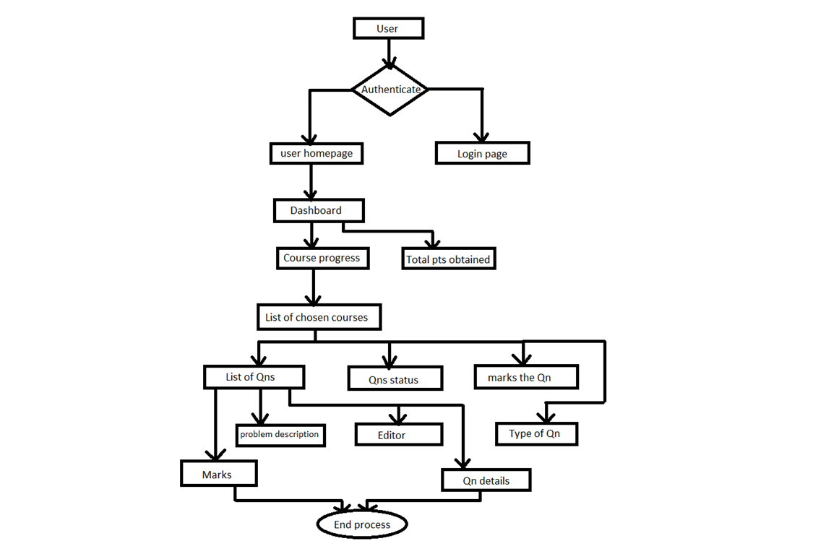
USER:
Data Flow diagram for User

Slide 6
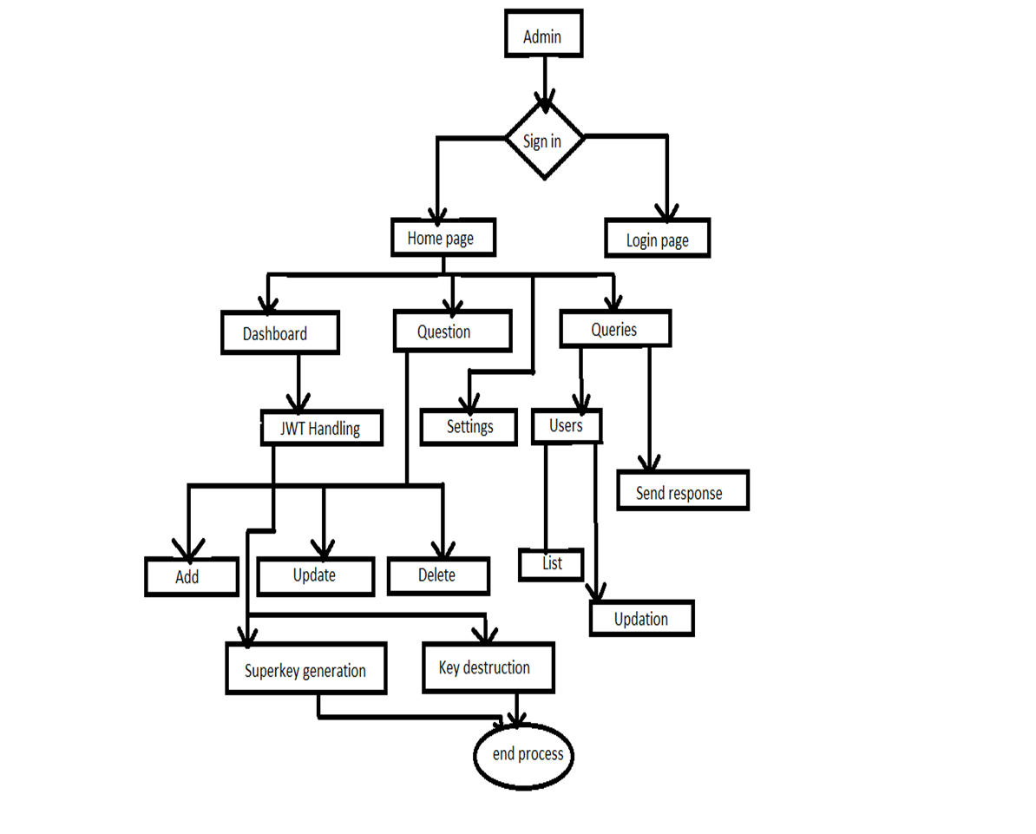
ADMIN:
Data Flow diagram of Admin

Slide 7
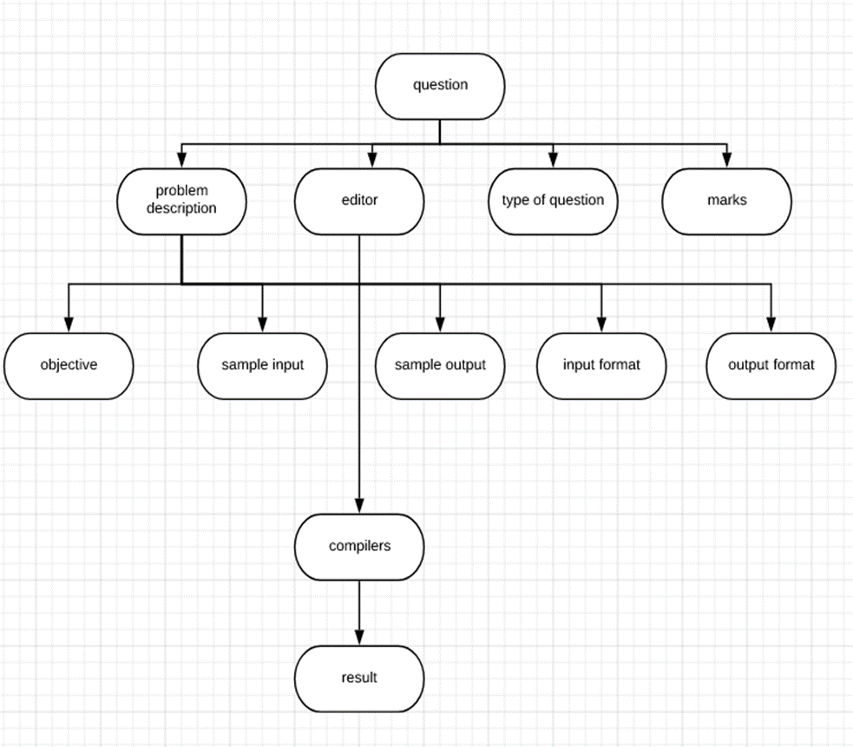
QUESTION:
Data Flow diagram of question

Slide 8
MODULES:
User:
Users have to register with their name, email id, phone number, username and password after registering he should login with his username and password.
If any user registered with fake email id then the super admin will have a access to suspend that user permanently.
If user is valid then he will be able to scan the code without facing any difficulties after scanning the code then he will get entire seed details.

Slide 9
Admin:
Admin plays main role in CODELAND, he has all rights to add, delete, and update any question.
He can add n number of questions.
He can show dashboard and list of students who got top in all exams.
He will also have right to delete any user in case they perform any malpractice.

Slide 10
Question:
We will provide an editor to write the code and to submit.
Users have to login first after he has to select course.
Question will be provided to the user along with sample input and sample output and constraints.
We will also give a sample syntax based on question user has to write the code and submit.
By accepting all constraints in question then only the test cases will be cleared.

Slide 11
SYSTEM DESIGN:
System design is most basic and important thing that needs to be done before going to any implementation of the application.
To represent the activity flow of different users we use different kind of diagrams like..
Class Diagram: The class diagram is a static diagram.It represents the static view of an application.
Class diagram is not only used for visualizing, describing and documenting different aspects of a system but also for constructing executable code of the software application.
The class diagram describes the attributes and operations of a class and also the constraints imposed on the system. The class diagram shows a collection of classes, interfaces, associations, collaborations and constraints. It is also known as a structural diagram.

Slide 12
Use Case Diagram: To model a system the most important aspect is to capture the dynamic behaviour. To clarify a bit in details, dynamic behaviour means the behaviour of the system when it is running /operating.
So only static behaviour is not sufficient to model a system rather dynamic behaviour is more important than static behaviour. Now as we have to discuss that the use case diagram is dynamic in nature there should be some internal or external factors for making the interaction. These internal and external agents are known as actors.
So use case diagrams are consists of actors, use cases and their relationships. The diagram is used to model the system/subsystem of an application.

Slide 13
Sequence Diagram: It represents the static view of an application. Class diagram is not only used for visualizing, describing and documenting different aspects of a system but also for constructing executable code of the software application.
Activity Diagram :Activity diagram is basically a flow chart to represent the flow form one activity to another. The activity can be described as an operation of the system.
So the control flow is drawn from one operation to another. This flow can be sequential, branched or concurrent.
Activity diagrams deals with all type of flow by using elements like fork, join etc.

Slide 14
IMPLEMENTATION:
Node.js:
Node.js is an open source server environment
Node.js can generate dynamic page content
Node.js can create, open, read, write, delete, and close files on the server
Node.js can collect form data
Node.js can add, delete, modify data in your database
The event loop is what allows Node.js to perform non-blocking I/O operations — despite the fact that JavaScript is single-threaded — by offloading operations to the system kernel whenever possible.

Slide 15
Creating a simple Node.js file?
var http = require('http');
http.createServer(function (req, res) {
res.writeHead(200, {'Content-Type': 'text/html’});
res.end('Hello World!');
}).listen(8080);
How to run simple Node.js file?
Save the file on your computer: C:\Users\Your Name\myfirst.js
Mongo DB:
Document Oriented Storage − Data is stored in the form of JSON style documents.
Index on any attribute
Replication and high availability
Auto-sharing
Rich queries
Fast in-place updates
Professional support by MongoDB

Slide 16
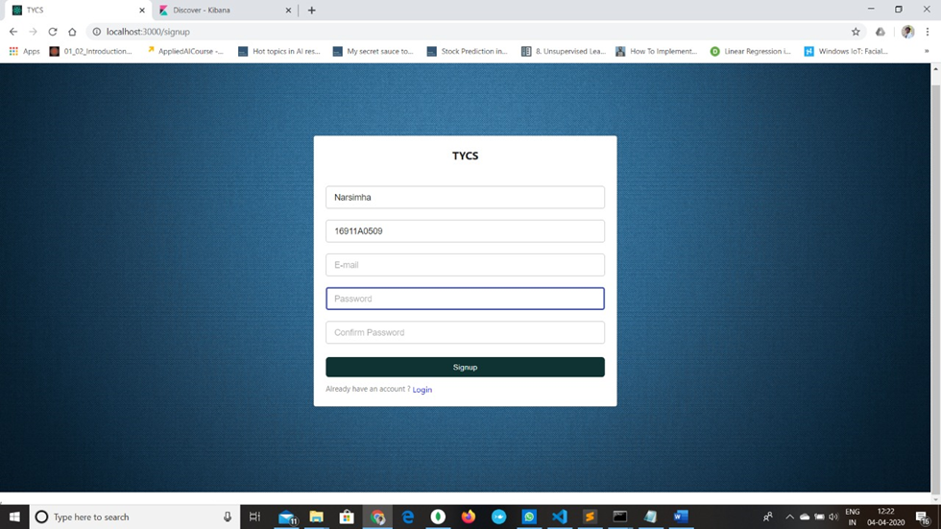
User signup page

Slide 17
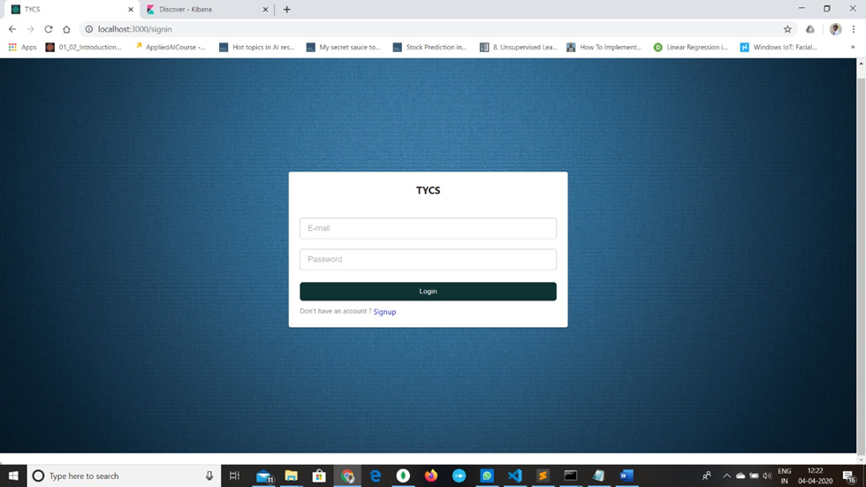
User login page

Slide 18
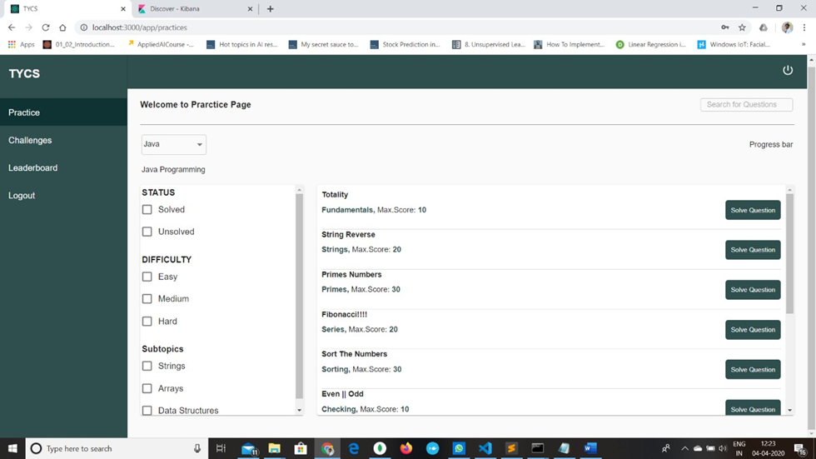
User Dashboard Page

Slide 19
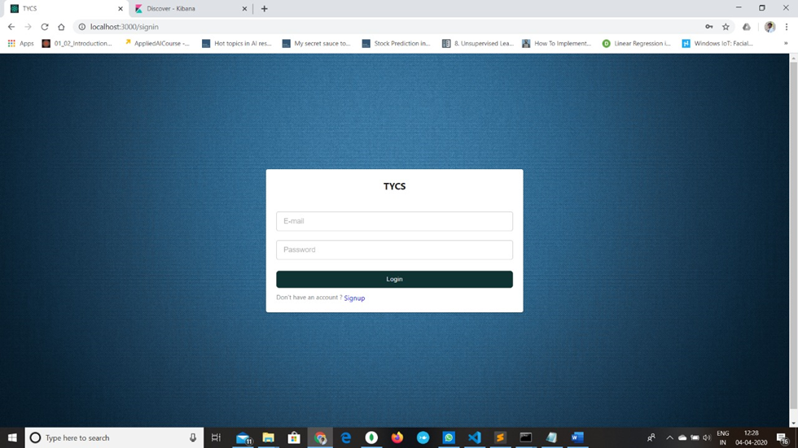
Admin Login page

Slide 20
CONCLUSION
The idea of the TYCS project is to develop the students programming knowledge in different programming languages that can be useful to survive in this competitive world and to crack the placements opportunities easily.

Slide 21
THANK YOU

