Slide 1



Slide 2
What is git
Creating git repository
Git download
Git installation
Git Buzz words/ Configuration
resolving

Slide 3
What is git ?
Git is a distributed
It is open-source version control system (VCS)
It enables to store code, track revision history, merge code changes,
It revert to earlier code version when needed.

Slide 4
What is git ?
Git stores your source code and its full development history locally in a repository.
It can create a copy of source code, known as a branch, which can work on in parallel to the main version.
we can commit changes to save progress.
we can merge branch back into the main version.
Every time you commit, Git takes a snapshot of work and compares it to previous versions with a viewable operation called a diff.
If there's been a change from previous commits, Git stores a new snapshot in the repository.
Git backup your code easily to a remote server.

Slide 5
Benifits of Git
Historical Change Tracking
Work as a Team
Improve Team Speed & Productivity
Availability

Slide 6
Repository
A repository is simply a place where the history of your work is stored.
It often lives in a .git subdirectory of your working copy - a copy of the most recent state of the files you're working on.
The Git repository is stored in the same directory as the project itself, in a subdirectory called .git.

Slide 7
Repository
Set of Commit Objects
Heads
(references to commit objects)
A head is simply a reference to a commit object. By default, there is a head in every repository called master.
Set of Files
References to parent commit objects
An SHA1 name, a 40-character string that uniquely identifies the commit object.

Slide 8
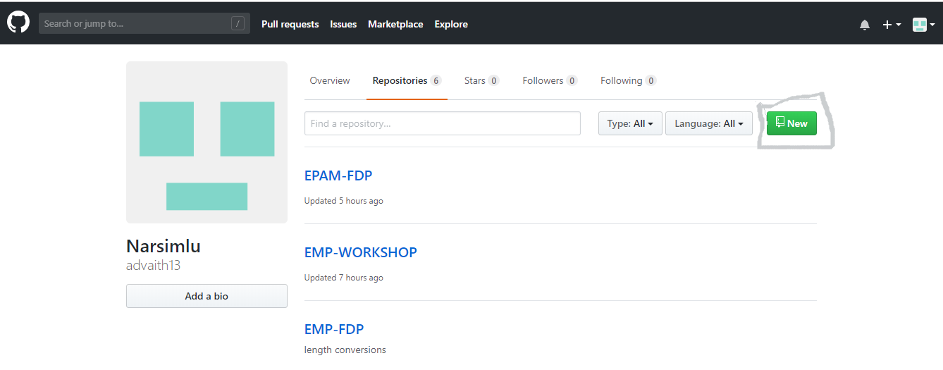
Creating Repository
Step1:

Slide 9
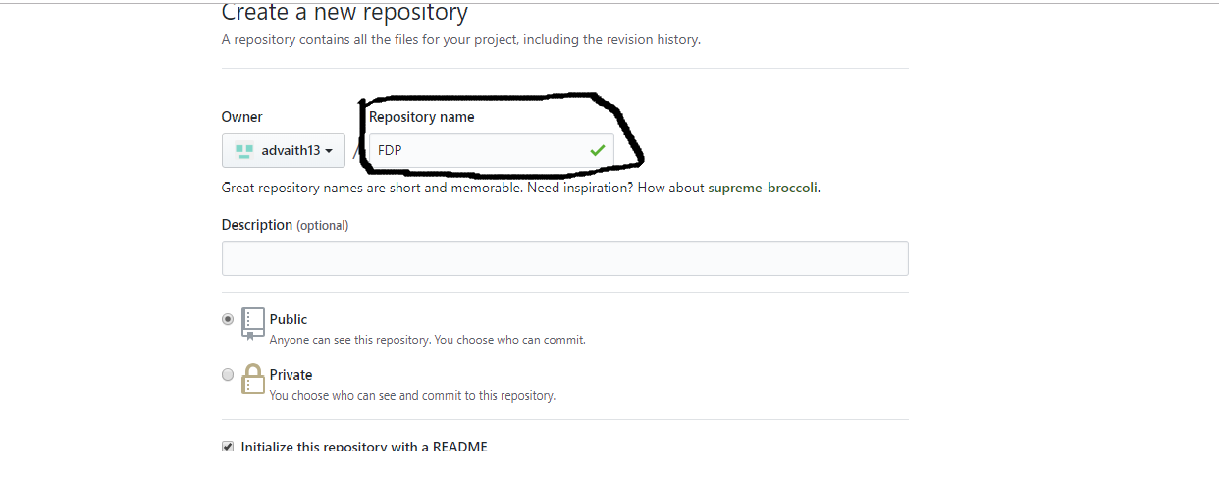
Step2

Slide 10
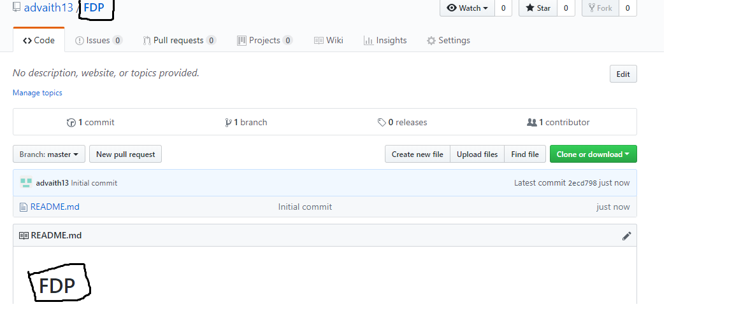
Step3

Slide 11
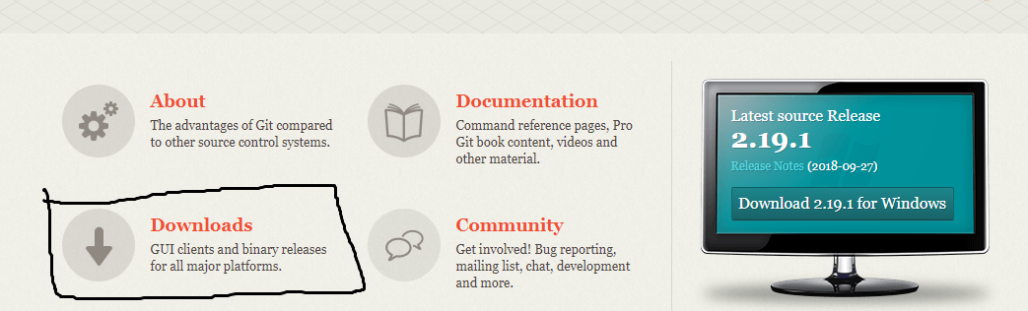
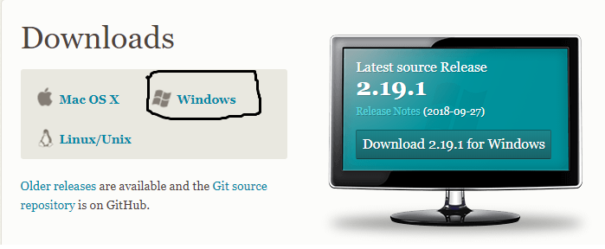
Git download and Installation
Step1: goto->https://git-scm.com/
Step2:
Step3: Click on download
and select type of OS which
we have it.
Step4: click setup file and git will install successfully

Slide 12
Git Buzz words/ Configuration
Git Terminologies:
Master
Branch
Head
Remote
Origin
Clone
Push
Pull
Fetch
Merge
Upstream
Downstream
forking

Slide 13
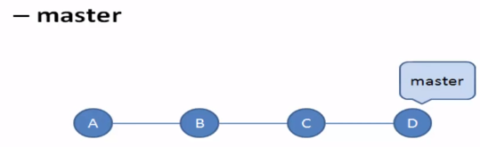
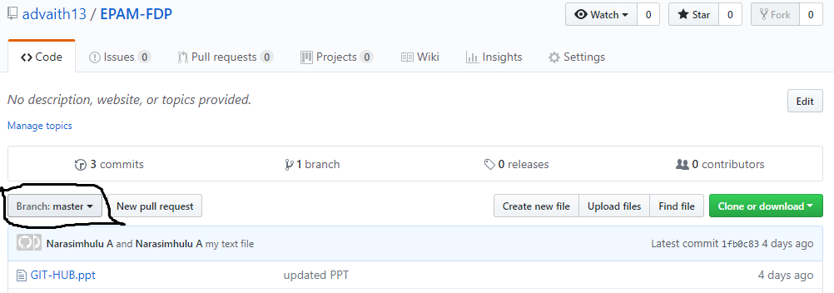
Master
The default branch that git creates when we creating repository
“Master” means – “the main branch” also called “trunk”
It always follows the master of remote repo.

Slide 14
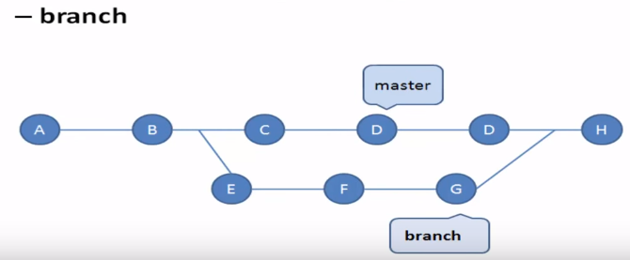
Branch
Branch is a light weight working copy for parallel line of development
Every branch has a staging area, working directory and project history
Branches can be created and managed in different ways based on selected workflows
Renaming branches:
” git push <REMOTENAME> <LOCALBRANCHNAME>:<REMOTEBRANCHNAME>”

Slide 15
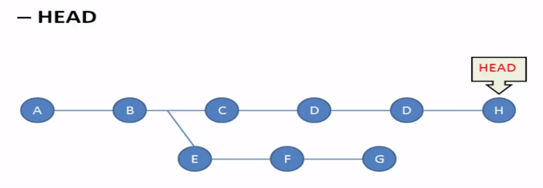
Head
Head is a pointer to the latest commit for the working branch.
Only one HEAD per repository
Switching the branch the HEAD will point to the latest commit for selected branch
After each commit, the HEAD will point to the latest commit

Slide 16
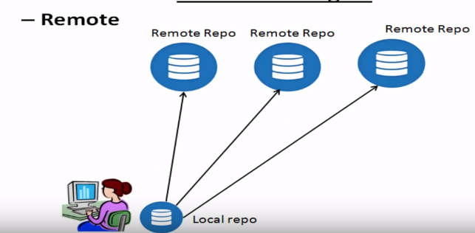
Remote
Remote is a git repository on a network outside the local machine
There can be more than one remote pointing from the local repository
Remote repository can be managed and referenced with short names
Command: “git remote –v”
git remote add origin git@github.com:NarsimluM/FSB.git

Slide 17
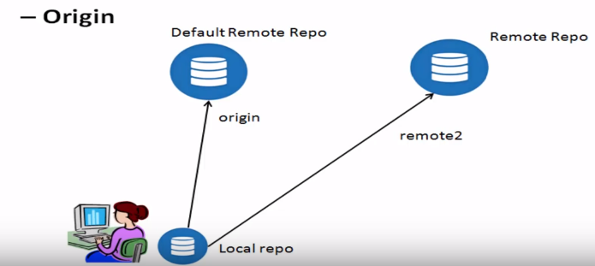
Origin
Git associates remote repository with names
Origin is logical name set for the default repository

Slide 18
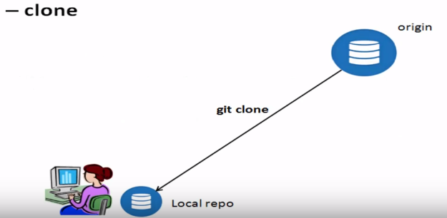
Clone
To get the copy of existing repository from a remote repository
Clone is similar to checkout with SVN
To replicate the repository on the local machine for the first time.
Command: git clone git@github.com:NarsimluM/FSB.git

Slide 19
git clone <url> <directory>
Clone from specific branch
git clone <url> --branch master --single-branch [<folder>]
git clone -b master https://github.com/NarsimluM/FSB

Slide 20
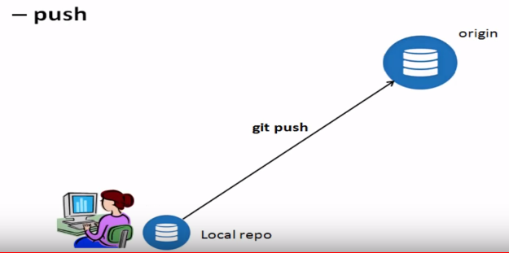
Push
To push the changes from the local repository to the remote repository
This is performed after committed the changes to the local repository
This is sync the changes from the local repository with remote repository
Command: “git push <REMOTENAME> <BRANCHNAME> “
Deleting a remote branch or tag: “git push <REMOTENAME> :<BRANCHNAME> “

Slide 21
Pull
To get the updates from the remote repository to the local repository.
This is the changes from the remote repository local repository and keeping the local repo up to date
Pull command will take the latest code from the remote repo and merge the changes with the local repo.
Similar to “git pull” but will not merge the changes with the local repo.
After “get fetch” merge should be performed explicitly
To get the updates from the remote repository to the local repository
Command:” git fetch upstream”
Fetch

Slide 22
Upstream repo and downstream repo
Both are relative to each other
Ex:
When data is flowing between repo A to repo B ,repo A is upstream repo and repo B is downstream repo.
Repo B will pull data from repo A.
Command: “git remote add upstream URL(where we want to navigate)”

Slide 23
Forking
A fork is a copy of a repository.
Forking a repository allows you to freely experiment with changes without affecting the original project.
forks to propose changes is for bug fixes.
Fork the repository.
Make the fix.
Submit a pull request to the project owner.

