Slide 1


AI reinvention made real
Accenture Innovation Challenge 2026

Slide 2
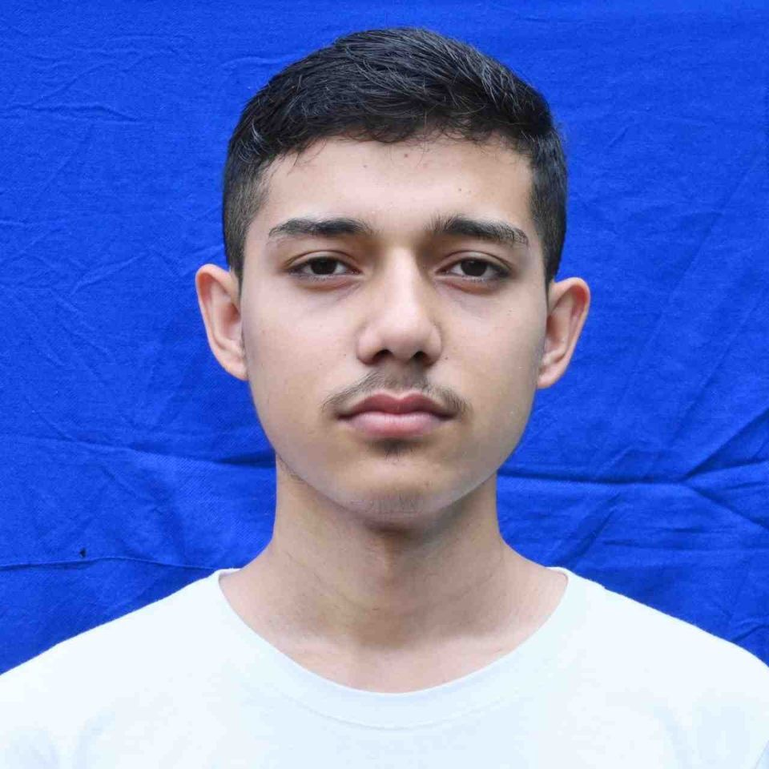
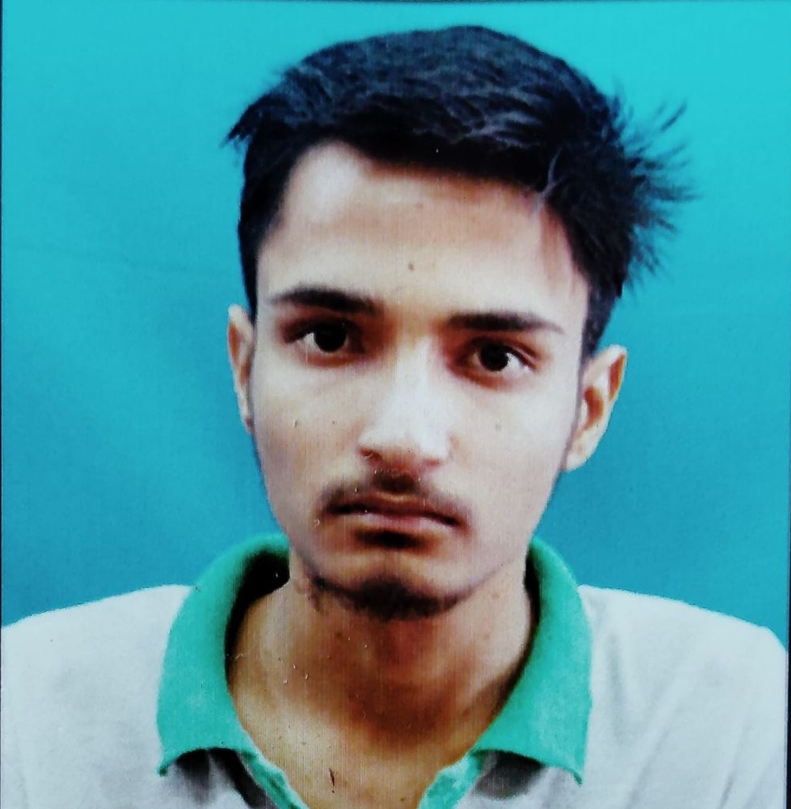
Team details
TEAM NAME: UpStream
Satish Kumar (Team Leader)
Narsing Sharma
College: IIT Roorkee
Stream:Civil Engineering
Year of graduation:2028
College: IIT Roorkee
Stream:Civil Engineering
Year of graduation:2028

Slide 3
Describe the problem statement (200 words)
A vehicle assembly line is a chain where one slow station stops everything behind it. When a station begins drifting off its take time, the effect ripples downstream for thirty or forty minutes before anyone reacts, and by then the line is already down. Unplanned downtime costs automotive plants roughly $2.3 million per hour, and each hour costs about 50% more than it did in 2019 (Siemens, 2024).
Defects behave the same way. A torque setting drifts at Station 12. Nothing fails there. The fault only surfaces at final inspection, forty minutes and thirty vehicles later. Under the widely used “rule of ten”, every stage a defect passes undetected multiplies the cost of correcting it tenfold: from seconds of rework at the station, to disassembly at end of line, to a field recall.
Plants are not short of data; they are covered in sensors and PLCs. The problem is that every tool they own is retrospective. Dashboards and MES reports describe what has already happened. Nothing tells a supervisor where the line will jam in two hours, or which station is quietly producing tomorrow’s warranty claims.
India built 28 million vehicles in 2024. Even singleDigit throughput and rework gains are worth crores per plant annually.

Slide 4
Proposed solution (200 words)
ShadowLine is a digital twin of the assembly line that runs four hours ahead of it.
We deliberately do not build a photorealistic 3D factory. The twin is a lightweight discrete-event model of what actually determines output: station cycle times, station states (active, blocked, starved), buffer levels, and the genealogy of each part. Weld physics, robot kinematics and CAD geometry are skipped.
Four layers. The signal layer reads what plants already emit: PLC station states, buffer counts, take deviation, torque and vision logs. No new hardware, so no retrofit capex. The twin core mirrors the live line. Three prediction heads run on top: bottleneck forecasting, using the Active Period Method (which identifies bottlenecks from uninterrupted active time alone) with Monte Carlo simulation of the next four hours, re-forked every 60 seconds; defect propagation, a learned station to station lag graph that traces an end of line failure back to its causing station; and virtual sensors, which infer state at manual or unsensored stations from neighbouring buffer levels and takt deviation. The action layer issues ranked alerts carrying cause, confidence and time to impact.
The output is not a dashboard. It is one line to a supervisor: “Station 14, 73% likely to bottleneck by 14:20.”

Slide 5

Video
Video Link (Youtube) = https://youtube.com/shorts/GrsjU1JUQ2E?si=KNjnfbGkxeU8Hsn7

Slide 6
Thank you

