Slide 1
Online Sports Arena Booking

Slide 2


Team Members
2110030102 - C Sri Charan
2110030011 - M. Nagendra 2110030159 - N. Abhinav
2110030246 - V. Akshay

Slide 3

Introduction
In today's digital age, online platforms are revolutionizing the way people book sports and leisure activities. This presentation will explore the beneﬁts and strategies for optimizing leisure through digital platforms.

Slide 4

Challenges in Traditional Booking
Traditional methods of booking sports and activities often involve inconvenient phone calls and limited availability information.
These challenges can lead to frustration and missed opportunities for leisure enthusiasts.

Slide 5

Utilizing online platforms for booking sports and activities offers advantages such as convenience, real-time availability, and secure transactions. These beneﬁts enhance the overall leisure experience for users.

Slide 6
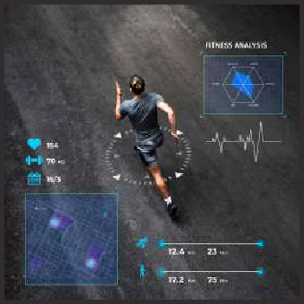
User Experience Enhancement
Online platforms enable seamless browsing, customized preferences, and instant conﬁrmations, leading to an enhanced user experience. These features contribute to increased satisfaction and repeat bookings.

Slide 7

Data-Driven Insights
By leveraging data from online bookings, businesses can gain valuable insights into customer preferences, peak booking times, and popular activities. This data- driven approach allows for informed decision-making and targeted marketing.

Slide 8

Mobile Accessibility
The widespread use of smartphones enables users to book sports and activities on-the-go. Mobile accessibility provides ﬂexibility and convenience, catering to the modern lifestyle of individuals.

Slide 9

Integration with Facilities
Online platforms can be integrated with facility management systems, streamlining the booking process and ensuring real-time availability updates. This integration enhances operational efﬁciency and customer satisfaction.

Slide 10

Marketing and Promotion
Digital platforms offer opportunities for targeted marketing campaigns, promotional offers, and loyalty programs. These strategies attract and retain customers, ultimately driving business growth.

Slide 11

Customer Feedback and Reviews
Online platforms facilitate customer feedback and reviews, providing valuable insights for continuous improvement.
Positive reviews also serve as powerful endorsements, inﬂuencing potential customers' decisions.

Slide 12

Security and Trust
Establishing robust security measures and transparent policies on online platforms builds trust with users. Assurance of secure transactions and data protection is crucial for fostering long-term customer relationships.

Slide 13

Global Reach
Online platforms provide the opportunity for sports and activity businesses to reach a global audience. This expanded reach opens doors for collaborations, partnerships, and diverse cultural experiences.

Slide 14

Conclusion
In conclusion, leveraging online platforms for sports and activity bookings presents a myriad of beneﬁts, from enhanced user experience to data-driven insights.
Embracing digital innovation is key to optimizing leisure and shaping the future of the industry.

Slide 15
Thanks!

