Slide 1
CROP PLANNING
Weekly presentation

Slide 2
27-July-2022

Slide 3
Overall week progress (20.07.2022 - 27.07.2022)
Analysis of seasonal fruits and vegetables
Collecting dataset for seasonal fruits
Analysis of daily price report
Analysis of weekly price report

Slide 4
Analysis of seasonal fruits and vegetables
Analysis the indian seasonal fruits and vegetables
Fruits
Apple
Grapes
Mango
Papaya
Pineapple
Jackfruit
Vegetables
Bitter Gourd
Gabbage
Cauliflower
Okra
Onion
Peas
Potato
Tomato
Reference : https://www.allthatgrows.in/blogs/posts/vegetable-growing-season-chart-india

Slide 5
Collecting dataset for seasonal fruits
Collects the daily price report of Pineapple for Kerala, Alappuzha district, Alappuzha market from Jan 01 2012 to June 31 2022.
Reference : https://agmarknet.gov.in/SearchCmmMkt.aspx?Tx_Commodity=20&Tx_State=KL&Tx_District=16&Tx_Market=128&DateFrom=01-Jan-2012&DateTo=31-Dec-2012&Fr_Date=01-Jan-2012&To_Date=31-Dec-2012&Tx_Trend=0&Tx_CommodityHead=Mango&Tx_StateHead=Kerala&Tx_DistrictHead=Alappuzha&Tx_MarketHead=Alappuzha

Slide 6
Analysis of daily price report
Number of data collected from daily price report for:
2012 | 253
2013 | 236
2014 | 232
2015 | 210
2016 | 174
2017 | 90
2018 | 128
2019 | 152
2020 | 141
2021 | 143

Slide 7
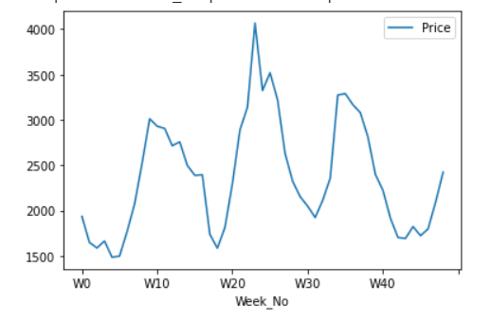
Graphical analysis of daily price report for 2012

Slide 8
Analysis of weekly price report
Due to the lack of data for daily analysis, found the average price for a week of a year and create weekly price report and analyse it.

Slide 9
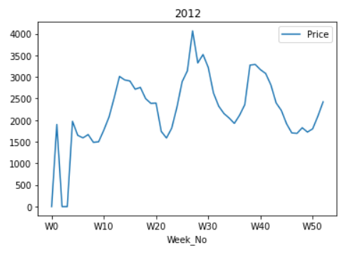
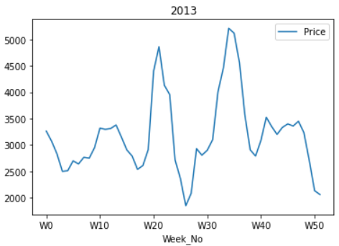
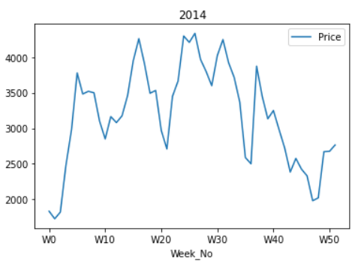
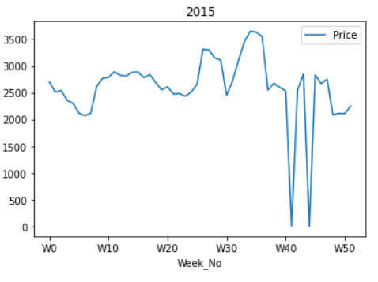

Slide 10
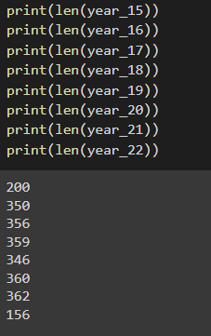
Data

Slide 11
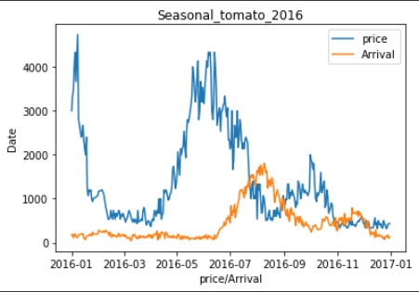
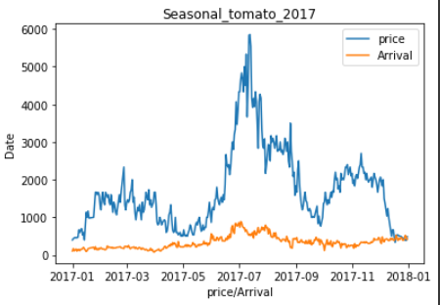
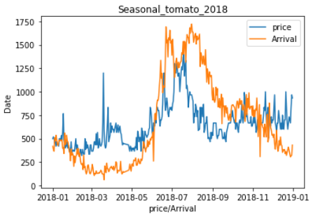
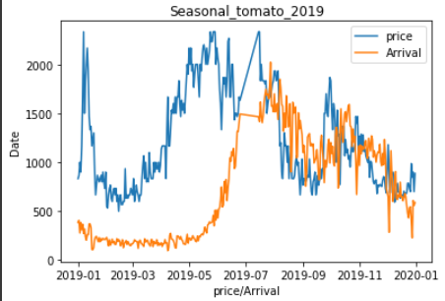
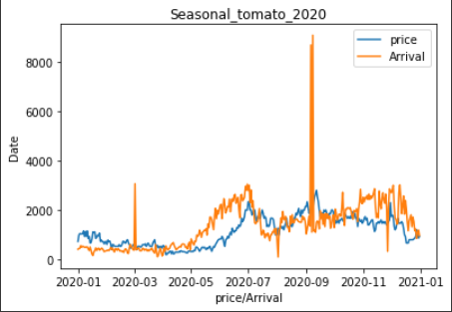
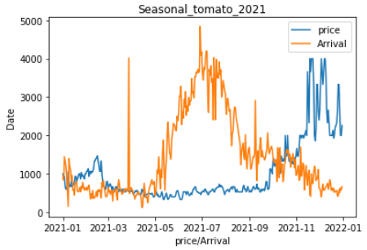
Tomato

Slide 12
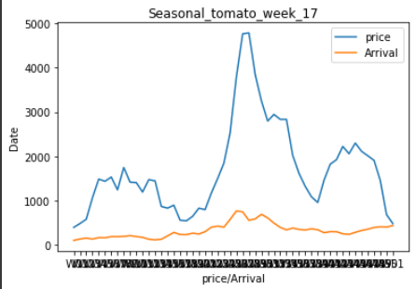
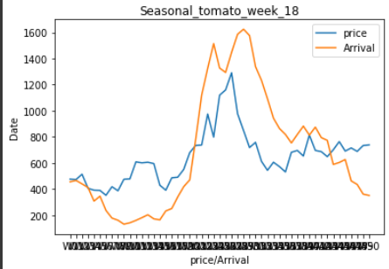
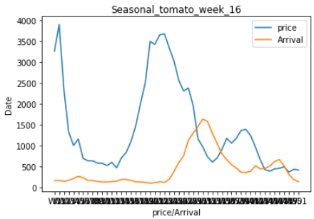
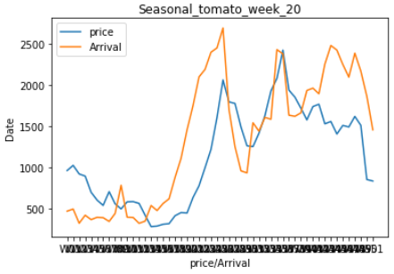
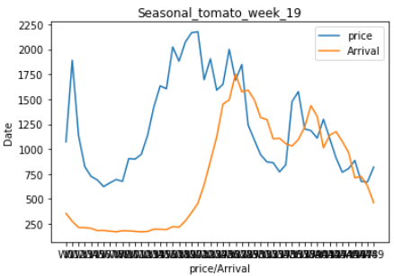
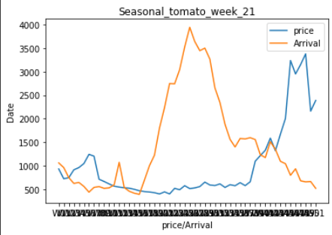
Tomato week

Slide 13
02-Aug-2022

Slide 14
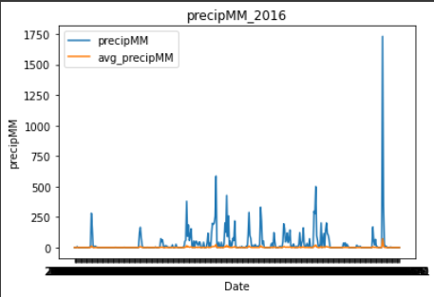
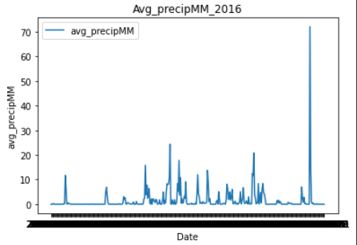
Pricipation vs Avg_pricipation

Slide 15
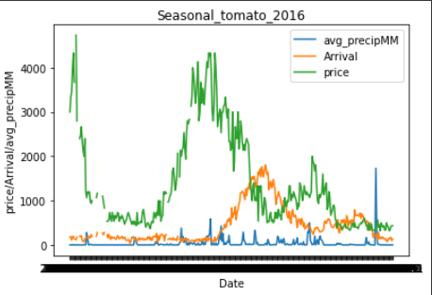
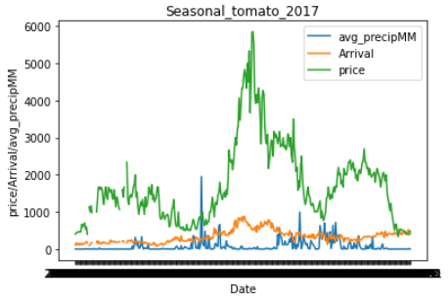
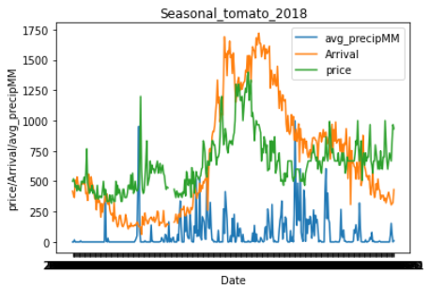
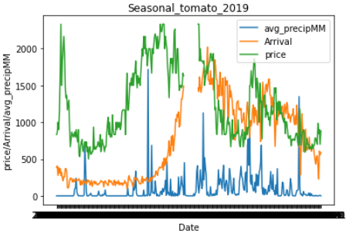
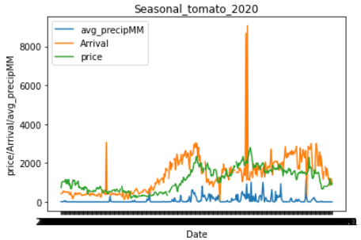
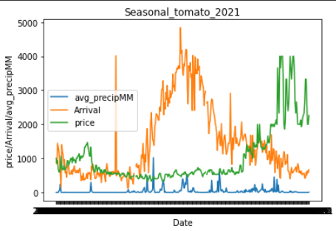
price,Arrival and pricipation

Slide 16
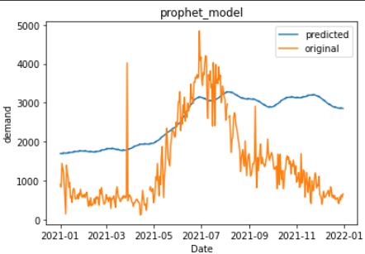
Predict Demand

Slide 17
05-Aug-22

Slide 18
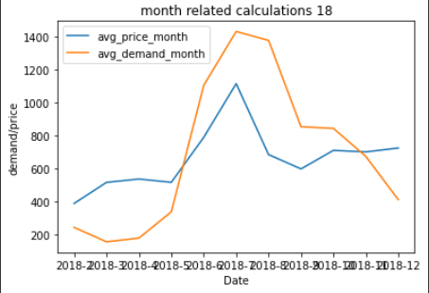
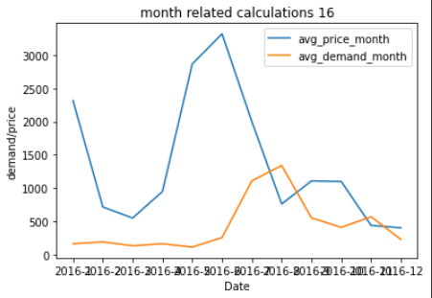
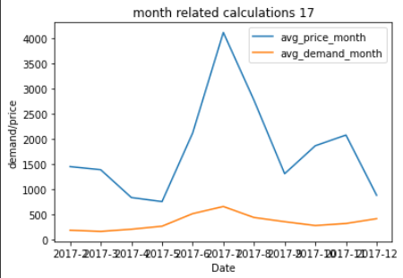
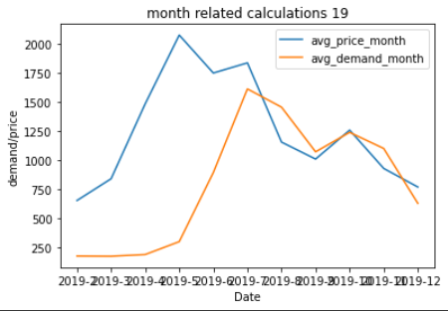
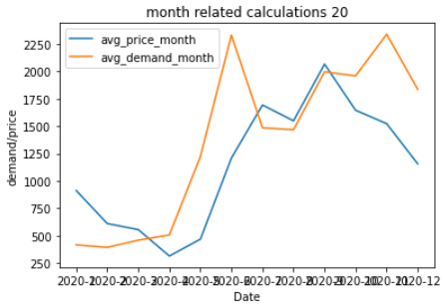
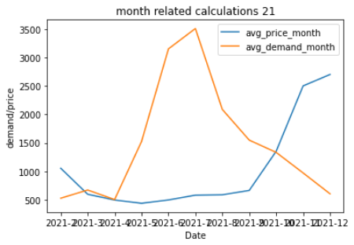
Monthly graphs

Slide 19
Year and month
['2016-1', '2016-2', '2016-3', '2016-4', '2016-5', '2016-6', '2016-7', '2016-8', '2016-9', '2016-10', '2016-11', '2016-12', '2017-1', '2017-2', '2017-3', '2017-4', '2017-5', '2017-6', '2017-7', '2017-8', '2017-9', '2017-10', '2017-11', '2017-12', '2018-1', '2018-2', '2018-3', '2018-4', '2018-5', '2018-6', '2018-7', '2018-8', '2018-9', '2018-10', '2018-11', '2018-12', '2019-1', '2019-2', '2019-3', '2019-4', '2019-5', '2019-6', '2019-7', '2019-8', '2019-9', '2019-10', '2019-11', '2019-12', '2020-1', '2020-2', '2020-3', '2020-4', '2020-5', '2020-6', '2020-7', '2020-8', '2020-9', '2020-10', '2020-11', '2020-12', '2021-1', '2021-2', '2021-3', '2021-4', '2021-5', '2021-6', '2021-7', '2021-8', '2021-9', '2021-10', '2021-11','2021-12']

Slide 20
avg_price_mont
[2314.9166666666665, 714.8695652173913, 548.7096774193549, 947.448275862069, 2865.8275862068967, 3320.366666666667, 1999.225806451613, 760.0967741935484, 1107.2666666666667, 1098.032258064516, 436.9, 401.7096774193548, 902.2692307692307, 1453.0833333333333, 1390.6774193548388, 839.1666666666666, 758.2903225806451, 2120.2, 4114.5161290322585, 2769.2580645161293, 1311.6, 1866.483870967742, 2078.7, 883.9032258064516, 459.61290322580646, 387.67857142857144, 515.741935483871, 536.0, 516.0967741935484, 789.0, 1114.6451612903227, 684.1612903225806, 597.4, 709.7741935483871, 700.5, 724.2258064516129, 1184.967741935484, 655.6071428571429, 841.9354838709677, 1483.3666666666666, 2073.1290322580644, 1748.04, 1835.1764705882354, 1155.9354838709678, 1010.4, 1258.4516129032259, 930.2333333333333, 771.0, 913.3548387096774, 611.8275862068965, 556.6, 315.73333333333335, 469.41379310344826, 1210.0, 1693.3666666666666, 1548.9, 2066.633333333333, 1645.1935483870968, 1523.3333333333333, 1156.7, 846.258064516129, 1052.392857142857, 594.6451612903226, 493.39285714285717, 436.19354838709677, 494.43333333333334, 579.1290322580645, 585.3333333333334, 662.3333333333334, 1351.6129032258063, 2501.3333333333335, 2702.2580645161293]
avg_demand_month
[161.70833333333334, 189.04347826086956, 131.5483870967742, 162.10344827586206, 111.51724137931035, 255.2, 1107.8387096774193, 1339.0, 550.9, 408.0967741935484, 568.0, 227.51612903225808, 151.42307692307693, 190.375, 167.19354838709677, 210.33333333333334, 269.93548387096774, 519.5333333333333, 661.0967741935484, 443.0967741935484, 359.8666666666667, 283.258064516129, 324.3666666666667, 419.4516129032258, 434.0, 242.75, 155.06451612903226, 177.45833333333334, 337.3225806451613, 1104.5333333333333, 1431.032258064516, 1377.0, 853.2, 843.4193548387096, 673.1, 411.0967741935484, 255.48387096774192, 179.64285714285714, 177.93548387096774, 192.2, 302.8709677419355, 894.72, 1611.764705882353, 1455.3548387096773, 1072.4333333333334, 1239.4516129032259, 1101.2333333333333, 631.3870967741935, 417.5806451612903, 395.0, 460.1666666666667, 508.1, 1223.344827586207, 2331.2, 1485.6, 1467.9, 1996.6666666666667, 1959.032258064516, 2339.4, 1836.5333333333333, 775.7096774193549, 525.1785714285714, 669.5483870967741, 501.32142857142856, 1522.6774193548388, 3152.9333333333334, 3511.0967741935483, 2087.1666666666665, 1547.2666666666667, 1331.3870967741937, 969.9666666666667, 602.5483870967741]

Slide 21
08th August 2022

Slide 22
IBM Research paper
Introduction
Related works
Dataset
Proposed methods
Experiments
Conclusion and future works

Slide 23
Introduction
Crop prices are affected due to:
area under cultivation for a particular crop
supply projection
government policies
consumer demands
supply chain aspects of producers for agriculture-based products
Weather conditions
Challenges in crop price forecasting
data quality issues
unreliability in future weather predictions
high fluctuation present in the historical crop price
crop price variations across neighboring marketplaces
Related works

Slide 24
III. Dataset
 | Weather Data | 2. Agmarknet Data
Features | Average humidity Total rainfall Average temperature | Minimum price per quintal Maximum price per quintal Model price per quintal Arrival volume
Reference | Weather Channel APIs to access the weather data for the geo-locations | Agricultural Marketing Information Network
Location | Davangere district in Karnataka state for the years 2017 and 2018. | For 7 markets in Kolar For Tomato & Maize Jan 2016 - Jul 2019
Note | Transport disturbance - heavy rainfall temperature and humidity affect the shelf life of crops quantity of crops brought to the marketplaces | Website is not updated on sundays. Thus, no arrival of crops on Sundays

Slide 25
IV. Proposed Method
Data preprocessing
Identification of missing value and filled with splined based technique
For Agmarknet all days except Sunday no entry - missing
Outlier
Detected by IQR (Interquartile range) method
were not modified(considered as human error when recording)
2. Statistical Analysis
ADF & KPSS tests
non-stationary, strict-stationary, trend-stationary or difference stationary
Tomato price - Strict stationary
Maize price - non- stationary
Agmarknet data is decomposed into trend, seasonal and residual components using additive seasonal decomposition techniques
Residual component/noise
Mean = 0
Avg Std Deviation: Tomato = 202.43; Maize = 34.39

Slide 26
3. Data quality based features
Already there are features from 2 datasets
Weather dataset - WD
Agmarknet dataset - AG
Additionally following features are proposed to capture the data quality issues - DQ
Missing flag (M) - binary
Outlier flag (O) - binary
Fourier Transform based features (FT) -
Time related features
Day & Month - Numerical value
Statistical Indicators (SI)
moving averages, moving standard deviation of the price timeseries

Slide 27
4. Feature Representation
Features : AG, WD, DQ

