Slide 1
Root Cause Analysis

Slide 2
Introduction
Objective
Identify the root cause of IOT device failure using sensor data
Predict remaining uselife(RUL) of devices before it fails

Slide 3
Dataset Description
CURRENT STATUS
Device_ID | Data
869170034808700 | Battery, Humidity, Light Intensity, Soil Conductivity, Moisture, Temperature
7023401402 | Battery, Internal_temperature, Soil conductivity, Moisture, Humidity, Temperature, Soil temperature
8691700352619740 | Battery, Internal_temperature, Soil conductivity, Moisture, Humidity, Temperature, Soil temperature, Signal Strength
869170034808684 | Battery, Humidity, Light Intensity, Soil Conductivity, Moisture, Temperature

Slide 4
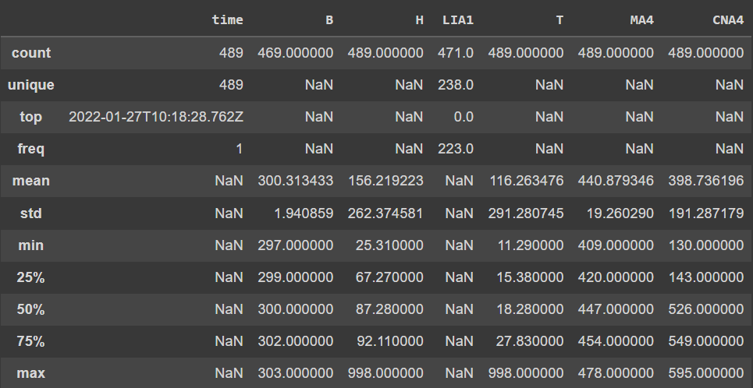
Single Device Analysis
For device 869170034808684

Slide 5
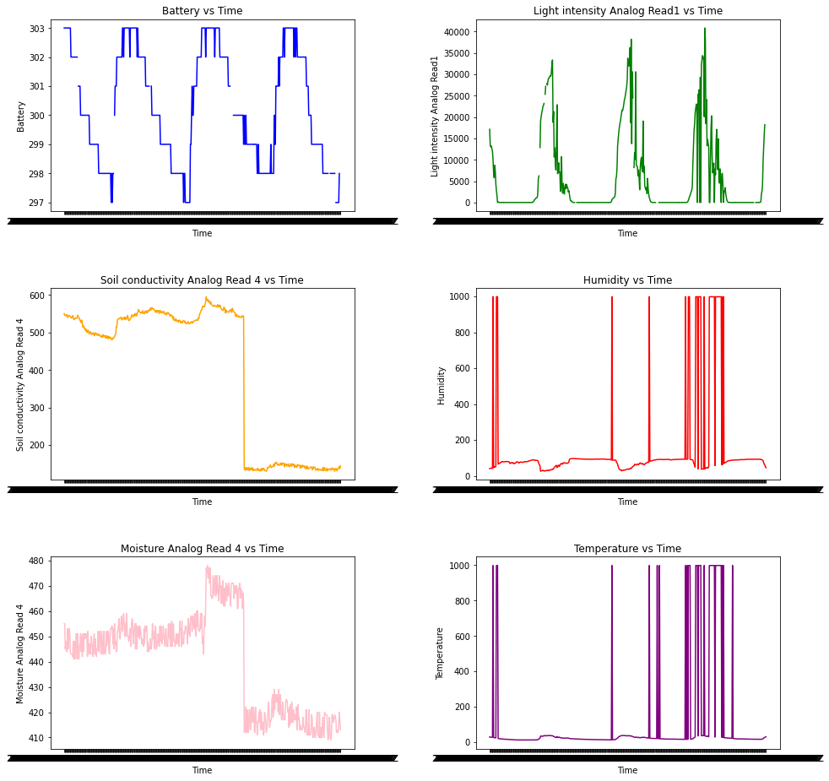
Plot Analysis

Slide 6
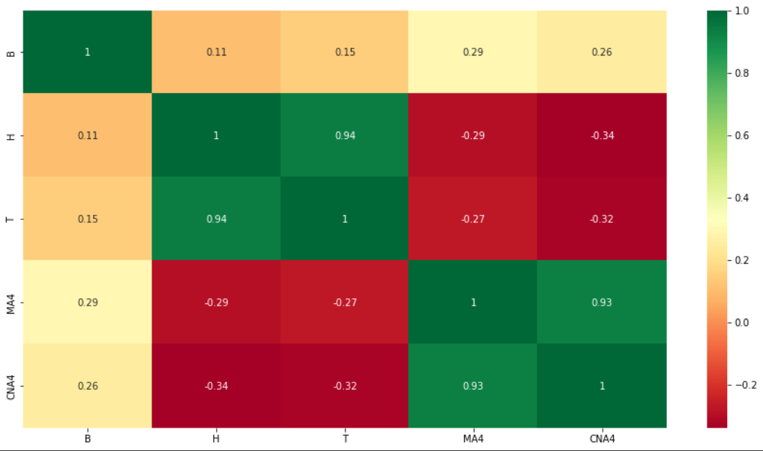
Correlation matrix

Slide 7
Sprint plan
Analyse more devices.
Observe different types of faults and find a way to label them.
Build the rules pattern.

Slide 8
THANK YOU

