Slide 1
Root Cause Analysis

Slide 2
Introduction
Objective
Identify the root cause of IOT device failure using sensor data
Predict remaining uselife(RUL) of devices before it fails

Slide 3
Current status

Slide 4
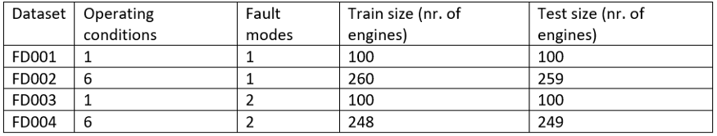
RUL Prediction
Dataset —> Nasa’s Turbofan Data
Features: Engine id, time cycle, sensor 1 to sensor 21
Fault modes : HPC degradation, Fan degradation (1:HPC, 2: HPC+fan)
RUL
Grouping the engines by its id
Max operating time Cycle
RUL = Max_cycle - Current_cycle

Slide 5
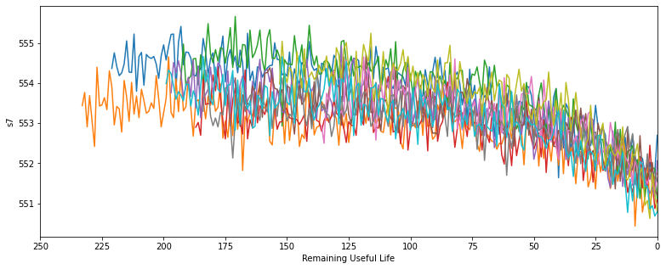
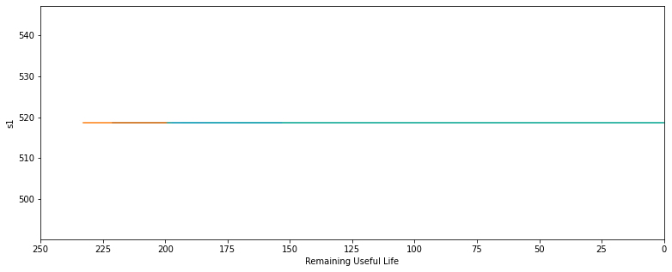
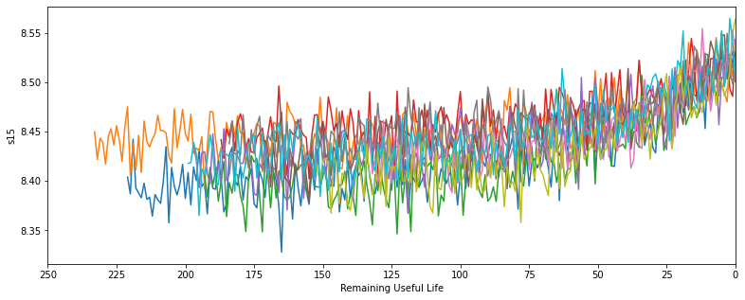
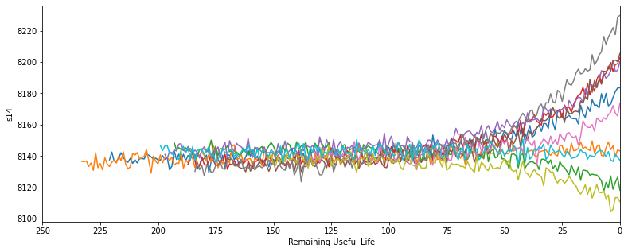
Data Analysis

Slide 6
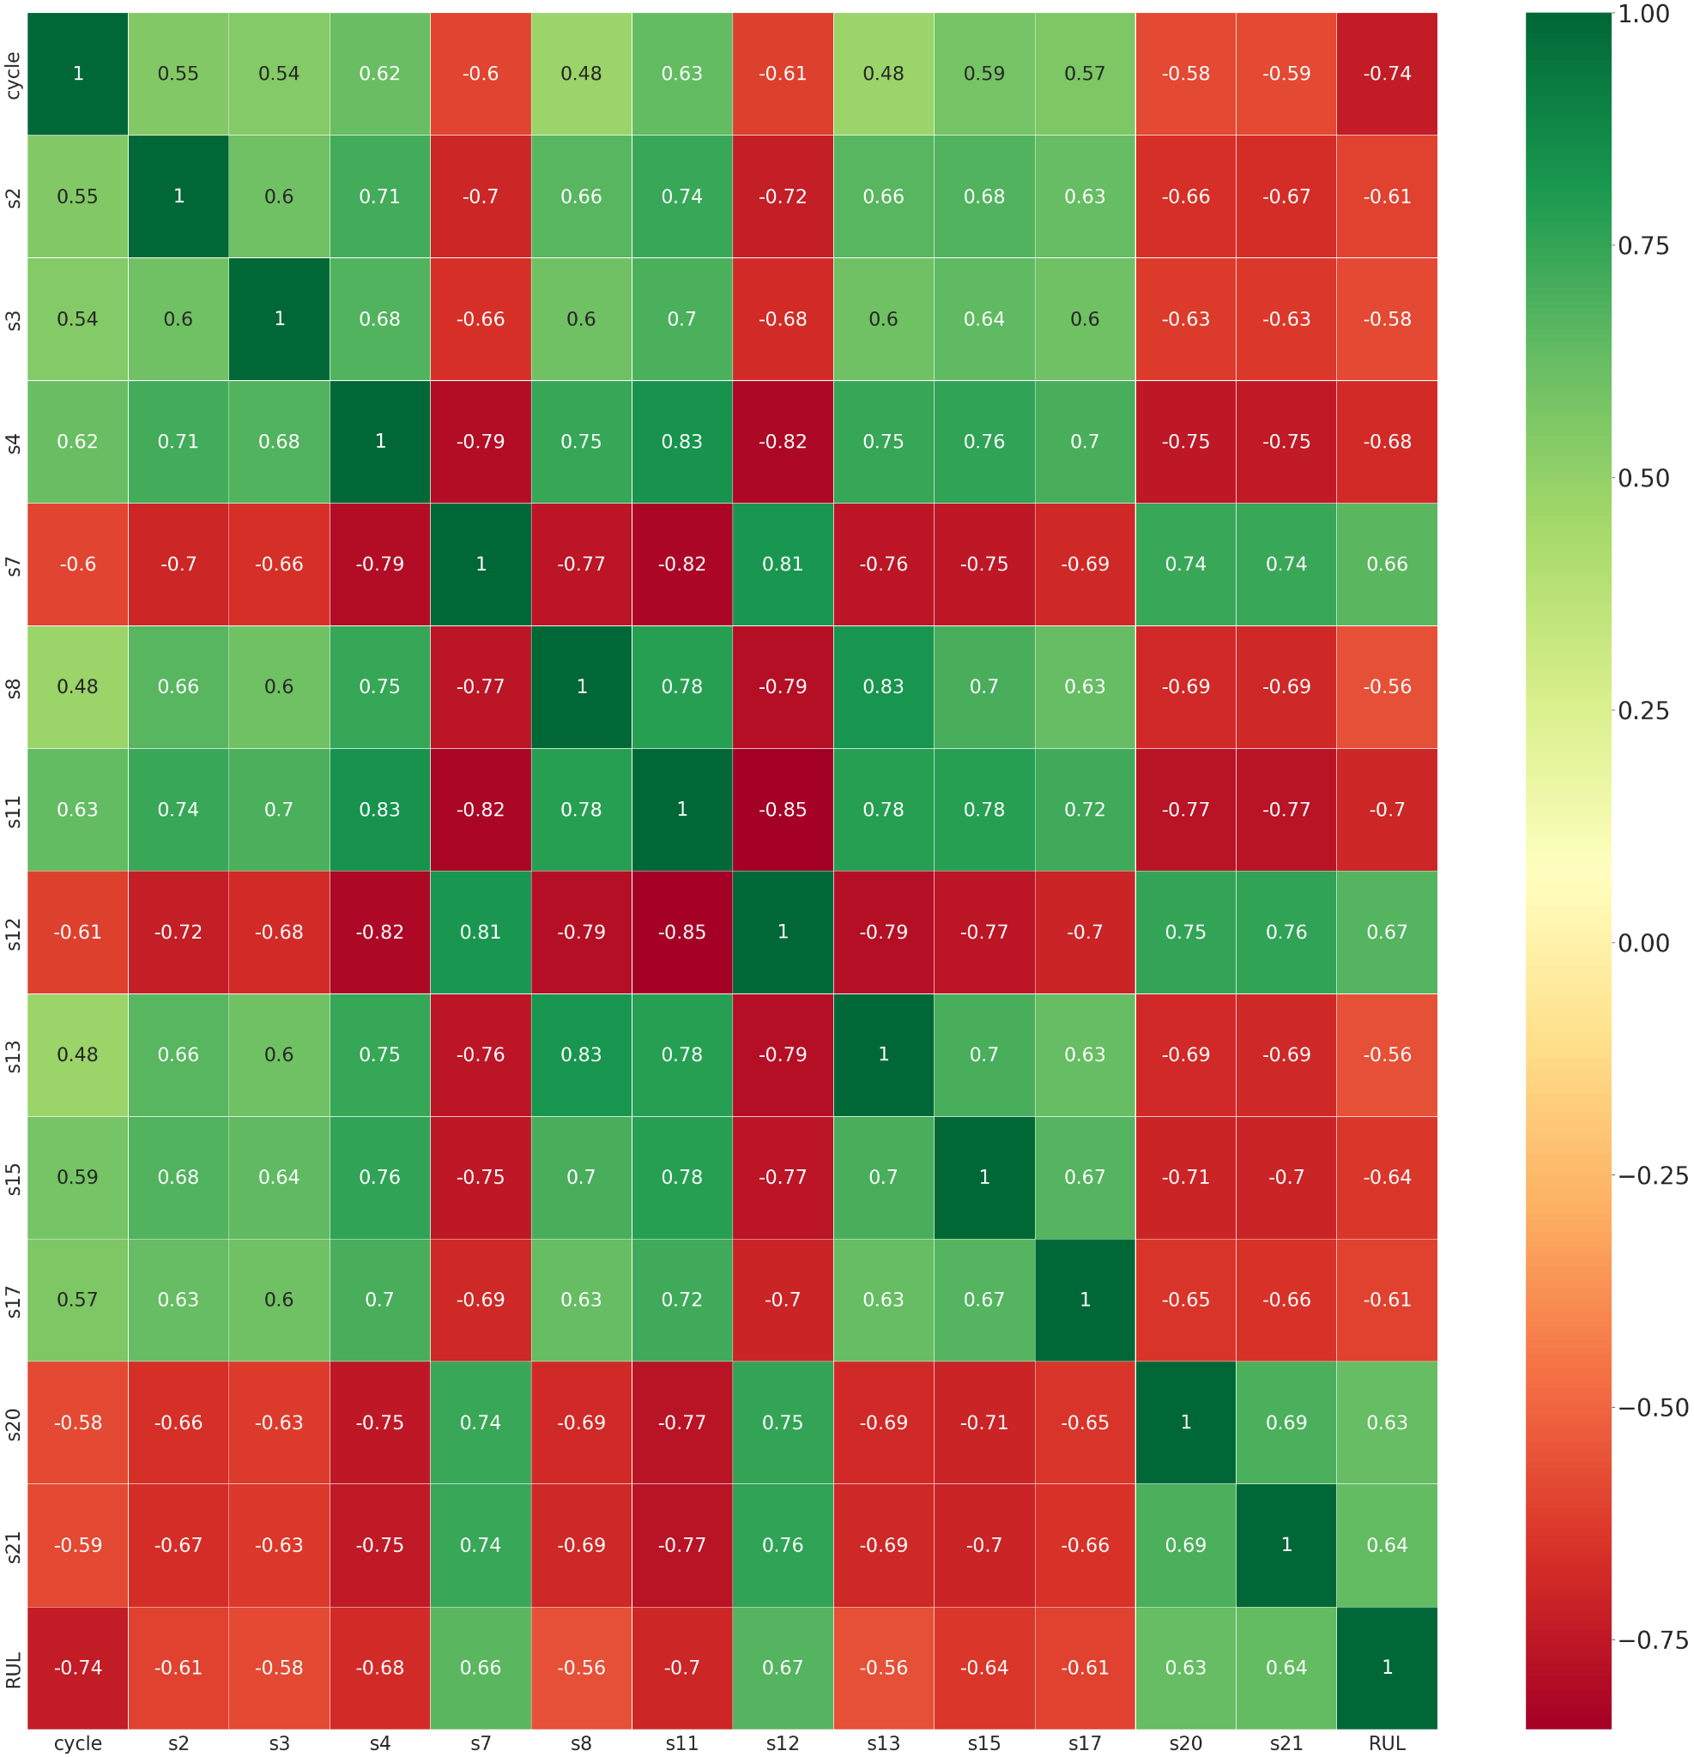

Slide 7
Summary of RUL prediction
Dataset | algorithm | train_RMSE | test_RMSE
FD001 | Liner_regression | 22.7 | 22.9
FD001 | SVM | 23.17 | 22.6
FD001 | Random forest | 7.9 | 19.4
All 4 dataset | Linear_regression Random Forest | 21.9 6.7 | 31.3 27
FD001 | Simple MLP model | 24.2 | 25.36
FD001 | LSTM LSTM_H_Tune 1 LSTM_H_Tune 2 | 13.5 12.31 15 | 38 29.9 27

Slide 8
Fault Classification
Dataset →Solar system (GPVS)
Two modes MPPT —> Maximum Power Mode IPPI —> Limited Power Mode
Each mode has 7 fault dataset and 1 fault free dataset
15 features including fault type label
109342 rows × 15 columns
Fault were introduced manually

Slide 9
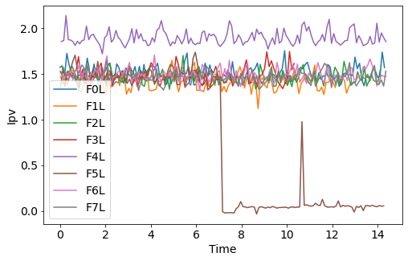
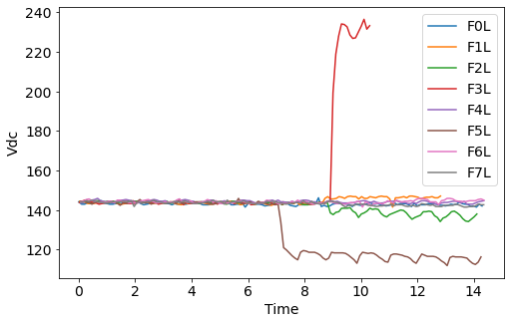
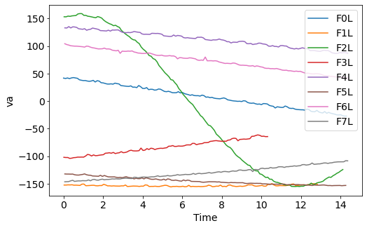
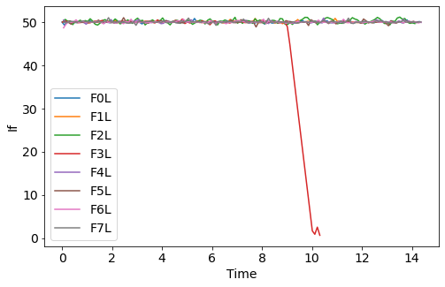
Data Analysis
Limited Power Mode

Slide 10
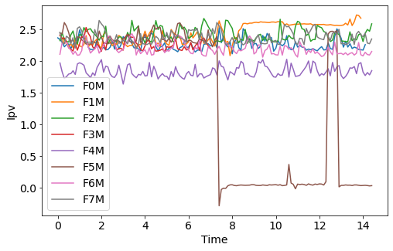
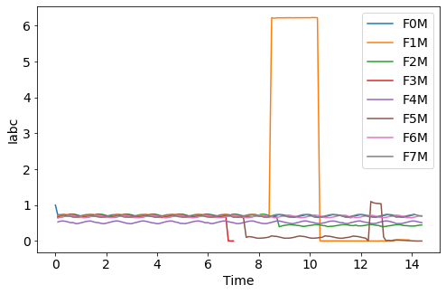
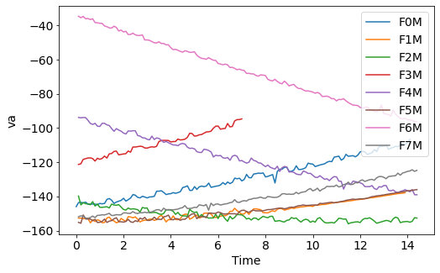
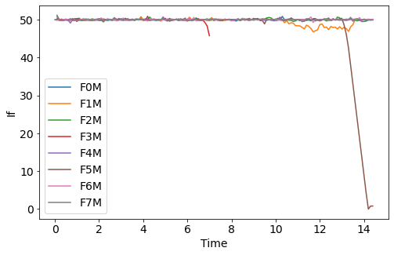
Max power Mode

Slide 11
Summary of Fault Classification
Model | Test Accuracy
Random Forest Classifier | 0.95
Decision Tree | 0.90

Slide 12
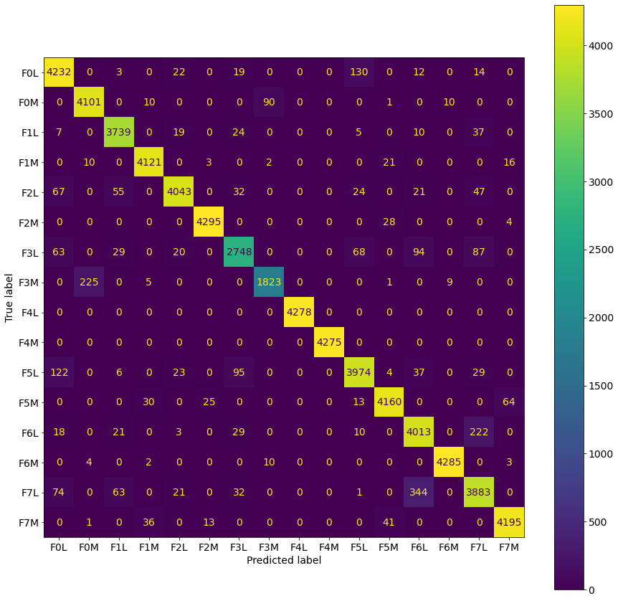

Slide 13
Next Sprint Plan
What if our data is available ?

Slide 14
Predictive Maintenance/Fault type classification Pipeline
Dataset
Compute RUL
Label the data
Testing and evaluation
ML models
Data Preprocessing and feature engineering

Slide 15
Data Preprocessing
Noise Removal
Principal Component Analysis
Auto-encoders for noise removal
Analyzing the correlation between features and target variable
Smoothing
Exponential smoothing
Moving coverage
Scaling the data
Frequency domain analysis
Create a new set of features based on signal processing approach(FFT)
Creating new statistical features
Mean, mode, median etc.

Slide 16
ML Strategies
Conventional regression techniques for RUL prediction
SVM, RF, MLP etc
Time Series Approach
CNN based RUL prediction
Combinations of 1DCNN , LSTM and Dense layer

Slide 17
Thank YOU

