Slide 1

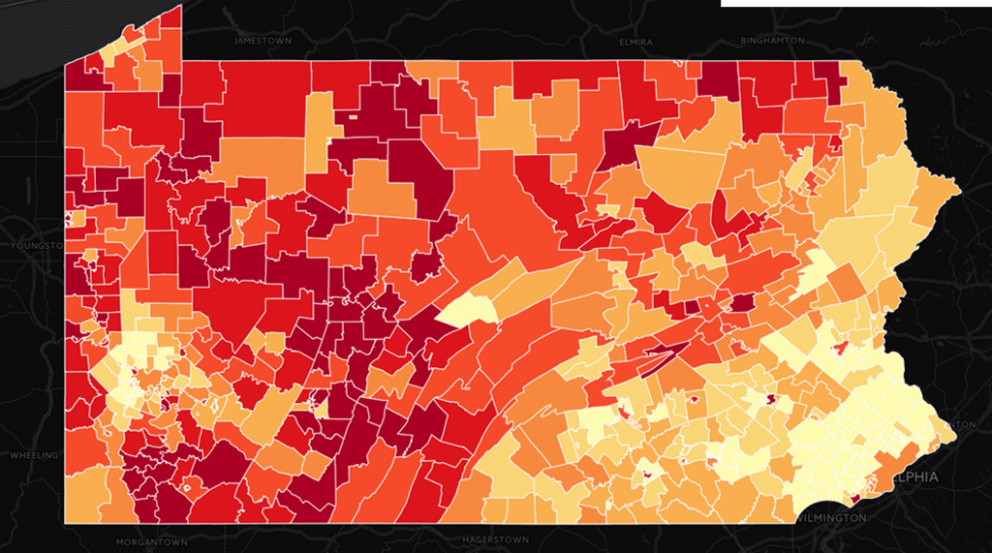
Group 1:
Web Based Population Clustering
Connor Barthen, Nathan Barthen, & Cole Cassano
Notes:
Image - https://whyy.org/articles/which-pa-school-districts-get-the-highest-percentage-of-aid-from-the-state/

Slide 2
Introduction
Webpage that selects and displays clusters of student addresses by the density of total addresses.
User will select specific schools to use for clustering.
Clustering information can be used to estimate bus information.
Estimate total number of buses needed.
Estimate potential bus routes.
Notes:
-Breif explanation of what it does.
Purpose (generate routes for buses), but first need to select stu addr to use for routes…. Needs to cluster and randomly select addr to use as students
….

Slide 3
Motivation
Will give schools/users information about their buses.
Are they over spending on number of buses.
Can give estimations/suggestions to potential bus routes.
Gave us an opportunity to experience new things.
Geojson / shapefiles / clustering
Notes:
-schs may over spend on busing
-Give sch districts a tool to compare their current busing structure to our to see if their routing could be diff / changed / improved / save money.

Slide 4
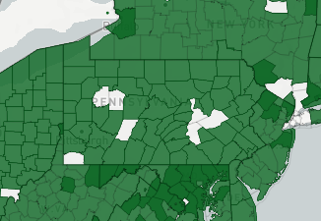
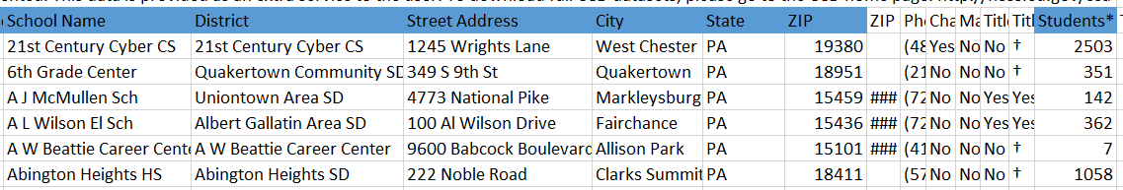
Body - Data & School Selection
Data Collection:
-OpenAddresses.io - sample address (txt)
-US Census Bureau - shapefiles (map files)
-NACE - school information (csv)
On the Website:
Select a State →
Select a County →
Select a School District →
Pull School(s) Information…
OpenAddresses - available counties
School Information file - sample
Notes:
At the start of our project, we had to collect a lot of data that we were going to need. This included a long list of addresses for each state that could be used for clustering and randomly generating student addresses. To know which addresses were in the given school district to use for clustering, we used shapefiles. Shapefiles are basically a file of a map that contains, in our case, the polygons of each school district. And of course we needed the data for all of the different school districts and the schools within those districts.
On the actual website, the user would first select a State. Right now only Pennsylvania is complete, but adding more states is fairly straightforward. After selecting the state we will go find all of the Counties for the user, where they can then select a specific County, which will then list all of the School Districts. When they select a School District this will go pull all of the schools data for that given District and present the user with the clustering options.

Slide 5
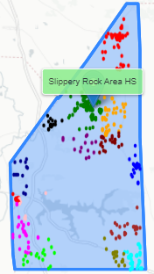
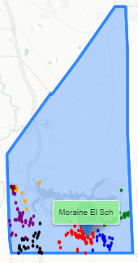
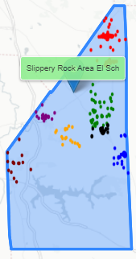
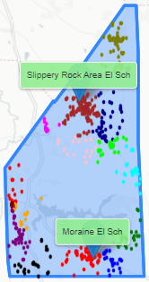
Body - Clustering / Routing
Example Clustering - Slippery Rock Area SD
After School(s) Information is pulled:
-Every School District buses their students
differently.
-All Separate OR All Together
-Middle & High together OR Separate
-Elementary all together OR Separate
-Clustering must accommodate all of these
combinations.
-Must also handle exceptions when data is
missing.
-Ex. Add/Edit School, missing polygon,
not enough addresses.
-Generate Routing input file & email user file.
#1 - High School Only
#2 - Only Moraine Ele
#3 - Only Slippery Rock Ele
#4 - Both Elementary Schs
Notes:
The clustering part of the project is where a lot of our code gets executed. Since every school district may bus and route their students differently, it has to handle all of the different possible busing configurations. For example, Slippery Rock Area School District may bus Middle and High Schools together, but bus the two elementary schools separately. This means that depending on how the district wants to bus their schools, the clustering is executed differently. We added a few examples of how the clustering would look when different options are selected. The first picture shows the high school being routed by itself… The next two pictures shows how elementary schools clusters would look if they wanted them routed separately. As you can see in the picture Moraine did not select addresses from the upper half of the district since they should belong to the other elementary school. The last picture shows if the elementary schools were routed together. In this case, Slippery Rock only contains 2 elementary schools, so it is selecting addresses from the entire district. If Slippery Rock contained a third elementary school, you would see that there may be a blank area on the map, where clustering was skipped since it may have belonged to the third elementary school.
After the clustering is done and the student addresses are assigned, the user is able to generate the bus routing input file that can be used later. The user is also able to email themselves the file as well.

Slide 6
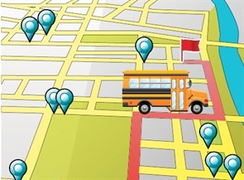
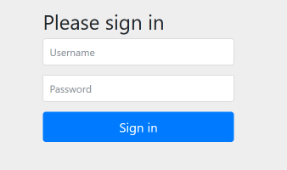
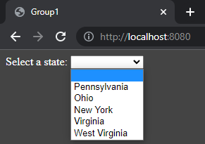
Future Work
Add a Login / Sign Up Page:
Limit where users can go and what they can control.
Every user having full unrestricted access is a security risk.
Add a Bus Routing Algorithm:
Algorithm that takes the cluster information and generates bus routes.
Plots routes based on the most optimal paths.
Add More States to the Program:
*Currently only supports PA, but school information is added for 5 states (missing addresses).
Technical Manual details steps to add more states.
Ideally the program would be usable for every state.

Slide 7
Conclusion
Our goal was to create a program that can use school information and make meaningful clusters/models:
Schools can then compare this information and determine what they need to change.
Are they over spending on bussing?
Are they routing in the most efficient way?
The webpage is simple:
However, a lot is going on in the background (especially when clustering).
User is able to select what information they want and how they want to cluster schools.
Room for future work/additions.
Overall a lot was accomplished in the 14 weeks we were given.

Slide 8
DEMO

Slide 9
Clustering Variations

Slide 10
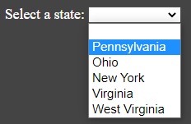
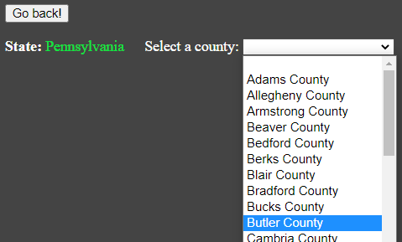
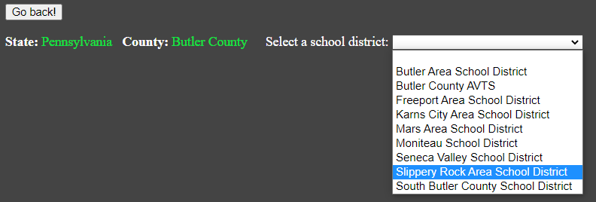
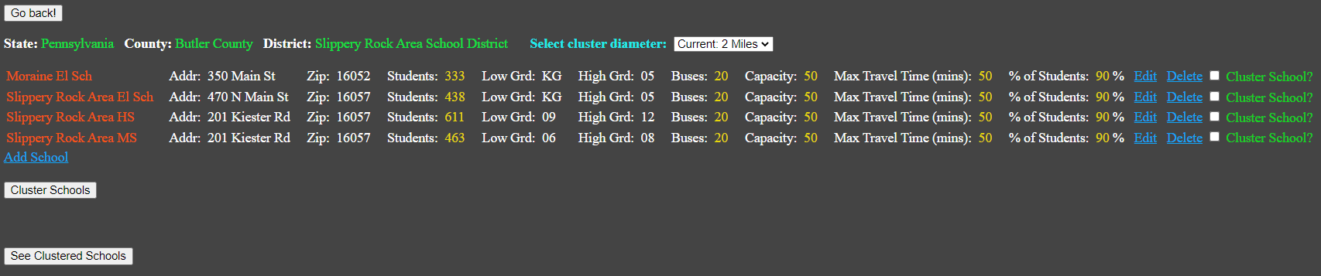
1/3 - DEMO Backup

Slide 11
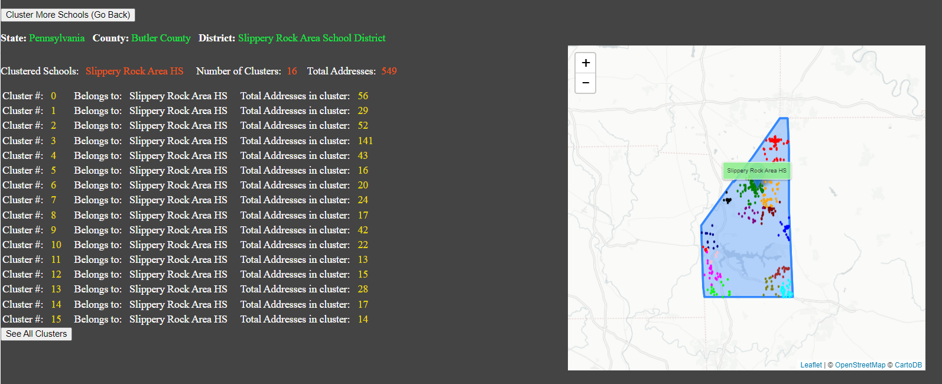
2/3 - DEMO Backup

Slide 12
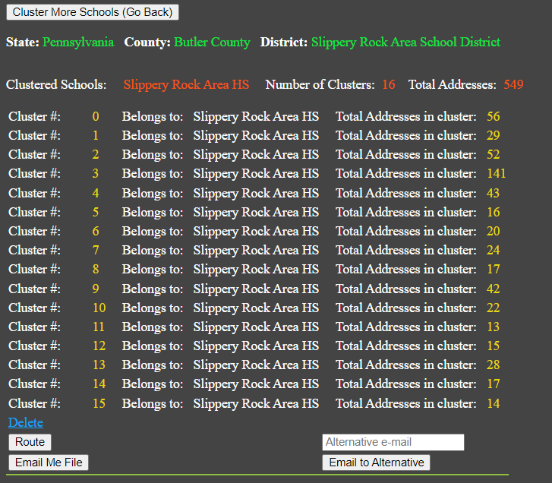
3/3 - DEMO Backup

