Slide 1


Department of Computer Science and Engineering
AI Generative Personalized Interview
Preparation Platform
SDG : 4 (QUALITY EDUCATION)
NARUNIKKA R – 211421104170
MONIKA M – 211421104165
DEVIPRIYA S M - 211421104054
Project Coordinator:
Dr. KAVITHA SUBRAMANI, PROFESSOR.
Project Guide: Dr. LAKSHMI D
ASSOCIATE PROFESSOR.

Slide 2
Abstract
This project introduces an AI-powered interview preparation platform designed to optimize job candidates' readiness by leveraging advanced Natural Language Processing (NLP) techniques. The platform analyzes resumes in multiple formats, including PDF, DOCX, and Google Drive links, to generate personalized interview questions, aptitude tests, and self-introduction prompts tailored to the user's professional background. The system provides instant feedback on responses, allowing candidates to track their progress and refine their answers for better performance. Additionally, the platform evaluates resumes for Applicant Tracking System (ATS) compatibility, offering an ATS score to help candidates optimize their resumes for better visibility during the hiring process. With an easy-to-use interface and secure authentication, the platform enhances the interview preparation journey by giving candidates the tools to articulate their strengths, assess their preparedness, and improve their chances of success in a competitive job market.

Slide 3
Introduction
In today's competitive job market, preparing for interviews can be a daunting task. Traditional preparation methods are often generic and do not cater to an individual's unique career path. To address this gap, we have developed an AI-based interview preparation platform that customizes the syllabus based on your resume. This platform leverages the power of artificial intelligence to analyze your professional background, skills, and experience, then tailors the interview preparation process specifically to your profile. Whether you are applying for a technical role, a managerial position, or something else, the platform ensures that you focus on the most relevant topics and skills for the job you're targeting. Our innovative system provides personalized mock interviews, study materials, and question banks, helping you prepare with greater efficiency and confidence. With continuous feedback and performance tracking, you can identify areas for improvement and fine-tune your responses to increase your chances of success. By aligning the syllabus with your career goals, this platform maximizes your preparation efforts, offering a dynamic and individualized approach to mastering the interview process.

Slide 4
Objective of the Project
Personalizes Interview Preparation: Analyzes resumes to generate tailored interview questions, aptitude tests, and self-introduction prompts based on the user's professional background and career goals.
Enhances Interview Performance: Provides instant feedback on interview responses, helping candidates refine their answers and improve their interview skills, boosting their confidence and performance in real interview scenarios.
Optimizes Resume for ATS Compatibility: Evaluates resumes for compatibility with Applicant Tracking Systems (ATS), offering an ATS score and suggestions for improvement to increase the chances of the resume being noticed by recruiters.
Supports Multiple File Formats: Allows users to upload resumes in various formats (PDF, DOCX, Google Drive links), ensuring accessibility and ease of use for candidates with different document types.
Offers Personalized Access and User-Friendly Interface: Provides a smooth and intuitive user experience with built-in authentication, ensuring secure and personalized access to interview preparation resources.

Slide 5
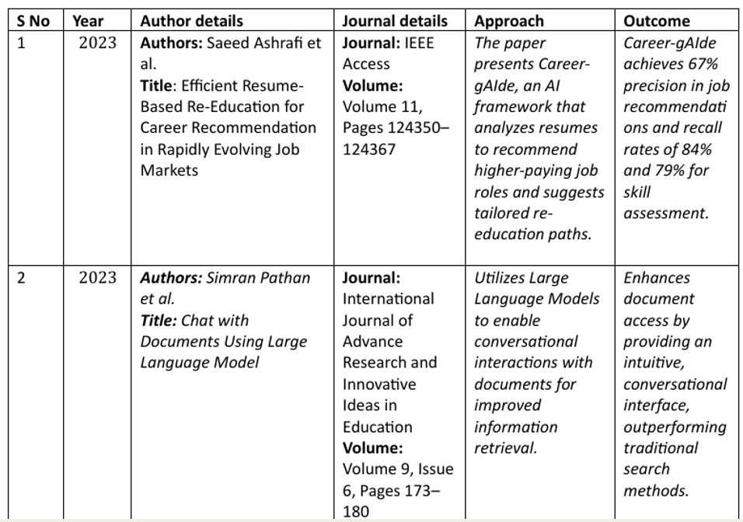
Literature Survey

Slide 6
Literature Survey

Slide 7
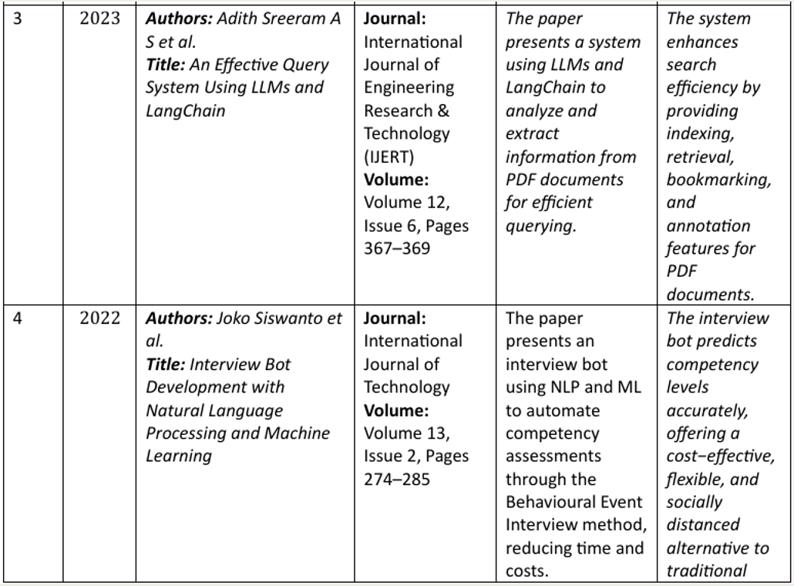
Literature Survey

Slide 8
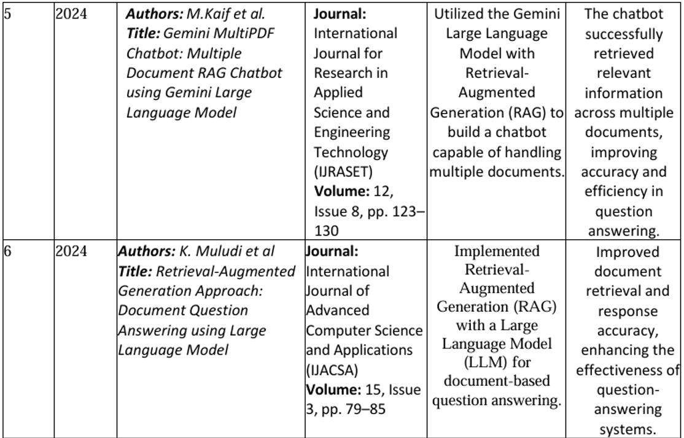
Literature Survey

Slide 9
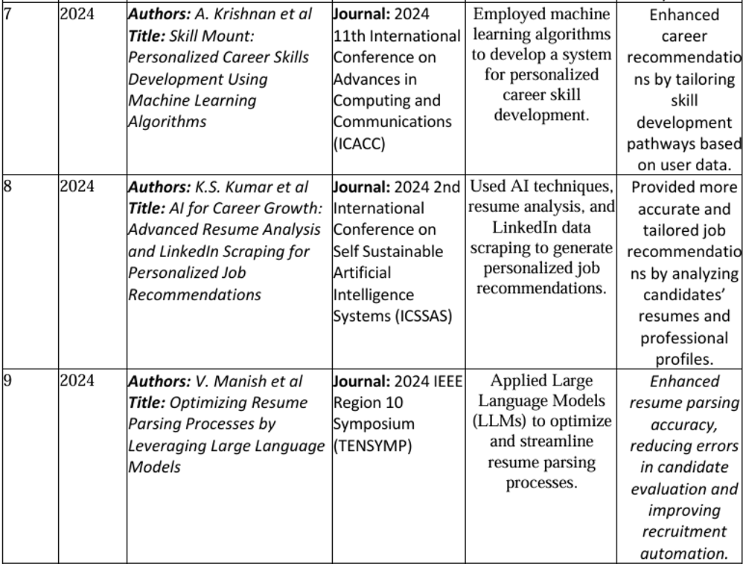
Literature Survey

Slide 10
Problem Statement
In today's competitive job market, candidates struggle with interview preparation due to the lack of personalized guidance tailored to their skills and experience. Existing platforms for resume analysis, mock interviews, and aptitude tests work in isolation, offering generic feedback without leveraging the candidate's resume. There is no unified system that integrates resume-based question generation, self-introduction assistance, mock tests, and ATS scoring, leaving candidates unable to effectively articulate their strengths or optimize their resumes. An AI-powered platform that extracts key resume details, generates customized interview questions, conducts mock tests, and evaluates ATS compatibility would enhance job seekers' confidence and improve their chances of success.

Slide 11
Existing System
Resume Analysis Tools (e.g., HireVue, Zety):
Extract details from resumes, match candidates to jobs, and offer feedback. However, they lack personalized question generation.
Mock Interview Platforms (e.g., Pramp, InterviewBuddy):
Provide mock interviews and feedback, but typically focus on general interview practice rather than personalized self-introductions or aptitude tests.
Aptitude Test Platforms (e.g., HackerRank, TestGorilla):
Generate and evaluate technical and aptitude tests, but don't integrate resume-driven question generation or self-introduction features.

Slide 12
Limitations
Lack of Personalized Question Generation – Resume analysis tools like HireVue and Zety extract details but do not generate tailored interview questions based on a candidate’s specific skills and experience.
Generalized Mock Interviews – Platforms like Pramp and InterviewBuddy provide mock interviews but lack customization based on a candidate’s background, making the experience less relevant to their specific job role.
No Resume-Driven Aptitude Tests – Aptitude test platforms such as HackerRank and TestGorilla assess general skills but do not generate questions tailored to the candidate’s resume, potentially leading to an irrelevant or inefficient assessment process.

Slide 13
Limitations
Limited Self-Introduction Guidance – Existing platforms do not assist candidates in crafting structured and engaging self-introductions tailored to their experience and job aspirations.
No Instant Feedback Mechanism – Many tools provide evaluations, but few offer real-time feedback on aptitude tests, self-introductions, and interview responses, delaying the learning process.
Poor Integration of ATS Scoring – Resume screening tools may check ATS compatibility but do not offer an integrated solution that combines resume analysis, ATS scoring, and interview preparation in a single platform.

Slide 14
Proposed System
The proposed system, focused on automating career recommendations and interview preparation through resume analysis, could benefit from enhanced integration of real-time feedback mechanisms, allowing dynamic adjustments to recommendations based on user progress.
Additionally, incorporating more advanced NLP models to handle diverse resume formats and career paths would improve the system's adaptability and precision.

Slide 15
Software used
1. Operating System: Windows 10/11
2. Programming Language: Python 3.8+
3. Libraries & Frameworks:
Web Framework: Streamlit
Document Processing: PyPDF2 , docx2pdf
Vector Database: FAISS
Large Language Model (LLM): Google Gemini API
Text Processing: langchain, langchain_text_splitters (for chunking and processing documents)
Database: Firebase
Authentication: Custom authentication via database.py (for user login and registration)
Audio Processing: gtts (for text-to-speech conversion), pygame (for audio playback)

Slide 16
Hardware used
Here's a brief summary of the specifications:
Processor: Intel Core i5 (10th Gen or newer) or AMD Ryzen 5
RAM: Minimum 8GB, Recommended 16GB for better performance
Storage: 256GB SSD (Solid-State Drive) for faster data access
These specs are suitable for general use, multitasking, and moderate performance tasks.

Slide 17
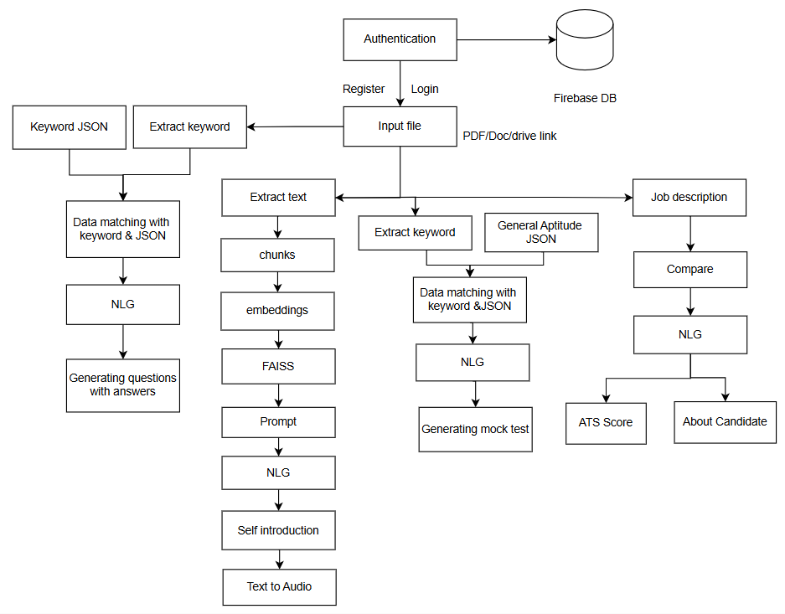
System Architecture

Slide 18
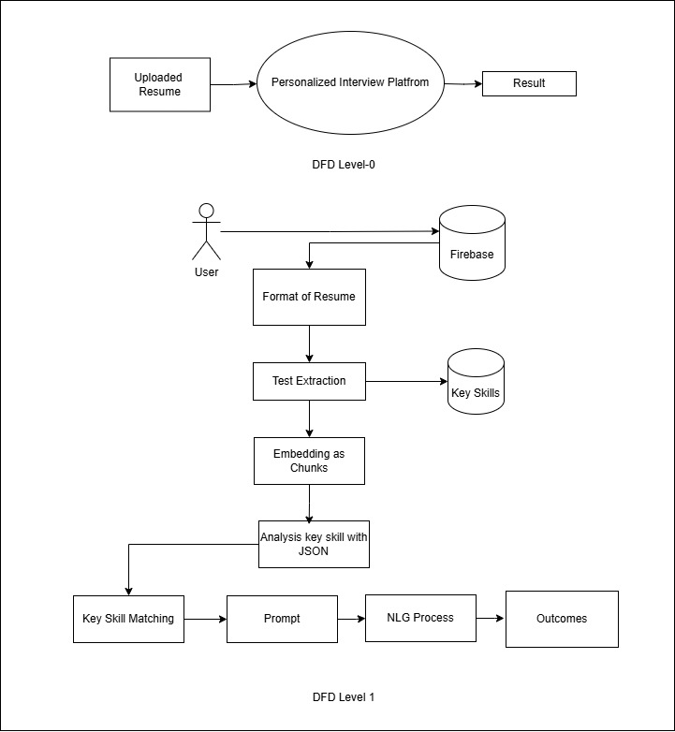
System Design - DFD

Slide 19
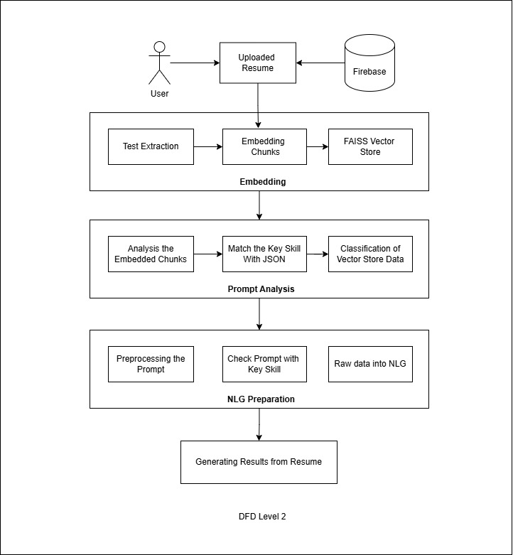
System Design -DFD

Slide 20
Module Description
Data Handling & Preprocessing Module
Question Generation Module
Mock test Module
ATS scoring & Resume Analysis
Generate About self
Data Handling & Pre-processing Module:
Responsible for loading, extracting, and preprocessing relevant data.
Loads keywords and test questions from JSON files.
Extracts skills from input text using regex and predefined keyword sets.
Prepares data for question generation by normalizing and cleaning text.

Slide 21
Module Description
Question Generation Module:
Creates MCQs and interview questions based on extracted skills.
Ensures relevance by mapping questions to detected keywords.
Generates AI-powered answers for both types of questions.
Mock test Module:
Conducts an AI-powered mock test with real-time evaluation.
Generates a customizable number of test questions dynamically.
Allows users to select answers and submit responses through an interactive UI.
Scores the test in real time and provides instant feedback, including performance-based effects

Slide 22
Module Description
ATS scoring & Resume Analysis:
Evaluates a resume’s strength and relevance for a job application.
Analyzes resume content using ATS scoring techniques.
Identifies missing or weak areas by comparing extracted keywords with job descriptions.
Provides actionable feedback to improve resume alignment with job requirements.
Generate about Self:
This module plays a crucial role in assisting users with crafting a well-structured, professional, and engaging self-introduction based on their resume information.
By leveraging advanced AI and Natural Language Processing (NLP) techniques, the system ensures that the generated self-introduction effectively highlights the user's qualifications, skills, and experiences in a coherent manner.

Slide 23
Performance Evaluation
Test case no. | Test Scenario | Test Steps | Expected Result | Status
1 | Verify resume upload functionality | Upload a resume file (PDF/DOCX). | uploads the resume without errors. | Pass
2 | Verify job description input | Enter or upload the job description. | Enter or upload the job description. | Pass
3 | Check resume parsing accuracy | Upload a resume. Click on 'Analyze Resume'. | The system extracts and displays key details (skills, experience, education, etc.). | Pass
4 | Identify missing keywords | Upload resume and job description. Click 'Check ATS Score'. | The system highlights missing keywords required for better matching. | Pass

Slide 24
Performance Evaluation
5 | Validate percentage match calculation | Upload resume and job description. Click ‘Percentage Match’. | The system displays an accurate match percentage. | Pass
6 | Ensure system provides relevant suggestions | Upload resume and job description. Click 'Improve Resume'. | The system provides actionable improvement suggestions. | Pass
7 | Verify question generation based on input | Select 'Generate Mock Test'. Enter the number of questions. | The system generates the correct number of questions in quiz format. | Pass

Slide 25
Performance Evaluation
8 | Ensure quiz can be taken without errors | Start the mock test, Answer all questions, Submit the test. | The system records and evaluates responses successfully. | Pass
9 | Verify score calculation | Complete and submit the mock test. | The system displays a score breakdown. | Pass
10 | Check system behavior for invalid inputs | Upload an unsupported file format, Enter non-numeric values in the question count field. | The system displays an appropriate error message. | Pass

Slide 26
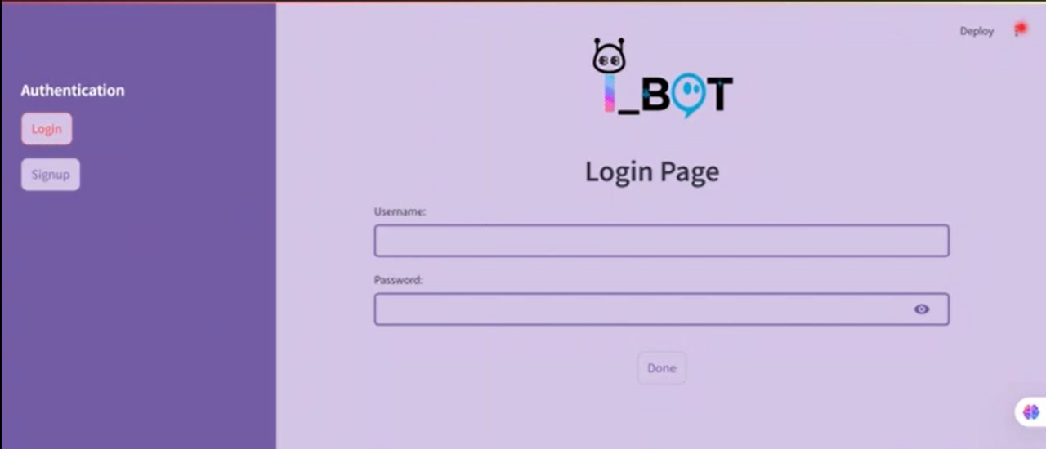
Screen Shots

Slide 27
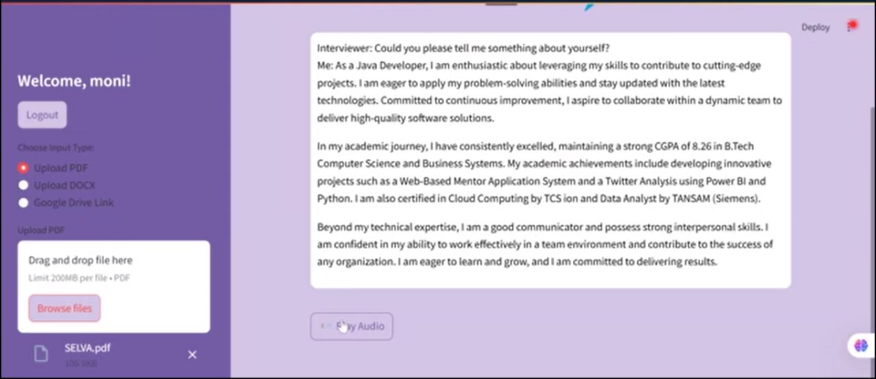
Screen Shots

Slide 28
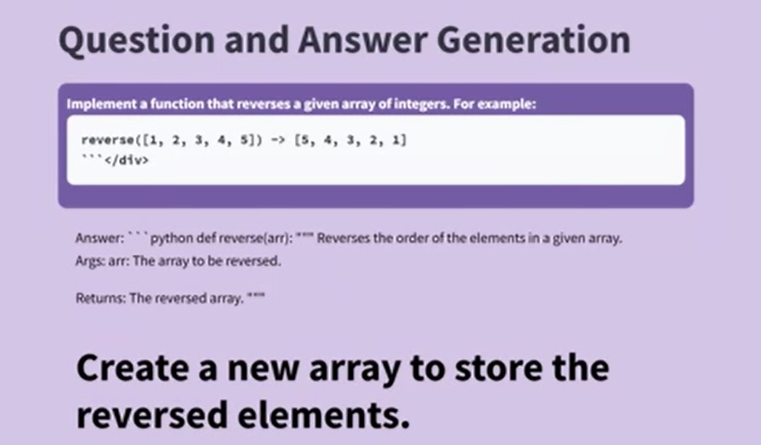
Screen Shots

Slide 29
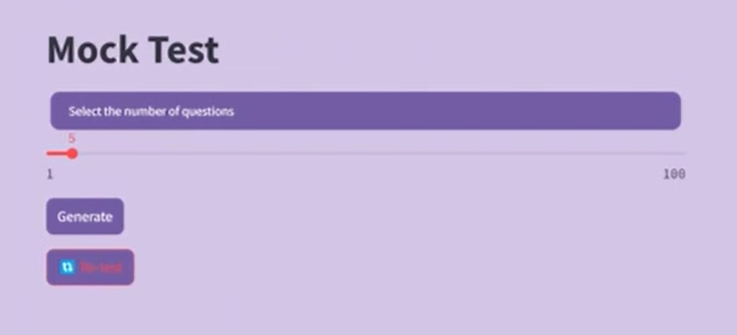
Screen Shots

Slide 30
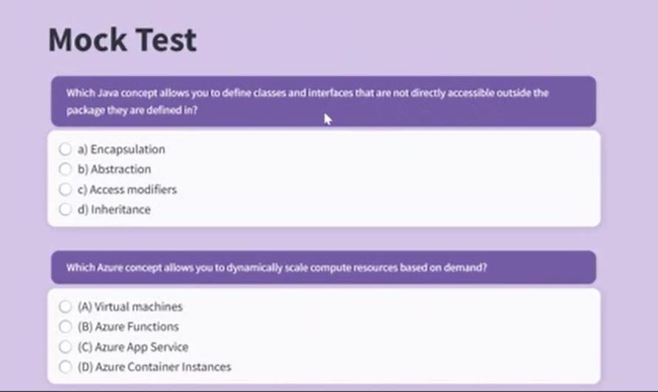
Screen Shots

Slide 31
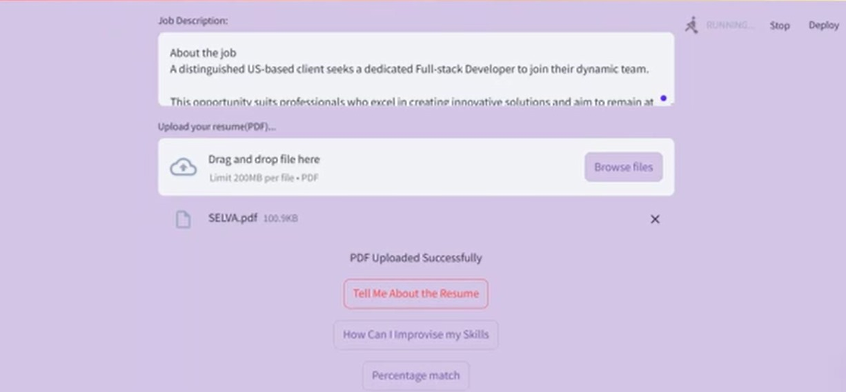
Screen Shots

Slide 32
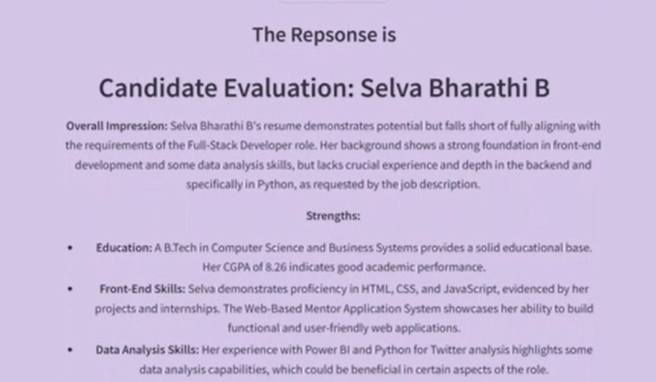
Screen Shots

Slide 33
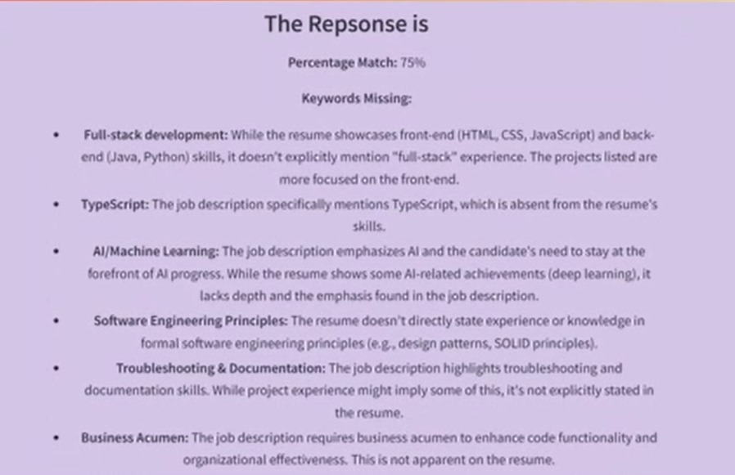
Screen Shots

Slide 34
Conclusion
This project leverages the power of AI, particularly Google Gemini AI, and advanced deep learning techniques to create an adaptive and efficient system for interview preparation and skill assessment. By dynamically extracting relevant keywords and generating context-aware questions and answers, the platform ensures accurate, personalized, and coherent content. The integration of automated question generation, intelligent answer validation, and structured data processing makes this solution a valuable AI-driven tool for students and professionals, enhancing their chances of success in competitive job markets.

Slide 35
Reference Paper
[1]. S. Ashrafi, B. Majidi, E. Akhtarkavan, and S. H. R. Hajiagha, "Efficient Resume-Based Re-Education for Career Recommendation in Rapidly Evolving Job Markets," IEEE Access, vol. 11, pp. 124350–124367, 2023.
[2]. M. Kaif, S. Sharma, and S. Rana, "Gemini MultiPDF Chatbot: Multiple Document RAG Chatbot using Gemini Large Language Model," International Journal for Research in Applied Science and Engineering Technology (IJRASET), vol. 12, no. 8, pp. 123–130, 2024.
[3]. K. Muludi, K. M. Fitria, J. Triloka, and S. Sutedi, "Retrieval-Augmented Generation Approach: Document Question Answering using Large Language Model," International Journal of Advanced Computer Science and Applications (IJACSA), vol. 15, no. 3, pp. 79–85, 2024.
[4]. J. Xu, M. Sun, Z. Zhang, and J. Zhou, "ChatUIE: Exploring Chat-based Unified Information Extraction Using Large Language Models," in Proceedings of the 2024 Joint International Conference on Computational Linguistics, Language Resources and Evaluation (LRECCOLING 2024), Torino, Italia, May 2024, pp. 3146–3152.
[5]. S. Sanaei, B. Majidi, and E. Akhtarkavan, "Deep Multisensor Dashboard for Composition Layer of Web of Things in the Smart City," in 2018 9th International Symposium on Telecommunications (IST), Tehran, Iran, 2018, pp. 211–215.
[6]. A. Krishnan, J. Joseph, N. N. Nihal, S. F. S. Salva, and P. C. V, "Skill Mount: Personalized Career Skills Development Using Machine Learning Algorithms," in 2024 11th International Conference on Advances in Computing and Communications (ICACC), 2024, pp. 1–6.

Slide 36
Reference Paper
[7]. K.S.Kumar,P.Srihari, andC.J. Raman,"AIforCareer Growth: Advanced Resume Analysis and LinkedIn Scraping for Personalized Job Recommendations," in 2024 2nd International Conference on Self Sustainable Artificial Intelligence Systems (ICSSAS), 2024, pp. 1287–1293.
[8]. A. D, K. S, N. E. R, K. K, J. M. S, and R. R, "Resspar: AI-Driven Resume Parsing and Recruitment System using NLP and Generative AI," in 2024 Second International Conference on Intelligent Cyber Physical Systems and Internet of Things (ICoICI), 2024, pp. 1–6.
[9]. V. Manish, Y. Manchala, Y. V. Reddy, S. B. Chopra, and K. Y. Reddy, "Optimizing Resume Parsing Processes by Leveraging Large Language Models," in 2024 IEEE Region 10 Symposium (TENSYMP), 2024, pp. 1–5.
[10]. A. Mishra, S. Singh, and R. C. Jisha, "AI-Powered Model for Intelligent Resume Recommendation and Feedback," in 2024 15th International Conference on Computing Communication and Networking Technologies (ICCCNT), 2024, pp. 1–6.
[11]. T. Patel and A. Gupta, "AI-Driven Job Matching System Using Deep Learning Techniques," IEEE Transactions on Computational Intelligence and AI in Games, vol. 17, no. 2, pp. 231–245, 2023.
12]. J. Kang and M. Lee, "Resume Analysis Framework Using WordEmbeddingsandRankingAlgorithms," Expert Systems with Applications, vol. 217, pp. 119–132, 2023.

Slide 37
Reference Paper
[13]. L. Zheng, P. Wu, and D. Li, "GIRL: Generative Intelligent Resume Learning for Job Matching," ACM Transactions on Information Systems (TOIS), vol. 42, no. 1, pp. 1–25, 2024.
[14]. C.Du,X.Zhou,andY.Wang,"JobRecommendation System using LLM-Based Generative Adversarial Networks," IEEE Transactions on Knowledge and Data Engineering, vol. 36, no. 1, pp. 57–68, 2024.
[15]. M. Rahman, T. Sinha, and R. Bose, "ResumAI: An AI-Driven Career Counseling and Resume Enhancement Platform," Journal of Artificial Intelligence Research (JAIR), vol. 78, pp. 243–262, 2023.
[16]. P. Decorte, M. Esposito, and J. Tang, "Career Path Prediction Using Resume Representation Learning and Skill-Based Matching," IEEE Transactions on NeuralNetworks and Learning Systems, vol. 35, no. 3, pp. 322–336, 2024.
[17]. Y. Chen, X. Sun, and L. Zhang, "Large Language Models for Automated Job Recommendation and Resume Screening," Journal of Machine Learning Research vol. 24, no. 6, pp. 1456–1478, 2023.
[18]. H.KimandS.Park, "Neural Network-Based Resume Analysis and Applicant Ranking System," IEEE Access, vol. 12, pp. 40230–40247, 2024.
[19]. X. Wei and J. Xu, "AI-Powered Personalized Career Development Framework Based on Natural Language Processing," Future Generation Computer Systems, vol. 150, pp. 99–115, 2024.
[20]. A. Verma, P. Agarwal, and S. Roy, "Enhancing Job Seeker Experience with AI-Powered Resume Evaluation," International Journal of Intelligent Systems, vol. 38, no. 2, pp. 215–230, 2024.

Slide 38
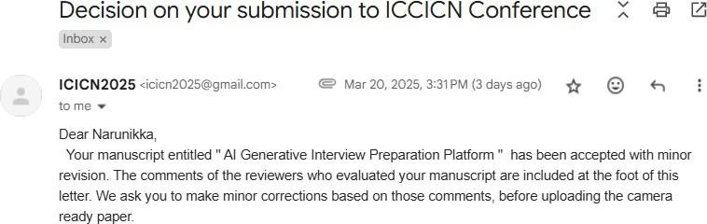
Conference
ICICN2025
International Conference on Computational Intelligence & Communication Networks Hybrid Mode
Organized By “DEPARTMENT OF INFORMATION TECHNOLOGY, EASHWARI ENGINEERING COLLEGE”
ACCEPTANCE MAIL:

Slide 39
THANK YOU

