Slide 1
CROPS RECOMMENDATION
Group Members:-
1.Arpit Gupta
2.Devashish Nannaware
3.Kunal Sakhre
4.Shubham Sable

Slide 2
Problem statement:-
As we know , farmers usually face losses in their
Crop selection ,there are many reasons for the loss,rainfall ,right crops according to environmental conditions etc.
So we have came up with a solution for this problem ,by this ,the new farmers who doesn’t have plenty of knowledge about farming ,will be able to grow right crops ,such a way that there are more chances of getting good profit !

Slide 3
AIM:-
To predict the profit of a particular crop,by knowing some parameters,like yield,cultivation cost,year.

Slide 4
Algorithms Used:-
We have used two algorithms for prediction of profit from crops ,the two algorithms are :-
1.Decision tree Classfier &
2.Linear Regression

Slide 5
Dataset Used:-
We have used a dataset,which has different columns,as crops name,states,year,cost of cultivation and profit

Slide 6
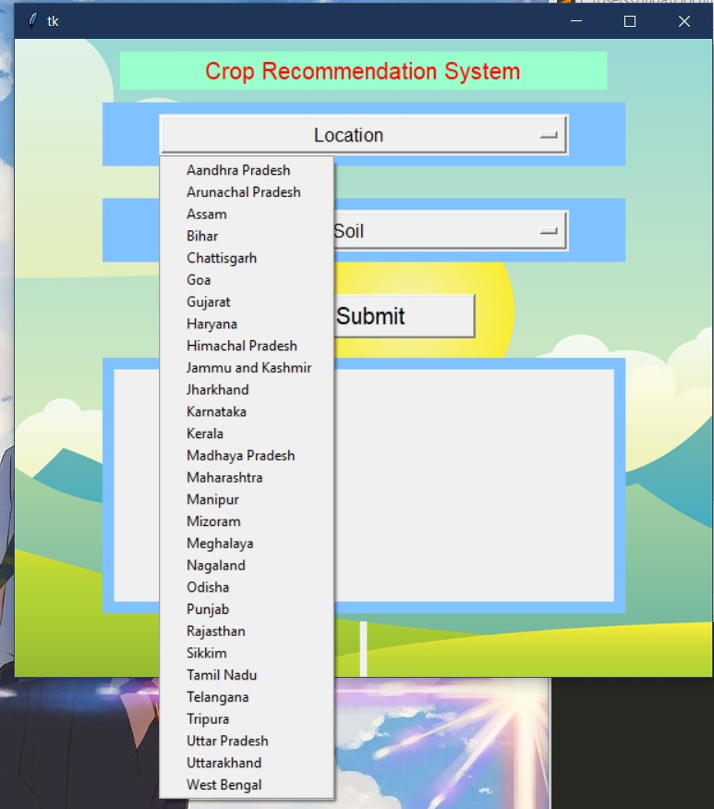

Slide 7
