Slide 1

CREDIT CARD FRAUD DETECTION USING MACHINE LEARNING.
BY:NARVA SIDDHARTHA
2203A52045
Trainer:MR.D.RAMESH
ASST. PROFESSOR
CS and AI&ML
24-09-2023

Slide 2
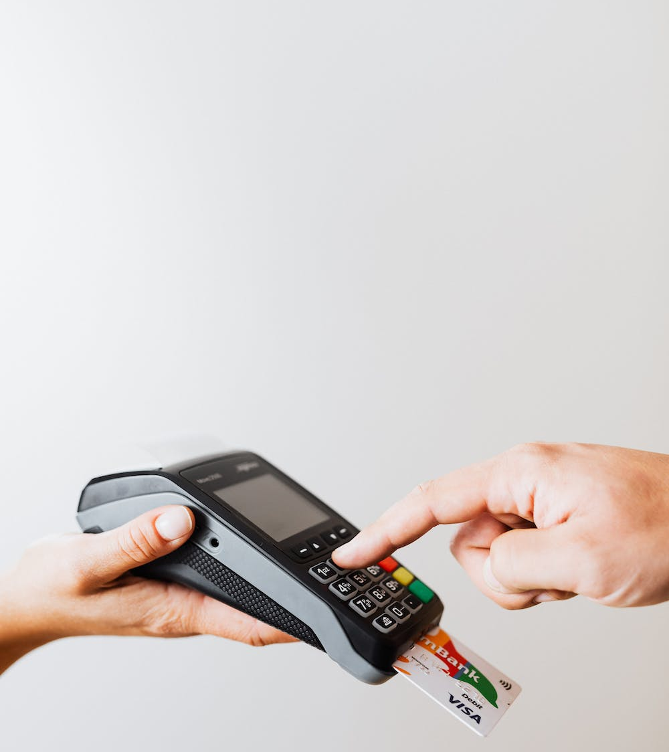
agenda
Introduction to Credit Card Fraud
How Machine Learning Works in Fraud Detection
Data Collection and Preprocessing
Model Selection and Training
Evaluation Metrics
Real-world Case Studies
Conclusion and Future Directions

Slide 3

introduction
Credit Card Fraud
"Hello, and welcome to my presentation on Credit Card Fraud Detection using Machine Learning. In today's world, credit card fraud is a pressing concern. We'll show you how Machine Learning, a form of artificial intelligence, can help us spot and prevent fraudulent activities. Let's dive in!"

Slide 4
How Machine Learning Works in Fraud Detection
CREDIT CARD TRANSACTIONS
Machine learning in fraud detection involves training a model with historical transaction data, labeling transactions as fraudulent or legitimate. The model learns patterns and relationships within the data, enabling it to recognize potential fraud based on transaction features. After training and validation, the model is tested on unseen data to assess its effectiveness in identifying fraudulent activities. This automated approach helps financial institutions and businesses detect fraud swiftly and accurately, enhancing security and reducing financial losses.

Slide 5

Data Collection and Preprocessing
Steps to be followed:
Data Cleaning
Data Transformation
Feature Selection
Data Splitting
Handling Imbalanced Data
Outlier Detection
Normalization and Standardization
Time-Based Features
Dimensionality Reduction
Data Validation

Slide 6
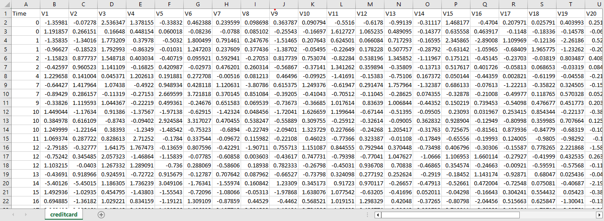
Data-set

Slide 7
Model Selection and Training:
MODELS FOR CREDIT CARD FRAUD DETECTION
Logistic Regression
Logistic Regression is a widely used machine learning algorithm in credit card fraud detection projects due to its simplicity and interpretability.
Data Preparation
Model Building
Model Evaluation
Model Interpretation
Model Deployment
Monitoring and Maintenance
Accuracy: 94.4184018315

Slide 8
Support Vector Machines (SVM)
Support Vector Machines (SVM) are employed in credit card fraud detection by first preparing the data, selecting relevant features, and splitting it into training, validation, and test sets. SVMs then use kernel functions to map the data into a higher-dimensional space where they seek the best hyperplane to separate fraudulent from legitimate transactions, maximizing the margin between them. The model's performance is evaluated using metrics like accuracy and precision on a validation set, and hyperparameters, including the kernel type, are fine-tuned for optimal results. Once validated, the SVM model can be deployed to identify potential fraud in real-time transactions, with ongoing monitoring and periodic retraining to adapt to evolving fraud patterns. SVMs excel in scenarios with complex, non-linear data relationships.

Slide 9
K-Nearest Neighbour(K-NN) with Bootstrap:
K-Nearest Neighbors (K-NN) is a supervised machine learning algorithm used for classification and regression tasks.
Instance-Based Learning: K-NN is an instance-based learning algorithm. It makes predictions by comparing a new data point to its k-nearest neighbors in the training data.
- Classification and Regression: K-NN can be used for both classification and regression tasks. For credit card fraud detection, it's typically used for classification to determine whether a transaction is legitimate or fraudulent.
- K-Value Selection: The choice of the number of neighbors (k) is crucial. A small k may make the model sensitive to noise, while a large k may make it too biased. Selecting an appropriate value of k involves experimentation and validation.
- Bootstrap aggregating, commonly known as bagging, is an ensemble technique used to improve the performance of machine learning models, including K-Nearest Neighbors (K-NN). Here's how K-NN can be used in combination with bootstrap aggregation.

Slide 10
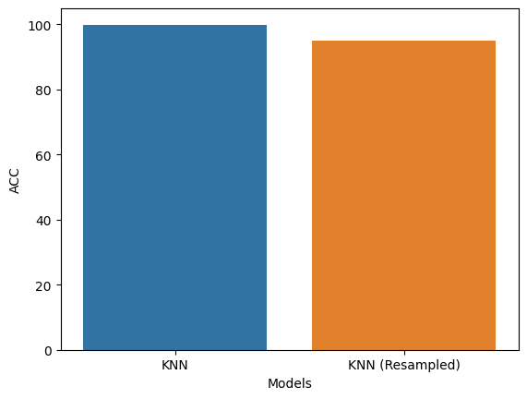
KNN WITH BOOTSTRAP:

Slide 11

Other models:
Neural Networks
Gradient Boosting Machines
K-Nearest Neighbors (K-NN)
Decision Trees
Evaluation Metrics

Slide 12
APPROACH:
Collect historical transaction data, including features like transaction amount, location, time, and customer behavior.
Anonymize or encrypt sensitive information, such as cardholder names or full card numbers.
Clean the data by handling missing values, duplicates, and inconsistencies.
Split the data into training, validation, and test sets.
Select relevant features based on domain knowledge and data analysis.
Create additional features if necessary, like time-based features (e.g., day of the week, time of day).
Choose the machine learning model(s) to implement, such as Logistic Regression or Support Vector Machines, based on the problem's complexity and data characteristics.
Scale or normalize numerical features to ensure they have similar scales.
Encode categorical variables using techniques like one-hot encoding.

Slide 13
Train the selected model using the training dataset. - For SVM, choose an appropriate kernel (e.g., linear, polynomial, RBF) and optimize hyperparameters (e.g., C for regularization) during training. - Assess the model's performance using evaluation metrics like accuracy, precision, recall, F1-score, and ROC-AUC on the validation set. -Adjust the decision threshold for classifying transactions based on the desired balance between precision and recall. -Deploy the trained model into a real-time environment for evaluating new transactions. -Continuously monitor the model's performance in production and retrain it as needed to adapt to evolving fraud patterns. -This approach outlines the key steps involved in implementing machine learning models like Logistic Regression and SVM for credit card fraud detection, from data preparation to model deployment and maintenance. It emphasizes the importance of continuous monitoring and adaptation to effectively combat evolving fraud tactics.

Slide 14

Conclusion and Future Directions:
In simple terms, our project uses computer technology to help prevent credit card fraud. We collected and analyzed data about transactions, and with the help of smart software (like a helpful robot), we built a system that can spot suspicious activities. This system works by learning from past fraud cases and getting better over time. It's like having a security guard for your credit card, always on the lookout for anything unusual. By doing this, we aim to protect your money and make online payments safer for everyone.

Slide 15



THANK YOU
NARVA SIDDHARTHA
+91 7680904822
SIDDHARTHA.NARVA@GMAIL.COM

