Slide 1
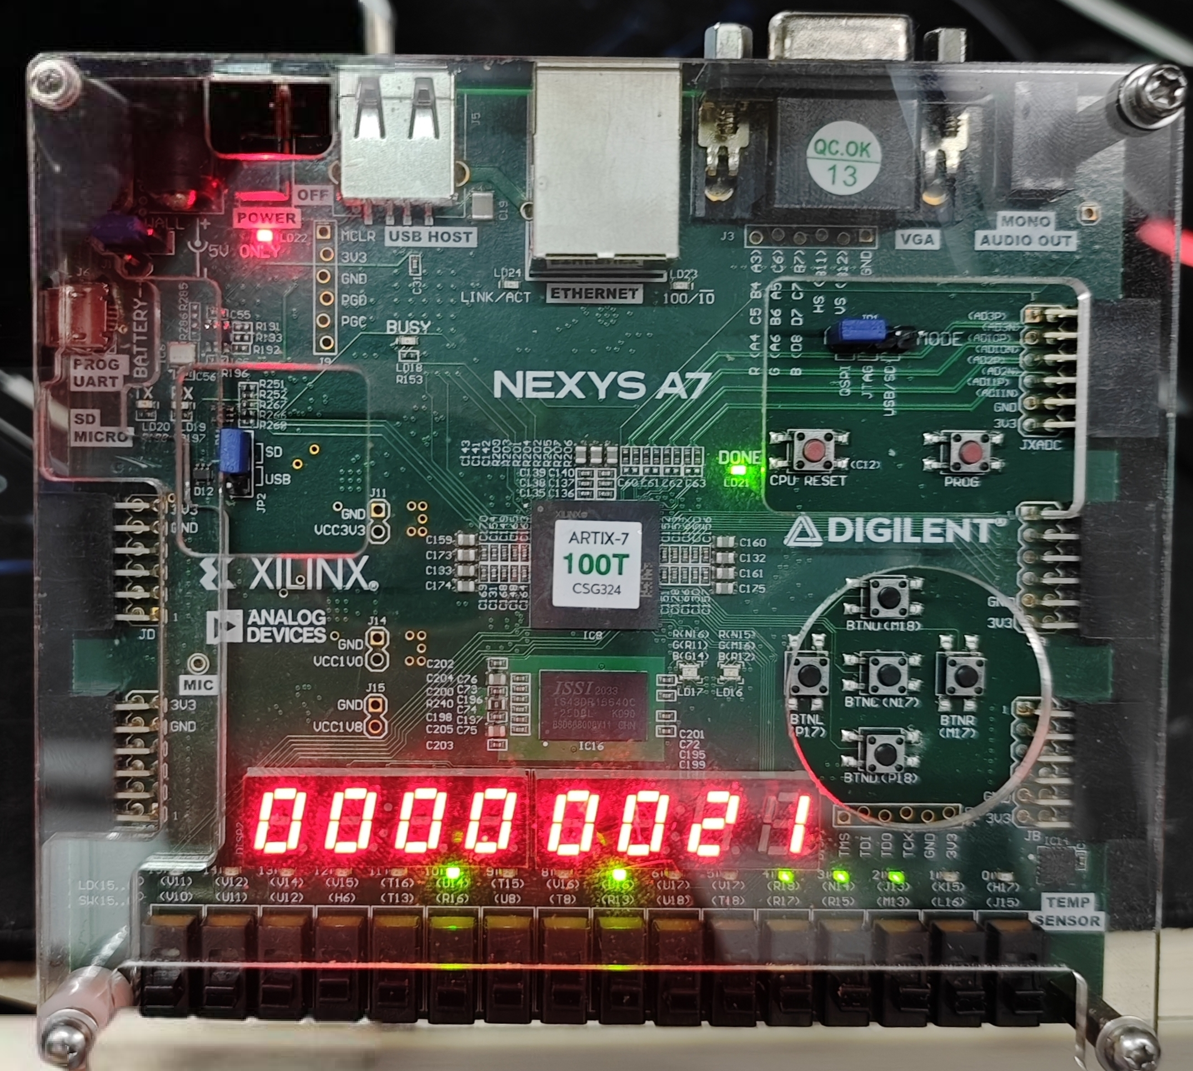
OpenRV - A five-stage pipeline processor and SoC system based on RISC-V

