Slide 1

IHM Project : The GameCube
Aina Nary Andriambelo
Samuel Constantino
Spring semester 2014

Slide 2
Plan
Introduction
GSR Data
Game description
Implementation
Evaluation
Future work

Slide 3
Introduction
Human-Machine Interaction with GSR data
Goal : Control stress level and excitement

Slide 4
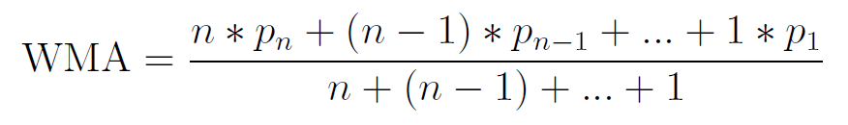
GSR Data
Weighted Moving Average :
  Smoothes out spikes by giving more weight to older data
  Used in finance and economy to represent trends
  Slight delay when trends shift

Slide 5
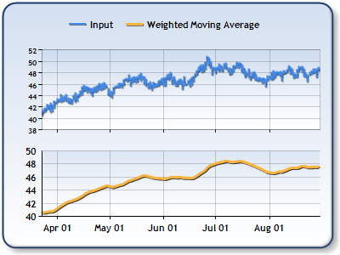
Weighted Moving Average
http ://support2.dundas.com/OnlineDocumentation/WinChart2003/WeightedMovingAverage.html

Slide 6
Game description
Cube rotates according to the player's excitement
Relaxation mode
Challenge mode :
  Score
  Time
  Missions
  Events

Slide 7
Implementation
Python 3.0 and Blender
Sensor Data sent by socket
3D art inspired by low polygon art

Slide 8

(c) Jeremiah Shaw & Danny Jones

Slide 9
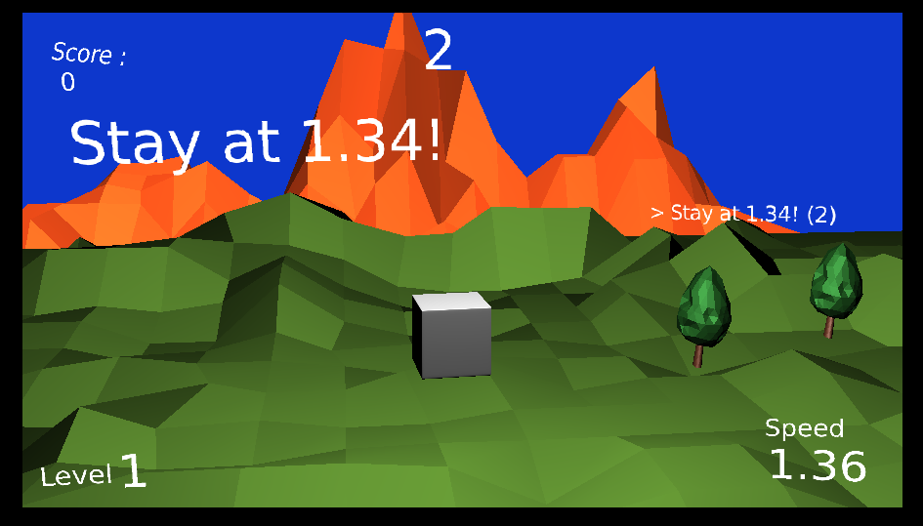

Slide 10
Evaluation
GSR indicates arousal state
Game is hard because of lack of direct input !
Player input :
  Increasing speed by talking
  Decreasing by focusing on the cube
  Stabilization really difficult
With experience learn how to control

Slide 11
Conclusion
Future work :
  Add more input : voice, camera
  GSR as an accessory instead of main input
  Upgrade graphics

Slide 12
Demonstration

