Slide 1
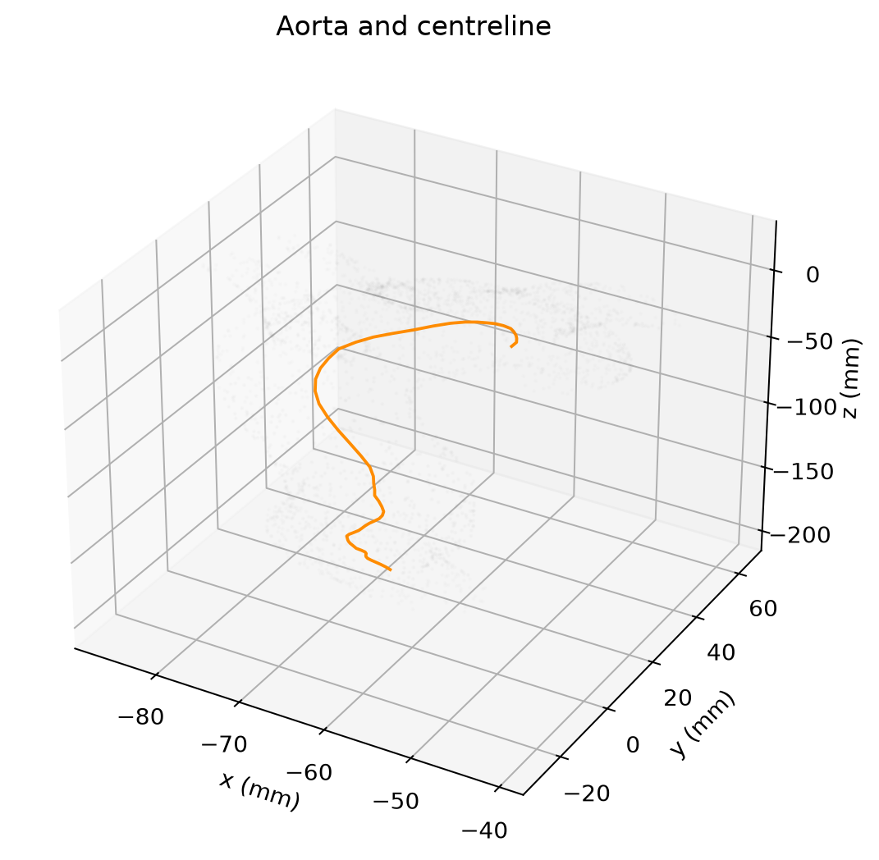
From Physics to Physiology
Project 2
1D flow assumptions
in a healthy aorta
Rosalie Post and Mark Bongers
Nasreddine Ouchene, Rosalie Post, Mark Bongers
Bart de Iongh, Ibtissame Ezzahi
Notes:
Rosalie Post | Target: 30 seconds
SPEAKING TEXT
We use a healthy aorta to investigate how well a one-dimensional description represents a more detailed three-dimensional flow. Our case contains bends and side branches, with a rigid vessel wall. We work with an existing simulation and test the assumptions using its pressure and velocity fields. We will first explain the measurements, then compare the reference profiles, and finish with the momentum balance.
CUES
Introduce Rosalie and Mark. The picture shows the actual model wall and the sampled main-aorta centreline.
SOURCES (not spoken)
FtP_Aorta_1D_Assumptions.ipynb, completed student version of 12 October 2026.
Vascular Model Repository, model 0012_H_AO_H and matching rigid-wall 3D results. Actual prepared section fields and extraction record in data/actual_volume_sections.npz and .json.
User-provided FtP Project (1).pdf, page 1: planned presenters and model; page 2: group members.

Slide 2
The question and the 1D assumptions
How well do 1D assumptions hold in this aorta?
Each section becomes area A, flow Q and mean pressure P̄.
Mostly axial flow
Uniform pressure within each section
Fixed velocity-profile correction α
Friction follows the assumed profile
Mass balance along the vessel
The full momentum balance
2
Notes:
Rosalie Post | Target: 50 seconds
SPEAKING TEXT
The question is how well a 1D model can represent flow in this realistic vessel. A 1D model describes each cross-section using its area, flow rate and mean pressure. This saves detail, but it needs assumptions about the flow within a section. We examine whether flow is mainly axial and pressure is uniform. We also test how a fixed velocity profile and its friction law affect the balance. Finally, we check conservation and calculate a momentum residual. We use the allowed healthy model, so our conclusions concern its bends and branches.
CUES
Define A, Q and mean P. Explain that alpha represents the velocity-profile correction and f represents signed friction.
SOURCES (not spoken)
Simone Saitta, FP2P_projects_Simone.pptx, Project 2, slide 2. Canvas course 89400, file 10917250.
FtP_Aorta_1D_Assumptions.ipynb, completed student version of 12 October 2026.
User-provided project plan, page 3: A1–A6 working hypotheses. Healthy-model scope confirmed by the project group in this conversation.

Slide 3
Measurements from the 3D simulation
Existing rigid-wall data from the Vascular Model Repository
Sections perpendicular to the centreline
Integrate actual pressure and velocity with triangle-area weights
Exclude branch regions from single-vessel derivatives
201 snapshots
47 usable sections
T = 0.937 s
Q = ∫ uₛ dA U = Q/A P̄ = (1/A) ∫ P dA
3
Notes:
Rosalie Post | Target: 50 seconds
SPEAKING TEXT
Our input is an existing rigid-wall simulation from the Vascular Model Repository. We follow the centreline and place sections perpendicular to its local direction. The prepared data contain actual pressure and velocity values on those filled sections. We calculate flow by integrating the downstream velocity and mean pressure by weighting pressure with triangle area. Weighting matters because mesh points are unevenly spaced. We analyse 201 snapshots of one complete cycle and 47 usable sections. We exclude branch neighbourhoods from derivatives because a single-vessel balance does not include their side outlets. The cap conservation check includes those outlets.
CUES
Distinguish analysing existing 3D results from running a new CFD solver. Mention SI conversion and one cardiac period of 0.937 s.
SOURCES (not spoken)
FtP_Aorta_1D_Assumptions.ipynb, completed student version of 12 October 2026.
Vascular Model Repository, model 0012_H_AO_H and matching rigid-wall 3D results. Actual prepared section fields and extraction record in data/actual_volume_sections.npz and .json.
results/geometry.csv, cap_flows_m3_s.csv and actual_volume_section_metrics.csv; aorta_functions.py section_metrics and load_sections.

Slide 4
The flow measurements conserve mass
Global mismatch
0.000022%
Local mismatch
0.35%
Maximum differences, scaled by peak inlet flow
4
Notes:
Rosalie Post | Target: 60 seconds
SPEAKING TEXT
For incompressible flow in a rigid domain, inlet flow should equal the sum of outlet flows. The two curves almost overlap. The maximum global mismatch is about 0.000022 percent of peak inlet flow. This is a computational conservation check. We then make a stricter local comparison: section flow versus inlet flow minus the upstream branch flows. Its maximum difference is 0.35 percent of peak inlet flow. This supports consistent section measurements. We use peak inlet flow as the denominator, so the percentage remains interpretable when instantaneous flow is small. These checks establish consistency of the flow measurements rather than accuracy against a patient experiment.
CUES
Point out the overlapping curves. Keep global and local errors distinct. Both percentages use peak inlet flow.
SOURCES (not spoken)
FtP_Aorta_1D_Assumptions.ipynb, completed student version of 12 October 2026.
results/cap_flows_m3_s.csv and findings.csv; notebook code cells 5, 6 and 9.

Slide 5
A Womersley case checks the calculations
Known straight-tube solution
Mean-speed error
4.0 × 10⁻⁷ m/s
No-slip at the wall
Analytical balance holds
Reference calculation checks before interpreting the aorta
5
Notes:
Rosalie Post | Target: 50 seconds
SPEAKING TEXT
Before interpreting the aorta, we use a known solution for pulsatile flow in a straight circular tube. Womersley flow changes profile with phase, whereas a Poiseuille profile has a fixed parabolic shape. Our check recovers the imposed mean speed with an error of about four times ten to the minus seven metres per second. It also satisfies no-slip at the wall and the analytical momentum balance. The plot shows four phases of that controlled case. This checks the reference calculation and balance conventions. The aorta has more complex geometry, so the known case cannot by itself validate the physiological behaviour of our model.
CUES
The known case uses radius 10 mm and mean speed 0.2 + 0.08 cos(2πt/T) m/s. Use the phase legend, then point to the wall at r/R = 1.
SOURCES (not spoken)
FtP_Aorta_1D_Assumptions.ipynb, completed student version of 12 October 2026.
aorta_functions.py check_analytical_cases and womersley_reference; notebook code cell 10. Controlled analytical reference, not a patient measurement.

Slide 6
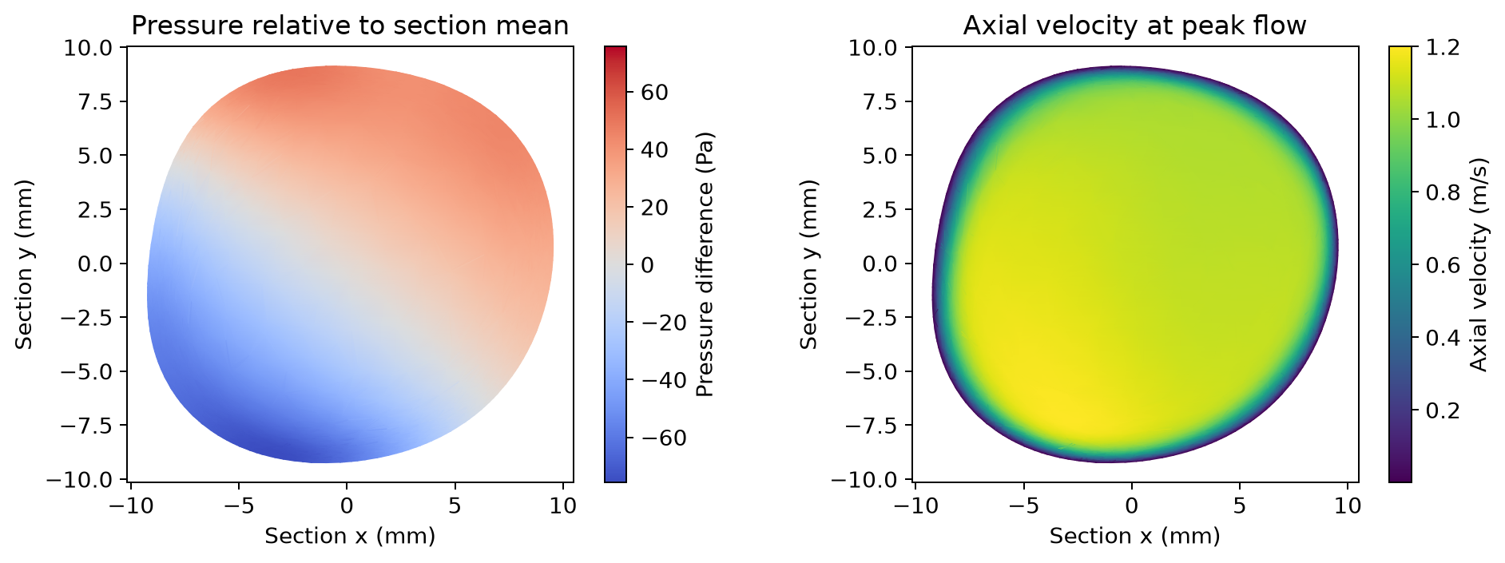
Pressure varies across the section
Section at 199 mm, at peak section flow
Pressure range: 126 Pa
6
Notes:
Rosalie Post | Target: 55 seconds
SPEAKING TEXT
These maps show one descending-aorta section, about 199 millimetres from the inlet, at its peak section flow. On the left, colour shows pressure relative to the area-weighted section mean. The pressure range is about 126 pascals. That is only 0.8 percent of the mean pressure, but about 24 percent of the dynamic pressure based on the mean speed. Those denominators answer different questions. A small fraction of absolute pressure does not automatically make a transverse pressure gradient irrelevant. The right map shows axial velocity and its spatial variation. Mark will now look more closely at the velocity profiles and friction comparisons.
CUES
This is cycle fraction 0.10. Mean pressure is 15.6 kPa. The pressure comparison uses this example only and does not establish uniformity throughout the vessel.
SOURCES (not spoken)
FtP_Aorta_1D_Assumptions.ipynb, completed student version of 12 October 2026.
results/figures/section_pressure_velocity.png; actual_volume_section_metrics.csv at s = 0.1989983727 m and cycle fraction 0.10.

Slide 7
The velocity profile changes with phase
At peak flow
α = 1.06
In-plane RMS
7.1% of axial RMS
Point spread shows variation around the section
7
Notes:
Mark Bongers | Target: 65 seconds
SPEAKING TEXT
The scatter plot keeps all the section points rather than reducing them to a single smooth curve. At a given radius, the spread shows variation around the section. The peak-flow profile is relatively flat through much of the interior. Its measured momentum correction is about 1.06, compared with 1.33 for Poiseuille and 1.10 for the blunt reference. At this peak-flow example, the in-plane RMS velocity is 7.1 percent of the axial RMS velocity. That supports mostly axial flow for this particular section and phase. The profiles change across the saved cycle, so we should not extend that conclusion to every phase. The radius is area-equivalent, and the actual boundary is not perfectly circular.
CUES
Quarter and half interval mean fractions 0.25 and 0.50 of the saved cycle, not named physiological phases. The backup slide compares alpha over the cycle.
SOURCES (not spoken)
FtP_Aorta_1D_Assumptions.ipynb, completed student version of 12 October 2026.
data/actual_volume_sections.npz, station 46, frames 20, 50 and 100; results/example_section.vtp; actual_volume_section_metrics.csv.

Slide 8
Reference profiles predict different friction
f = Kᵣ U Poiseuille: Kᵣ = 8πν Blunt ζ = 9: Kᵣ = 22πν
References use the same measured mean-flow history
8
Notes:
Mark Bongers | Target: 65 seconds
SPEAKING TEXT
We next compare signed friction at the same section. The Poiseuille and blunt profiles use different friction coefficients. The Womersley reference also changes force with the pulsatile flow. All three references use the same measured bulk-flow history. The near-wall curve estimates force using velocity gradients and the no-slip condition. It does not use the magnitude of the supplied surface wall-shear field as a signed force. The curves differ in magnitude and phase, which changes their contribution to the momentum balance. We preserve their signs because friction during changing or reversing flow cannot be interpreted from magnitude alone. The estimate still depends on how we sample close to the wall.
CUES
f = K_R U. K_R = 8πν for Poiseuille and 22πν for ζ = 9. The Womersley reference uses a straight tube with the area-equivalent radius.
SOURCES (not spoken)
FtP_Aorta_1D_Assumptions.ipynb, completed student version of 12 October 2026.
results/actual_volume_section_metrics.csv f_measured and U; aorta_functions.py womersley_reference; data/actual_volume_sections.json: probe depth and viscosity.

Slide 9
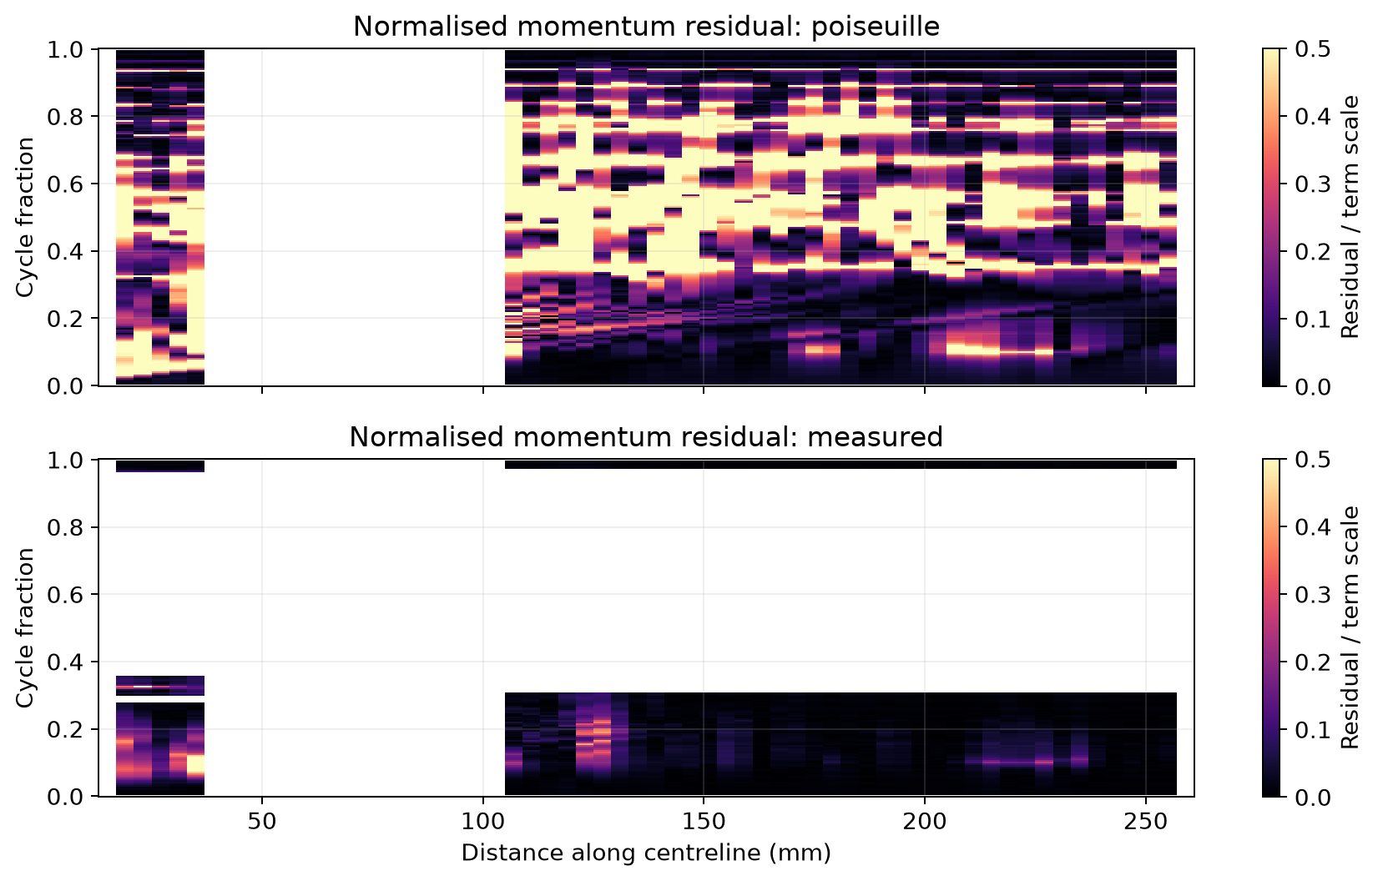
The projected momentum balance
R = ∂Q/∂t + ∂(αQ²/A)/∂s + (A/ρ)∂P̄/∂s + f
White regions: excluded or unavailable values. Summary uses common samples.
9
Notes:
Mark Bongers | Target: 65 seconds
SPEAKING TEXT
The equation combines local acceleration, convective transport, the mean-pressure gradient and signed friction. Their sum is the residual. We normalise its absolute value by the sum of term magnitudes, with the small numerical floor defined in the notebook. Dark regions on the map show relatively small residuals. Larger values occur at particular positions and phases, so a single average hides variation. White regions have no available result, including branch exclusions and low-flow masking. We compute spatial derivatives separately within continuous usable section runs. This avoids differentiating across a branch gap. We interpret the residual as consistency of this projected balance, while remembering that sampling, geometry and numerical derivatives also affect it.
CUES
The displayed map uses measured alpha and near-wall force. Colour saturates at 0.5. Endpoints remain excluded. The next slide compares common samples fairly.
SOURCES (not spoken)
FtP_Aorta_1D_Assumptions.ipynb, completed student version of 12 October 2026.
results/figures/momentum_residual_maps.png, lower measured panel; actual_volume_momentum_measured.csv; aorta_functions.py balance_terms and analyse_sections.

Slide 10
The closure comparison
Normalised residual as a percentage of the term scale
Closure | Median | 95th percentile
Poiseuille | 4.6% | 49.6%
Blunt ζ = 9 | 4.4% | 45.4%
Measured α and f | 1.2% | 17.5%
Same 2,878 station–time pairs for every closure
Measured corrections reduce the median. Larger residuals remain.
10
Notes:
Mark Bongers | Target: 65 seconds
SPEAKING TEXT
This table compares three ways to close the same momentum balance. We use the same 2,878 available station-time pairs for every row. That matters because the measured correction becomes unstable near zero net flow and therefore has more missing values. The median normalised residual is 4.6 percent for Poiseuille, 4.4 percent for the blunt profile and 1.2 percent when we use the measured profile correction and near-wall force estimate. The measured closure also has a lower 95th percentile, but that value is still 17.5 percent. This suggests the choice of closure matters. Because we change alpha and friction together, this comparison does not isolate how much each one contributes.
CUES
Percentages are relative to the sum of momentum-term magnitudes. They are not percentages of clinical accuracy. Keep the median and 95th percentile distinct.
SOURCES (not spoken)
FtP_Aorta_1D_Assumptions.ipynb, completed student version of 12 October 2026.
results/closure_residual_statistics.csv, all three rows; notebook code cell 18.

Slide 11
Limits of the analysis
Rigid walls
One anatomy and one cycle
Near-wall sampling affects force
No mesh-convergence evidence
Probe-depth comparison is a sensitivity check
11
Notes:
Mark Bongers | Target: 50 seconds
SPEAKING TEXT
The wall-force estimate requires a derivative close to the wall. The plot compares probes at 0.30 and 0.15 millimetres. Their differences show that the sampling choice can affect the result. This is a sensitivity check and does not establish mesh convergence. The model also has rigid walls, one anatomy and one available cycle. We therefore cannot assess compliance, generalise across different anatomies, or demonstrate cycle-to-cycle convergence. Branch masking and derivative choices further restrict the available region. These limits do not cancel the consistency checks, but they control how confidently we can interpret the remaining residual as a limitation of a 1D description.
CUES
Avoid claiming the healthy model covers stenotic flow. Anatomical stenosis is not required for this agreed project case.
SOURCES (not spoken)
FtP_Aorta_1D_Assumptions.ipynb, completed student version of 12 October 2026.
results/actual_volume_section_metrics.csv f_measured and f_half_depth; data/actual_volume_sections.json; original model metadata and model specification.

Slide 12
Conclusions
Conservation supports consistent flow measurements.
Measured profile and friction information reduces the typical residual.
Position, phase and numerical limits still affect the result.
A 1D description can summarise bulk transport, with care in its closures.
12
Notes:
Mark Bongers | Target: 55 seconds
SPEAKING TEXT
For this healthy aorta, the conservation checks support consistent flow measurements. The section maps and profiles show details that a few 1D quantities cannot retain. Using measured profile and friction information reduces the typical projected momentum residual compared with the fixed references. However, the residual still varies with position and phase, and our numerical limits remain relevant. Our conclusion is that a 1D description can summarise the bulk transport, while its closures and the region of application need careful interpretation. We would next test additional geometries and numerical resolution before making broader claims. We are happy to discuss where the 1D description is useful and which checks should come next.
CUES
Finish the main talk here. Allow about 3 minutes for questions. Open a backup slide only if it answers a question.
SOURCES (not spoken)
FtP_Aorta_1D_Assumptions.ipynb, completed student version of 12 October 2026.
results/findings.csv and closure_residual_statistics.csv; scope limitations documented in results/validation.md.

Slide 13
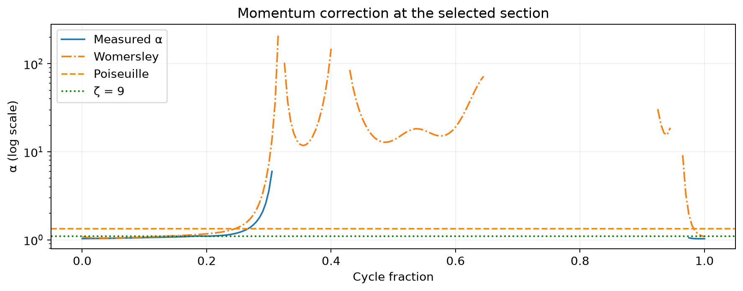
Backup: profile correction over the cycle
Selected section. The vertical axis is logarithmic.
Actual α: 5% low-flow cutoff. Womersley reference: 1% cutoff.
13
Notes:
Either presenter | Target: 0 seconds
SPEAKING TEXT
This backup compares the measured profile correction with Poiseuille, the blunt reference and Womersley over the cycle. The logarithmic axis makes the wide positive range visible. Alpha divides a velocity-squared integral by net flow squared, so counterflow or near-zero net flow can make it large. We mask the actual section below five percent of local peak flow. The Womersley helper uses a one-percent cutoff, so the gaps are not identical. This is a reference comparison rather than a fitted local closure.
CUES
Use this only if asked about fixed alpha, the logarithmic scale or low-flow gaps.
SOURCES (not spoken)
FtP_Aorta_1D_Assumptions.ipynb, completed student version of 12 October 2026.
results/figures/profile_factor_comparison.png; aorta_functions.py womersley_reference and analyse_sections.

Slide 14
Sources and reproducibility
Vascular Model Repository
Model 0012_H_AO_H and matching rigid-wall results
www.vascularmodel.com
Wilson, Ortiz and Johnson (2013)
Journal of Medical Devices 7(4), 040923
doi:10.1115/1.4025983
Project 2 brief and From Physics to Physiology teaching material
Notebook and included scripts: python main.py
AI assistance in drafting and code organisation
14
Notes:
Either presenter | Target: 0 seconds
SPEAKING TEXT
The input simulation comes from the Vascular Model Repository. We preserve its model notices and cite the repository publication. The Project 2 brief and course lectures provide the modelling context. Our notebook and included supporting scripts contain the calculations behind these slides. Running main.py regenerates the notebook figures and tables from the included actual section fields. Drafting and code organisation used AI assistance. The group should review the interpretation and speaking text before presenting.
CUES
Course instructions: current Simone and Ed guidelines specify 11 minutes plus 3 minutes discussion and 20% presentation weight. No dedicated template or detailed scoring rubric was found in accessible material checked on 12 October.
SOURCES (not spoken)
Simone Saitta, FP2P_projects_Simone.pptx, Project 2, slide 2. Canvas course 89400, file 10917250.
Simone guidelines, rules_projects_Simone.pdf, page 2, Canvas file 10928253. Ed guidelines, page 1, Canvas file 10939851. Current Canvas syllabus, course 89400.
Wilson, Ortiz and Johnson (2013). The Vascular Model Repository: A Public Resource of Medical Imaging Data and Blood Flow Simulation Results. Journal of Medical Devices 7(4), 040923. doi:10.1115/1.4025983.
FtP_Aorta_1D_Assumptions.ipynb, completed student version of 12 October 2026.
MODEL DATA NOTICES (not spoken)
# Copyright (c) Stanford University, the Regents of the University of California,
# Open Source Medical Software Corporation, and other parties.
#
# All Rights Reserved.
#
# Permission is hereby granted, free of charge, to any person obtaining
# a copy of this data to use the data for research and development
# purposes subject to the following conditions:
#
# The above copyright notice and this README-COPYRIGHT file shall be
# included in all copies of any portion of this data.
#
# Whenever reasonable and possible in publications and presentations
# when this data is used in whole or part, please include an
# acknowledgement similar to the following:
#
# "The data used herein was provided in whole or in part with
# Federal funds from the National Library of Medicine under Grant
# No. R01LM013120, and the National Heart, Lung, and Blood Institute,
# National Institutes of Health, Department of Health and Human Services,
# under Contract No. HHSN268201100035C"
#
# AND/OR
#
# N.M. Wilson, A.K. Ortiz, and A.B. Johnson, “The Vascular Model Repository:
# A Public Resource of Medical Imaging Data and Blood Flow Simulation Results,”
# J. Med. Devices 7(4), 040923 (Dec 05, 2013) doi:10.1115/1.4025983.
#
# AND/OR
#
# Reference the official website for this data: www.vascularmodel.com
#
#
# THE DATA IS PROVIDED "AS IS", WITHOUT WARRANTY OF ANY KIND, EXPRESS
# OR IMPLIED, INCLUDING BUT NOT LIMITED TO THE WARRANTIES OF
# MERCHANTABILITY, FITNESS FOR A PARTICULAR PURPOSE AND NONINFRINGEMENT.
# IN NO EVENT SHALL THE AUTHORS OR COPYRIGHT HOLDERS BE LIABLE FOR ANY
# CLAIM, DAMAGES OR OTHER LIABILITY, WHETHER IN AN ACTION OF CONTRACT,
# TORT OR OTHERWISE, ARISING FROM, OUT OF OR IN CONNECTION WITH THE
# DATA OR THE USE OR OTHER DEALINGS IN THE DATA.
README-COPYRIGHT
# Copyright (c) Stanford University, the Regents of the University of California,
# Open Source Medical Software Corporation, and other parties.
#
# All Rights Reserved.
#
# Permission is hereby granted, free of charge, to any person obtaining
# a copy of this data to use the data for research and development
# purposes subject to the following conditions:
#
# The above copyright notice and this README-COPYRIGHT file shall be
# included in all copies of any portion of this data.
#
# Whenever reasonable and possible in publications and presentations
# when this data is used in whole or part, please include an
# acknowledgement similar to the following:
#
# "The data used herein was provided in whole or in part with
# Federal funds from the National Library of Medicine under Grant
# No. R01LM013120, and the National Heart, Lung, and Blood Institute,
# National Institutes of Health, Department of Health and Human Services,
# under Contract No. HHSN268201100035C"
#
# AND/OR
#
# N.M. Wilson, A.K. Ortiz, and A.B. Johnson, “The Vascular Model Repository:
# A Public Resource of Medical Imaging Data and Blood Flow Simulation Results,”
# J. Med. Devices 7(4), 040923 (Dec 05, 2013) doi:10.1115/1.4025983.
#
# AND/OR
#
# Reference the official website for this data: www.vascularmodel.com
#
#
# THE DATA IS PROVIDED "AS IS", WITHOUT WARRANTY OF ANY KIND, EXPRESS
# OR IMPLIED, INCLUDING BUT NOT LIMITED TO THE WARRANTIES OF
# MERCHANTABILITY, FITNESS FOR A PARTICULAR PURPOSE AND NONINFRINGEMENT.
# IN NO EVENT SHALL THE AUTHORS OR COPYRIGHT HOLDERS BE LIABLE FOR ANY
# CLAIM, DAMAGES OR OTHER LIABILITY, WHETHER IN AN ACTION OF CONTRACT,
# TORT OR OTHERWISE, ARISING FROM, OUT OF OR IN CONNECTION WITH THE
# DATA OR THE USE OR OTHER DEALINGS IN THE DATA.

