Slide 1
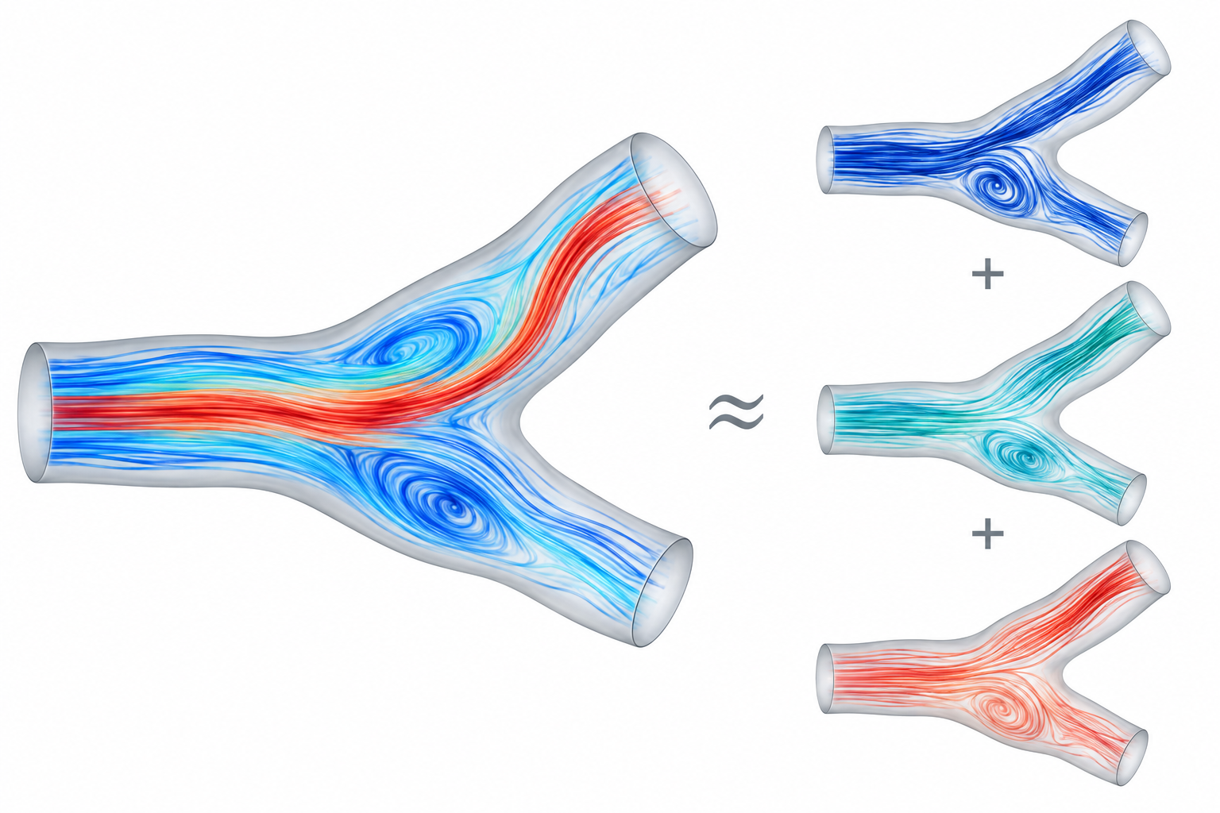
PROJECT 1 / MEDIUM-LOW
Reduced-order velocity fields with POD
How many spatial modes capture the flow?
CORE WORK
01
Build the snapshot matrix and compute POD with SVD.
Verify using the analytical Womersley tube.
02
Compare two anatomies: modes needed for 90%,
99% and 99.9% energy. Interpret the leading modes.
03
Measure reconstruction error for velocity and wall
shear stress. Explain why the errors differ.
OPTIONAL STRETCH
Learn coefficients from inflow features.
Explore a shared basis across geometries.
1 / 4

Slide 2
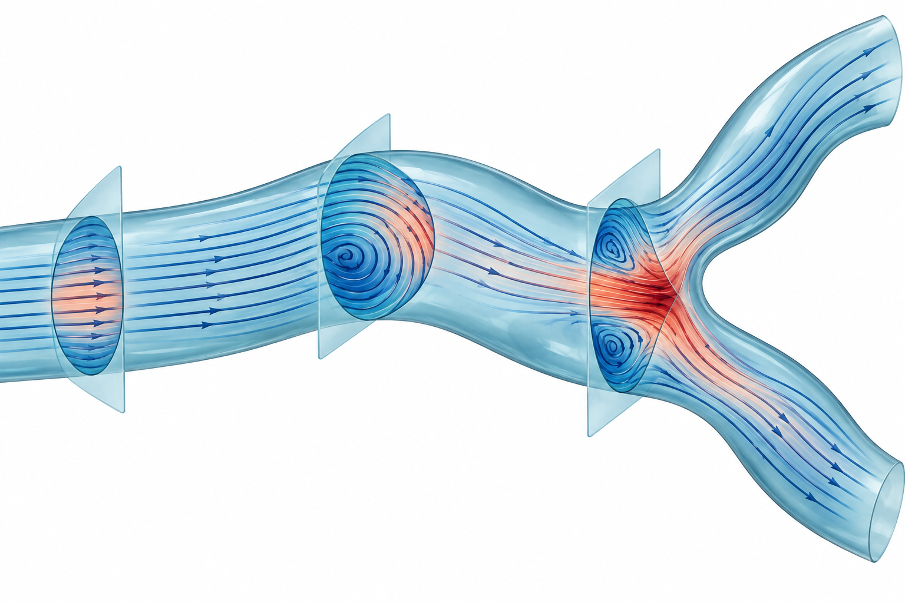
PROJECT 2 / MEDIUM
How good are the 1D assumptions?
Where does a 1D description stop being accurate?
CORE WORK
01
Slice the 3D flow: area, flow rate, mean pressure and
velocity profiles. Check mass balance and Womersley.
02
Map pressure non-uniformity. Compare momentum
coefficient alpha and friction with reference profiles.
03
Evaluate the 1D momentum-equation residual
along the vessel, including bends and stenoses.
OPTIONAL STRETCH
Fit local closures to reduce the residual.
Compare a 0D/1D model with the 3D solution.
2 / 4

Slide 3
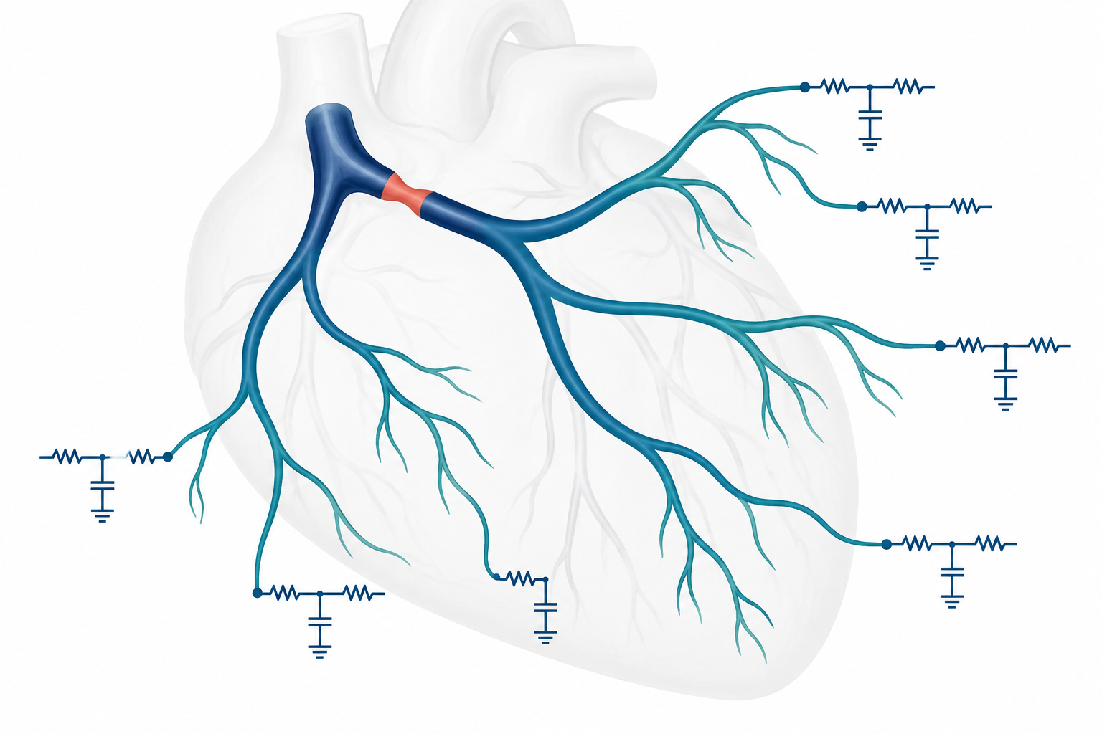
PROJECT 3 / HIGH
A 1D solver for coronary artery trees
Can a fast tree model reproduce coronary 3D CFD?
CORE WORK
01
Extend the supplied Python openBF core to arbitrary
trees with a Newton-based junction solver.
02
Add Windkessel outlets and intramyocardial
back-pressure to obtain diastole-dominant flow.
03
Test convergence and mass conservation. Compare
flow split, pressure drop and virtual FFR with 3D CFD.
OPTIONAL STRETCH
Add stenosis losses and virtual stenting.
Test sensitivity to stiffness, resistance and radius.
AI-generated schematics
3 / 4

Slide 4
PROJECT 4 / SCOPE BY PROPOSAL
Propose your own project
Choose a course-inspired question you can test in 3 weeks
PROPOSAL & APPROVAL
01
Submit a 2-page proposal: question, physics, data,
core and stretch outcomes, and a verification case.
02
Include a week plan and division of work.
Pitch in a 10-minute meeting with the coordinator.
03
Acceptance may require changes. Otherwise select
Project 1, 2 or 3. The same grading criteria apply.
4 / 4

