Slide 1
Introduction
Ed van Bavel
e.vanbavel@amsterdamumc.nl
020-5665203 (work) / 020-5667788 (secr)

Slide 2
From Physics to Physiology
Ivo van Stokkum
Simone Saitta
Ed van Bavel
Support Naomi Duits

Slide 3
Aim today
Hours 1-2:
Introduce ourselves and the course
Introduce the content lectures, set up groups
Discuss modeling
Hours 3-4 (we need to move to the NU building Theater6-NU-4C07):
Lecture 1: circulation and steady flow (followed by group exercises on Thursday)

Slide 4
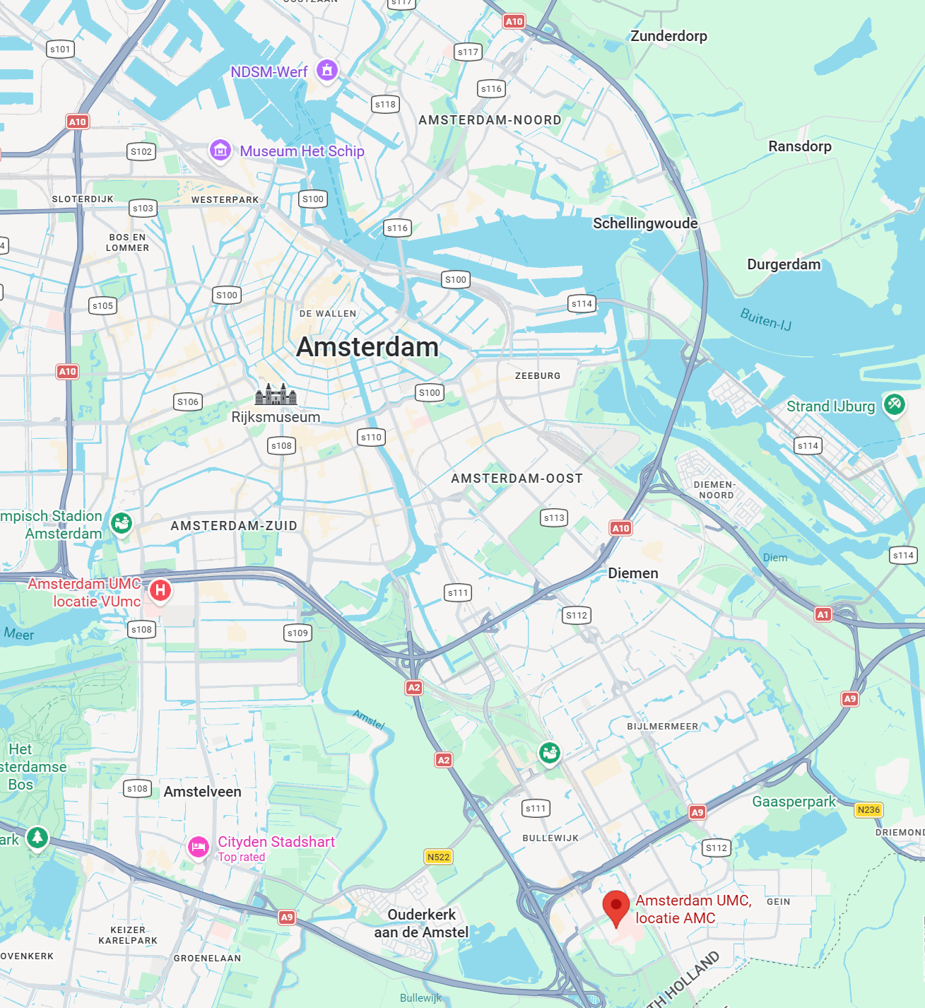
INTRODUCTION
Simone Saitta
Data-driven quantitative image analysis
for cardiovascular medicine
Assistant Professor — qurAI group
Dept. of Biomedical Engineering & Physics, Amsterdam UMC
Informatics Institute, University of Amsterdam
s.saitta@amsterdamumc.nl

Slide 5
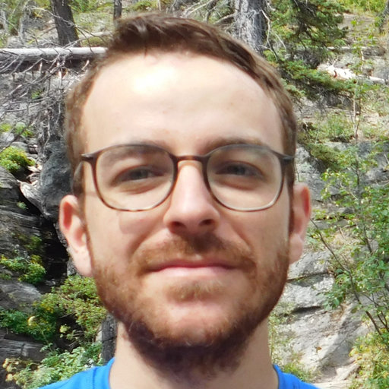
Who am I
Imperial College London
MSc thesis & Research Assistant, Biofluids and Transport Group — 4D flow MRI analysis (built the flow4D tool)
National University of Singapore
Research Engineer — simulation & registration of 4D fetal heart echocardiography
Politecnico di Milano
Simone Saitta, PhD
PhD in Bioengineering, cum laude (2023) — data-driven quantification of imaging biomarkers; visiting researcher at the Cambridge Image Analysis group
Biomedical engineer working on
AI for cardiovascular imaging
Amsterdam UMC & UvA — since 2024
Assistant Professor in Cardiovascular Image Analysis, qurAI group; technical lead of the CARA Lab (real-time AI for intracoronary OCT)

Slide 6
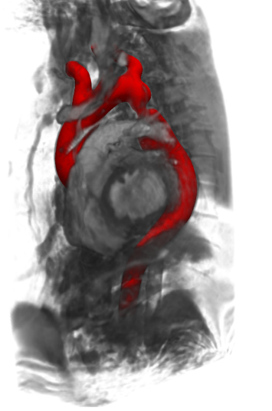
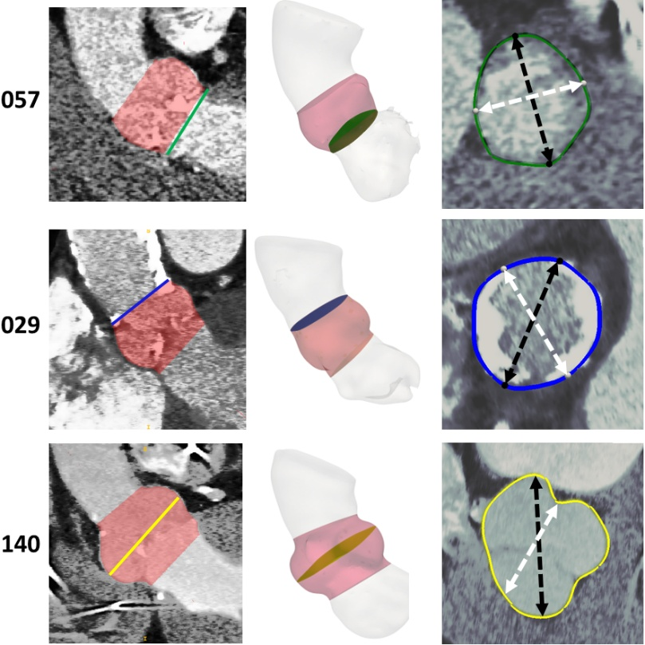
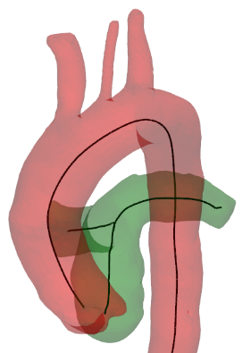
Research example: cardiovascular flow & image analysis
Non-invasive hemodynamics from 4D flow MRI — pressure drops in aortic coarctation, wall shear stress via variational data assimilation (4DVar)
Implicit neural representations — unsupervised super-resolution & denoising of 4D flow MRI
Deep learning for procedure planning — automated aortic root analysis for TAVI (CT), thoracic aorta analysis for TEVAR
Geometric deep learning — learning hemodynamic fields directly on coronary & aortic meshes (surrogates for CFD)
4D flow MRI · CT-based TAVI planning · patient-specific aortic models

Slide 7
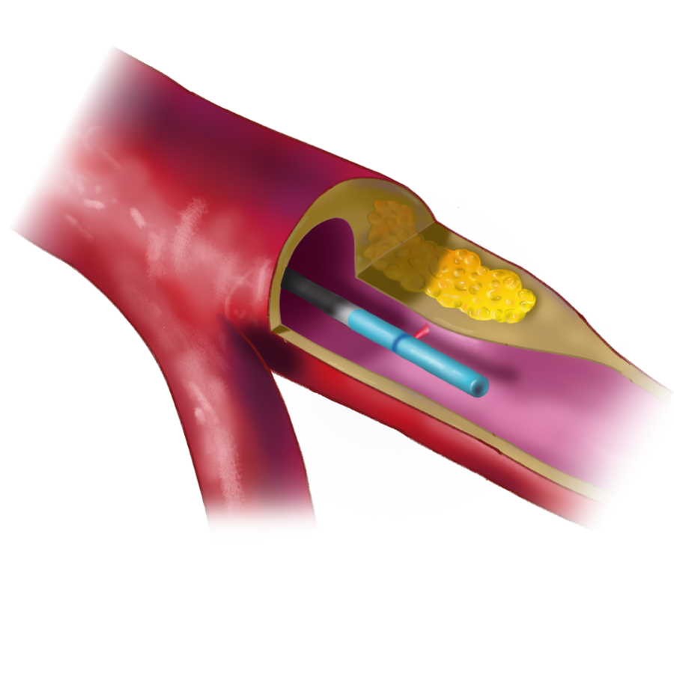
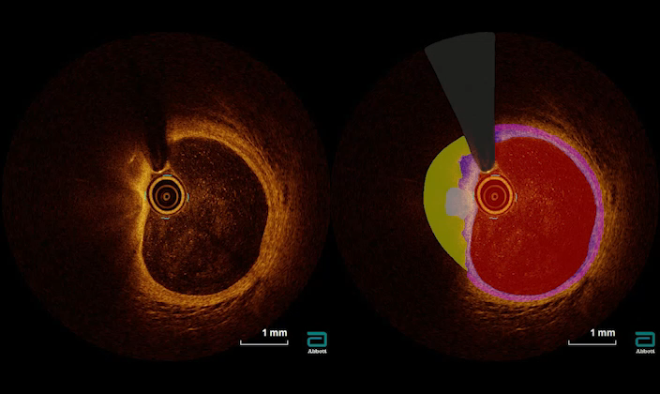
Research example: AI for intracoronary OCT (CARA Lab)
OCT: high-resolution 3D imaging (10 µm) of coronary arteries during percutaneous coronary intervention — rich, but slow to analyze
Goal: robust, real-time AI at the catheterization lab — Amsterdam UMC · Radboudumc · Abbott (ROBUST / ICAI)
Vessel & plaque segmentation — fast inference via knowledge distillation
Artifact detection & uncertainty quantification — when should the cardiologist trust the model?
Detecting rupture-prone plaques (TCFA) and linking them to clinical outcomes (Eur Heart J, 2025)
Coronary OCT: raw frame (left) → AI tissue segmentation (right)

Slide 8
Many open questions in cardiovascular AI
Which biomarkers can we measure without a catheter?
→ flow physics, 4D flow MRI, CFD, inverse problems
How do we make AI fast & robust enough for the cath lab?
→ efficient architectures, knowledge distillation, real-time segmentation
When should a clinician trust the model?
→ uncertainty quantification, validation, prospective clinical studies
Can we recover 3D coronary anatomy + flow from a single X-ray angiogram?
→ probabilistic digital twins — my new NWO Veni project (2026)
Interested in these topics? s.saitta@amsterdamumc.nl · saitta-s.github.io · cara-ai-lab.nl

Slide 9
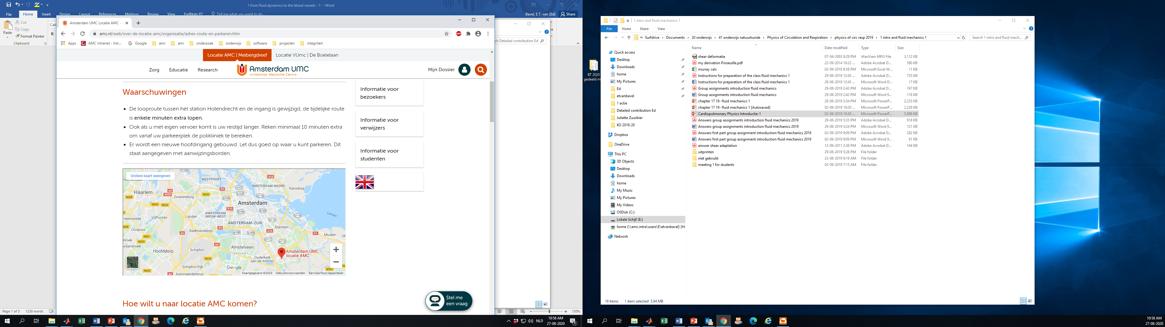
Ed van Bavel:
https://pure.amsterdamumc.nl/en/persons/ed-van-bavel
https://bme-physics.nl/

Slide 10
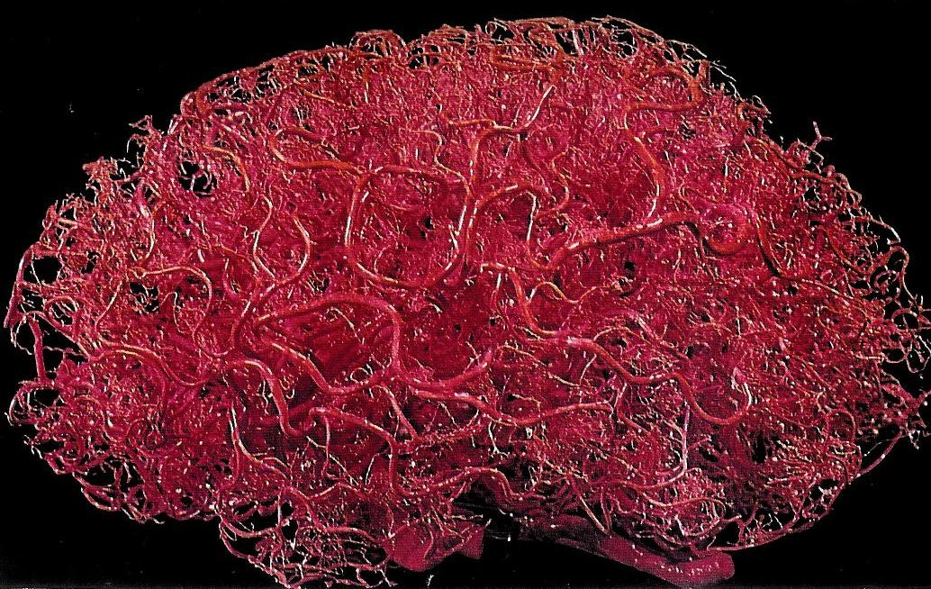
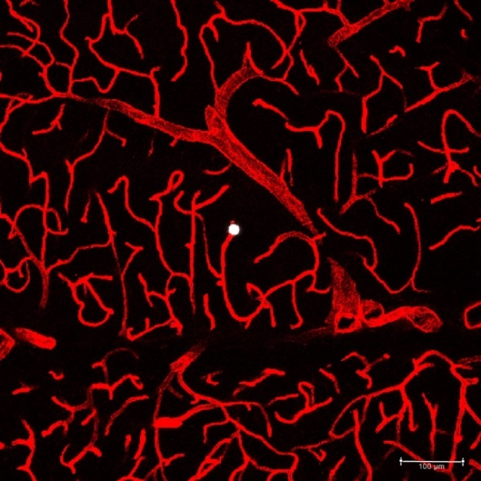
Research example: cerebral circulation, stroke and stroke treatment
Microcirculation: Millions of vessels

Slide 11
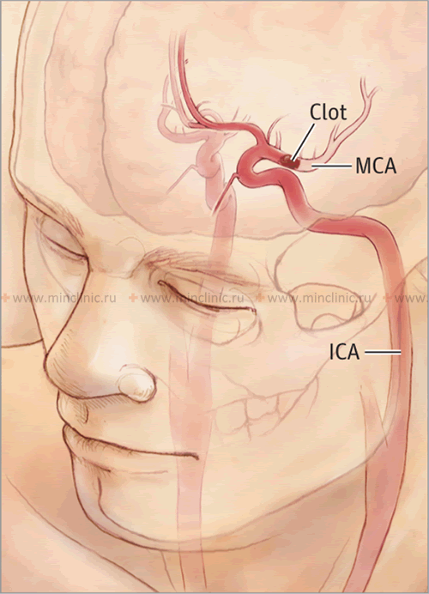
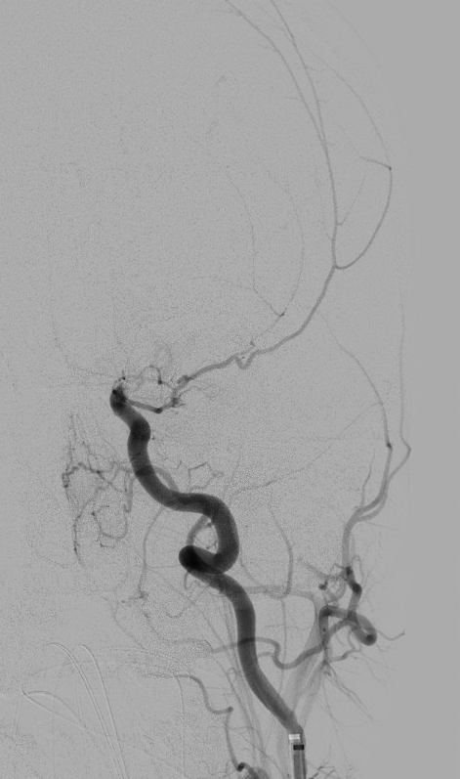
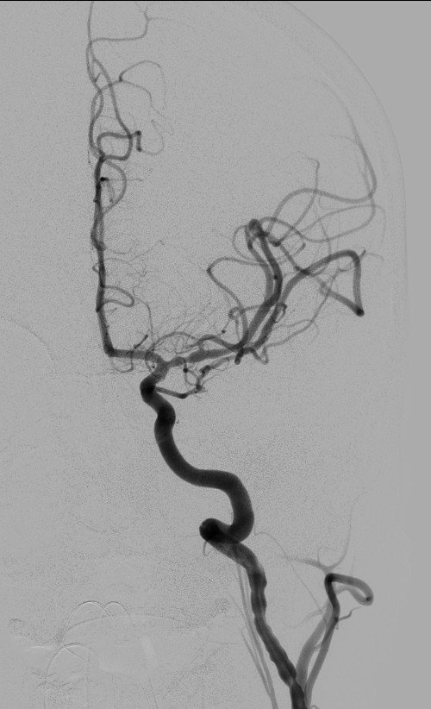
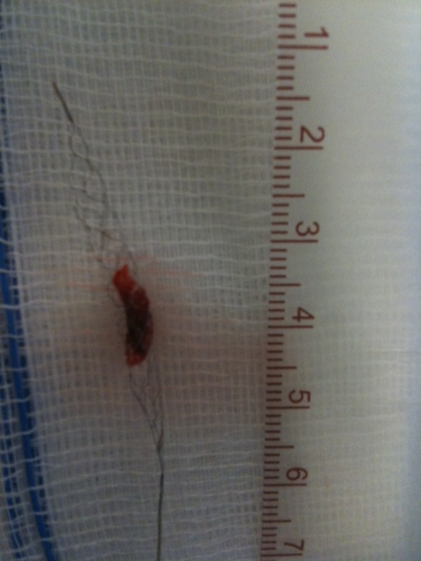
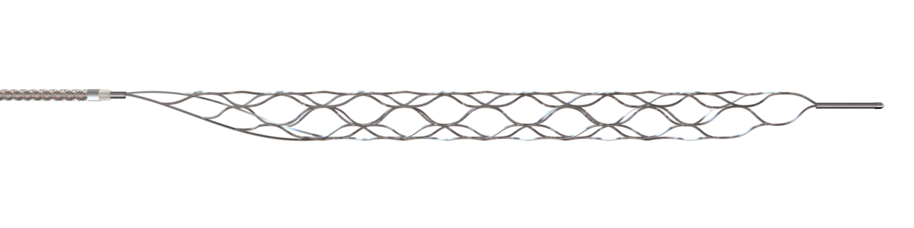
Research example: cerebral circulation, stroke and stroke treatment
Endovascular
Trombectomy
https://www.youtube.com/watch?v=cWh1ovlJg24

Slide 12
Many questions in stroke research
What happens after stroke with brain vessels, neurons? (biology, modeling of tissue progression, 3D dynamic)
How much blood still flows to the volume at risk? (clot permeability, bypass vessels => transport physics and their modeling, 0D, 1D, 3D)
How to design the best clot retriever? (clot mechanics, wall mechanics, engineering=> finite elements)
How to better treat the patient? (randomized controlled clinical trials, in silico clinical trials)

Slide 13
FP2P course
September
October
Ivo classes on Mathematica
Simone classes on Python
Mathematica exam
Group projects
Presentation and report
Content classes on Ph&Ph
(Ed and Simone)
Written exam

Slide 14
Final score
> 80% of assignments have to be handed in, on time.
Active role in groups is required
Practical exam Ivo part halfway: 30%
Written exam Ed/Simone part halfway: 30%
Final assignment (group work) presentation: 20%
Final assignment (group work) report: 20%

Slide 15
Academic honesty
One particular concern that we, as lecturers, have is how to prevent fraud or plagiarism. This is an important issue, because we have to guarantee the integrity of the degree you will be getting through our programme. For this, we appeal to and rely on your academic honesty. Typically, an open book exam/report will contain the following text:
“During the exam, the only communication allowed is with the lecturer, who is available to offer clarification of the exam questions. As part of the assessment the examiner can contact you later for further discussion on the submitted report. We expect academic honesty from you, and that all work handed in is your own. As a proof of that commitment, please insert below this paragraph a scan or photo of your signature.”

Slide 16
Usage of AI tools in education
Be transparent about your use of AI tools in your research or writing, and clearly identify any outputs generated with the help of AI.
https://canvas.uva.nl/courses/6070/pages/responsible-use-of-ai-tools

Slide 17
Rules for the usage of AI
"The normal plagiarism rules apply to the Assignments. That means that you must submit your own work, and if you copy code from someone else (including code you found online or using generative AI such as Bing or MS Copilot, ChatGPT or Github Copilot) without adapting it substantially yourself, you need to give credit for it, so that we can properly judge the parts that you did for yourself and not give credit to you for work done by others. It is however fine to work together and discuss possible solutions with others but copying other people's work verbatim (or with only minor adaptation) and without credit is absolutely forbidden, and suspected cases will be reported to the Examination Board."

Slide 18
Content classes Ed / Simone
Introduction of a range of physical relations and their relevance for physiology
Cardiovascular system
Learning goal this part: learn to apply physical relations for analyzing (new) physiological systems.
Understand / apply / analyze / create; NOT MEMORIZE
Six classes of four hours each
Group assignments in class and after class, straightforward-challenging-too challenging.
Mathematical assignments but no / only few coding assignments here
October group assignments will be python based

Slide 19
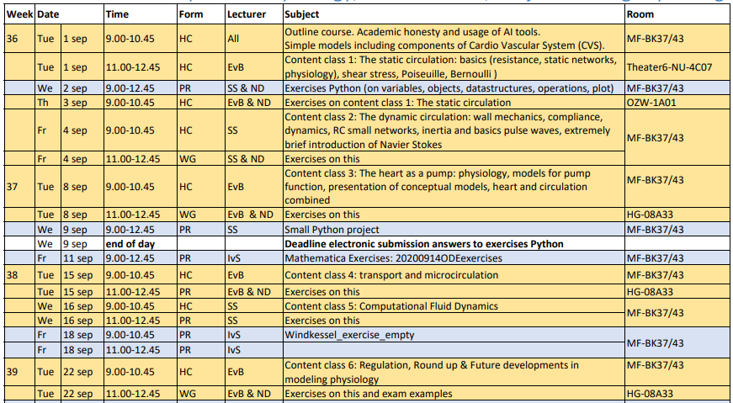

Slide 20
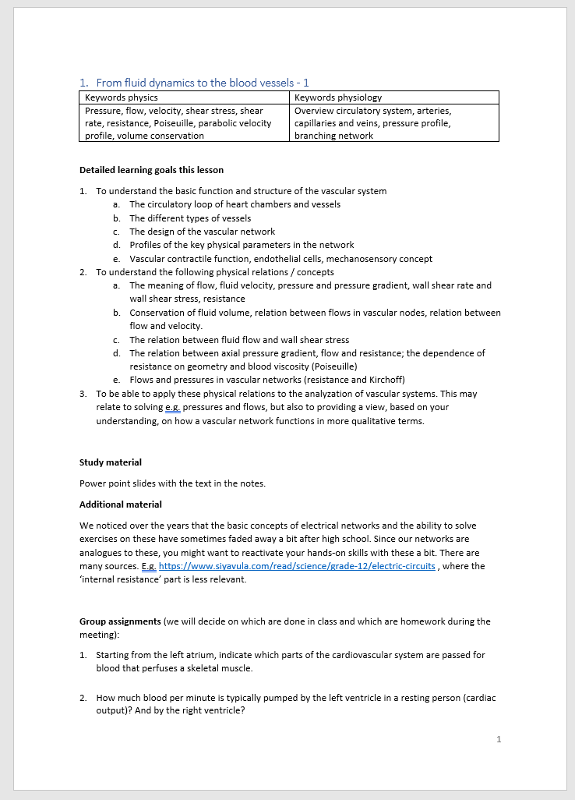

Content classes Ed / Simone
Description of each class will be on Canvas
  Keywords
  Learning goals
  Study material
    Mostly powerpoints WITH NOTES
    Some additional suggestions
    You may want to consult:
  Group assignments
https://www.bol.com/nl/nl/f/medical-physiology/38743877/

Slide 21
Content classes Ed / Simone
On Canvas for each of six classes:
Description of class
Slides and notes therein
Any additional documents of interest
Model answers to group assignments (after the deadline)
Bring the group assignments to class yourselves! We won’t distribute them
Feedback on your assignment answers
Mostly in class
For work done at home: general feedback, not per group but comments on Canvas and/or discussion at start of next class.

Slide 22
Content classes Ed / Simone
Groups: Work in groups of four.
Keep the same group throughout the 6 content classes.
Assignments are done in class and (for class 1-5) after class
Each student hands in the answers to the assignment in Canvas before the deadline (typically start of next class but see Canvas assignments).
  A single pdf (the same for all group members if you worked on it together)
  Indicate name / student number / group number
  Use decent handwriting if you scan in
  Each student actively contributes to at least 5 of the 6 sets of assignments
Make assignments together, don’t distribute tasks
Ensure all group members are participating

Slide 23
Groups…

Slide 24
From Physics to Physiology
Physics: the science of matter and energy
  The fundamental science
  (Classical) mechanics: motion and forces
  a bit thermodynamics,
  a bit electromagnetic fields.
https://www.physoc.org/explore-physiology/what-is-physiology/

Slide 25
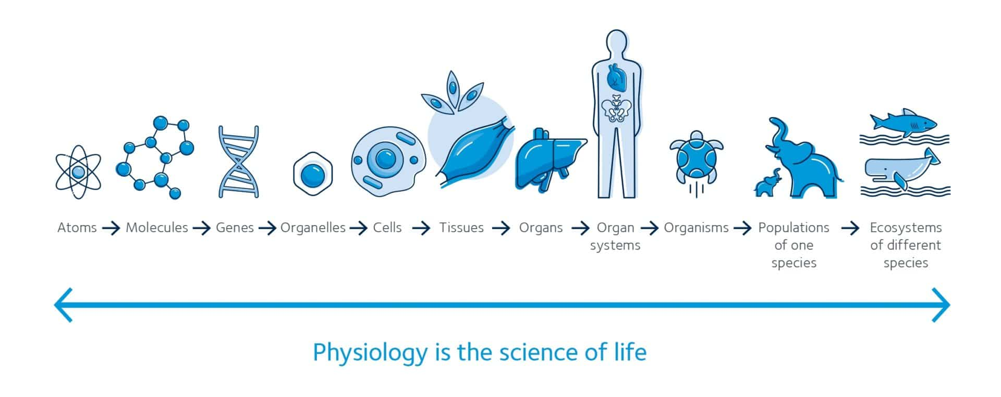
From Physics to Physiology
Physiology: the science of function of living things
  Multiscale
  Dynamic
  Integrative
  Experimental science
https://www.physoc.org/explore-physiology/what-is-physiology/

Slide 26
From Physics to Physiology
Anatomy: the science of structure of living things
  Multiscale
  Static / Dynamic at long time scale
  Experimental science
https://www.physoc.org/explore-physiology/what-is-physiology/

Slide 27

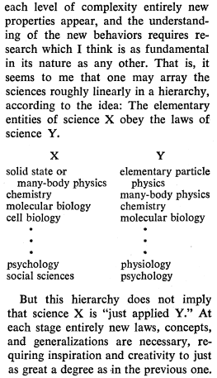
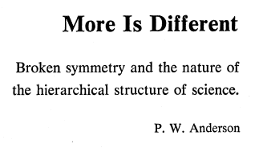

Slide 28
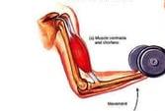
From Physics to Physiology
Example: muscle contraction
Forces and flows
Muscle growth
Shortening velocity
Maximal active force
Force generation
Muscle growth
Structure
Function
Length-Force relation

Slide 29
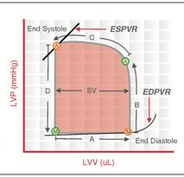
From Physics to Physiology
Example: the heart as a pump
Forces and flows
Cardiac hypertrophy
Filling in the rest phase
Arterial pressure,
Cardiac output
Arterial pressure,
Cardiac output
Cardiac hypertrophy
Structure
Function
Passive and active pressure-volume relation of left venrtricle

Slide 30
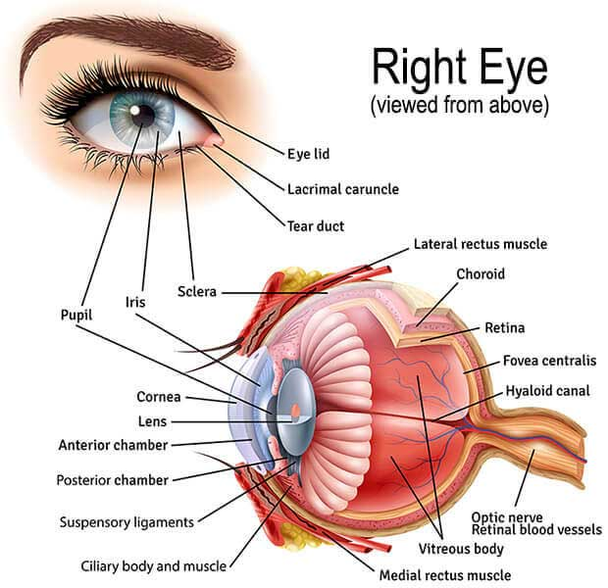
From Physics to Physiology
Example: the eye
Physics
Structure
Function

Slide 31
Systems and models
System: a group of elements (sub-systems) with their relations and relations with the outside world that constitute a complex and integrated whole
E.g the Cardiovascular System
Model: a relevant part of a system
specific elements: e.g. the systemic circulation but not the pulmonary circulation
Specific relations: effect of blood pressure on kidney but not brain
Specific aspects: e.g. for the heart the pumping but not the ECG
Specific time scale: e.g. physiological response but not growth/remodeling
Specific level of integration: organs but not the molecules
And so on

Slide 32
Models
A model represents those features of reality that are relevant for the specific purpose set by the modeler

Slide 33
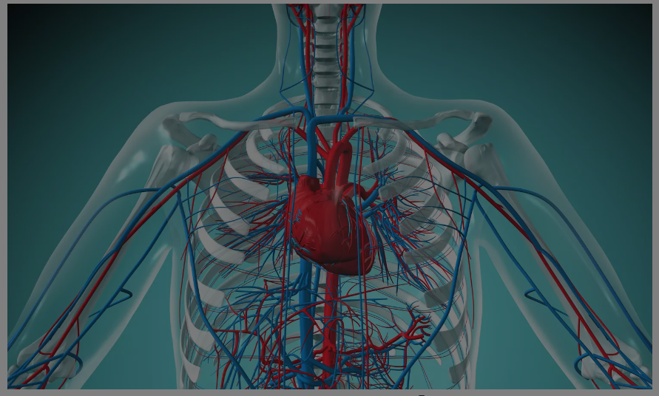
Anatomical model
https://www.thoughtco.com/cardiovascular-system-373577

Slide 34
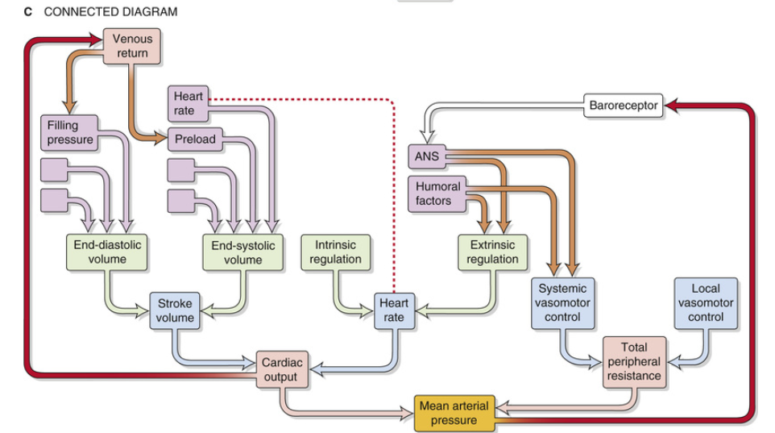
Physiological model

Slide 35
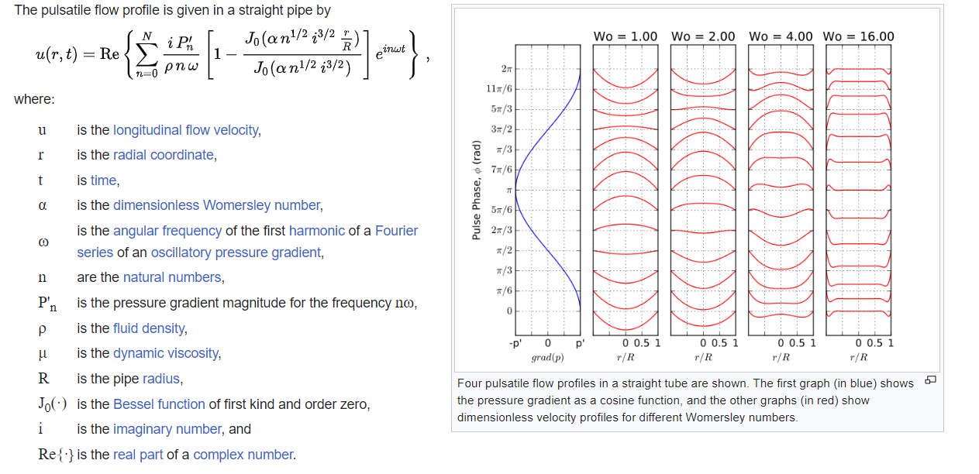
Physical / Mathematical model

Slide 36
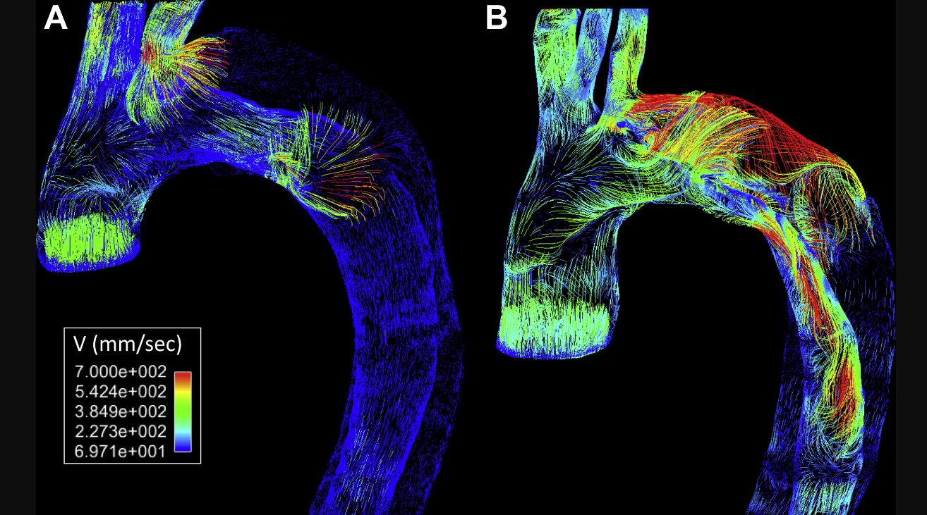
Engineering model
https://ars.els-cdn.com/content/image/1-s2.0-S0741521415003006-gr2_lrg.jpg

Slide 37
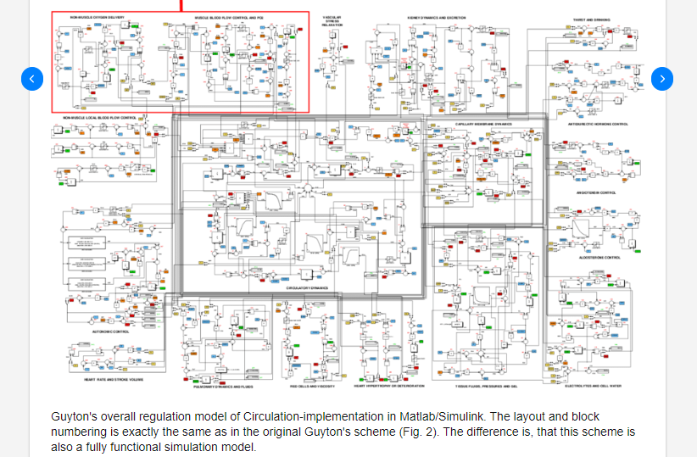
“comprehensive” simulation model
https://www.researchgate.net/figure/Guytons-overall-regulation-model-of-Circulation-implementation-in-Matlab-Simulink-The_fig4_228683930

Slide 38
Models
A model represents those features of reality that are relevant for the specific purpose set by the modeler
Question: what purposes could a modeler have?

Slide 39
Some purposes of models of biological/physical systems
Make studies on a system feasible
  Finite number of parameters
  Scale in time and / or space
  Make the study safe / reduce costs
Generate a concrete / quantitative representation that allows analysis by simulation and/or mathematics
Analysis
  Understand how a system works
  Unravel which processes / parameters are critical for outcome
  Test specific hypotheses
  Fit model parameters to experimental data
  Predict future
Aid in decisionmaking
Visualization
Mental picture
Communication

Slide 40
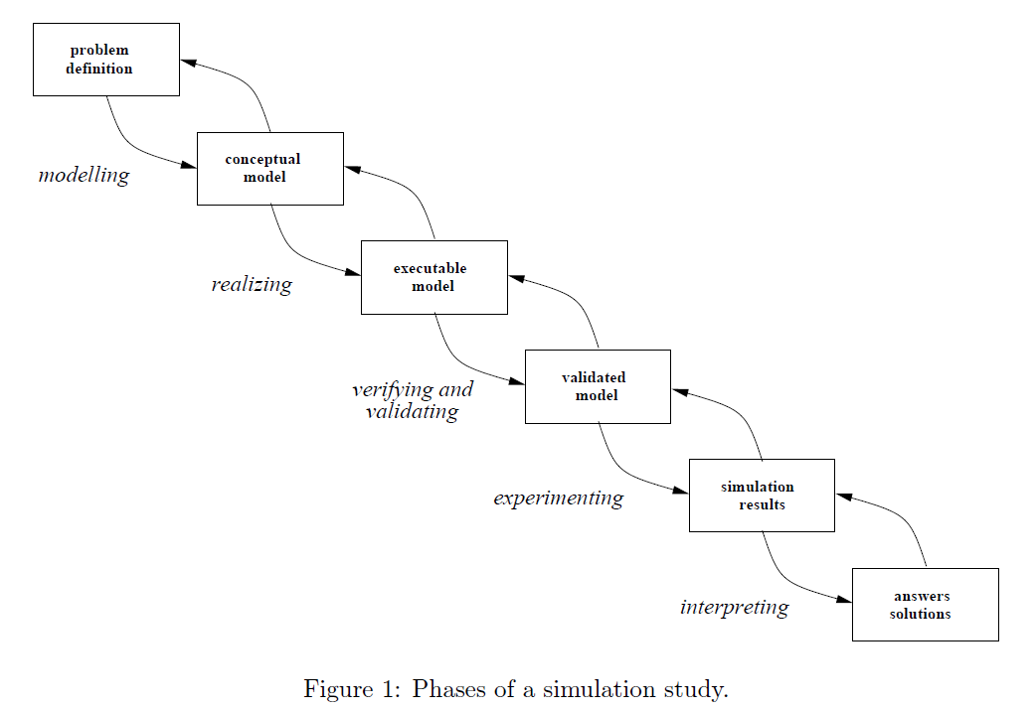
Steps in simulation
Verification is the process of checking whether your simulation model is correctly implemented and free of errors.
Validation is the process of checking whether your simulation model is a good representation of the real system.
https://www.researchgate.net/publication/229124727_Business_Process_Simulation

Slide 41
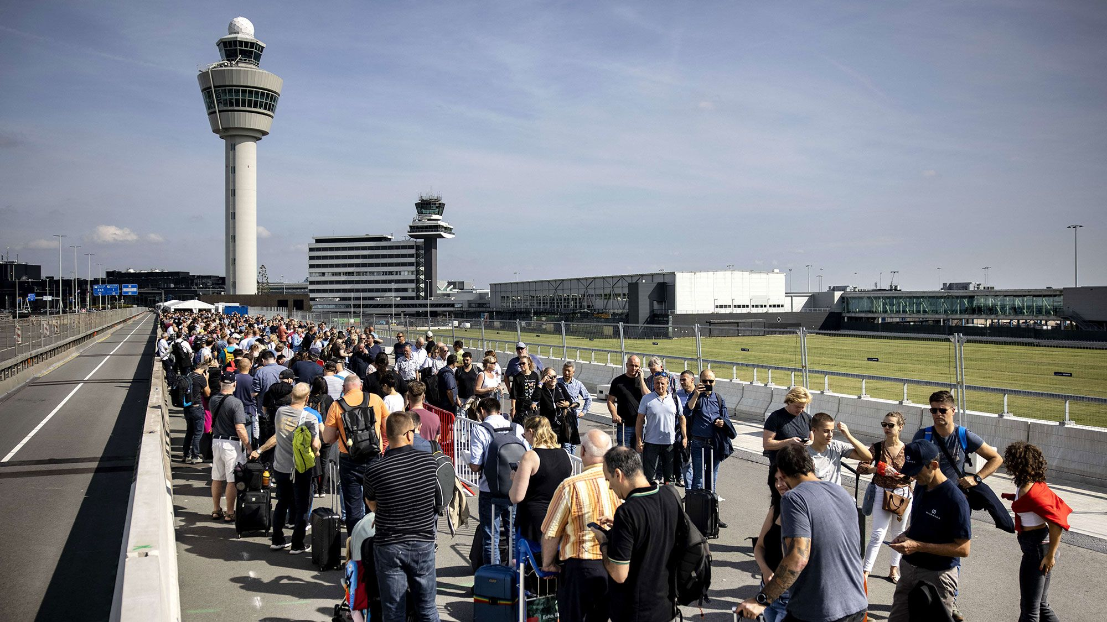
Simulation of the Schiphol security queue..
Problem definition?
Conceptual model?

Slide 42
Discuss in couples: Modeling the Schiphol queue
What is the problem?
What could a conceptual model look like?

Slide 43
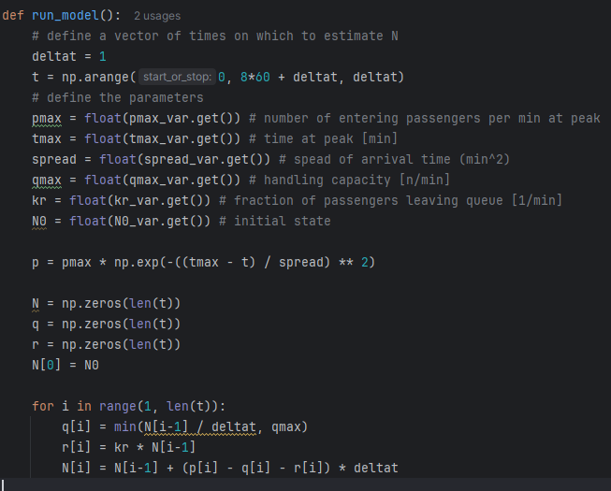
Simulation of the Schiphol security queue..
Conceptual model
Executable model
Input: passengers
entering p(t)
State: length
of queue (N)
Passengers giving
up r(N)
Passengers through
security q(N)

Slide 44
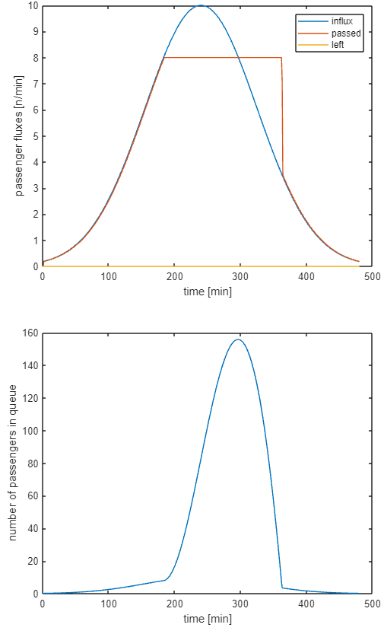
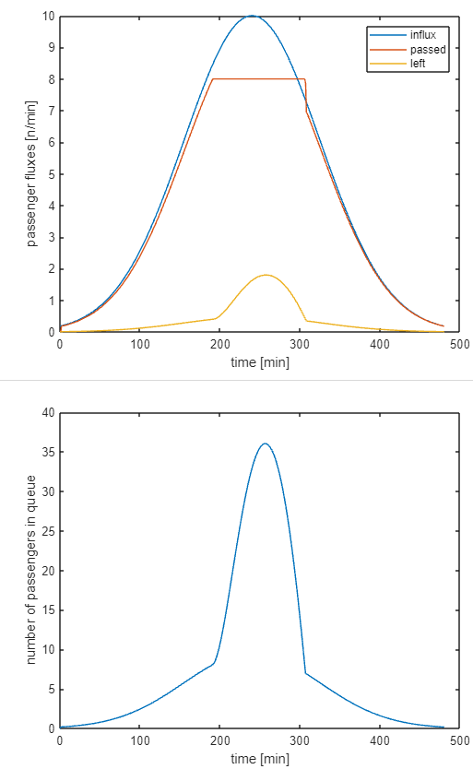
Simulation of the Schiphol security queue..
Everybody stays in queue kr=0 [1/min]
Passengers give up kr=0.05 [1/min]
Simulation results

Slide 45
Simulation of the Schiphol security queue..
Verification
N is taken continuous, delta t discrete …
Validation
Decent models of passenger behavior?
Variation in e.g. handling time? => data needed
Answers, solutions?
What was the problem, queue length or waiting time or passengers missing flights?
Other answers may need completely different approach
See also e.g. https://web.mst.edu/~gosavia/queuing_formulas.pdf

Slide 46
The Cardiovascular System
Specific purpose of using the Cardiovascular System: to provide insight and skills on using modeling and simulation for understanding physical / physiological / anatomical interactions
Relevant physics
Relevant physiology (and anatomy)
Modeling (mathematics) and simulating their interaction
  In Mathematica
  In Python

