Slide 1

JAVA
AWT
SALES MANAGEMENT SYSTEM
In developing a Sales Management System using Java AWT (Abstract Window Toolkit), We leveraged the powerful GUI (Graphical User Interface) capabilities provided by AWT to create a user-friendly and efficient interface. AWT, being part of the Java Foundation Classes, facilitated the design and implementation of various graphical components such as buttons, text fields, and frames to construct a friendly environment for users.

Slide 2
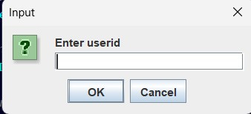
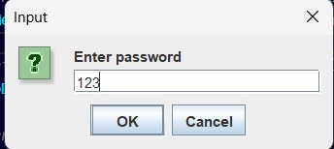
In The Initial Section, Users Are Prompted To Enter Their Credentials Through A Streamlined Interface, Requiring User Id And Password Input For Secure Access To The Sales Management System.

Slide 3
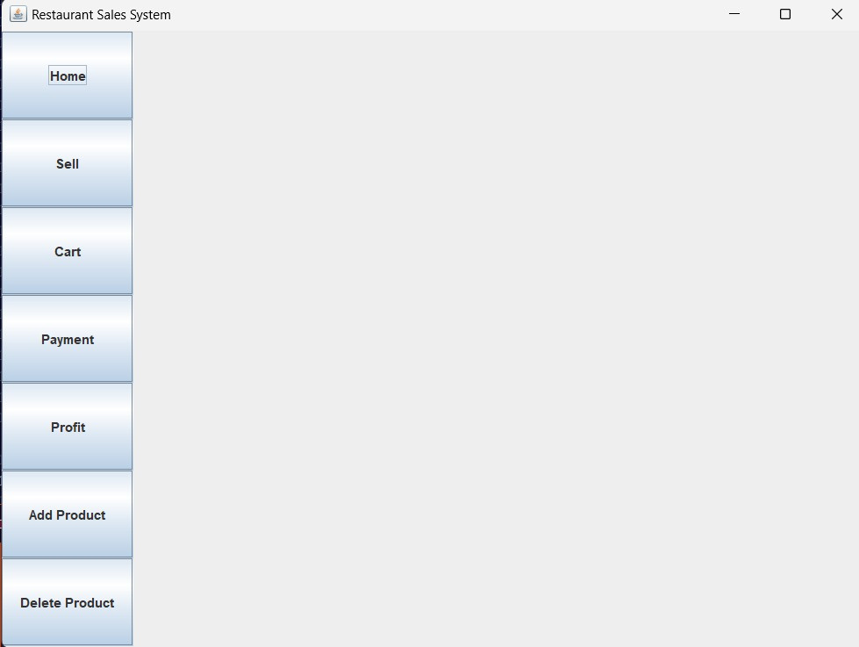
The Interface Features A Structured Layout, With Navigation Options Elegantly Positioned On The Left Side For Easy Accessibility

Slide 4
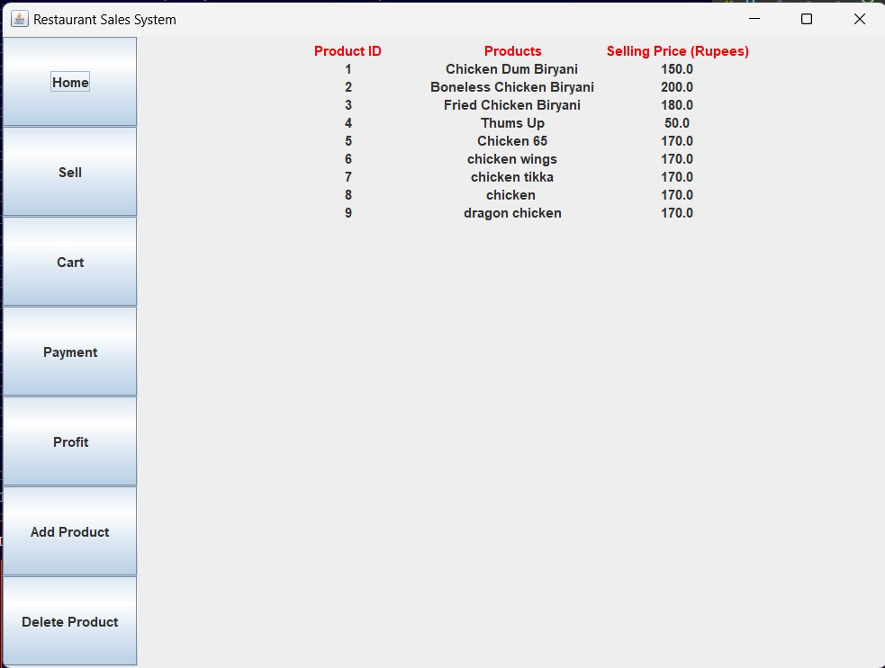
On The Homepage Of Our Restaurant Management System, Users Are Greeted With An Organized List Of Available Items, Elegantly Presented For Easy Navigation.

Slide 5
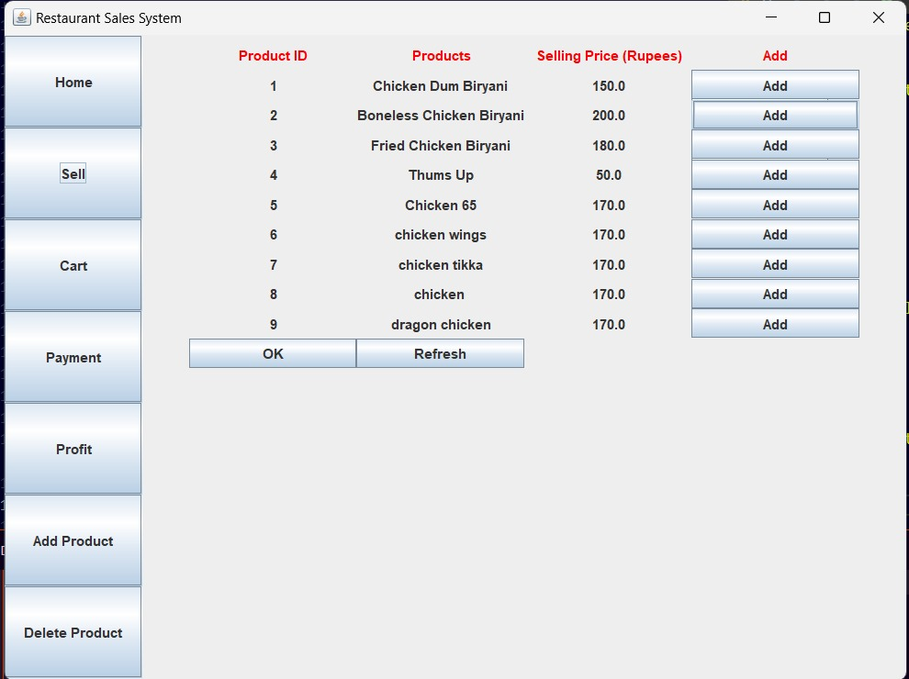
On The Sales Page, Just Pick What You Want To Sell, Hit "Ok," And You're Done – Making The Process Simple And Quick.

Slide 6
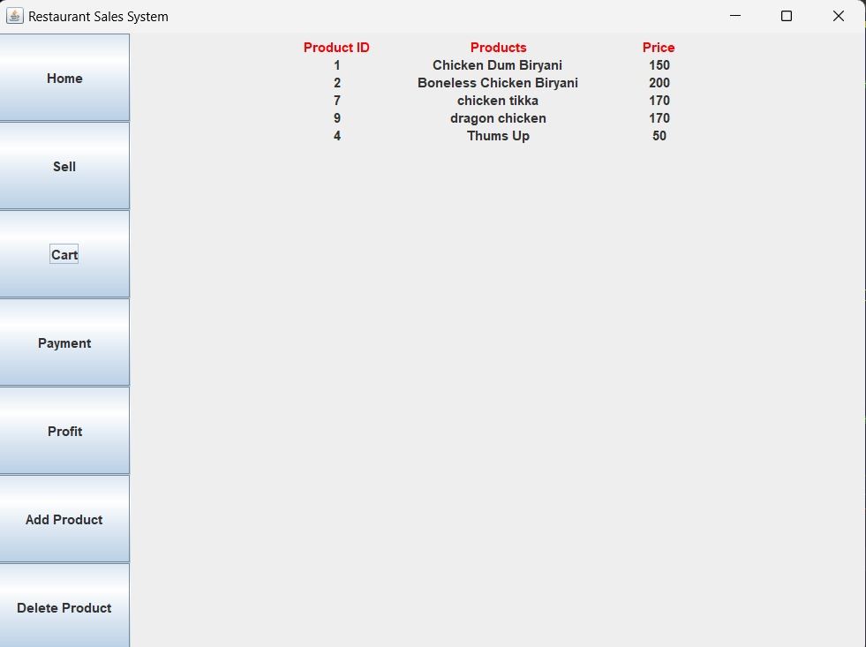
Once Items Are Selected, The Cart Page Provides A Clear Overview, Simplifying The Checkout Process For A Straightforward Experience.

Slide 7
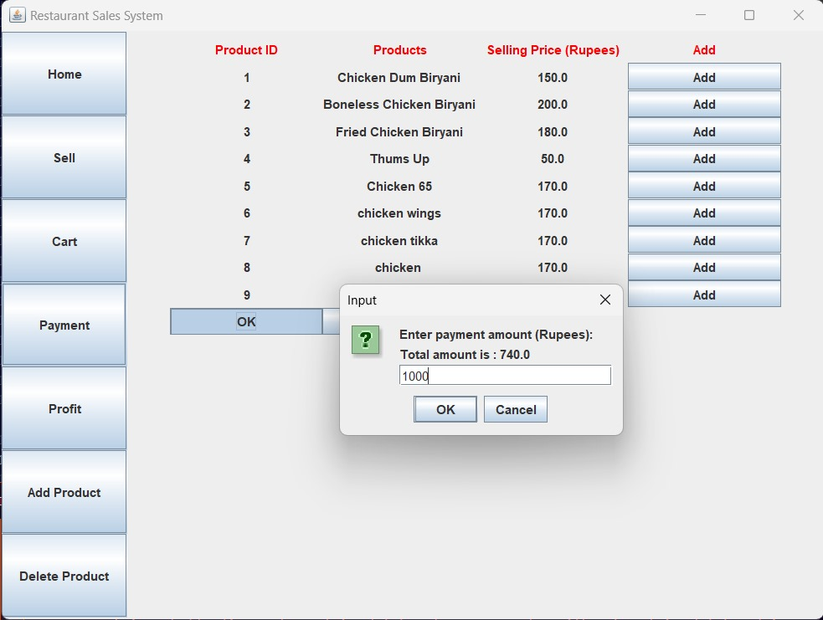
The Payment Page Is Where You Settle The Bill, Making The Transaction Seamless And Efficient.

Slide 8
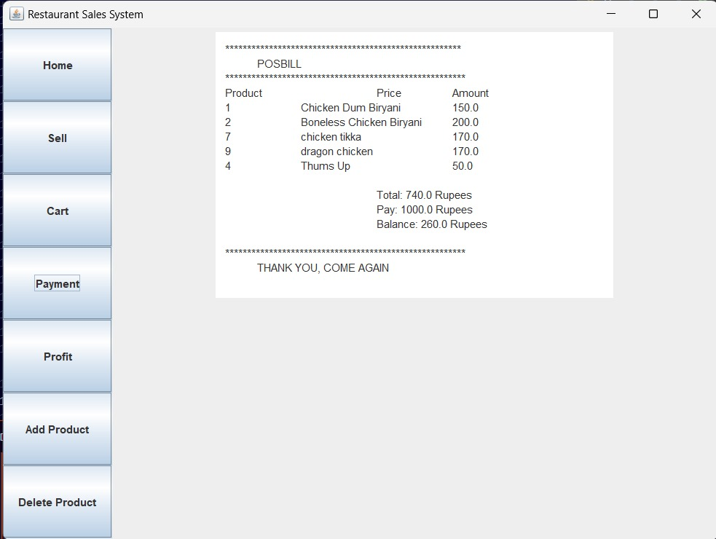
Once You've Paid, You Get A Simple Bill With All Your Payment And Product Details.

Slide 9

For Additional Transactions, Simply Click The "Refresh" Button, And The Cart Will Be Emptied, Allowing For Seamless And Repeatable Transactions As Needed.

Slide 10
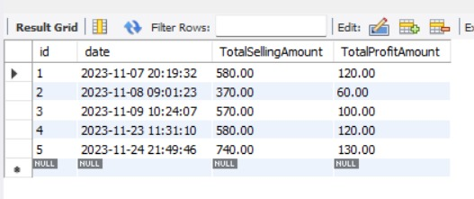
Our App Smoothly Connects To A Database, Keeping Track Of Transactions With Details Like Date, Time, Selling Amount, And Profit. This Ensures An Organized Record For Future Reference And Analysis.

Slide 11
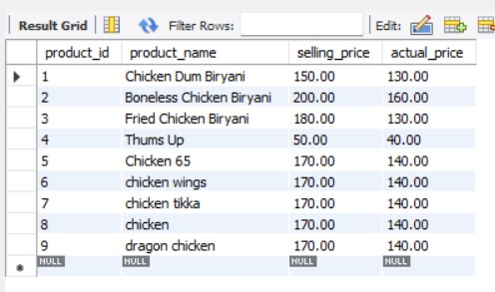
We've got a complete list of items stored in our database, making it easy to manage and retrieve product information for a smooth and organized operational process

Slide 12
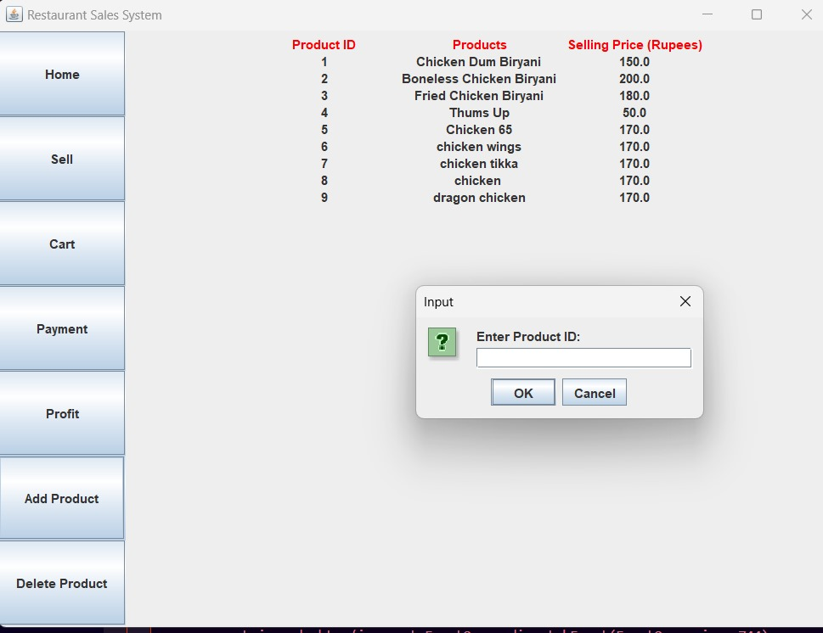
Clicking "Add Product" opens a user-friendly dialog box, making it easy to add new products to our system. This feature boosts the efficiency of updating our product catalog.

Slide 13
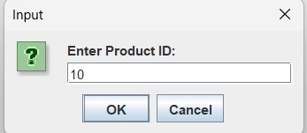
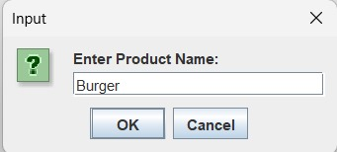
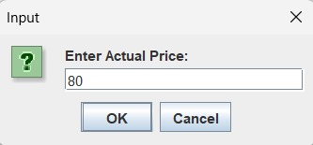
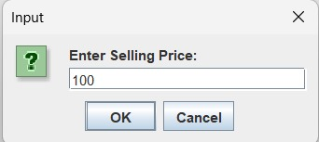
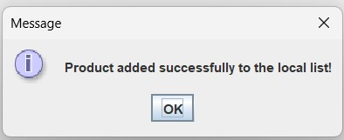
To Add A New Product, Input The Product ID, Product Name, Actual Price, And Selling Price, Streamlining The Process For Efficient Catalog Updates.

Slide 14
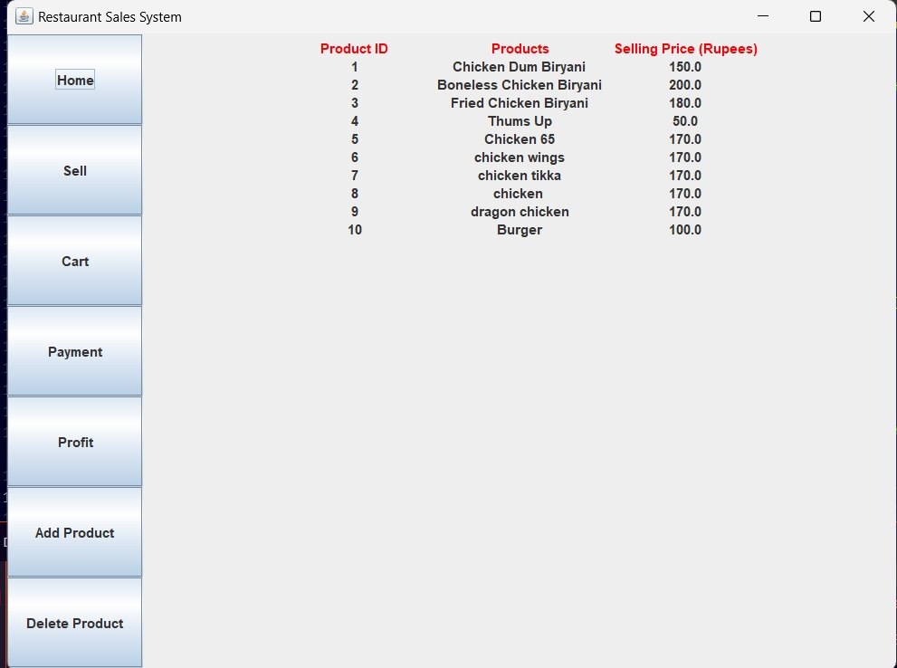
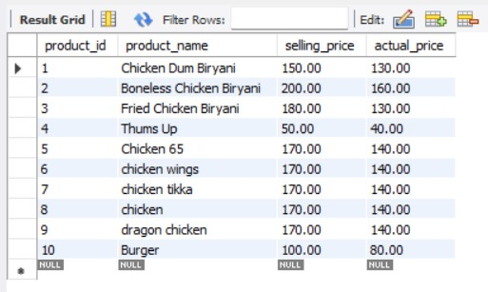
Enter product details, and it's instantly added to the app and database. Easy as that!

Slide 15
Now, let's move on to deleting products from our list.

Slide 16
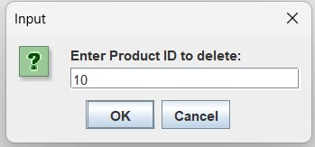
Click "Delete," and enter the Product ID in the dialog box — that's it for removing products!

Slide 17
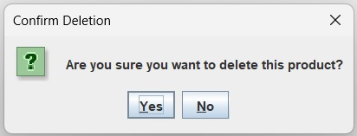
Click Yes To Delete

Slide 18
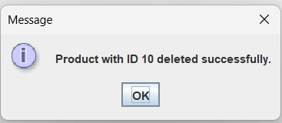
Deletion Message Will Be Displayed

Slide 19
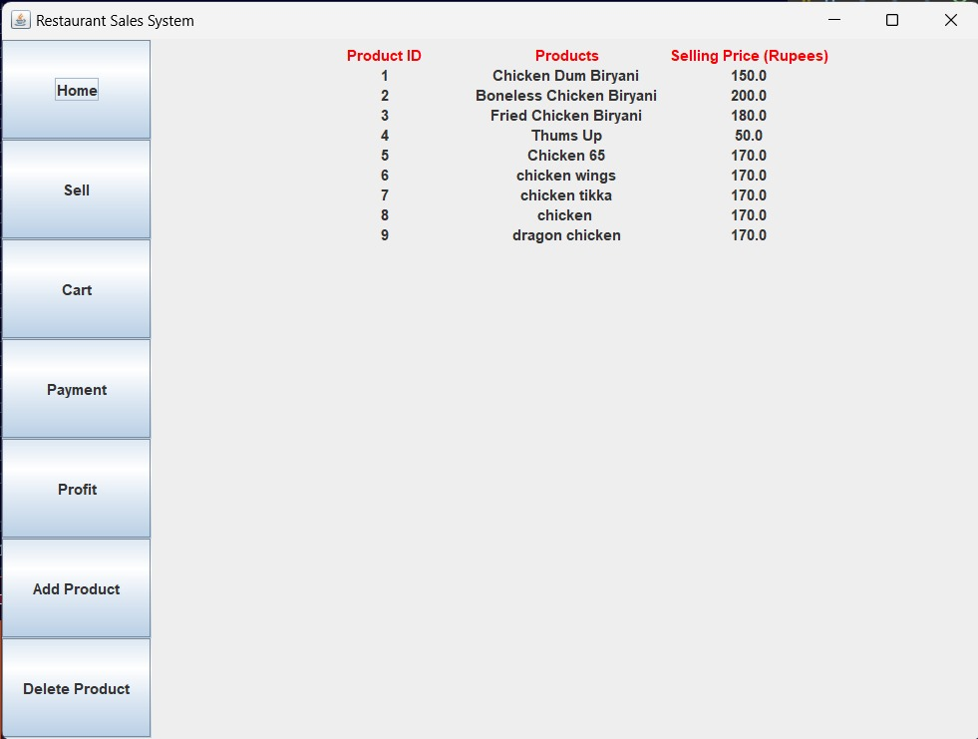
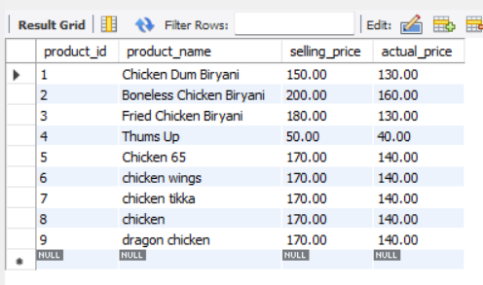
The New List Is Displayed In Our Application And Database

Slide 20
THANK YOU

