Slide 1
Md Nurul Amin
E-Commerce Security

Slide 2
Security and Legal Aspects of
E-Commerce
Security of Clients and Service Providers
Relevant provisions in IT Act
Threats in E-Commerce
Offences
Secure Electronic
Records
Digital Signature ( Penalties and Adjudication)

Slide 3
Objectives of the IT Act
To provide legal recognition for transactions:-
Carried out by means of electronic data interchange, and other means of electronic communication, commonly referred to as "electronic commerce“
To facilitate electronic filing of documents with Government agencies and E-Payments
To amend the Indian Penal Code, Indian Evidence Act,1972, the Banker’s Books Evidence Act 1891,Reserve Bank of India Act ,1934
Aims to provide for the legal framework so that legal sanctity is accorded to all electronic records and other activities carried out by electronic means.

Slide 4
Objectives
Legal Recognition for E-Commerce
Digital Signatures and Regulatory Regime
Electronic Documents in place of paper documents
E-Governance
Electronic Filing of Documents
Amend certain Acts
Define Civil wrongs, Offences, punishments
Investigation, Adjudication
Appellate Regime

Slide 5
Security in E-Commerce
Introduction :-
E-Commerce security refers to the principles which guide safe electronic transactions, allowing the buying and selling of goods and services through the Internet, but with protocols in place to provide safety for those involved.
Definition :-
Ecommerce security is a set of protocols that safely guide ecommerce transactions. Stringent security requirements must be in place to protect companies from threats like credit card fraud, or they risk jeopardizing revenue and customer trust, due to the inability to guarantee safe credit card processing.

Slide 6
Threats in E-Commerce
A threat is anything that can disrupt the operations, functioning, integrity, or availability of a network system.
A threat is an object, person , or other entity that represents a constant danger to an asset.
Management must be informed of the various kinds of threats facing the organization.
By examining each threat category management effectively protects information through policy, education, training and technology.

Slide 7
Type of Threats in E-Commerce
Secrecy threats
Wiretapping and integrity threats
Cyber vandalism
Spoofing denial of service threats
Threats from internal employees

Slide 8
Secrecy Threats
Secrecy is a technical issue that requires sophisticated physical and logical mechanism and focuses on the prevention of unauthorised disclosure of information.
The privacy of information on internet is threatened by snipper programs. A snipper program provides the means to tap into internet and record information that passes through a particular computer while travelling from source to destination.
Unauthorised individuals steal personal information (eg., credit card number, name, address, etc.) by recording information packets;
Snipper programs read, descrypt, and record email transmissions.

Slide 9
Wiretapping and Integrity Threats
This threat occurs when a message stream of information (e.g., banking transaction) is altered by an unauthorised person.
Attackers attempt to read stored files, message packets passing by on the network. Other processes , memory, etc.

Slide 10
Cyber Vandalism
Electronically defacing an existing Web site's page by inserting different content material (which may include offensive pornographic material).
It is also an example of an integrity violation of the web site contents. Such a violation could cause damage to e-commerce operations through denial of service or loss of trust in the web site.
Cyber-Vandalism is intentionally disrupting, defacing, or even destroying a site

Slide 11
Spoofing
Misrepresenting oneself by using fake email addresses or masquerading as someone else.
Pretending to mimic someone or presenting a fake web site to spoof visitors (e.g., a hacker substitutes their web site address in place of the real one by one by taking advantage of backdoors).
This type of action can have direct consequences for buyers and sellers using e-commerce sites to transact business

Slide 12
Denial of Service Threats
Flooding a Web site with useless traffic to inundate and overwhelm the network.
Distributed Denial of Service attack uses numerous computers to attack the target network from numerous launch points.
The denial of service attacks may cause a network to shut down, making it impossible for users to access the site. The longer the site is shut down , the more damage is done to a site’s reputation.

Slide 13
Threats from Internal Employees
Employees with access to sensitive information.
Sloppy (casual and loose-fitting) internal security procedures.
Able to roam throughout an organization’s system without leaving a trace.
In case of e-commerce sites, the largest disruptions to service, destruction of sites, and diversion of customer credit data and personal information come from trusted insider employees.

Slide 14
Security of Clients and Service Provider
E-commerce security is the protection of e-commerce assets from unauthorized access, use, alteration, or destruction.
6 dimensions of e-commerce security
Integrity: prevention against unauthorized data modification
Nonrepudiation: prevention against any one party from reneging on an agreement after the fact
Authenticity: authentication of data source
Confidentiality: protection against unauthorized data disclosure
Privacy: provision of data control and disclosure
Availability: prevention against data delays or removal

Slide 15
The tools used to protect information and systems against compromise, intrusion and misuse
Firewalls
Encryption
Message authentication
Site blocking
Operating system controls
Anti-virus software
Scanners
Active monitors
Behaviour blockers
Integrity checkers

Slide 16
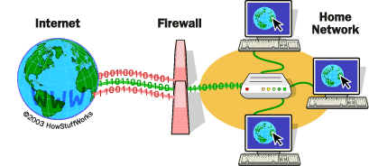
Firewalls
A firewall is a software or a hardware combination that is installed in a network to control the packet traffic that moves through it. Companies will place a firewall at the internet entry point of their networks as it provides a defense between a network and the internet.
All traffic from the inside to outside and from outside to inside the network must pass through it.
Only authorized traffic, as defined by the local security policy, is allowed to pass through it.
The firewall itself is immune to penetration.

Slide 17
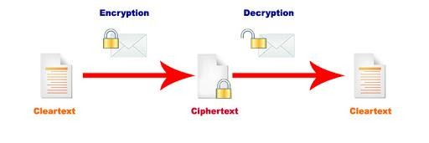
Encryption
The process of transforming plain text or data into cipher text that cannot be read by anyone outside of the sender and the receiver.
The purpose of encryption is
to secure stored information and
to secure information transmission.
Cipher text is text that has been encrypted and thus cannot be read by anyone besides the sender and the receiver

Slide 18
Message Authentication
Protect against active attacks
falsification of data
eavesdropping
Message is authentic if it genuine and comes from the alleged source.
‘authentication allows received to verify that message is authentic
Message has not altered
Message is from authentic source
Message timeline

Slide 19
Site Blocking
Site blocking is a software based approach that prohibits access to certain websites that are deemed inappropriate by management.
It is a process by which a firewall or www proxy prevents users from accessing some network resources.
For example, sites that contain explicit objectionable material can be blocked by management to prevent employees from accessing these sites from company’s internet servers.

Slide 20
Operating System Controls
The computer operating systems have a built-in user-name and password requirement.
This feature of operating system provides a level of authentication.
If the user is listed in the accesses list for the requested access, the access is allowed, otherwise a protection violation occurs, and the user job is denied access to the file.

Slide 21
Anti-Virus Software
A virus is a form of software that attaches itself to another program that can cause damage to a host system. A worm is a kind of virus that reproduces itself on computers that it infects. Both of these annoyances moves rapidly through the internet. Antivirus software can detect viruses and worms and can delete them or isolate them on the host computer so they cannot run (ex: Norton, Symantec, McAfee).

Slide 22
Scanners
The scanners checks or scans the operating system and other application software installed on the hard drives. While scanning, it checks the bit patterns in all software against the bit patterns contained in the virus definition of the scanner. If they are found similar, they are labelled as virus.

Slide 23
Active Monitors
Active monitors are used to watch what is happening on a system. This is the real time or on-access portion of your virus scanner. If you only use the on-demand scanner you will only detect files once they have been infected.
It blocks a virus to access the specific portions to which only the operating system has the authorized access.

Slide 24
Behavior Blockers
A behavior blocker is a type of program that prevents certain actions from being taken. A behavior blocker may prevent a program from writing to the registry, the boot sector, or files. Sometimes behavior blocking technologies are built into programs that have other capabilities as well.
Blockers can potentially detect a virus at an early stage. Most hardware-based antivirus mechanisms are based on the concept

Slide 25
Integrity Checkers
Integrity checking products work by reading your entire disk and recording integrity data that acts as a signature for the files and system sectors. An integrity check program with built-in intelligence is the only solution that can handle all the threats to your data as well as viruses. Integrity checkers also provide the only reliable way to discover what damage a virus has done.
Integrity checking is the process of comparing the current state of stored data and/or programs to a previously recorded state in order to detect any changes (and so it sometimes called change detection).

Slide 26
Digital Signature and Electronic Signature
An electronic and Digital Signatures
Authenticates the identity of the sender of a message, or the signer of a document,
Or ensures that the contents of a message are intact.
Digital Signatures features:
Are easily transportable,
Cannot be imitated by someone else,
And can be automatically time-stamped
The ability to ensure that the original signed message arrived means that : the sender can not easily repudiate it later.

Slide 27
Digital signature – how?
Bind the message originator with the exact contents of the message
A hash function is used to transform messages into a 128-bit digest (message digest).
–The sender’s private key is used to encrypt the message digest (digital signature)
–The message + signature are sent to the receiver
–The recipient uses the hash function to recalculate the message digest
–The sender’s public key is used to decrypt the message digest
–Check to see if the recalculated message digest = decrypted message digest

Slide 28
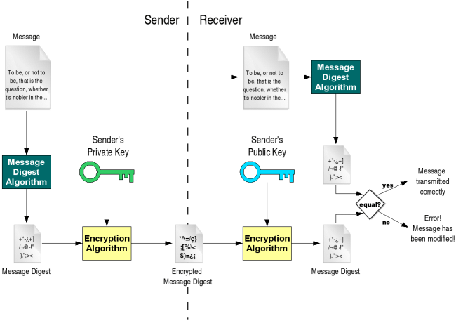

Slide 29
Data Security Standard (DSS)
PCI DSS (often referred to as just “PCI”) is an industry standard that ensures credit card information collected online is being transmitted and stored in a secure manner.
International Organization for Standardization (ISO)
Personal Data.
Personal data or personal information refers to any data that can be linked back to a specific individual — most simply, this includes names, email addresses, and phone numbers.
Transport Layer Security (TLS), Secure Sockets Layer (SSL), and HTTPS authentication
Multi-factor authentication (MFA), 2-factor authentication (2FA), or 2-step verification (2SV).

Slide 30
Malware and ransomware
Malware, or “malicious software,” is software that attackers install on your system. Ransomware is a type of malware that locks the victim out of their system, or prevents access to data, until a ransom is paid to the attacker. Here are a few symptoms you may experience if your system becomes infected:
Links take you to the wrong page destination.
New toolbars or buttons appear in your browser, or new icons show up on your desktop.
You experience a near-constant barrage of ad pop-ups.
Your system is slow or repeatedly crashes, or your browser freezes frequently and becomes unresponsive.
Your emails keep bouncing.

Slide 31
The Biggest Security Threats to Ecommerce Site
Phishing
Phishing is a type of social engineering, and refers to methods used by attackers to trick victims — typically via email, text, or phone — into providing private information like passwords, account numbers, social security numbers, and more.
BigCommerce Note: BigCommerce will never send you an email with a link to update your store or your login credentials. If you receive an email, phone call, or text from “BigCommerce” in which personal information is requested, contact customer support directly for validation.

Slide 32
The Biggest Security Threats to Ecommerce Site
SQL injection
Cross-site scripting (XSS)
XSS involves inserting a piece of malicious code (typically JavaScript) into a webpage. Unlike some other kinds of attacks, this one doesn’t impact the site itself, but it would impact the users of that page — i.e., your shoppers — exposing them to malware, phishing attempts, and more.
E-skimming.
E-skimming refers to a method of stealing credit card information and personal data from payment card processing pages on ecommerce sites. Attackers gain access to your site either via a successful phishing attempt, brute force attack, XSS, or third-party compromise, then capture in real time the payment information your shoppers enter into the checkout page.

Slide 33
Best Practices for Ecommerce Security
Implement strong, unique passwords — and help make sure your customers do, too
Protect your devices
Steel against social engineering attempts
Implement additional authentication factors
Only store the customer data that you need
Make sure your site is always up to date
Switch to HTTPS: Before you make that switch, you must purchase an SSL certification from your hosting company. Having an up-to-date SSL certificate and HTTPS protocol has become the standard
Back up your data
Regularly review all plugins and third-party integrations
Do a pre-holiday security check
Increase your fraud protection

Slide 34
Prepare your customer service team
Secure Your Servers and Admin Panels
Payment Gateway Security
Train Your Staff Better
The benefits of SaaS
Educate Your Clients

