Slide 1
Adobe Illustrator
VECTOR GRAPHICS CREATION WITH ADOBE Illustrator (Day 1)
By FIROZ MAHMUD

Slide 2
Objectives
Explore the Illustrator workspace
View and modify artboard elements
Work with objects and smart guides
Create basic shapes
Apply fill and stroke colors to objects
Select, move, and align objects
Transform objects
Line and pen tools
Saving your files

Slide 3
Explore the Illustrator Workspace
The arrangement of windows and panels that you see on your monitor is called the workspace.
Illustrator offers a number of predefined workspaces that are customized for different types of tasks.
The default workspace is called Essentials.
You can switch from one workspace to another by clicking Windows on the Application bar, pointing to Workspace, and then choosing a workspace.

Slide 4
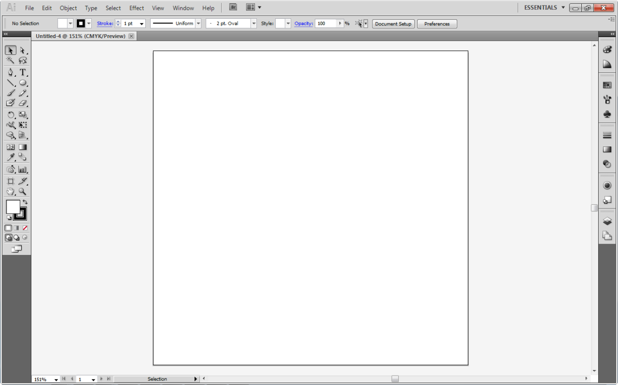
Explore the Illustrator Workspace
Essentials Workspace Application bar
Workspace switcher
Control panel
Tools panel
Panels dock
Artboard

Slide 5
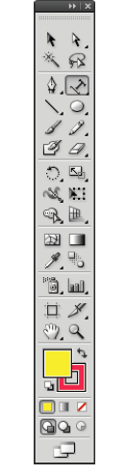
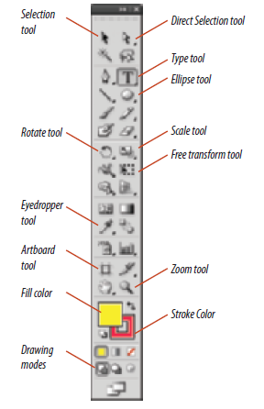
Explore the Illustrator Workspace
The Tools panel houses all the Illustrator tools.
Many tools are hidden behind others that have a small black triangle in the lower-right corner.

Slide 6
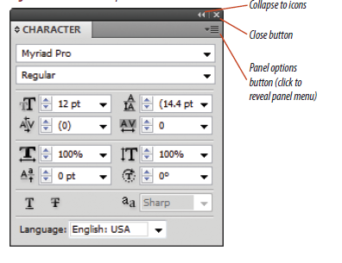
Explore the Illustrator Workspace
Panels are windows containing features for modifying and manipulating Illustrator objects.
Panels are arranged in groups on the right side of the workspace.
To access the panel menu for additional options, click the Panel options button.

Slide 7
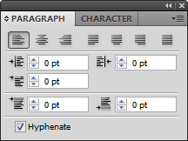
Explore the Illustrator Workspace
You can group panels together, as shown here, to better manage your workspace.

Slide 8
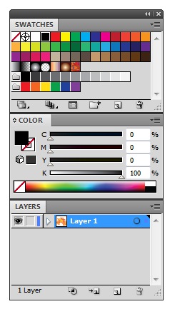
Explore the Illustrator Workspace
You can dock panels together, as shown here, so you can move them together.

Slide 9
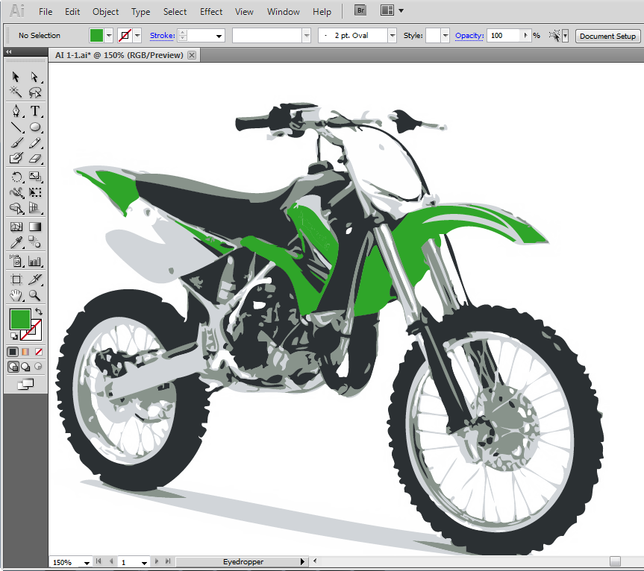
View and Modify Artboard Elements
The Zoom tool is found on the Tools panel and is used to adjust magnification.
Click the document window with the Zoom tool to enlarge it.
Press and hold [Alt](Win) or [option](Mac) while clicking the document to reduce it.
Magnification levels indicated here

Slide 10
View and Modify Artboard Elements
To switch temporarily to the Zoom tool while using other tools, press and hold [Ctrl][Spacebar](Win) or [Command] [Spacebar](Mac), then click to zoom in.
To zoom out, press and hold [Ctrl][Alt][Spacebar](Win) or [Command][option][Spacebar](Mac).
The Hand tool is found on the Tools panel.
Use the Hand tool to move a document around.
The keyboard shortcut for accessing the Hand tool is to simply press and hold [Spacebar].

Slide 11
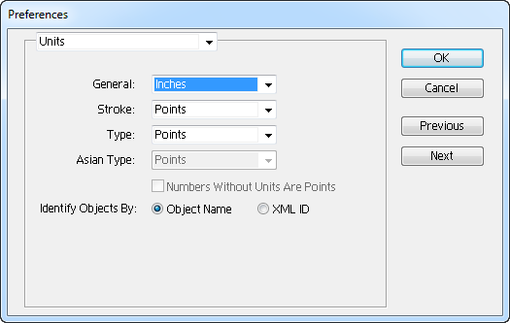
View and Modify Artboard Elements
Illustrator has several features to help with precise positioning and sizing.
Rulers are positioned at the top and left side of the pasteboard.
Set an option for hiding or showing rulers on the View menu.
You can determine the units with which you want to work in the Preferences dialog box.
Click Edit (Win) or Illustrator (Mac) on the Application bar, point to Preferences, then click Units to display the dialog box.
Change default unit settings in the Preferences dialog box.

Slide 12
View and Modify Artboard Elements
All objects you create have visible selection marks or selection edges.
When you select an object those edges automatically show.
You can option to hide them on the View menu.

Slide 13

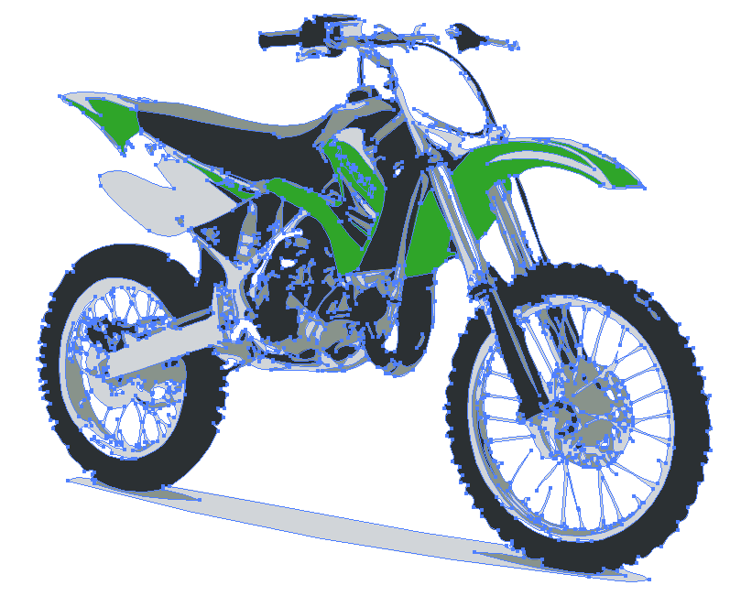
View and Modify Artboard Elements
Selection marks visible
Selection marks hidden

Slide 14
View and Modify Artboard Elements
Screen modes are options for viewing your documents.
The two basic screen modes are Normal and Outline.
In Normal mode, objects are displayed with fills, strokes, and effects.
In Outline mode, objects are displayed as hollow shapes, with no fills, strokes, or effects.
Working in Outline mode can be helpful for careful selection.

Slide 15
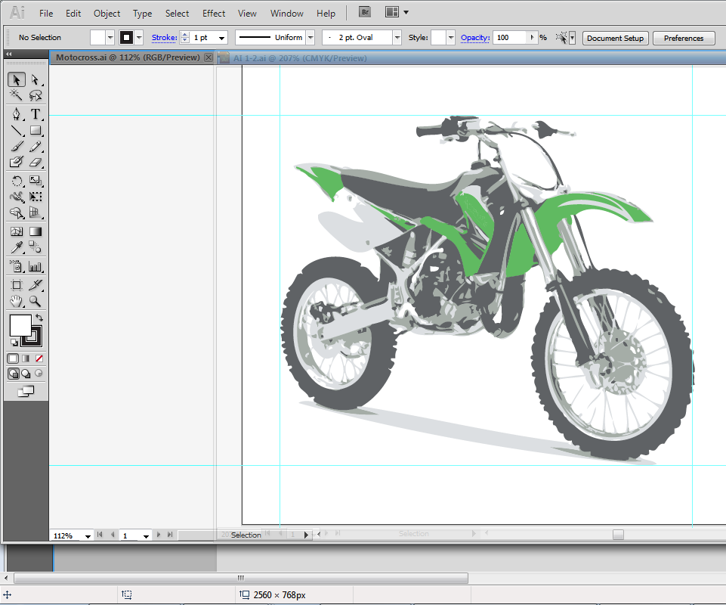
View and Modify Artboard Elements
You can work with multiple open documents.
You can set them as tabs in your workspace.

Slide 16
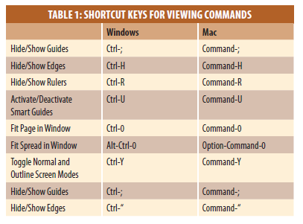
View and Modify Artboard Elements
Shortcut keys allow quick access to commands essential for performing basic and complex operations.
When available, shortcut keys are listed beside commands on the menu.

Slide 17
Work with Objects and Smart Guides
Objects in Illustrator are any individual pieces of artwork you create, such as:
Shapes
Lines
Text
You can use the bounding box of an object to resize it.
Select the Show Bounding Box option on the View menu.
Click and drag any of the eight handles that appear to change the object’s shape and size.

Slide 18
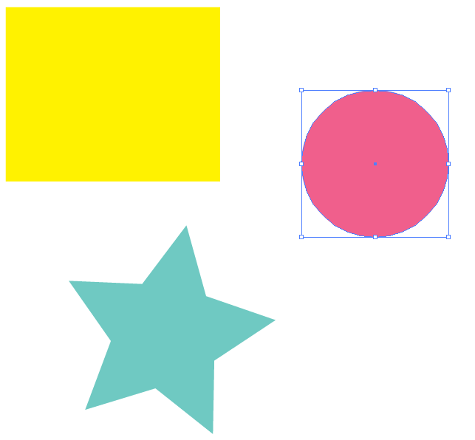
Work with Objects and Smart Guides
Selected circle with the bounding box showing.

Slide 19
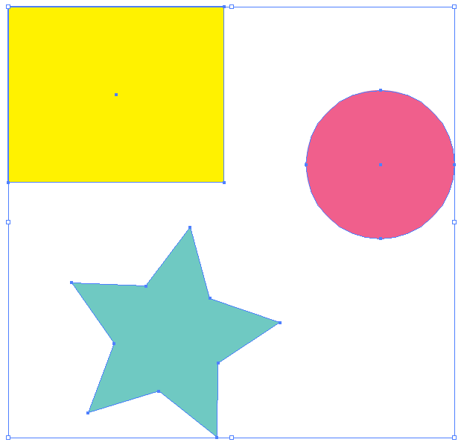
Work with Objects and Smart Guides
When you select multiple objects, a single bounding box appears around all of them.

Slide 20
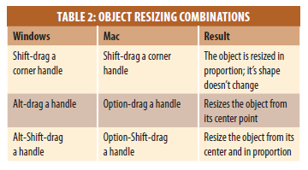
Work with Objects and Smart Guides
Keyboard shortcuts for resizing objects

Slide 21
Work with Objects and Smart Guides
You can copy and paste objects in Illustrator.
Objects are pasted at center of artboard by default.
The Edit menu offers three other paste options.
The Paste in Front command pastes the copy directly in front of the original.
The Paste in Back command pastes the copy directly behind the original.
The Paste in Place command also pastes a copy directly in front of the original.

Slide 22
Work with Objects and Smart Guides
Other useful Object menu commands include:
Hide
Lock
Group
Ungroup
Smart guides give you visual information for positioning objects precisely in relation to the artboard or other objects.
When activated, smart guides appear automatically when you move objects.

Slide 23

Work with Objects and Smart Guides
Smart guides aligning the top edges of two objects.

Slide 24
Create Basic Shapes
Basic geometric shapes are the foundation of Illustrator.
Bitmap Images are created using a square or rectangle grid of colored squares called pixels.
All digital images are composed of pixels.
The number of pixels in a given inch is referred to as image’s resolution.
Bitmap images are resolution-dependent.

Slide 25
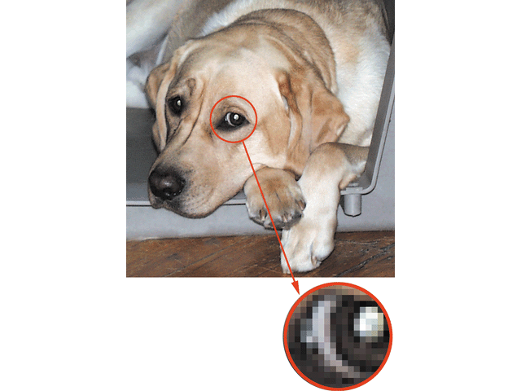
Create Basic Shapes
Enlarging bitmap images negatively impacts image quality.
Bitmap image
Pixels

Slide 26
Create Basic Shapes
Graphics created in Illustrator are vector graphics.
They are created with lines and curves.
They are defined by mathematical objects called vectors.
Vector graphics consist of anchor points and line segments, together referred to as paths.
They can be scaled to any size.
They are resolution-independent.

Slide 27
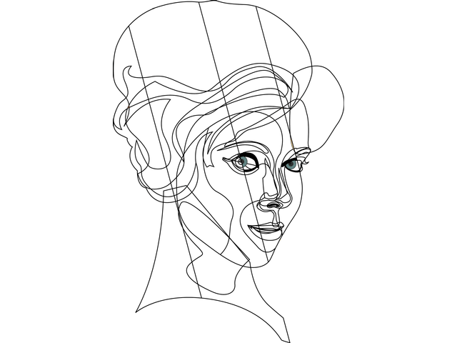
Create Basic Shapes
Vector graphic

Slide 28
Illustrator Concept: Paths
When you create artwork in Illustrator, you do so by drawing lines and shapes that combine to form a whole picture.
Each item you create is called an object.
For each object, there is an outline, called a path, made up of points and lines.
Each shape you create can have a fill (filling in the space inside the path) and a stroke (tracing the path).

Slide 29
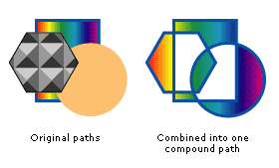
Illustrator Concept: Paths
At right are a few examples of that rectangle with different fills and strokes. Note that you may choose to use no stroke to fill with a pattern or a gradient, and even to use special brushes on the stroke.

Slide 30

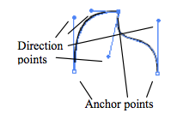
Points
If a line changes direction at a point, it may do so either as a corner point (as in the rectangle at left) or as a smooth point.
Smooth points and corner points are both used to create curved lines and shapes, and consist of an anchor point (the white boxes we have already seen), and one or more direction points (indicated by slightly smaller circles).
The shape of a curve is determined by the angle and distance of the direction points.

Slide 31
Shape Tools
The easiest thing to draw in Illustrator is an enclosed shape, such as a rectangle, ellipse, or polygon. Click the Shape tool (usually set to Rectangle ) to begin drawing, or select another shape: Rounded Rectangle, Ellipse, Polygon, or Star .
To draw the shape, just click and drag on your workspace. Thin lines will appear indicating the outline of your shape, and the shape will be completed when you release the mouse button.
Note: holding down the Shift key as you draw a Rectangle or Ellipse will restrict you to a perfect square or circle!

Slide 32
Pencil Tools
Use the Pencil tool to create free-flowing lines and shapes. As you draw, a thin lines will appear indicating the outline of your shape, and the shape will be completed when you release the mouse button.
Re-tracing an existing shape with the Pencil tool to redraw sections of the line, or the whole thing.
Alternatively, you can use the Smooth tool to automatically smooth zig and zags out of your lines.
The Smooth tool is located under the Pencil tool in your toolbox. Click-and-hold on the Pencil tool to see the icon for the Smooth tool.

Slide 33
Selection Tools
Once you have created an object, the Selection tool lets you select the entire object for further manipulation.
The Direct-Selection tool lets you select parts of an object, individual anchor points, direction points, and segments.
Use the Direct-Selection tool to “morph” shapes, or to adjust direction points.

Slide 34

Exercise
Drawing with Shapes, Pencil, Pen and Selection Tools
Draw a basic square, then see how many of these shapes you can replicate, using only the Pencil and Direct-Selection tools.

Slide 35
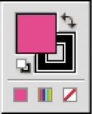
Apply Fill and Stroke Colors to Objects
Click the Fill or Stroke button on the Tools panel to switch between them.
Swap Fill and Stroke button
Fill button
Stroke button
Default Fill and Stroke button

Slide 36
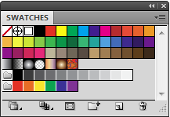
Apply Fill and Stroke Colors to Objects
The Swatches panel is central to color management.
It is the simplest resource for applying fills and strokes to objects.
When an object is selected, click a swatch in the panel to apply a color as the fill or stroke, depending on which is activated.
Dragging a swatch to an unselected object will change the color of its fill or stroke, depending on which is activated.
Pre-set colors, gradients, patterns,
and shades of gray.

Slide 37
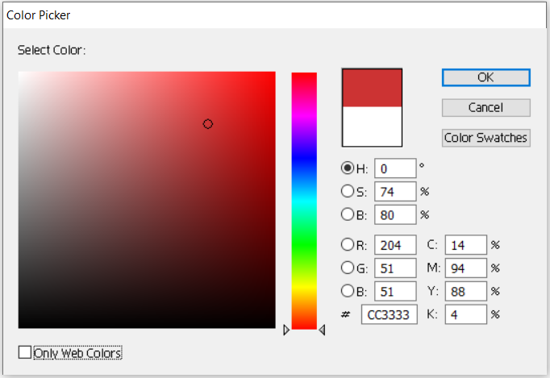
Making New Color Choices
The colors in the default Swatches Palette are fairly limited, but you can select new colors. Double-click on a color in the Stroke/Fill area to access the Color Picker.
Adjust the slider in the “rainbow” bar to choose the hue you want, then pick the desired shade from the large box. You can enter numerical color values (from a web page, or other digital image) in the text boxes.
You can add your new color to your swatches, for easy re-use. Simply click the New Swatch icon in the Swatches palette. To remove a color from your Swatches, click on that swatch, then click the Trash icon.

Slide 38
Color Gradients
A gradient mixes two or more colors together in the fill area of an object. If only solid color swatches are visible, click the Gradient Swatches button to view gradients.
To apply a gradient, select the object, and click on the swatch for the gradient you want to use. Once a gradient has been applied, use the Gradient Tool and Gradient Palette (located under the Stroke Palette) to modify the gradient – changing it from linear to radial, and changing the direction and length of the transitions from one color to another.
If you particularly like a modification you have made to a gradient, click on the gradient box in the Gradient Palette, and drag it to the Swatches Palette. A new swatch will be created for your gradient.

Slide 39
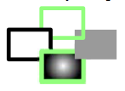

Exercise
Create a new color. Add it to your Swatches Palette
Draw a shape. Copy and paste it several times. Try to replicate the following versions of the object:
a. regular stroke and fill b. new color stroke, no fill c. colored fill, no stroke d. gradient fill, new color stroke
Draw a new shape. Fill it with a simple two-color gradient. Use the Gradient Tool and Gradient Palette to replicate these variations:

Slide 40
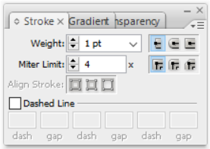
Strokes
In addition to the color of a line, you can also change several other properties. The Stroke Palette lets you change a number of things about your Stroke:
Weight: how thick your line appears
Cap: how the ends of your line appear
Join: how your line joins at corners
Miter Limit: how far the joined lines project at corners
Dashed Line: check this box to create a dashed line. In the boxes below, specify how long each dash should be, and how long the gaps between dashes should be.

Slide 41
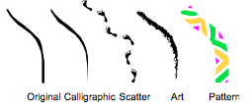
Brushes
Brushes can be applied to the stroke of any object, to significantly change the appearance of the line. There are four basic types of brushes.
Calligraphic: makes your lines resemble those drawn with a calligraphy pen
Scatter: scatters copies of an object along your line
Art: stretches a single copy of an object along your line
Pattern: applies a repeating pattern to your line
You can create new brushes yourself, when you become more familiar with Illustrator.

Slide 42
Transforming Objects
You’ve already seen how the Direct-Selection Tool can be used to move individual points of an object. There are also several built-in options for transforming objects.
The two easiest options are the Transform menu and the Transform Tools.
To use the basic Transform Tools, select an object, then the tool.
To apply transformations to an object using the menus, select the object, then go to Object > Transform on the menu. The advantage of the menus is that numeric values can be specified – Scale 150%, Rotate 32°, etc.

Slide 43
Transforming Objects
Rotate – dragging with the Rotate Tool rotates the object around a point; by default, the center point. You can move the point of rotation, by clicking before you begin dragging. Hold down the shift key to rotate in 15-degree increments.
Reflect – click once, then again in a different location to indicate a line over which to reflect the object.
Scale – drag to resize the object. Hold down the shift key to maintain original proportions.
Shear – drag to skew the object. Hold down the shift key to stick to 15-degree increments.
Free Transform – can scale, skew, or rotate the object, depending on where you click.

Slide 44
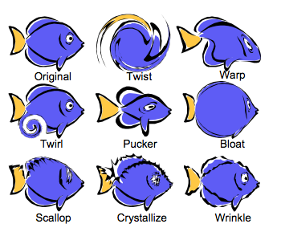
Liquify Tool
A number of tools are available to “liquify” your objects. When using these tools, objects become malleable, like wet paint.
Experiment with these tools to find out what they do. All are located under the Warp Tool, except the Twist Tool (which is under the Rotate Tool.)
Take special notice of the Warp Tool, which lets you re-shape an object freehand, as if it were an image on a piece of silly putty!

Slide 45
Select, Move, and Align Objects
To move or modify an object, select it with a selection tool, menu item, or command key.
Two basic ways to move objects:
Click and drag
Use arrow keys
Pressing [Alt](Win) or [option](Mac) when dragging creates a copy of an object.
Grouping objects allows them to be selected with one click of Selection tool
To group:
Select objects
Click Object on Application bar
Click Group

Slide 46
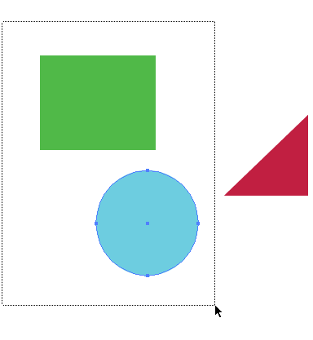
Select, Move, and Align Objects
A marquee selection is a dotted rectangle created when you drag the Selection tool around an object or objects.
Any object a marquee touches before the mouse button is released will be selected.
Marquee selection around two objects

Slide 47
Line and Pen Tools
The Line Segment Tool and Arc Tool are useful for adding details to your image.
The Line Segment Tool draws straight lines – hold down the shift key while dragging to restrict the line to 15-degree angles of rotation.
The Arc Tool draws curved lines – a quarter of an ellipse.
Far more useful, but also more difficult to use, is the Pen Tool.
Click multiple times in your document with the Pen Tool to create a freehand polygon shape. Each new click defines a new anchor point in the polygon.
As you near the point where you began the shape, the cursor will change, indicating it is ready to complete the shape by adding a small closed circle at lower right.
When you see this “close” cursor, you can click once to close the shape

Slide 48

Line and Pen Tools
When you click to add a new anchor point with the Pen Tool, you may choose to click and drag instead of clicking once. This turns a sharp corner into a smoothly curved one.
The Pen Tool is very useful for creating freehand smooth curves.
You can combine single-click anchor points (sharp corners) with click-and-drag anchor points (smooth corners) to create complex shapes that are more precise than freehand Pencil drawing.

Slide 49
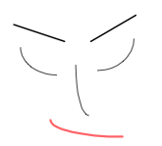
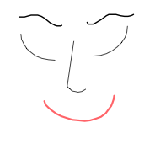
Exercise
1. Use the Line and Arc tools to draw a simple face, as below. Remember, you can change stroke weights and colors.
2. Remove some of the arcs from the face drawing, and replace them with more complex curves using the Pen tool.

Slide 50
Saving Your Files
As with all programs, remember to save frequently as you work. The standard file format for Illustrator is the Adobe Illustrator (.ai) file. Work saved as an .ai file can be re-opened in Illustrator with full editing capabilities. All objects, layers, styles, color and gradient swatches, etc. are saved for an .ai file.
When you are done with your artwork, you may choose to save it in other formats as well.

Slide 51
Saving Your Files
Use File > Save As to create these types of files: Adobe PDF – great for sharing documents online Illustrator EPS – a useful format for sharing with professional printers
Use File > Export to create these types of files: WMF – the format of Office Clipart. Preserves vector formatting, can be re-sized smoothly JPEG, Photoshop, TIFF – converts document to bitmap graphic (of varying quality)
Use File > Save for Web to create these types of files: GIF – a very good web format for most Illustrator files JPEG – another web format, you may want to use if you make extensive use of gradients.

Slide 52
Any Question?
Thank You

