Slide 1
Adobe Illustrator
VECTOR GRAPHICS CREATION WITH ADOBE Illustrator (Day 2)
By FIROZ MAHMUD

Slide 2
Objectives
Complex objects
Make direct selections
Opacity of objects and layers
Text in Illustrator
Create a Logo
Saving your files

Slide 3
Complex Objects
Sometimes you want to draw an object that cannot be created with one single action. Conveniently enough, Illustrator lets you group and join objects into more complex objects.
Grouping is the simplest way to make two or more objects behave as one. Simply select one object, then hold down the Shift key as you click on one (or several) more object(s), until you have selected everything you want in the group. Then go to the Object menu, and select Group. All lines and fills are preserved in a Group, and individual component objects can be selected with the Direct-Selection tool.

Slide 4
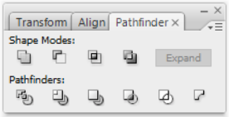
Complex Objects
For more complex effects, you may wish to use the Pathfinder. This Palette generally is not shown by default, so go to the Window menu to turn it on.
The most useful thing you can do with the Pathfinder is to add shapes together, or subtract one shape from another.
To add shapes, select two shapes, and click on the Add to shape area button. You will see the two shapes become one.
To subtract one shape from another, select both (making sure that the shape you want to take away is on top!) and click on the Subtract from shape area button.
When using these Pathfinder buttons, the original two shapes are still preserved, and can be selected with the Direct-Selection tool.
To make your Pathfinder changes permanent, select the changed objects, and click the Expand button.

Slide 5
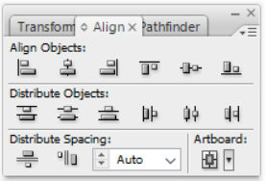
Complex Objects
In the same window as the Pathfinder, you’ll find the Align palette. You can use buttons in this palette to align multiple objects to the leftmost, rightmost, topmost, or bottom-most point in the group; or to align objects to their common vertical or horizontal center. There are also buttons to distribute objects evenly across an area, through their left, right, top, bottom, and vertical and horizontal center points.

Slide 6




Exercise
Create an eye made up of multiple ellipses grouped together. You can use Align to easily line up the centers of the objects.
Combine a star and five circles to make a stunning old-style Sheriff’s badge!
Subtract one circle from another to create a crescent moon.
Align a rectangle and a rounded rectangle to create a “computer monitor”. Group the two objects, then copy the group and paste three new copies into your document. Align these grouped objects, and distribute them evenly along the line.

Slide 7
Make Direct Selections
Use the Direct Selection tool to select individual anchor points or single paths of an object.
Drag a marquee or press and hold [Shift] while using the Direct Selection tool to select multiple anchor points or multiple paths.
Clicking the center of an object with the Direct Selection tool selects the entire object.
Click the edge to select the path only.

Slide 8
Make Direct Selections
The Add Anchor Points command creates new anchor points without distorting the object.
To add anchor points:
Click Object on the Application bar
Point to Path
Click Add Anchor Points

Slide 9
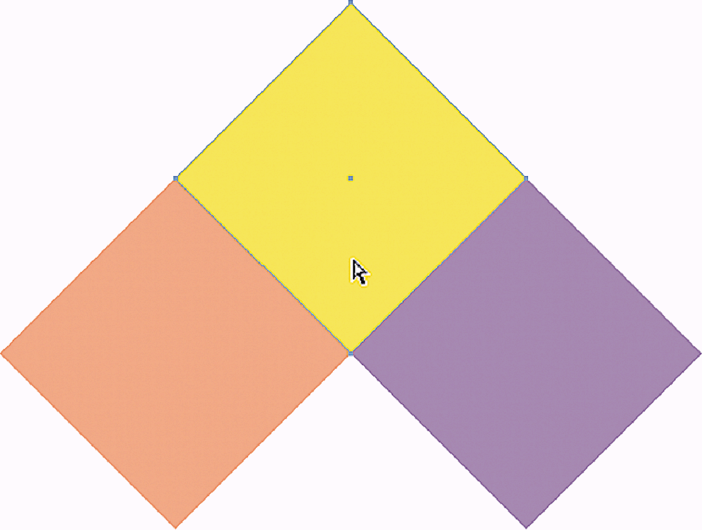
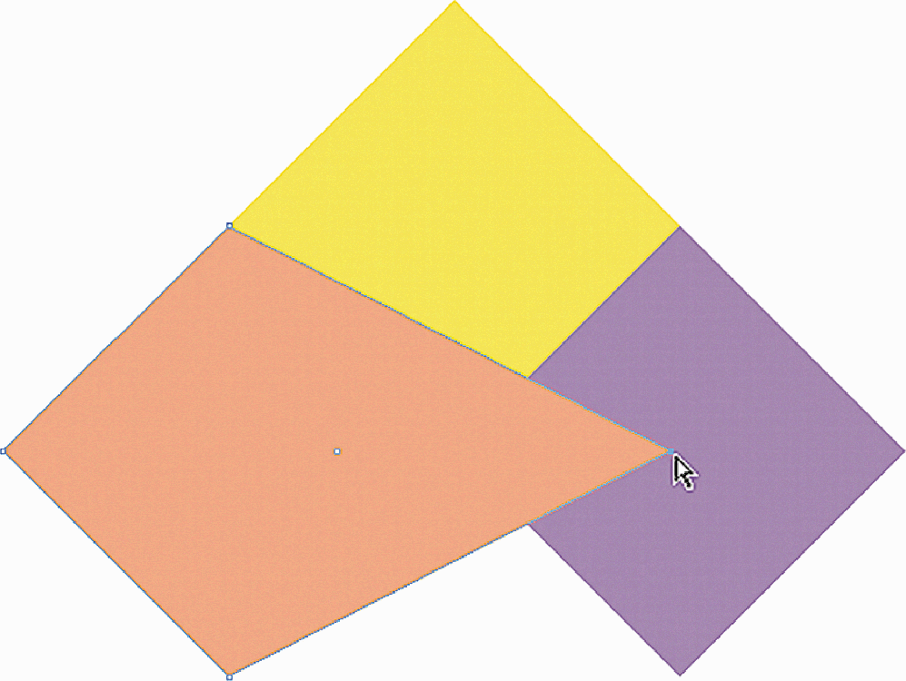
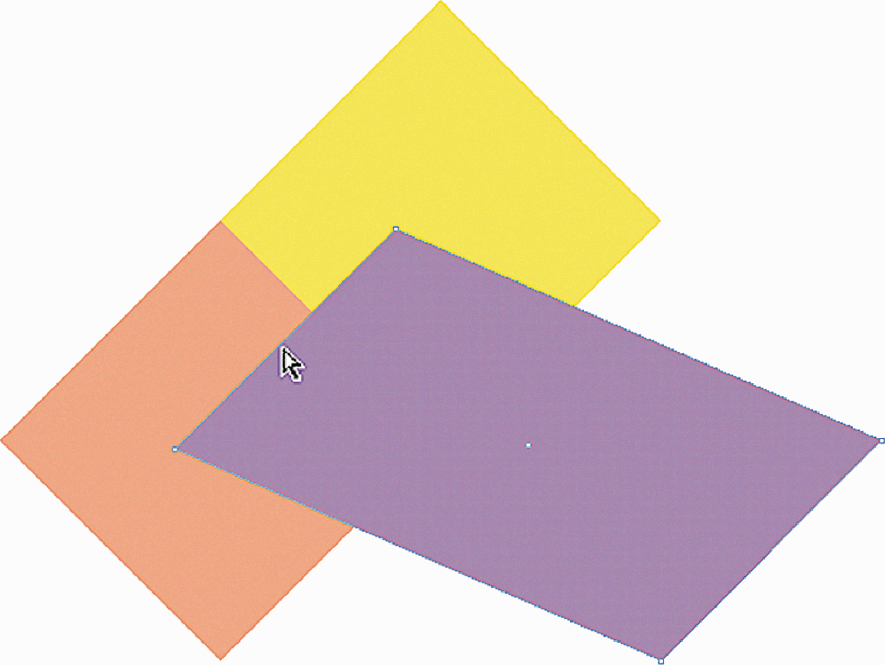
Make Direct Selections
Direct Selection tool selects single objects within groups
Direct Selection tool selects anchor points and paths

Slide 10
Make Direct Selections
Any object you create can be turned into a guide.
Select object
Click View on the Application bar
Point to Guides
Click Make Guides

Slide 11
Make Direct Selections
When an object becomes a guide, it loses its attributes, such as fill, stroke, and stroke weight.
Illustrator remembers its original attributes.
To transform a guide back into an object, click View on the Application bar, point to Guides, then click Release Guides.
The Draw Behind Drawing Mode and the Stacking Order refer to the order of how objects are arranged in front of and behind other objects on the artboard.
This is not the same concept as layers in a document.

Slide 12
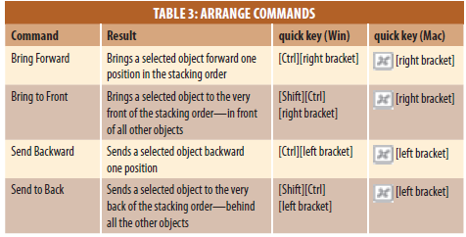
Make Direct Selections
You can manipulate the stacking order of objects with the Arrange commands on the Object menu or these shortcut keys.

Slide 13
Opacity of Objects and Layers
Each Layer can vary 100% opaque (solid), to 0% opaque (completely see-through; thus, invisible) with any amount of transparency in between. Individual objects within a layer may also be more or less opaque. Objects that are not 100% opaque will add together in opacity – thus, if you have two black objects that are each at 50% opacity, the area where they overlap will be 100% black.

Slide 14
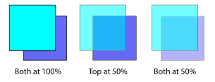
Opacity of Objects and Layers
To change opacity of a layer, click on the small circle to the right of the layer name in the Layers Palette. Then change the Opacity setting in the Transparency Palette.
To change opacity for a single object, simply select the object and adjust its Opacity in the Transparency Palette.

Slide 15
Text in Illustrator
To insert a short piece of text in Illustrator, simply select the Type Tool, click where you want the text to appear, and start typing. The text will be entered as a separate object.
To enter vertical text, choose the Vertical Type Tool, then click and type.
To change text attributes, access the Type Palette or use the Type menu. With the Type Tool selected, highlight the text you want to change, then make changes in the palette or on the menu.

Slide 16
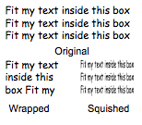
Text in Illustrator
For longer pieces of text, you should begin by defining a text box. Select the Type Tool, then click and drag on the Workspace to define the box. If you start by defining a text box, your text will wrap to the width of the box. You can then re-size the box, and the text will wrap to the new box size.

Slide 17
Text in Illustrator
If you do not start by defining your own text box, Illustrator creates one for you, but with more permanent boundaries. Illustrator-defined textboxes, when resized, will actually resize the individual letters, and will not re-wrap the text.
Text boxes of either type can be freely re-sized, just by using the Selection Tool.
Note: fonts used in an Illustrator document can only be displayed correctly when the viewer has those fonts installed on their computer. If working on more than one computer, you may have to carry font files on a disk with your Illustrator file.

Slide 18

Color in Text
By default, text that you enter in Illustrator has only a fill color assigned. Select a text box with the Selection Tool, and you can change that fill color, and can add a stroke color to outline your text. Try stroking text with a dashed line!

Slide 19
Placing Text From a Word Processor
Illustrator is not great as a word-processing tool. For longer pieces of text, do your editing in a word processing program such as Word, and then bring the text into Illustrator.
For medium-length text, you can just copy from Word and paste into a text box in Illustrator. Longer documents can be “placed” into Illustrator in their entirety – go to File > Place, and select your text file to place it on the page.

Slide 20
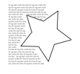
Wrapping Around an Object
You can wrap text around any object. Make sure that the object you want to wrap around is above the text you want to wrap (you may need to select the object and bring it to the front).
Then select both the text and the object, and go to the menu and choose Type > Wrap > Make.

Slide 21
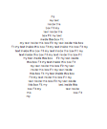
Fitting Text Inside an Object
To fit text inside an object, you must use the Area Type Tool. First, draw the object. Then select the Area Type Tool, and click on the object’s path (note: the path is the line around most objects, so clicking in the center of the object doesn’t work – click right on the edge of the object.) A type cursor will appear inside your path. Start typing, or paste type from another source.

Slide 22
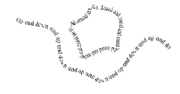
Path Type
Use the Path Type Tool to type along any path you have drawn. You can type along a curved line you’ve drawn with the pencil, or along the outline of a shape you created.
First, draw the object you want to type along. Then select the Path Type Tool, and click on the path. Then start typing, or paste text from another source.

Slide 23

Create a Logo

Slide 24
Saving Your Files
Use File > Save As to create these types of files: Adobe PDF – great for sharing documents online Illustrator EPS – a useful format for sharing with professional printers
Use File > Export to create these types of files: WMF – the format of Office Clipart. Preserves vector formatting, can be re-sized smoothly JPEG, Photoshop, TIFF – converts document to bitmap graphic (of varying quality)
Use File > Save for Web to create these types of files: GIF – a very good web format for most Illustrator files JPEG – another web format, you may want to use if you make extensive use of gradients.

Slide 25
Any Question?
Thank You

