Slide 1
Cryptography
Cryptography
The field of study related to encoded information (comes from Greek word for "secret writing")
Encryption
The process of converting plaintext into ciphertext
Decryption
The process of converting ciphertext into plaintext

Slide 2
Cryptography
Encryption
plaintext
message
ciphertext
message
Decryption
Encrypted(Information) cannot be read
Decrypted(Encrypted(Information)) can be

Slide 3
Cryptography
Cipher
An algorithm used to encrypt and decrypt text
Key
The set of parameters that guide a cipher
Neither is any good without the other

Slide 4
Substitution Ciphers
A cipher that substitutes one character with another.
These can be as simple as swapping a list, or can be based on more complex rules.
These are NOT secure anymore, but they used to be quite common. What has changed?

Slide 5
Caesar ciphers
A B C D E F G H I J K L M N O P Q R S T U V W X Y Z
D E F G H I J K L M N O P Q R S T U V W X Y Z A B C
Substitute the letters in the second row for the letters in the top row to encrypt a message
Encrypt(COMPUTER) gives FRPSXWHU
Substitute the letters in the first row for the letters in the second row to decrypt a message
Decrypt(Encrypt(COMPUTER))
= Decrypt(FRPSXWHU) = COMPUTER

Slide 6
Transposition Cipher
T O D A Y
+ I S + M
O N D A Y
Write the letters in a row of five, using '+' as a blank. Encrypt by starting spiraling inward from the top left moving counter clockwise
Encrypt(TODAY IS MONDAY) gives T+ONDAYMYADOIS+
Decrypt by recreating the grid and reading the letters across the row
The key are the dimension of the grid and the route used to encrypt the data

Slide 7
Cryptanalysis
Cryptanalysis
The process of decrypting a message without knowing the cipher or the key used to encrypt it
Substitution and transposition ciphers are easy for modern computers to break
To protect information more sophisticated schemes are needed

Slide 8
Encryption on computers
Roughly speaking, there are two different broad types of encryption that are used on computers today
  Symmetric encryption relies on keeping keys totally secret
  Asymmetric encryption actually publicizes one key, but keeps some information private also
Neither is really “better” - they just use different principles.
In reality, both are vulnerable to attacks.

Slide 9
Symmetric, or private key cryptography
Most common type is called a block cipher
  Processes the plaintext in fixed sizes blocks
Examples include DES, 3DES, and AES
All require a secret key which is known by both parties in the communication
Main issue here: need to securely swap the key. How can we do this?

Slide 10
DES: Data Encryption Standard
Adopted in 1977 by National Bureau of Standards (now NIST)
Divides message into blocks of 64 bits, and uses a key of 56 bits
Key idea for this: XOR the data with the key
  (Remember XOR? How did it work?)

Slide 11
DES
In July 1998, DES was officially cracked by a machine built by the EFF
  Total cost: under $250,000
  Total time: 6-8 months
They then published the details of their approach, which essentially was a brute force attack
Note: 56 bits means 2⁵⁶ keys to try
Also, not as easy as just trying. What do you always do to files before sending them somewhere?

Slide 12
3DES
Effort to salvage DES
Main algorithm: repeat DES 3 times with different keys (so key size is now 168 bits)
Still very secure - brute force attacks would take too long, and that is the only way to attack this algorithm
Main problem: SLOW

Slide 13
Advanced Encryption Standard (AES)
Designed in response to a call by NIST in 1998, and officially adopted in 2001
Block length is 128 bits, and keys can be 128, 192, or 256 bits.
Essentially, proceeds in 4 rounds (which are repeated):
  Substitute bytes
  Permute
  Mix columns
  Add round key

Slide 14
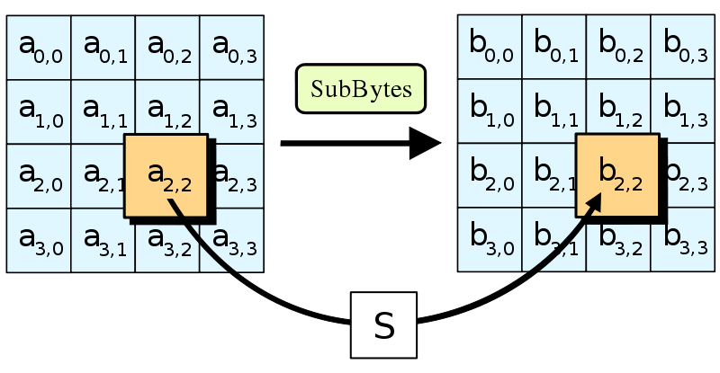
Stage 1: substitute bytes
AES computes a matrix which maps every 8-bit value to a different 8-bit value
Computed using properties of finite fields (go take some math classes to learn more about this)

Slide 15
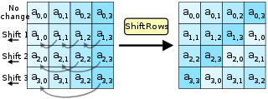
Stage 2: permute
AES then shifts each row, where each row is shifted a different amount

Slide 16
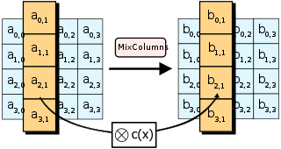
Stage 3: Mix columns
Here, the 4 bytes in each column are combined using a linear transformation
Essentially, the output of any byte depends on all the input bytes, so this “mixes” them together

Slide 17
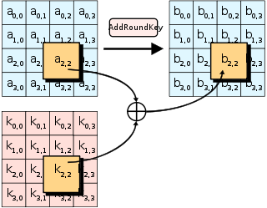
Stage 4: Add round key
Use XOR to combine the key with the message

Slide 18
Public Key Cryptography
First revolution in cryptography in hundreds of years
Originally introduced in a paper in 1976: “New directions in cryptography”, by Diffie and Hellman
Initially, based on the goal of computing a common secret key (so combines well with AES or other symmetric algorithms)

Slide 19
Public/Private Keys
What is it?
An approach in which each user has two related keys, one public and one private
One's public key is distributed freely
A person encrypts an outgoing message, using the receiver's public key.
Only the receiver's private key can decrypt the message

Slide 20
Basic operations
Logarithms: defined as the the exponent to which a fixed number, the base, must be raised to in order to produce that number
Examples:
  Log₃ 9 = 2, since 3² = 9
  Log₁₀1000 = 3, since 10³ = 1000
  Log₂64 = 6, since 2⁶ = 64

Slide 21
Basic operations (cont)
Modulo operation: just taking remainders
a mod b = remainder when a is divided by b
Examples:
  1 mod 3 = 1
  15 mod 10 = 5
  256 mod 2 = 0

Slide 22
Public and private keys
First, choose X, a secret key
Then choose Q = a prime number, and A = some other number
Set Y = A^{X} mod Q
Note that X = log_{A} Y mod Q

Slide 23
Public and private keys
Now publish Y, A, and Q, but keep X secret
Anyone knows that X = log_{A} Y mod Q, but this is difficult to compute!
This is called the discrete logarithm problem - very similar to factoring in terms of difficulty, so no polynomial time algorithm is known.
Essentially, computing Y given X is easy, but computing X given Y is much harder.
(Go take number theory.)

Slide 24
How to encrypt
So I know X, Y, A, and Q (but you don’t know X).
You get your own X’, and the tell me Y’=A^{X’} mod Q
We can now compute our own secret key (and use it for AES or some other algorithm)
  I will compute (Y’)^{X} mod Q = (A^{X’})^{X} mod Q
  You compute (Y)^{X’} mod Q = (A^{X})^{X’} mod Q
These are equal! But an eavesdropper can’t compute them, since they don’t have X or X’

Slide 25
Attacks
One downside: this is less secure than pure symmetric encryption
There are ways to attack this that do better than brute force
Number theory and group theory allow theoretical attacks that are provably better than exponential, but worse than polynomial time
So it is NOT known if this problem is really hard! Someone could develop a polynomial time attack. It just hasn’t been done yet.

Slide 26
RSA
In 1977, Rivest, Shamir, and Adleman came up with another way to use public key cryptography
Rather than secure key exchanges, this one actually lets you encrypt whole messages
Today, this is the most commonly used public key cryptosystem on the market

Slide 27
How RSA works
Choose 2 prime numbers, p and q
Set n=pq
Compute φ(n) = the number of numbers less than n which are relatively prime to n
  (That means numbers which have no common divisors.)
Here, φ(n) = φ(p) φ(q)
  What is φ(p)? φ(q)?

Slide 28
RSA (cont.)
So φ(n) = (p-1)(q-1), which we can compute.
Note that this is hard to find if you don’t know p and q, but it’s easy if you do.
Now pick a value e, where e is relatively prime to φ(n) . This is your public key.
Compute another value d, where we must have de = 1 mod φ(n). This is your private key.
  Example: Suppose e = 2, n = 11. Then d = 6, since we know (6)(2) mod 11= 12 mod 11 = 1

Slide 29
Encrypting with RSA
Now I have a message m, as well as e and n.
I compute c = m^{e} mod n, and send it to you.
You have d, so you can compute the value c^{d} mod n = (m^{e})^{d} mod n = m¹ mod n.
But without d, this is not easy! Equivalent to factoring in difficulty.

Slide 30
Public/Private Keys:
Other uses
Digital signature
Data that is appended to a message, made from the message itself and the sender's private key, to ensure the authenticity of the message
Digital certificate
A representation of a sender's authenticated public key used to minimize malicious forgeries

