Slide 1
Presentation on Network Accessories and its Function with relevant Picture
Group Members:
Md Jahirul Islam (1101)
Abul Kalam Mohammad Shamsuddin (1102)
Motiur Rahman Sheikh (1103)
Mizanur Rahman (1104)
Osman Gani (1105)

Slide 2
Computer Network Accessories
Computer Network: A group of two or more interconnected systems establishing a network connection using either cable or wireless media. Every nrtwork involves hardware and software.
Network Accessories: Some of the essential accessories used in computer networking. Available, cables still have a major relevance in the world of networking. Advanced users prefer an additional network card with advanced features

Slide 3
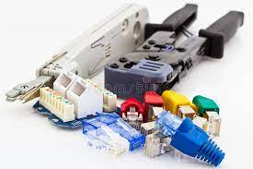
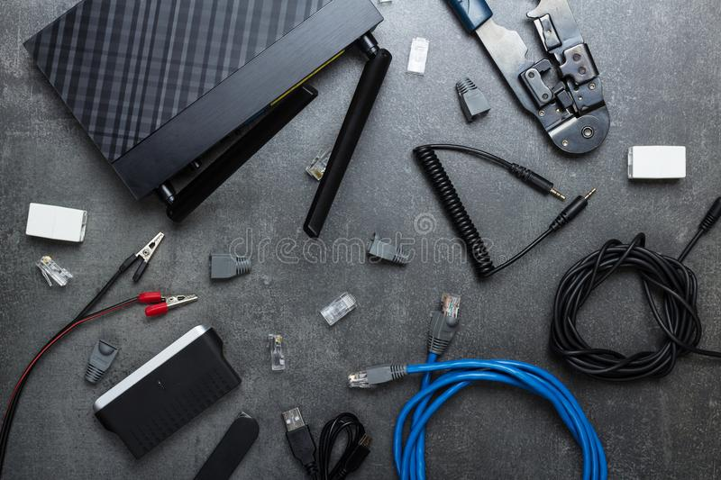
Network Accessories Outline
1. NIC 2. RJ45 Connector
3. Modem 4. Hub
5. Switch 6. Bridge
7. Router 8. Repeater
9. Optical Fiber
966 Networking Accessories 966 Networking Accessories

Slide 4
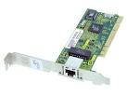
Network Interface Card
The network interface card (NIC) provides the physical connection between the network and the computer workstation.
It converts the data packets between two different data transmission technologies.
NIC is two types:
Media Specific: LAN card are used according to the media type;
Different types of the NICs are used to connect the different types of media.
Network Design Specific: - A specific network design needs a specific LAN card. For example FDDI, Token Ring and Ethernet.
It cannot use other types of NIC cards

Slide 5
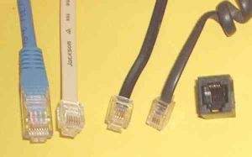
RJ45 CONNECTOR
The RJ 45 connector provides the physical connection between the Switch and the computer workstation (LAN Card).

Slide 6
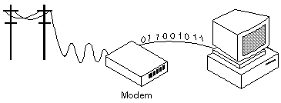
Modem
Modem (from modulator-demodulator) is a device that modulates an analog carrier signal to encode digital information, and also demodulates such a carrier signal to decode the transmitted information.
A Modem is the device that is used to connect with the Internet.
It is the device that enables the digital data to be transmitted over the telecommunication lines.
A Telco company uses entirely different data transmission technology from the technology that a PC uses for the data transmission.
It enables communication between the PC (Known as the DTE device) and the Telecom company' office (Known as the DCE device).
Gateway device is common type of Modem that shows the path of the remote destination address, like Email gateway, GSNW gateway and PAD gateway.

Slide 7
Hub
A hub or concentrator is a device for connecting multiple twisted pair or fiber optic Ethernet devices together, making them act as a single segment.
It is a centralized device that connects multiple devices in a single LAN network.
When Hub receives the data signals from a connected device on any of its port, it forwards to all other connected devices from the remaining ports;
It has one or more uplink ports that are used to connect it with another Hub.
Active Hub & Passive hub are of two types.

Slide 8
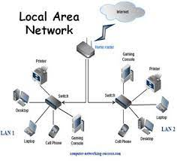
Switch
A network switch is a computer networking device that connects network segments.
It is the upgraded version of the Bridge. Besides providing all the functionalities of Bridge;
It also used to connect the multiple devices together in a LAN segment like Hub and Bridge;
It makes switching decisions in hardware by using Application Specific Integrated Circuits (ASICs).

Slide 9
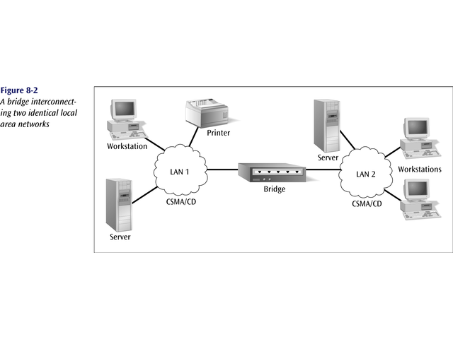
Bridge
It is used to divide a large network into smaller segments;
It connects different media types. Such as connects UTP with the fiber optic but cannot connect two different types of network layer protocol such as TCP/IP or IPX;
It connects different network architectures. Such as connects Ethernet with the Token ring; and
Bridge requires the same network layer protocol in all segments.
Local bridge, Remote bridge and Wireless bridge are of 3 types.

Slide 10
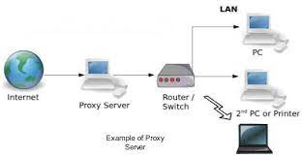
Router
The router connects the different network segments.
It switches the data packets between those networks which are either located in the different logical segments or built with the different network layer protocols.
When a router receives a data packet of any interface, it checks the destination address of that data packet and it forwards that data packet from the interface which is connected with the destination address.
To forward a data packet to its destination, router keeps the records of connected networks to maintain in a database table known as the routing table. Routing table can be built statically or dynamically.

Slide 11
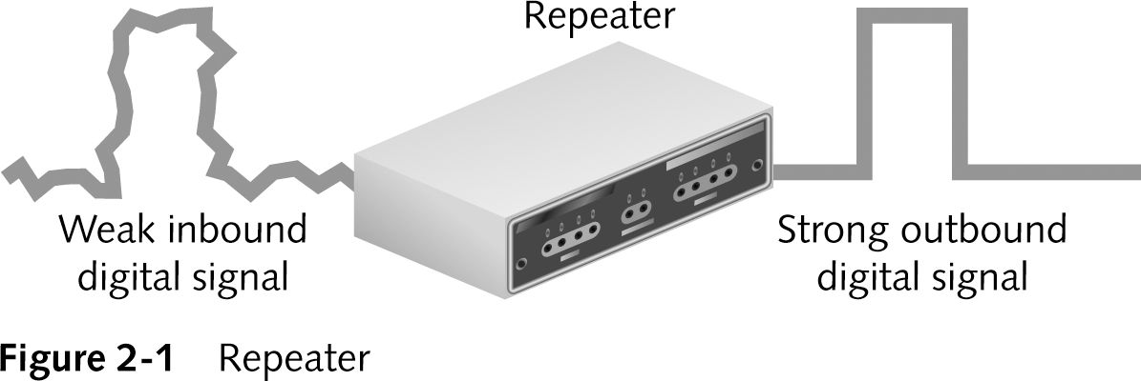
Repeater
Repeater repeats signals,
-clean and boost digital transmission
- Analog networks use amplifiers to boost signal.
Repeaters only work with the physical signal
-Cannot reformat, resize, or manipulate the data.
Repeaters are physical layer (layer 1) device.

Slide 12
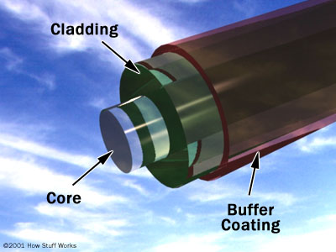
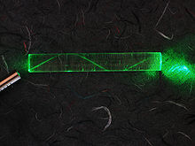
Optical fiber
Optical fiber is the technology associated with data transmission using light pulses travelling along with a long fiber which is usually made of plastic or glass. Metal wires are preferred for transmission in optical fiber communication as signals travel with fewer damages.

Slide 13
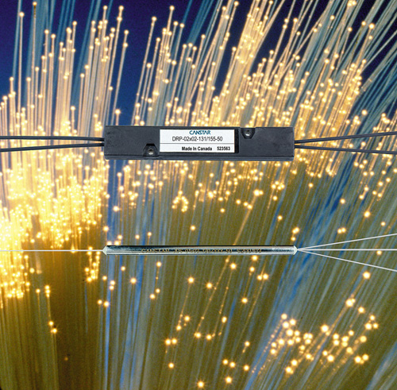
Optical cable line

Slide 14


