Slide 1
Nasdanika HTML
Fluent Java API for building Web UI

Slide 2
Overview
Fluent Java API for building:
Low level – HTML elements
Mid level:
Bootstrap 4.x UI elements and 21 Bootswatch themes
ECharts 4.2.1 factory and option builders
Font Awesome 5.x icons
jsTree 3.3.8 nodes and context menus
KnockoutJS 3.4.x
High level – HTML Applications
Using abstractions of actions and property sources
From EMF models data and meta-data
Generation of documentation for Ecore models
Dual delivery:
OSGi bundles – p2 repository
Jars - Maven repository (excluding EMF)

Slide 3
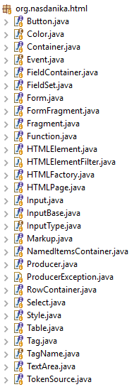

HTML
API for building HTML elements
Foundation for the other modules
How to use:
Obtain HTMLFactory
Create HTML elements
Configure the elements:
Attributes
CSS Classes
Styles
Output with toString() or produce()

Slide 4
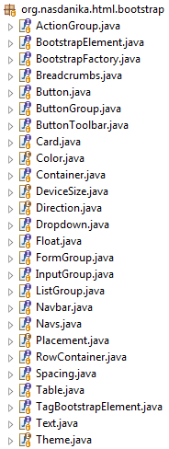

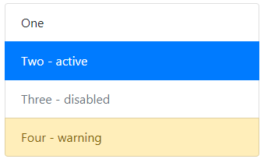
Bootstrap
API for building Bootstrap 4 elements
Built on HTML
How to use:
Obtain BootstrapFactory
Create elements
Configure the elements
Output with toString() or produce()
Fallback to HTML API’s when needed

Slide 5
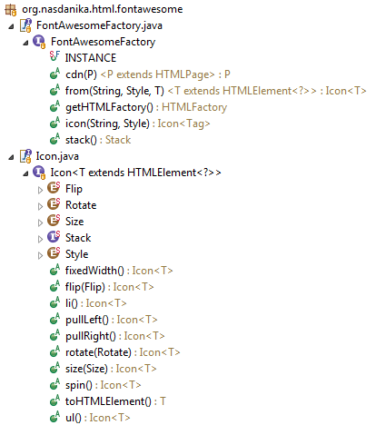

Font Awesome
API for building Font Awesome 5 icons
Built on HTML
How to use:
Obtain FontAwesomeFactory
Create icons
Configure the icons
Output with toString() or produce()
Fallback to HTML API’s when needed

Slide 6
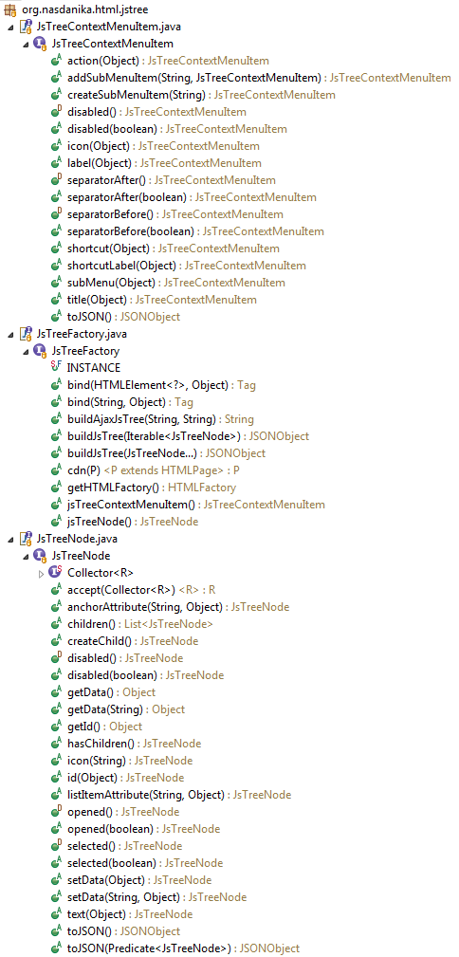
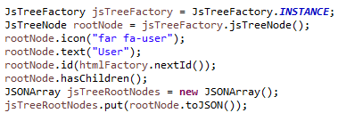
jsTree
API for building jsTree nodes and context menus
Built on HTML
How to use:
Obtain JsTreeFactory
Create nodes and menus
Configure the nodes and menus
Output to JSON

Slide 7
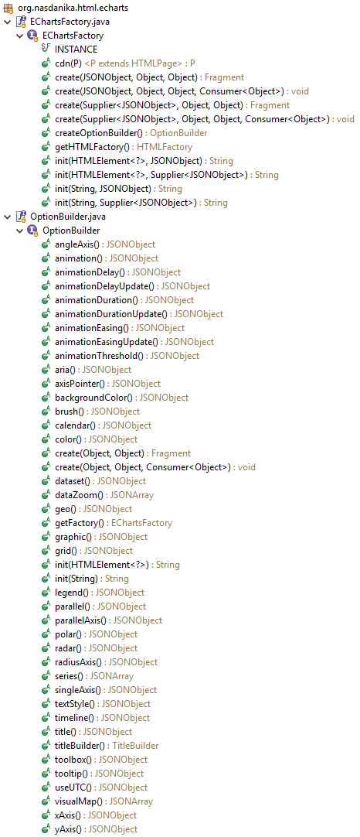
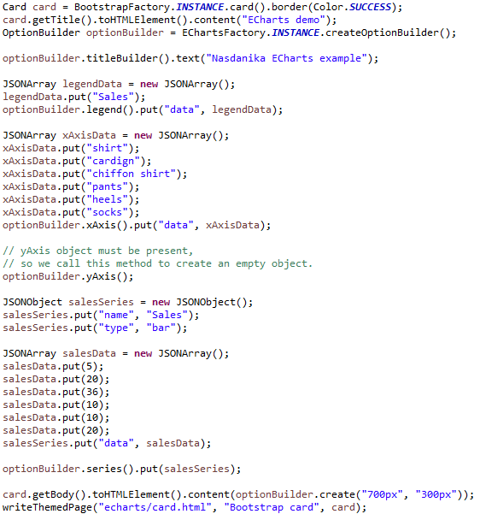
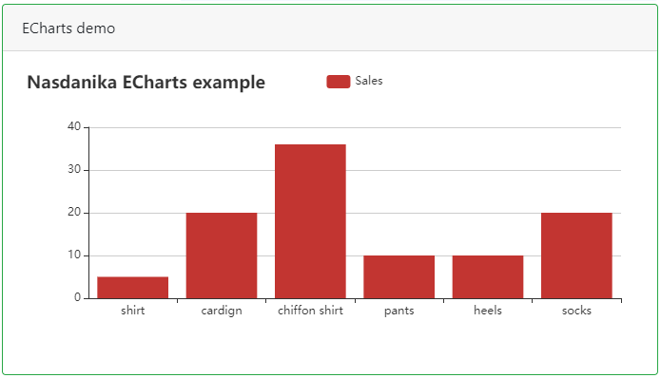
ECharts
API for building ECharts charts
Built on HTML
How to use:
Obtain EChartsFactory
Create OptionBuilder
Configure option and then create a chart

Slide 8
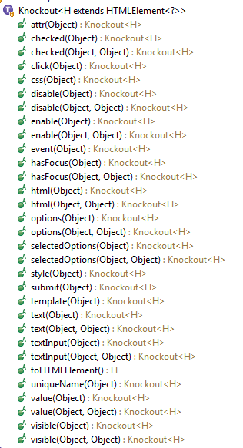
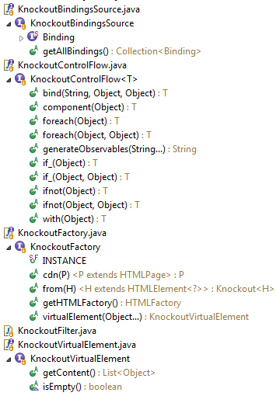
KnockoutJS
API for building KnockoutJS bindings
Built on HTML

Slide 9
Application - philosophy
Abstractions to thinks of user-system interaction as:
System invokes a user by passing them a callback (user) interface with actions to activate
Actions form a vocabulary of system-user interactions
The framework takes care of generating an HTML UI from actions and property sources
Subject - Verb – Object => User - Action - Property source:
"Customer views account details”:
Customer - user
Views account details – view action for “account” property source
If it can be articulated, it can be automated

Slide 10
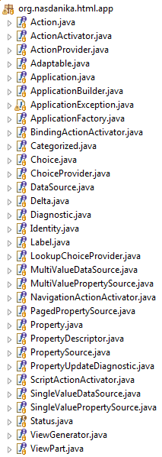
Application – key abstractions
Label – something with a text and an icon
Action – a label which can be activated by a user
Data sources and properties – low-level data access
Property sources and property descriptors – higher-level data access abstractions with UI attributes and actions
Application – header, navigation bar, navigation panel, content panel, footer
Application Builder – builds an application
Action Application Builder – builds an application from an action tree
ViewPart – a contributor to UI construction
ViewGenerator – provides common generation methods and access to factories – HTML, Bootstrap, …

Slide 11
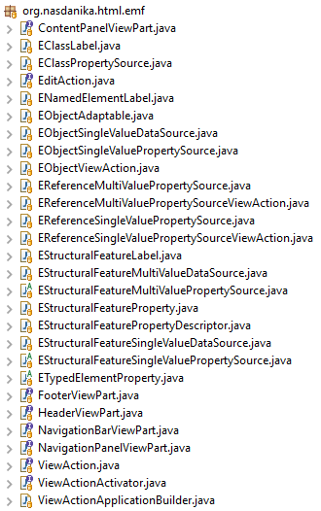
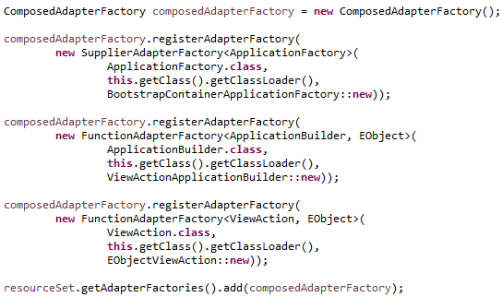
EMF
EMF adapters to the application abstractions
Use default implementations or customize
Register with a resource set:
Adapt EObject to generate HTML UI:
Can be used to generate static content and in dynamic Web applications

Slide 12
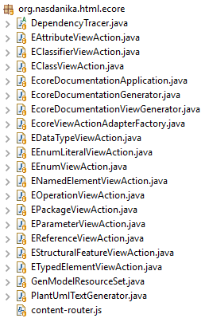
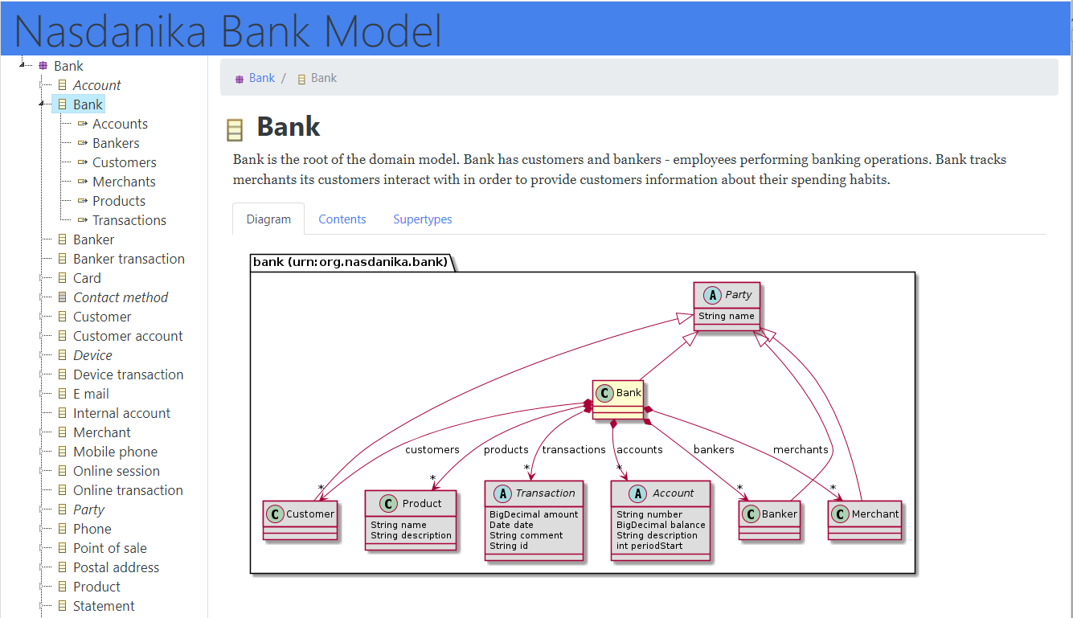
ECore
ViewAction adapters for Ecore model elements
Documentation generator and helper classes

