Slide 1


ENTERPRISE BACKEND STANDARDS
DGC API Guideline
Standard
Enterprise Backend Standards for Reliability,
Security, and Operability
Security First
Reliability by Design
Governance Aligned

Slide 2
OVERVIEW
Executive Summary
Clean Architecture
Governance-First API
Standardized layered structure for scalable backend services with strict separation of concerns.
Azure-style API conventions with standardized versioning, error contracts, and tracing.
Reliability by Design
Security Baseline
Idempotency, queue processing, and resilience policies built into the foundation.
Hard rule: no secrets in appsettings. User Secrets for local development only.
Dependency Governance
100%
Centralized version pinning for deterministic builds and controlled upgrades.
Pinned Versions

Slide 3
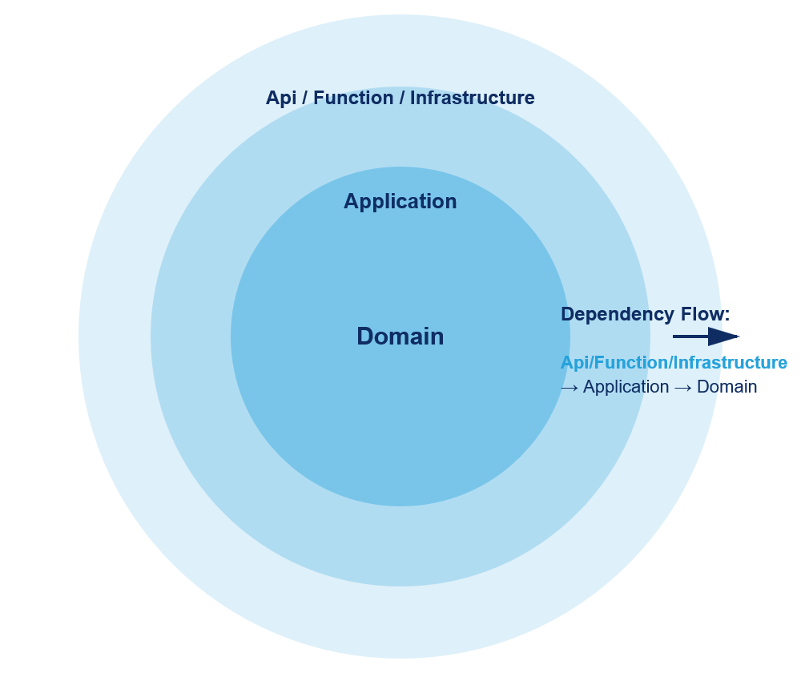
STRUCTURE
Architecture Standard
Onion-style layered architecture with strict dependency direction
Layered Architecture Diagram
Outer Layer
Api / Function / Infrastructure — Entry points, controllers, function triggers, and infrastructure implementations. Remains thin and orchestration-focused.
Middle Layer
Application — Orchestration layer coordinating use cases, applying business rules, and mediating between outer and core layers.
Core Layer
Domain — Pure business logic, entities, and domain services. Framework-agnostic and isolated from external dependencies.
Key Principle: Infrastructure remains replaceable through interfaces and extension-based composition.
Api/Function/Infrastructure → Application → Domain

Slide 4
DESIGN PATTERNS
Code Pattern Standard
Encouraged patterns for maintainable, testable, and reliable code
Repository Pattern
Unit of Work Pattern
PERSISTENCE ABSTRACTION
TRANSACTION COORDINATION
Purpose: Abstracts data access operations behind interfaces, decoupling business logic from persistence details.
Purpose: Coordinates multiple repository operations within a single atomic transaction.
Applies: All database access in Infrastructure layer.
Applies: Multi-entity operations requiring consistency.
Benefit: Enables testing with mocks, supports provider switching without service changes.
Benefit: Ensures data integrity, simplifies transaction management across services.
Specification Pattern
Static Mapper Pattern
QUERY ENCAPSULATION
DTO TRANSFORMATION
Purpose: Encapsulates query criteria into reusable, composable objects.
Purpose: Uses explicit static mapping methods for deterministic DTO transformations.
Applies: Complex filtering, search, and business rule queries.
Applies: All entity-to-DTO and request-to-entity conversions.
Benefit: Eliminates query duplication, centralizes filtering logic, improves readability.
Benefit: Compile-time safety, predictable behavior, easy to test and debug.
Validation Attribute Pattern
Idempotency Pattern
REQUEST VALIDATION
DUPLICATE PROTECTION
Purpose: Uses custom validation attributes for consistent request validation.
Purpose: Protects state-changing operations from duplicate processing.
Applies: API request models and input DTOs.
Applies: All non-safe endpoints requiring duplicate protection.
Benefit: Declarative validation, reusable rules, automatic model state checking.
Benefit: Prevents data corruption, supports safe retries, ensures consistency.
Transport Abstraction Pattern
Extension-based Composition
Purpose: Allows selecting Redis/In-Memory/Azure Queue Storage transport without API contract changes.
Purpose: Keeps startup wiring modular and maintainable through extension methods.
Benefit: Clean Program.cs, organized registrations, easy to extend.
Benefit: Environment flexibility, testability, no vendor lock-in.

Slide 5
API DESIGN
API Governance Standard
Azure-style conventions for consistent, traceable, and versioned APIs
Versioning Strategy
Error Contract
Query-parameter API versioning using date-based versions (e.g., ?api-version=2024-01-01 ).
Uniform validation and exception error contract with standardized error envelopes and HTTP headers.
Aligns with Azure API Management standards
Consistent error structure across all endpoints
Enables gradual API evolution without breaking changes
Machine-readable error codes for client handling
Request Tracing
Middleware Pipeline
Standardized request tracing with x-ms-request-id header propagation.
Consistent API behavior through centralized middleware and extension registration.
End-to-end request correlation
Global exception handling
Simplified debugging and log analysis
Modular, testable middleware components
100%
Key Insight: Governance-first design reduces integration friction and accelerates client adoption.
Standardized

Slide 6
RELIABILITY
Reliability and Idempotency Standard
Mandatory protection for state-changing operations
Idempotency is Mandatory
Idempotency Flow
Hard Rule: All endpoints requiring duplicate-request protection must implement idempotency.
1
Client Request
Includes Idempotency-Key header
Idempotency Key Contract
Replay Protection
2
Key Check
Request Mismatch Handling
Cache-Backed State
Cache lookup for existing request
Queue-Driven Processing
3
Decision
New: process & store. Replay: return cached.
Asynchronous message processing for resilience and service decoupling. Supports retry policies and dead-letter handling.
Resilience Policies
Retry and circuit-breaker policies for external API calls with configuration-driven parameters.
Critical: Idempotency prevents data corruption from network retries, client timeouts, and duplicate submissions.

Slide 7
MESSAGING
Messaging Standard
Approved transport options with abstraction layer
In-Memory
Redis
Azure Queue Storage
Lightweight transport for local development and unit testing.
High-performance transport for containerized and on-premise deployments.
Cloud-native transport for Azure deployments. Recommended for production.
Zero external dependencies
Low latency, pub/sub support
Cloud queue standard
Transport Abstraction
The queue abstraction layer enables runtime transport selection without changing API contracts or business logic.
Environment Fit
Testability
No Lock-in
Same code, different transports
In-memory for fast tests
Switch without code changes

Slide 8
DATA MANAGEMENT
Data and Database Standard
Database-First approach with EF Core 10 baseline
Database-First Approach
Connection Resiliency
Standard: Database schema is the source of truth. Models align to schema, not the reverse.
Configurable through policy keys in configuration:
EnableRetryOnFailure
boolean
Schema-driven modeling
Explicit migrations
MaxRetryCount
integer
EF Core 10
MaxRetryDelaySeconds
integer
Entity Framework Core 10 with explicit provider registration methods for PostgreSQL and SQL Server.
CommandTimeoutSeconds
integer
Provider Registration
Dedicated extension methods: AddPostgresqlServer() and AddSqlServer()
Note: Provider selection is controlled in code at composition time, not through configuration.

Slide 9
SECURITY
Security and Secret Management Standard
Hard rules for credential and configuration protection
Hard Rule: No Secrets in appsettings
Sensitive values must never be committed to appsettings.json or appsettings.Development.json. This is a non-negotiable security baseline.
Connection strings with credentials
API keys and tokens
Notification credentials
External API secrets
User Secrets
Deployment Secrets
LOCAL DEVELOPMENT ONLY
OUT OF SCOPE
Local development secrets are managed through ASP.NET Core User Secrets.
Deployment-time secret management is owned by the deployment team and outside this guideline scope.
dotnet user-secrets set "Key" "Value"
Handled via Azure Key Vault, CI/CD pipelines
appsettings.json Retains Only Non-Sensitive Values
Operational policy values, feature flags, and non-secret configuration only.

Slide 10
QUALITY ASSURANCE
Testing Standard
Comprehensive testing is mandatory — not optional
Comprehensive Testing is Mandatory
100%
Quality is treated as a release gate, not a best-effort activity.
Coverage Required
Unit Testing
Integration Testing
Isolate and test individual components, services, and business logic in isolation.
Verify component interactions, database operations, and external service integrations.
Fast execution, deterministic results
TestContainers for isolated dependencies
API Behavior Validation
Reliability & Regression
End-to-end API contract testing, response validation, and error scenario coverage.
Idempotency verification, retry policy validation, and regression safety checks.
Contract compliance verification
Prevents breaking changes
Release Gate: No deployment without passing all test stages.
xUnit
NSubstitute
FluentAssertions
Framework
Mocking
Assertions

Slide 11
DEPENDENCY MANAGEMENT
Direct dependencies only. Transitive dependencies are excluded.
Dependency Governance
Category | Package | Pinned Version
API & Versioning | Asp.Versioning.Mvc | 8.1.0
 | Asp.Versioning.Mvc.ApiExplorer | 8.1.0
 | Microsoft.AspNetCore.OpenApi | 10.0.3
 | Swashbuckle.AspNetCore | 10.1.1
Data & Database | Microsoft.EntityFrameworkCore | 10.0.3
 | Microsoft.EntityFrameworkCore.Design | 10.0.3
 | Npgsql.EntityFrameworkCore.PostgreSQL | 10.0.0
 | Microsoft.EntityFrameworkCore.SqlServer | 10.0.3
Resiliency & Integration | Microsoft.Extensions.Http.Resilience | 10.1.0
 | Microsoft.Extensions.Caching.Hybrid | 10.0.0
 | StackExchange.Redis | 2.11.0
 | Azure.Storage.Queues | 12.25.0
Functions Runtime | Microsoft.Azure.Functions.Worker | 2.51.0
 | Microsoft.Azure.Functions.Worker.Sdk | 2.0.7
 | Microsoft.Azure.Functions.Worker.Extensions.Storage.Queues | 5.5.3
Testing Baseline | Microsoft.NET.Test.Sdk | 17.13.0
 | xunit | 2.9.3
 | FluentAssertions | 8.0.1
 | NSubstitute | 5.3.0
 | coverlet.collector | 6.0.4
Centralized Package Management: All versions pinned in Directory.Packages.props for reproducible builds.
20
Direct Packages

Slide 12
REFERENCE
Appendix: Key Technical Terms
Definitions for architectural concepts and patterns
Idempotency
Repository Pattern
Property where an operation produces the same result whether executed once or multiple times. Prevents duplicate processing.
Abstraction layer that mediates between domain and data mapping layers, providing collection-like access to domain objects.
Unit of Work
Specification Pattern
Maintains a list of objects affected by a business transaction and coordinates writing out changes as a single atomic operation.
Encapsulates query criteria in reusable objects, enabling composition of complex business rules and filtering logic.
Transport Abstraction
EF Core
Pattern that decouples message queue implementation from business logic, enabling runtime transport selection.
Entity Framework Core — lightweight, extensible ORM for .NET supporting multiple database providers.
User Secrets
Clean Architecture
ASP.NET Core feature for storing sensitive configuration during development, outside source control.
Layered architecture where dependencies point inward toward domain logic, keeping frameworks and UI at the outer edges.
DTO
Extension Methods
Data Transfer Object — lightweight object for carrying data between processes, decoupling internal models from API contracts.
C# feature enabling addition of methods to existing types without modifying them, used for modular service registration.
For detailed implementation guidance, refer to the DGC API Guideline Solution documentation.
10
Terms Defined

