Slide 1
CREDIT CARD FRAUD DETECTION USING
MACHINE LEARNING
Domain: Machine Learning
Project Done by:
Irfana K V (Reg.No: 720917104020)
Naseela K T (Reg.No: 720917104036)
Akshay Sivaraj (Reg.No: 720917104701)
Final Year, Department of Computer Science and Engineering,
JCT College of Engineering and Technology, Pichanur, Coimbatore
Guided by:
Mr.G.Deeban Chakkarawarthi,M.E,MBA,
Assistant Professor,
Department of Computer Science and Engineering,
JCT College of Engineering and Technology,
Pichanur, Coimbatore

Slide 2
ABSTRACT
For years, card-present frauds were the most popular type of card fraud where perpetrators were presenting stolen or counterfeit cards in order to make a purchase.
Most credit card fraud nowadays, however, are card not present, usually involving online or over-the-phone exchanges where physical card does not have to be presented. It result in huge financial losses.
Criminals can use some technologies such as Trojan or Phishing to steal the information of other people’s credit cards.
Therefore, an effective fraud detection method is important since it can identify a fraud in time when a criminal uses a stolen card to consume.
One method is to make full use of the historical transaction data including normal transactions and fraud ones to obtain normal/fraud behavior features based on machine learning techniques, and then utilize these features to check if a transaction is fraud or not.

Slide 3
LITERATURE SURVEY
A paper done by Mandeep Singh, Sunny Kumar, Tushant Garg on “Credit Card Fraud Detection Using Hidden Markov Model” explained a method to find the spending profile of cardholders and then trying to find out the observation symbols which will help us for an initial estimate of the model parameters. It will also be explained how the HMM can detect whether an incoming transaction is genuine or not.
A similar research domain was presented by S P Maniraj, Aditya Saini, and Swarna Deep Sarkar [ International Journal of Engineering and Advanced Technology (IJEAT) ISSN: 2249-8958, Volume-8 Issue-5, June 2019] where they used Machine Learning and Data Science. This paper has explained in detail, how machine learning can be applied to get better results in fraud detection along with the algorithm, pseudocode, explanation its implementation and experimentation results. It end up creating a system that can, with enough time and data.
Another paper was done by Sahayasakila.V, D. Kavya Monisha, Aishwarya, Sikhakolli VenkatavisalakshiseshsaiYasaswi on “Credit Card Fraud Detection System using Smote Technique and Whale Optimization Algorithm” [International Journal of Engineering and Advanced Technology (IJEAT) ISSN: 2249-8958, Volume-8 Issue-5, June 2019] their aims in indentifying the fraud transactions occurring during the transactions made by the card holder. The system also aims to improve the convergence speed and solves the data imbalance.

Slide 4
INTRODUCTION
‘Fraud’ in credit card transactions is unauthorized and unwanted usage of an account by someone other than the owner of that account.
Necessary prevention measures can be taken to stop this abuse and the behaviour of such fraudulent practices can be studied to minimize it and protect against similar occurrences in the future.
This is a very relevant problem that demands the attention of communities such as machine learning and data science where the solution to this problem can be automated.
The number of valid transactions far outnumber fraudulent ones. Also, the transaction patterns often change their statistical properties over the course of time.
Machine learning algorithms are employed to analyse all the authorized transactions and report the suspicious ones.

Slide 5
EXISTING SYSTEM
HIDDEN MARKOV MODEL
A Hidden Markov Model is a finite set of states in which each state is associated with a distribution of probability.
Transition probabilities, a set of probabilities govern transitions between these state.
A possible outcome or observation that is associated with the image of probability distribution observation is produced in a particular state.
It is only the outcome, not the state that is visible to an external observer and therefore states are "hidden" to the outside.
It is used all the transaction amount as an observation symbol and the types of items are considered as states of HMM.
It is a method that, find the spending profile of cardholders and then trying to find out the observation symbols which will help us for an initial estimate of the model parameters.
It will also be explained how the HMM can detect whether an incoming transaction is genuine or not

Slide 6
Disadvantages
Highly expensive, both in terms of memory and compute time.
Low accuracy
Not scalable to large size data set.
HMM does not consider the state sequence dominating any given state because of its Markovian nature.
Features other than the observed power demand are not captured (e.g. time of day). However, the input-output HMM allow such state durations to be modelled.

Slide 7
PROPOSED SYSTEM
There are two kinds of methods for fraud detection, misuse detection and anomaly detection. This paper is about misuse method.
We use Random forest to train the normal and fraud behavior features.
The random forest algorithm for fraud detection and prevention has two cardinal factors that make it good at predicting things.
  Randomness
  Diversity
The main objective of Random forest algorithm to classify the collected data as normal and abnormal.
Machine learning algorithms are employed to analyze all the authorized transactions and report the suspicious ones.

Slide 8
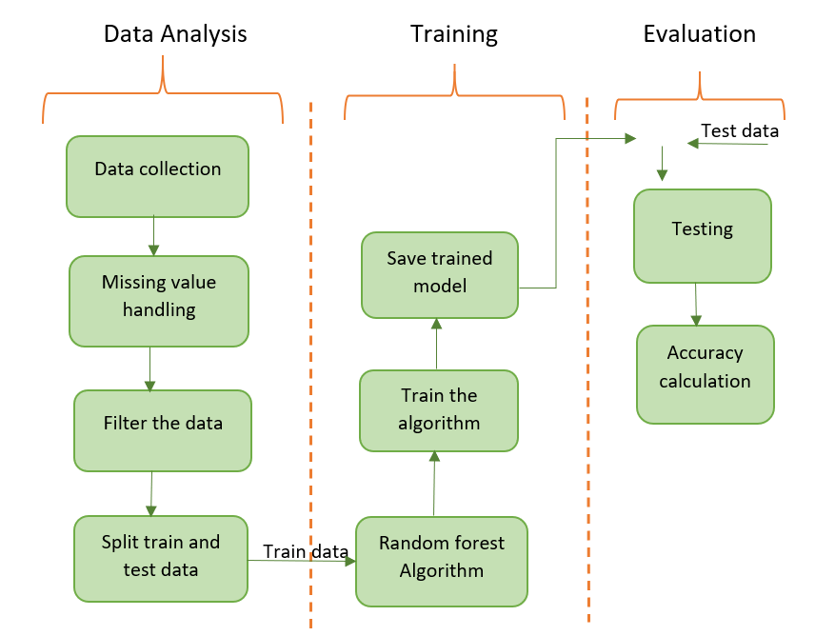
DATA FLOW DIAGRAM

Slide 9
MODULES
1.Data Collection and Analysis
In this project, we have to collect the data from the bank. But Bank does not provide transactional datas. So we collected datas from internet which already uploaded by some companies.
The dataset contains transactions made by Credit Cards from April-September 2005.
It include the user details and transactional details.
Data Cleaning
Filling or Removing missing values.
Removing the Outliers.
Categorical to Numerical Conversion.

Slide 10
2.Data Splitting
Data splitting is the act of partitioning available data into two. Usually for cross-validatory purposes.
One portion of the data is used to develop a predictive model. and the other to evaluate the model's performance.ie Training and Testing.
Our machine learning models will try to understand any correlations in our training set and then we will test the models on our test set to examine how accurately it will predict.
We use train_test_split function in order to make the split. The test_size=0.2 inside the function indicates the percentage of the data that should be held over for testing. It’s usually around 80/20 or 70/30.
3.Algorithm Building-Random Forest
Random forest is a type of supervised machine learning algorithm based on ensemble learning.
The capacity of random forest not only depends on the strength of individual tree but also the correlation between different trees.
The stronger the strength of single tree and the less the correlation of different trees, the better the performance of random forest.
The variation of trees comes from their randomness which involves bootstrapped samples and randomly selects a subset of data attributes.

Slide 11
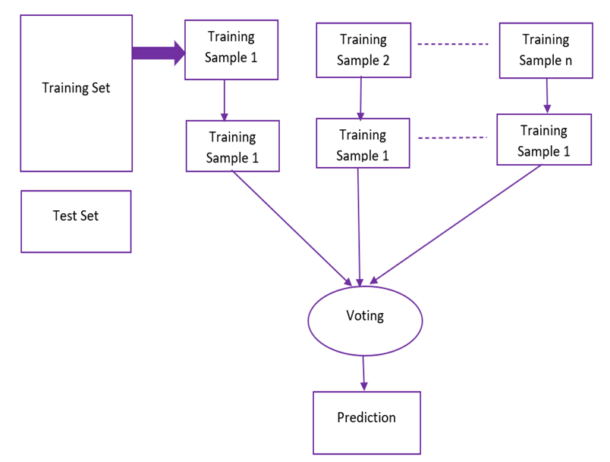
Working:
The following are the basic steps involved in performing the random forest algorithm
Pick N random records from the dataset.
Build a decision tree based on these N records.
Choose the number of trees you want in your algorithm and repeat steps 1 and 2.
For classification problem, each tree in the forest predicts the category to which the new record belongs. Finally, the new record is assigned to the category that wins the majority vote.

Slide 12
4.Training
A training model is a dataset that is used to train an ML algorithm.
It consists of the sample output data and the corresponding sets of input data that have an influence on the output.
The training model is used to run the input data through the algorithm to correlate the processed output against the sample output.
The result from this correlation is used to modify the model.
5.Testing and Evaluation
The testing set consisting of a set of testing samples should be separated from the both training and validation sets, but it should follow the same probability distribution as the training set.
Accuracy rate is not enough to measure the performance of a random forest model when the data is significantly imbalanced.
Positive corresponds to fraud instances and Negative corresponds to normal instances. Evaluate these data and check its accuracy.

Slide 13
Advantages
It overcomes the problem of overfitting by averaging or combining the results of different decision trees.
The random forest algorithm is not biased.
This algorithm is very stable.
It works well with both categorical and numerical features.
The random forest algorithm also works well when data has missing values or it has not been scaled well.
Scaling of data does not require in random forest algorithm.

Slide 14
SYSTEM REQUIREMENTS
Hardware Requirements
1.RAM: 4-GB
2.STORAGE: 80 GB Hard Disk
Software Requirements
1. Language: Python
2. Operating System: Windows, Linux
3. Back End Software: Anaconda, Spyder

Slide 15
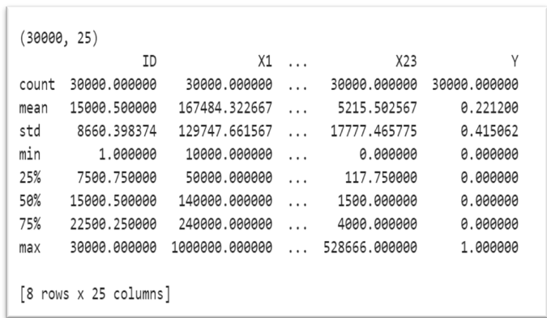
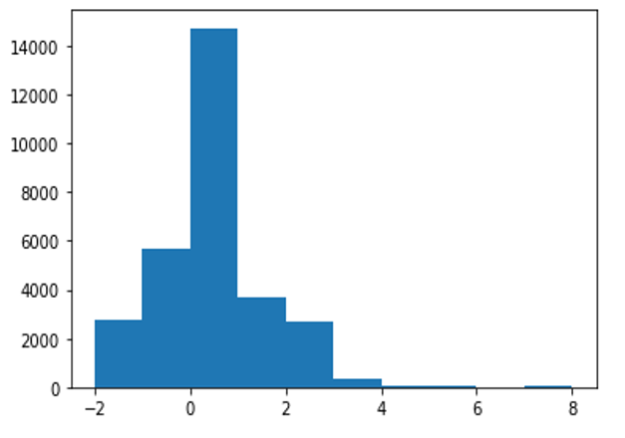
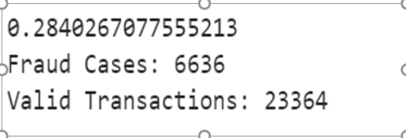
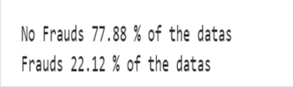
OUTPUTS
fig1.Description of the dataset fig2.Distribution of Amount
fig3.Percentage of Normal and Fraud
fig4.Number of Fraud and Normal

Slide 16
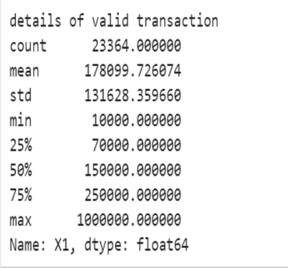
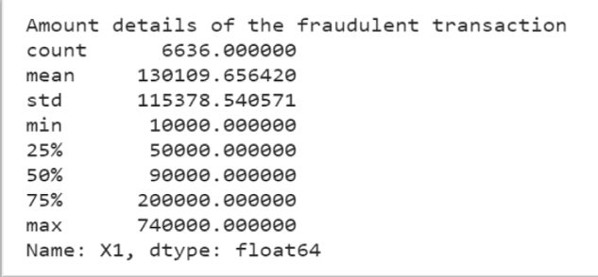
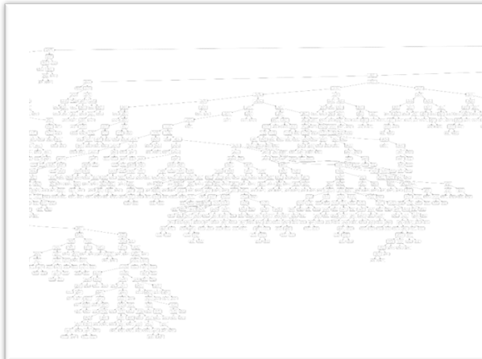
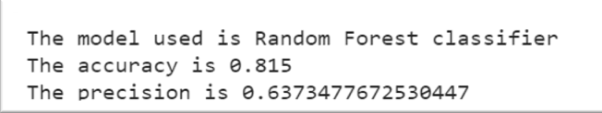
fig5.Amount details of fraudulent transaction fig6.details of valid transaction
fig7:Random Tree fig8:Evaluation

Slide 17
CONCLUSION
Credit card fraud has increased exponentially in recent years. Accordingly, one of the main tasks of the financial industries is to develop an accurate and easy credit card fraud detection system.
There are different categories of transaction scam as well as several methods to detect them. However, all these methods remain insufficient.
This paper has examined the performance of Random forest model, which Consist of multiple trees and each tree is trained on a subset of data and reduce the overall biasedness.
And also even if a new data point is introduced in the dataset the overall algorithm is not affected. So it helps to improve the voting and make better prediction.

Slide 18
FUTURE ENHANCEMENT
While we couldn’t reach out goal of 100% accuracy in fraud detection, we did end up creating a system that can, with enough time and data, get very close to that goal.
More room for improvement can be found in the dataset.
The precision of the algorithms increases when the size of dataset is increased. Hence, more data will surely make the model more accurate in detecting frauds and reduce the number of false positives.

Slide 19
REFERENCES
“Credit Card Fraud Detection Using Hidden Markov Model” published by International Journal Of Engineering And Computer Science Volume 8 Issue 11 November 2019.
“Credit Card Fraud Detection using Machine Learning and Data Science” published by International Journal of Engineering Research & Technology (IJERT) ISSN: 2278- 0181 Vol. 8 Issue 09, September-2019
“Credit Card Fraud Detection System using Smote Technique and Whale Optimization Algorithm” published by International Journal of Engineering and Advanced Technology (IJEAT) ISSN: 2249-8958, Volume-8 Issue-5, June 2019
“Credit Card Fraud Detection: A Realistic Modeling and a Novel Learning Strategy” published by IEEE TRANSACTIONS ON NEURAL NETWORKS AND LEARNING SYSTEMS, VOL. 29, NO. 8, AUGUST 2018
Credit Card Fraud Detection through Par enclitic Network Analysis By Massimiliano Zanin, Miguel Romance, Regino Criado, and SantiagoMoral” published by Hindawi Complexity Volume 2018, Article ID 5764370

Slide 20
Thank you!!!

