Slide 1


SMART INDIA HACKATHON 2026
Problem Statement ID – SIH26108
Problem Statement Title-
AI-Powered Recommendation Engine for Identifying Applicable Indian Standards for Procurement Specifications
Theme- Smart Automation
PS Category- Software
Team ID- 33
Team Name –Winter is Coming
1

Slide 2
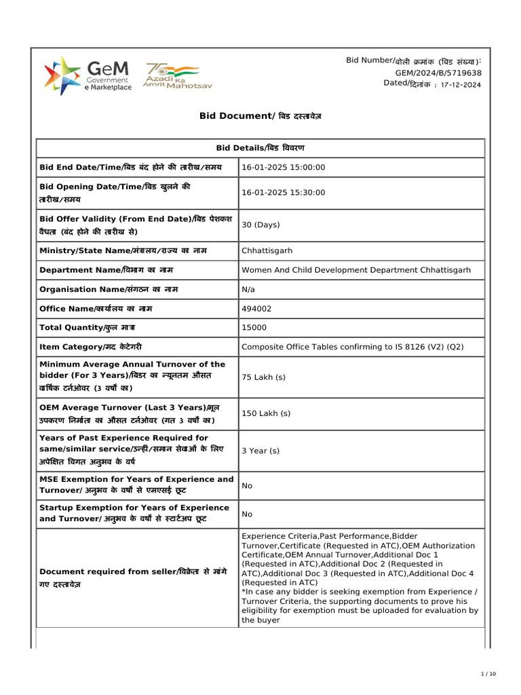
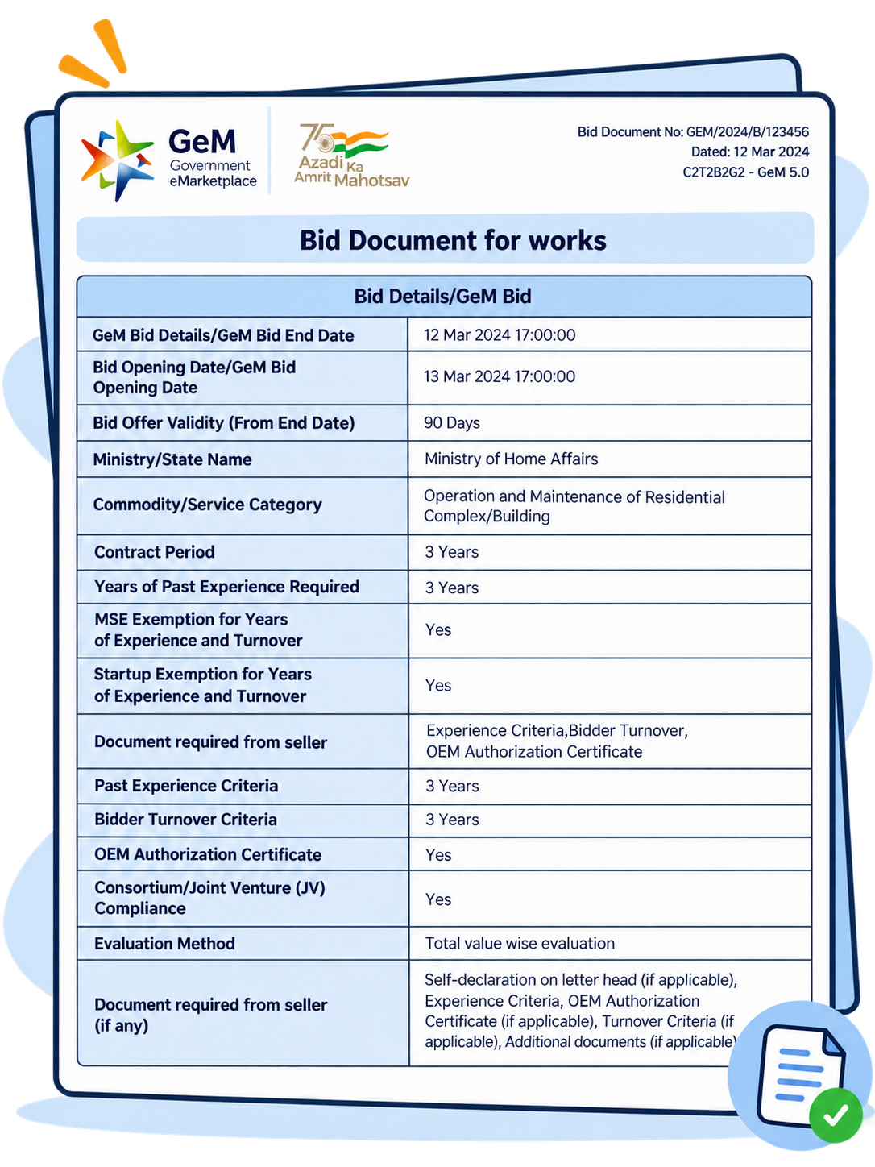
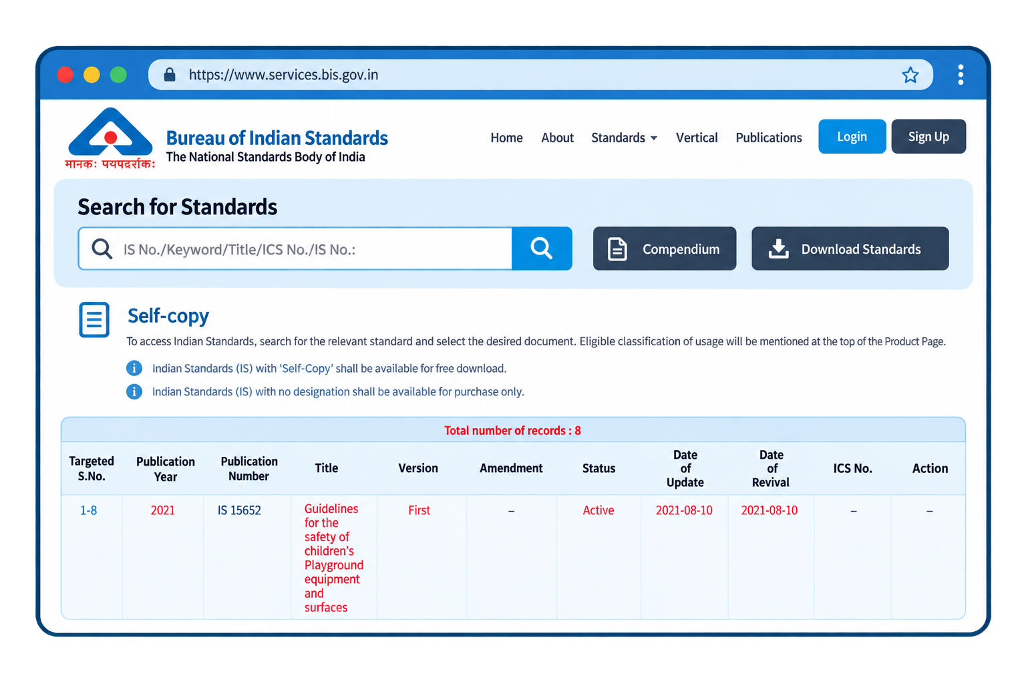
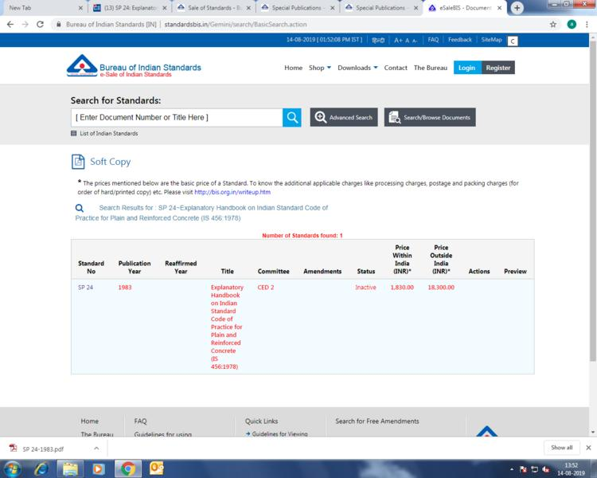


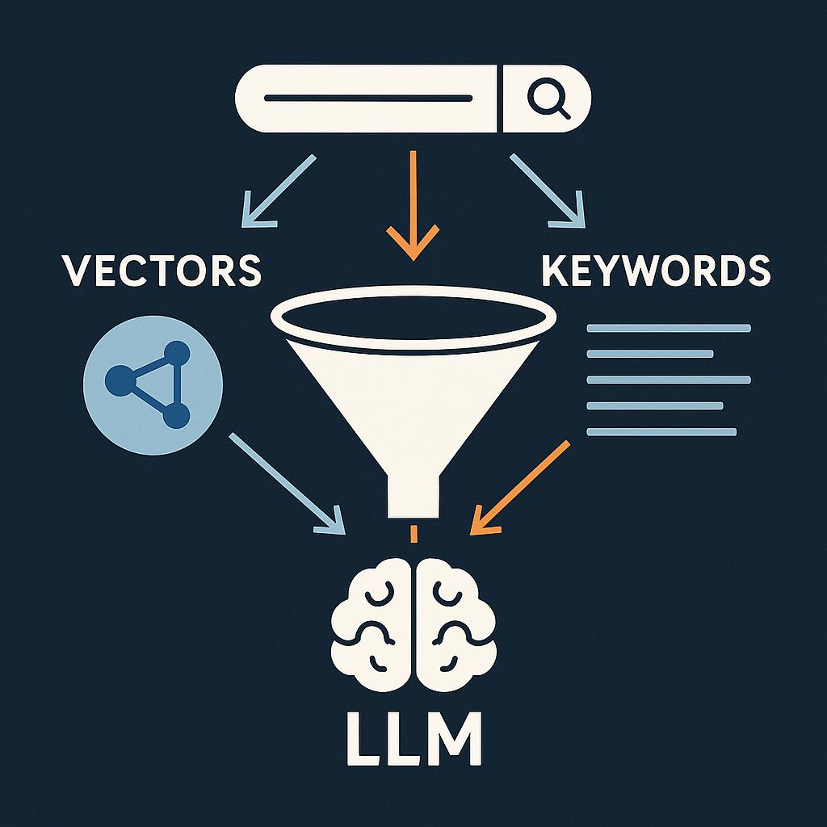




BIS-SpecAI AI-Powered Indian Standards & Procurement
Your Team Name
Evidence-Backed AI
One Search → Complete Compliance View
Deprecation-Aware.
Procurement-Ready
Difficult Standard Discovery
Compliance Risk
Complex Dependencies
Outdated Citations
Proposed Solution
Unique Value Proposition
Existing Problem
Hybrid AI Search
Normative Graph.
Automated QCO Enforcement
GEM-Ready Clause Generation.

Slide 3
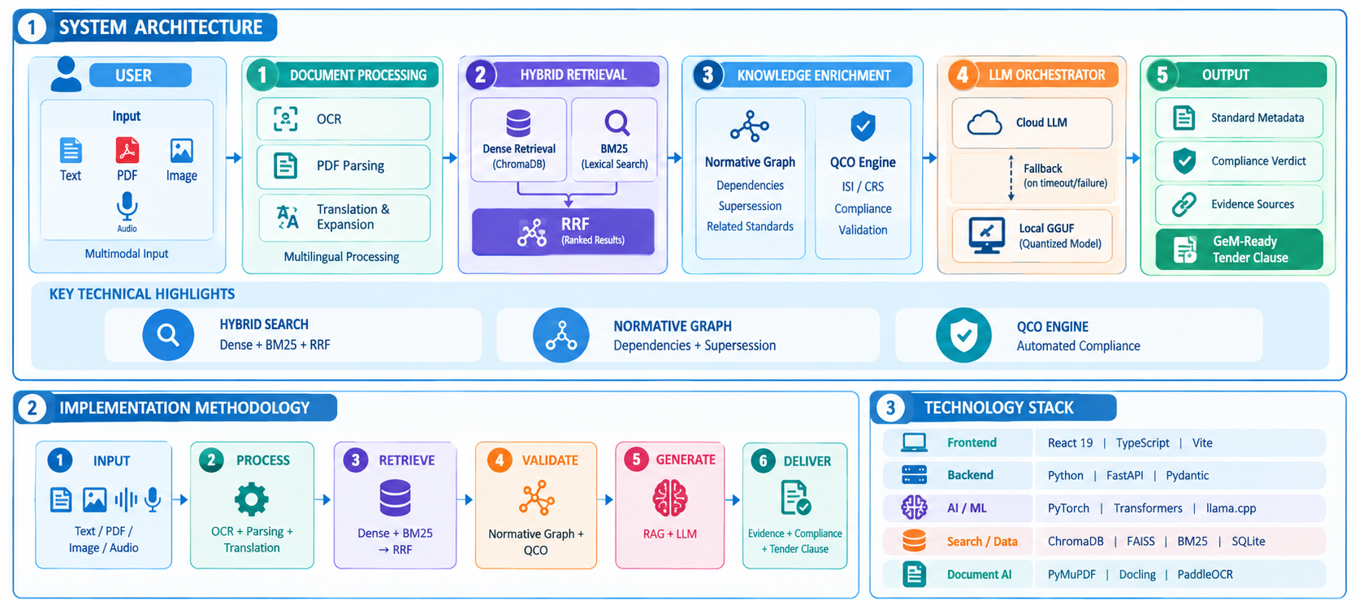
TECHNICAL APPROACH
Your Team Name

Slide 4




FEASIBILITY AND VIABILITY
Your Team Name
FEASIBLILITY
Modular Architecture
Open-Source AI Stack
Cloud + Local Execution.
API-Based Integration
CHALLENGES
Data Quality & Updates
LLM Latency
GPU Constraints
Multilingual Complexity
MITIGATION
Validation & Updating
Cascading Cloud → Local LLM
Quantized GGUF Models
Translation + Query Expansion
VIABILITY
Cost-Effective Deployment
Regulatory & Legal
Data Sovereignty
Scalable & Sustainable Operations

Slide 5





IMPACT AND BENEFITS
Your Team Name
TARGET AUDIENCE
Public Procurement Officers
Bidders, MSMEs & Vendors
Regulatory Authorities
BENEFITS
Economic Benefits
Social & Safety
Risk Management

Slide 6
RESEARCH AND REFERENCES
Your Team Name
source | LINK
Two-Stage Retrieval & Reranking | HuggingFace

