Slide 1


SMART INDIA HACKATHON 2026
Problem Statement ID – SIH26108
Problem Statement Title-
AI-Powered Recommendation Engine for Identifying Applicable Indian Standards for Procurement Specifications
Theme- Smart Automation
PS Category- Software
Team ID- 33
Team Name –Winter is Coming
1

Slide 2
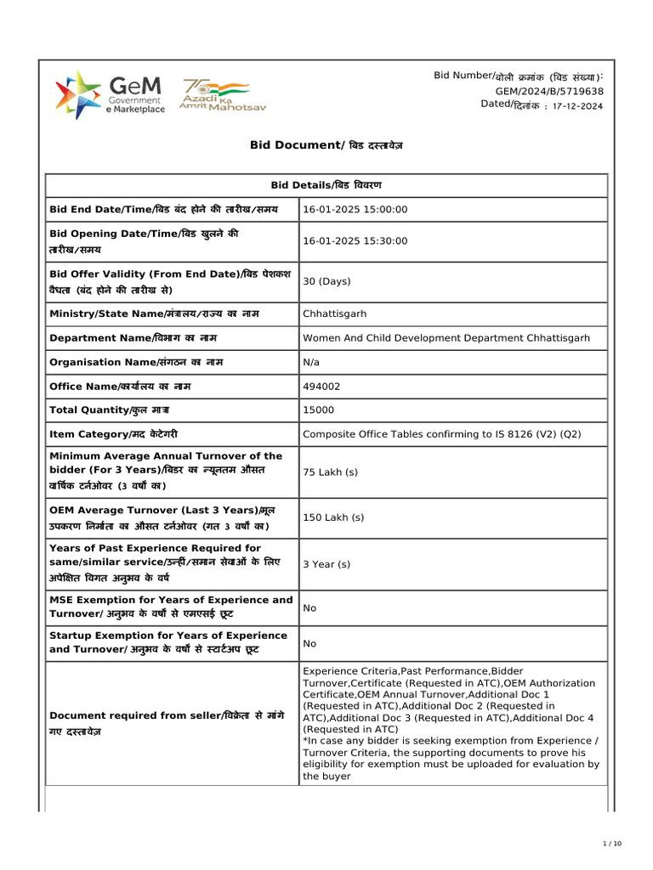
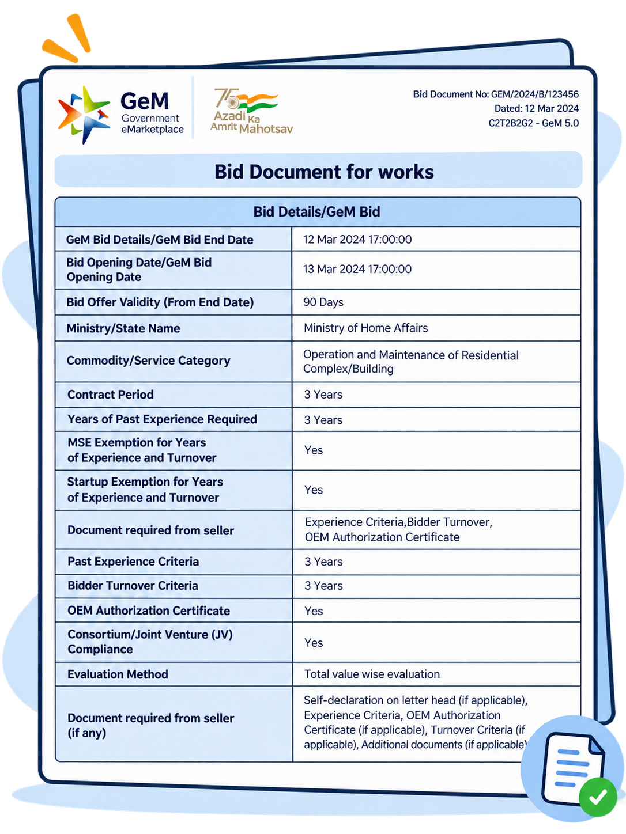
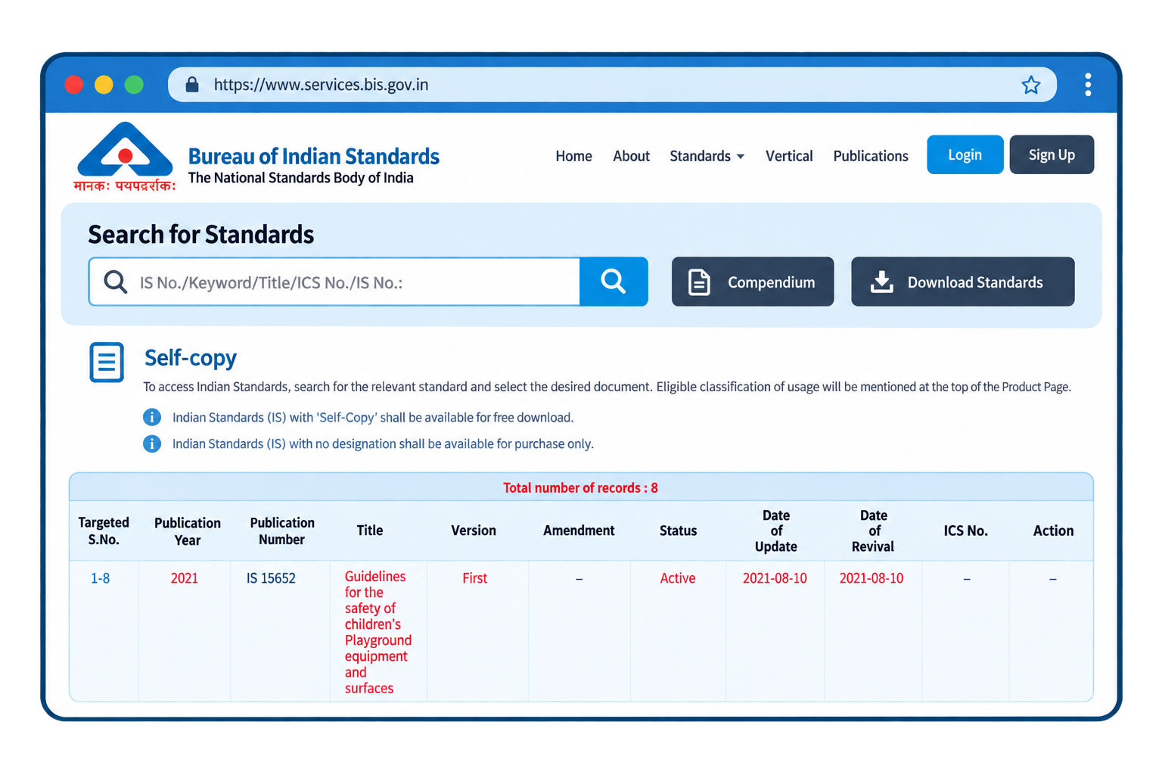
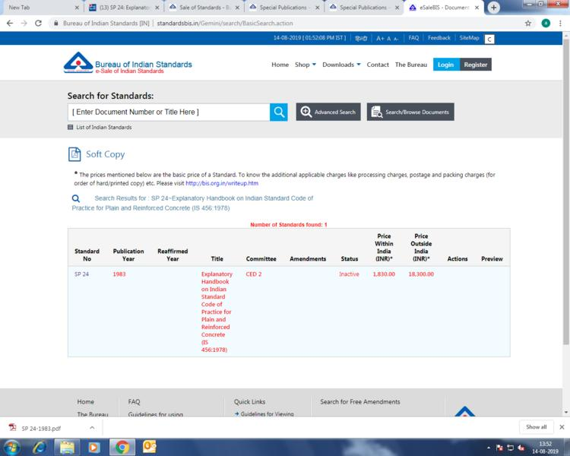


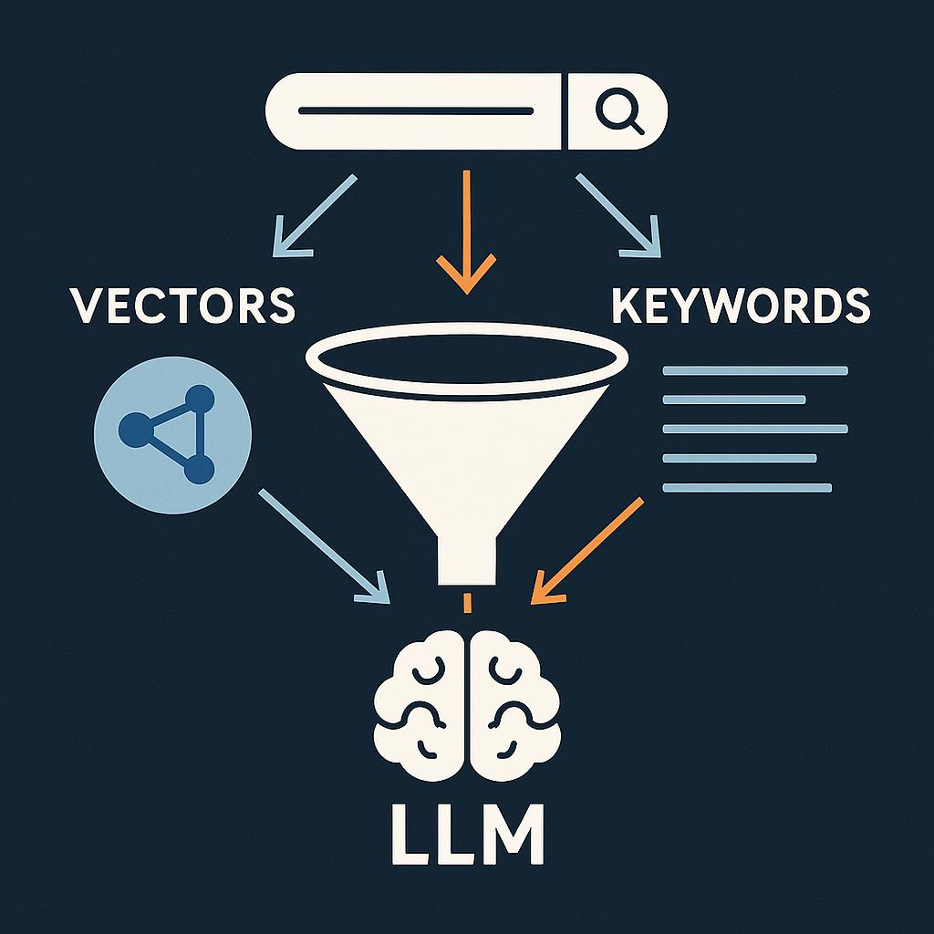




BIS-SpecAI AI-Powered Indian Standards & Procurement
Your Team Name
Evidence-Backed AI
One Search → Complete Compliance View
Deprecation-Aware.
Procurement-Ready
Difficult Standard Discovery
Compliance Risk
Complex Dependencies
Outdated Citations
Proposed Solution
Unique Value Proposition
Existing Problem
Hybrid AI Search
Normative Graph.
Automated QCO Enforcement
GEM-Ready Clause Generation.

Slide 3
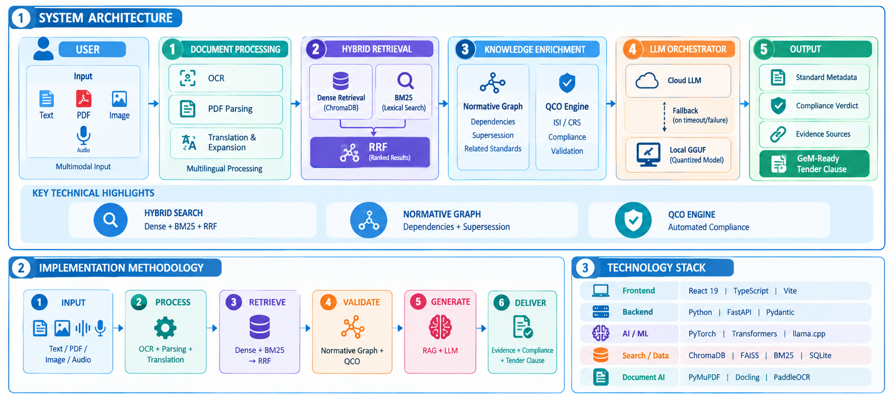
TECHNICAL APPROACH
Your Team Name

Slide 4




FEASIBILITY AND VIABILITY
Your Team Name
FEASIBLILITY
Modular Architecture
Open-Source AI Stack
Cloud + Local Execution.
API-Based Integration
CHALLENGES
Data Quality & Updates
LLM Latency
GPU Constraints
Multilingual Complexity
MITIGATION
Validation & Updating
Cascading Cloud → Local LLM
Quantized GGUF Models
Translation + Query Expansion
VIABILITY
Cost-Effective Deployment
Regulatory & Legal
Data Sovereignty
Scalable & Sustainable Operations

Slide 5





IMPACT AND BENEFITS
Your Team Name
TARGET AUDIENCE
Public Procurement Officers
Bidders, MSMEs & Vendors
Regulatory Authorities
BENEFITS
Economic Benefits
Social & Safety
Risk Management

Slide 6
RESEARCH AND REFERENCES
Your Team Name
SOURCE | LINK
BIS Standards Portal | standards.bis.gov.in
BIS Quality Control Orders | bis.gov.in/QCO-guidance
Government e-Marketplace | gem.gov.in
Sentence Transformers CrossEncoder | sbert.net/cross-encoder
Chroma Documentation | docs.trychroma.com
Notes:
Sources cited in the table: 1. BIS Standards Portal: https://standards.bis.gov.in/ 2. BIS Quality Control Orders Guidance: https://www.bis.gov.in/wp-content/uploads/2021/08/Guidance-Document-on-Quality-Control-Orders-QCOs.pdf 3. Government e-Marketplace: https://gem.gov.in/ 4. Sentence Transformers CrossEncoder documentation: https://www.sbert.net/docs/cross_encoder/usage/usage.html 5. Chroma Documentation: https://docs.trychroma.com/

Slide 7





BIS-SpecAI Customizable Procurement Workflow
Your Team Name
INPUT COMPONENTS
WORKFLOW COMPONENTS
OUTPUT COMPONENTS
Tender specification
Document parsing
Applicable Indian Standards
Hybrid retrieval
Supporting documents
Compliance verdict
Normative reference graph
Language and query options
GeM-ready tender clause
QCO compliance check
Select the modules required for each procurement specification.
Notes:
Workflow labels are original adaptations of the BIS-SpecAI architecture in this deck. SVG icon assets: Font Awesome Free, https://fontawesome.com/ and https://github.com/FortAwesome/Font-Awesome (CC BY 4.0).

