Slide 1

Intro to RavenDB with NancyFX

Slide 2
A little about me
Justin Soliz
@justinsoliz
www.justinsoliz.com

Slide 3

Before we begin...

Slide 4
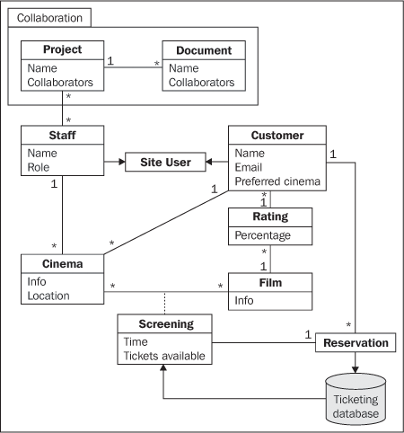
Relational Database

Slide 5

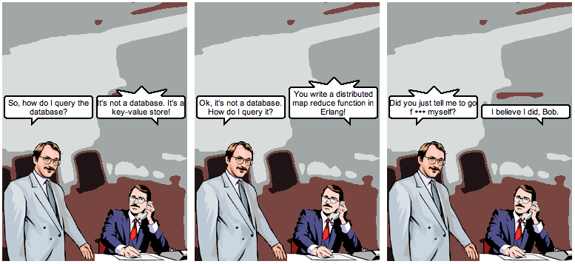
@jrecursive

Slide 6
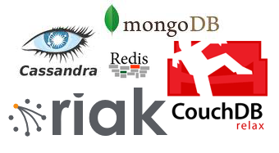
So what’s out there?

Slide 7

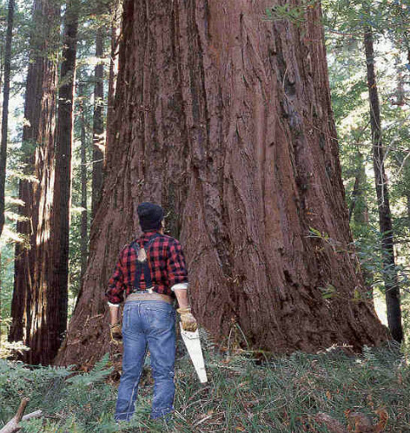

Slide 9
What is Raven?
Raven is a .NET Linq enabled Document Database, focused on providing a high performance, schema-less, flexible and scalable NoSQL data store for the .NET and Windows platforms.

Slide 10

Ok... So what does that mean?

Slide 11
What it offers
Linq
Transactions
Safe by default
Ad hoc queries
Extensibility
Live Projections
Replication
Replicate to RDBMS
Set based operations

Slide 12
The API
IDocumentStore
IDocumentSession
IDocumentQuery

Slide 13
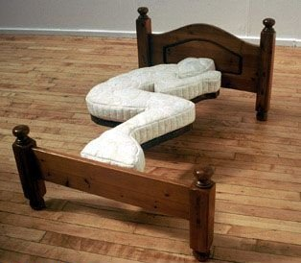
Micro web frameworks
Use only what you need...

Slide 14

NancyFX, a Sinatra inspired framework
require ‘sinatra’
get ‘/’ do
‘Hello World’
end

Slide 15
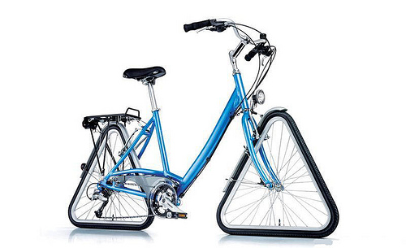
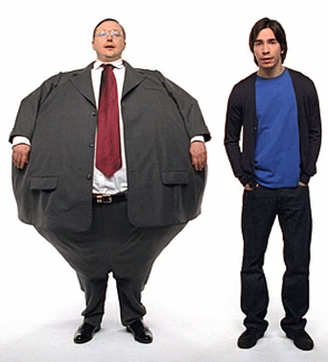
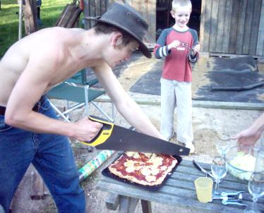
What it isn’t
Asp.Net MVC Nancy

Slide 16
Hosting options
Asp.Net
Self-hosted
Wcf
OWIN

Slide 17

The middleman
Some common middleware...
Rack
WSGI
OWIN

