Slide 1




A big thanks to NashDotNet’s sponsors!
Our “Rock Star” sponsors ($1,000 per year)
Our VIP sponsor ($500 per year)

Slide 2

Intro to RavenDB with NancyFX

Slide 3
A little about me
Justin Soliz
@justinsoliz
www.justinsoliz.com

Slide 4

Before we begin...

Slide 5
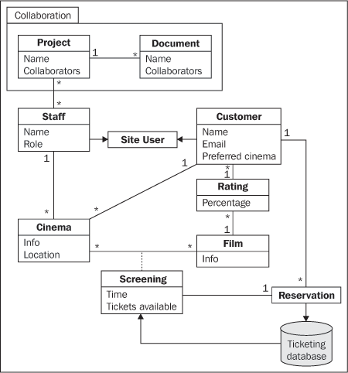
Relational Database

Slide 6

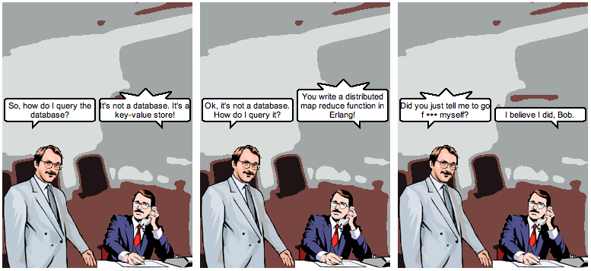
@jrecursive

Slide 7

So what’s out there?

Slide 8

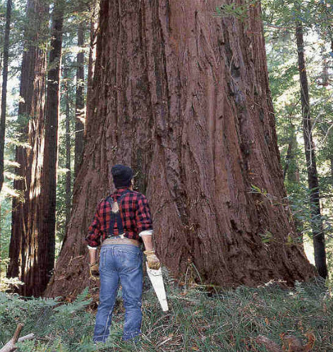

Slide 10
What is Raven?
Raven is a .NET Linq enabled Document Database, focused on providing a high performance, schema-less, flexible and scalable NoSQL data store for the .NET and Windows platforms.

Slide 11

Ok... So what does that mean?

Slide 12
What it offers
Linq
Transactions
Safe by default
Ad hoc queries
Extensibility
Live Projections
Replication
Replicate to RDBMS
Set based operations

Slide 13
RESTful Architecture
Documents - http://localhost:8080/docs/{document_id}
Attachments -http://localhost:8080/static/{attachment_path}
Index –
http://localhost:8080/indexes/{index_id}

Slide 14
The API
IDocumentStore
IDocumentSession
IDocumentQuery

Slide 15
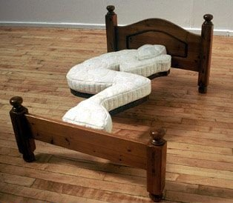
Micro web frameworks
Use only what you need...

Slide 16

NancyFX a Sinatra inspired framework
require ‘sinatra’
get ‘/’ do
‘Hello World’
end

Slide 17
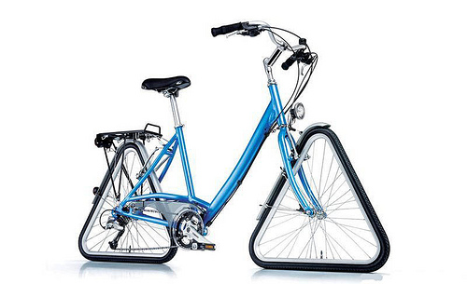
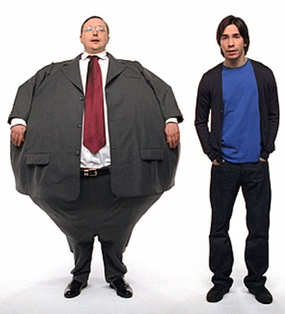
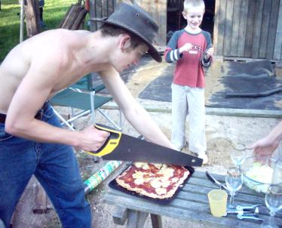
What it isn’t
Asp.Net MVC Nancy

Slide 18
Hosting options
Asp.Net
Self-hosted
Wcf
OWIN

Slide 19

The middleman
Some common middleware...
Rack
WSGI
OWIN

Slide 20
OWIN
Open Web Interface for .Net
Available Kayak, Mono etc..
Who uses it?

Slide 21
Bringing it together

Slide 22
Questions/Comments
Presentation Slide and Samples
https://github.com/justinsoliz/ravendb_nancyfx_presentation

