Slide 1
Intro to RavenDB with NancyFX

Slide 2
A little about me
Justin Soliz
@justinsoliz
www.justinsoliz.com

Slide 3
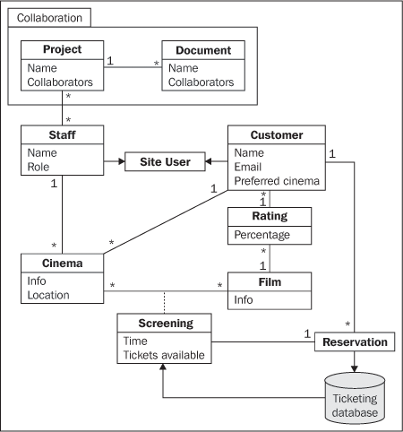
Relational Database

Slide 4

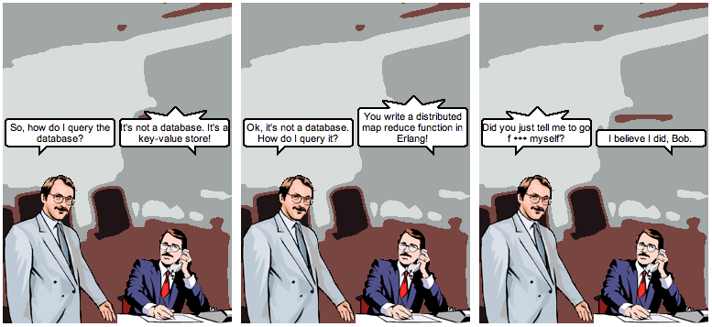
@jrecursive

Slide 5

So what’s out there?

Slide 6

