Slide 1


INDUSTRIAL FAULT INDICATION SYSTEM
with SMS ALERT
Seminar on
Presented by
Quazi Nashif Alam
V23HE8Q1

Slide 2
INDUSTRIAL FAULT ALERT SYSTEM
ABSTRACT
INDUSTRIAL FAULTS IDENTIFICATION
ALERT BROADCAST AND MANAGEMENT
REMOTE MANAGEMENT OF SAFETY MODULE
V23HE8Q1

Slide 3
INDUSTRIAL FAULT ALERT SYSTEM
REQUIREMENTS
V23HE8Q1

Slide 4
INDUSTRIAL FAULT ALERT SYSTEM
SOFTWARE
KEIL C COMPILER
FLASH MAGIC
μVISION 4
V23HE8Q1

Slide 5
INDUSTRIAL FAULT ALERT SYSTEM
HARDWARE
MCU : LPC2148
MEMORY : AT24C256
INPUT : KEYPAD, SWITCH
OUTPUT : LCD, LED
GSM : M550A
V23HE8Q1

Slide 6

INDUSTRIAL FAULT ALERT SYSTEM
MCU
LPC2148
V23HE8Q1

Slide 7
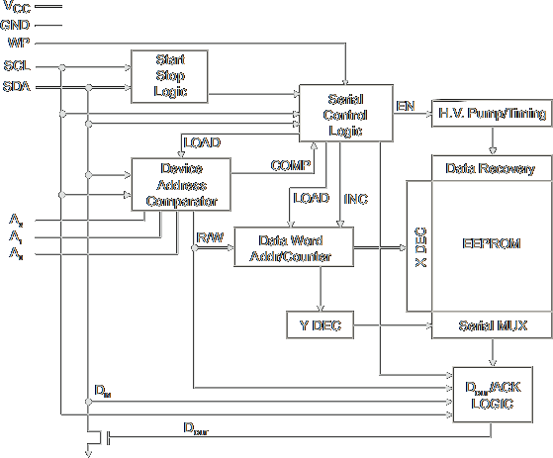
INDUSTRIAL FAULT ALERT SYSTEM
MEMORY
AT24C256
V23HE8Q1

Slide 8
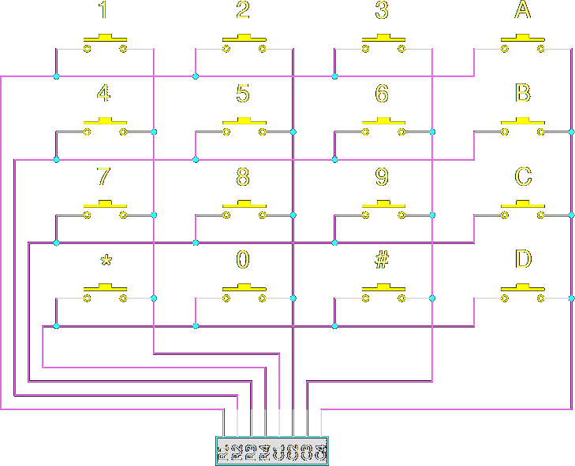
INDUSTRIAL FAULT ALERT SYSTEM
INPUT
KEYPAD
SWITCH
V23HE8Q1

Slide 9
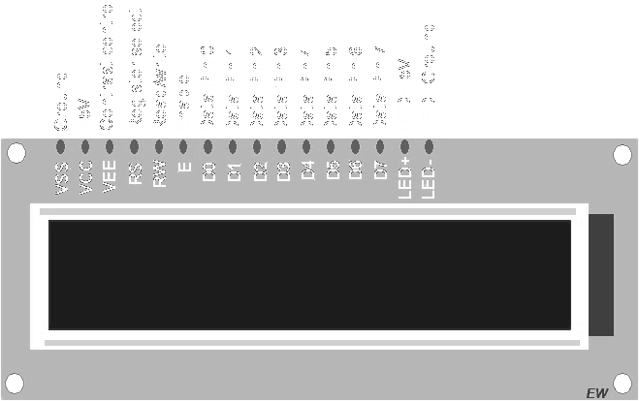
INDUSTRIAL FAULT ALERT SYSTEM
INPUT
LCD
LED
V23HE8Q1

Slide 10
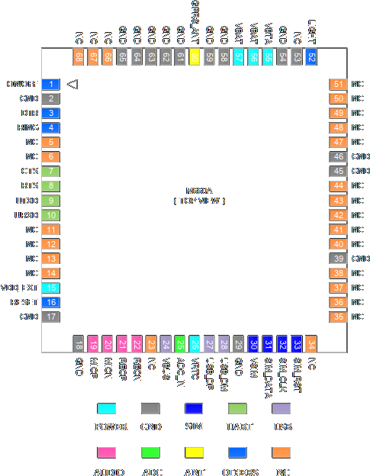
INDUSTRIAL FAULT ALERT SYSTEM
GSM
M550A
V23HE8Q1

Slide 11
INDUSTRIAL FAULT ALERT SYSTEM
PROJECT IMPLEMENTATION
V23HE8Q1

Slide 12
INDUSTRIAL FAULT ALERT SYSTEM
BLUEPRINT
FAULT IDENTIFICATION (SENSOR)
BROADCAST OF ALERT (SMS, PAS)
SAFETY THRESHOLD MAINTAINANCE (GSM, ON-DEVICE)
V23HE8Q1

Slide 13
INDUSTRIAL FAULT ALERT SYSTEM
FAULT IDENTIFICATION
THRESHOLD LOADING
CONSTANT MONITORING
FAULT HANDLING
V23HE8Q1

Slide 14
INDUSTRIAL FAULT ALERT SYSTEM
ALERT
BROADCAST OF SMS
LOCAL PHYSICAL ALERT INITIATION
POST MITIGATION ALERT HANDLING
V23HE8Q1

Slide 15
INDUSTRIAL FAULT ALERT SYSTEM
MAINTAINANCE
ON-DEVICE
REMOTE SMS
SECURITY
V23HE8Q1

