Slide 1
Deep Learning-Based Detection of Mangrove Gain and Loss in Aringay La Union
Nash Francis M. Caluza
Reymark O. Boado
Erica Meneses
Elaiza Praise Y. Milana
Lyka B. Vejano
Adviser: Fernan H. Mendoza, DIT
Bachelor of Science in Computer Science
Don Mariano Marcos Memorial State University – South La Union Campus · College of Computer Science
Notes:
Before we begin, may we kindly request everyone to rise as Erica Meneses leads us in prayer.
"Good afternoon, dear panelist. We present our thesis proposal, 'Deep Learning-Based Detection of Mangrove Gain and Loss in Aringay, La Union.’ . We are Caluza, Boado, Meneses, Milana, and Vejano, and our adviser is Dr. Fernan H. Mendoza."

Slide 2
INTRODUCTION
Situation Analysis
WHY MANGROVES MATTER
MANGROVES IN DECLINE
PROVEN TOOLS, FREE DATA
▸ Global cover significantly decreased; loss acute in Southeast Asia (Worthington et al., 2020; FAO, 2023; Lomeo & Singh, 2022)
▸ Philippines: historically 400,000–500,000 ha; considerable reductions since (Pillodar et al., 2023; Sasi et al., 2025)
▸ Drivers vary by region: aquaculture, reclamation, land-use change (Primavera, 2000)
▸ Deep learning + remote sensing now standard for environmental monitoring; CNNs lead (Zhang et al., 2025)
▸ Sentinel-2: freely available, recurrent multispectral imaging (ESA, 2024)
▸ Coastal defense & biodiversity habitat
▸ Carbon storage & environmental balance
Notes:
Why Magrove Matter? Mangrove are important because it protects the coastline from the waves and erosion, it is also become a habitat for different species, and it stores carbon, which contributes tp climate change mitigation.
However, according to Food and Angriculture Organization in United Nations and Lomeo and Singh, global mangrove cover has been significantly decreasing, especially in South East Asia. In the Philippine context, historical estimates place between 400,000 to 500,000 hectares, with considerable reductions reported since, cause by aquaculture expansion, land reclamation, and land use change that vary by regional context.
At the same time, Deep Learning combines with remote sensing has become the standard for environmental monitoring, where Convolutional Neural Network established as the leading methodology supported by multispectral imagery from Sentinel-2
Sentinel 2 = European Space Agency

Slide 3
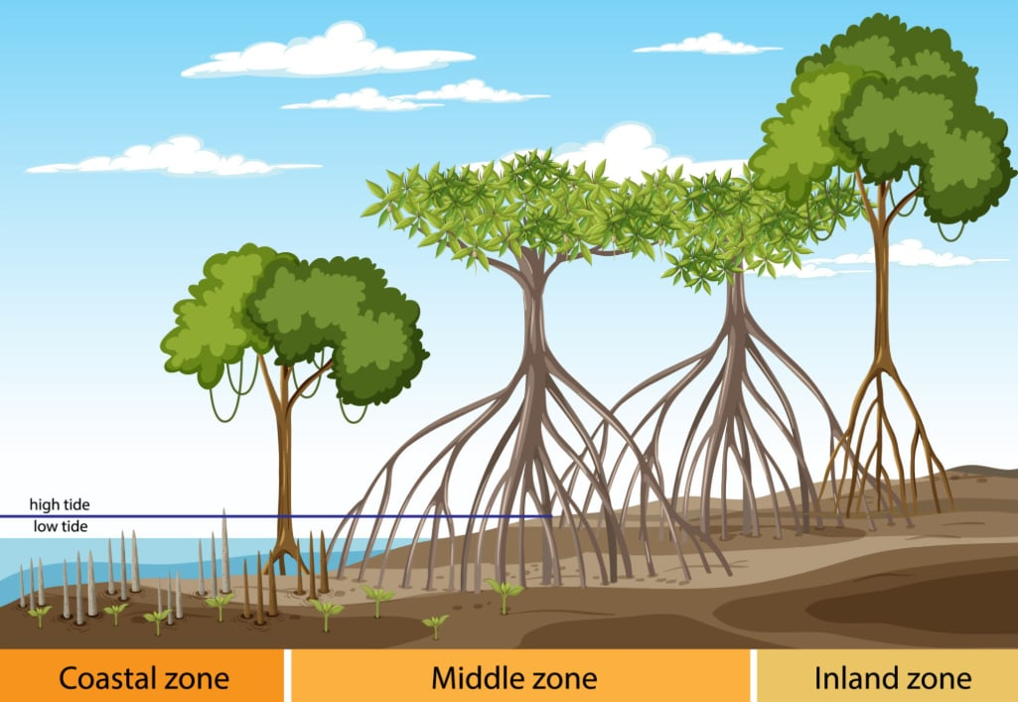
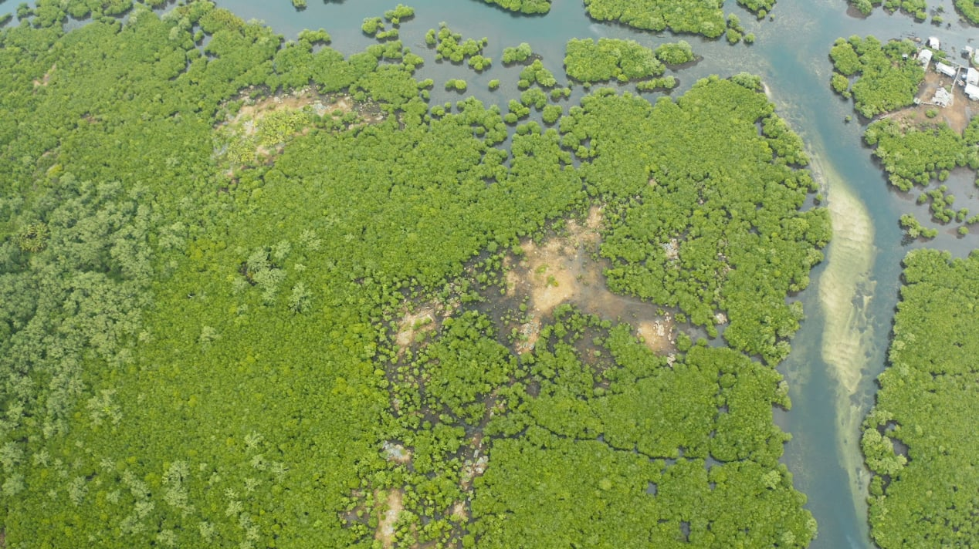
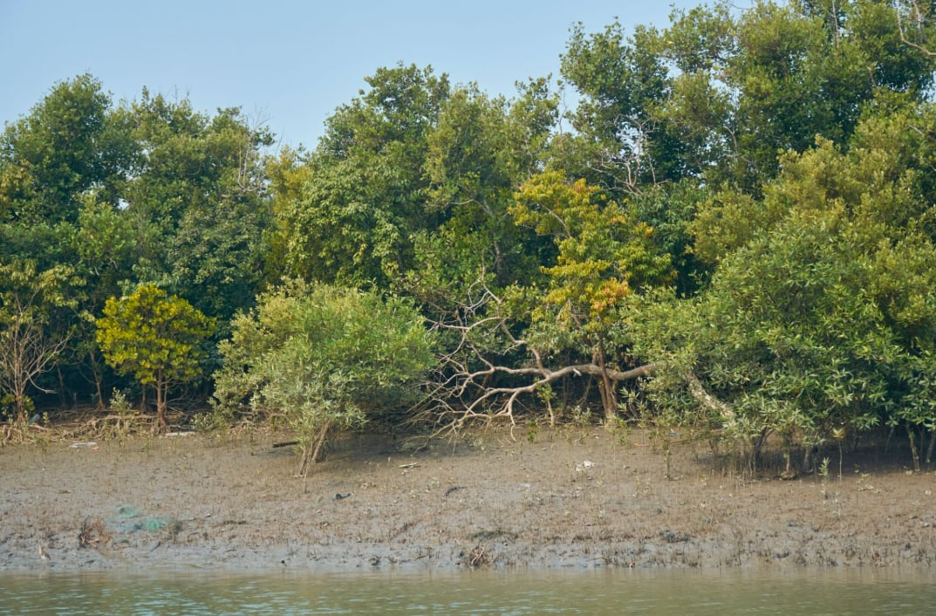
RESEARCH GAP
What Existing Work Does Not Cover
▸ Coarse global & national products — Global Mangrove Watch & the 2023 Philippine Mangrove Map use low resolutions and generalized methods → may miss localized transitions, fragmentations, narrow coastlines
▸ No localized dataset — U-Net + Sentinel-2 proven in Myanmar, Florida, and Bohol; no localized dataset exists for Barangay Dulao
The solution: a localized mangrove dataset + a combined gain-and-loss detection approach for Barangay Dulao, Aringay, La Union.
Notes:
Existing global and national products—like the Global Mangrove Watch and the 2023 Philippine Mangrove Map—rely on coarse resolutions and generalized methods. Because of this, they often miss fine-grained localized transitions, patch fragmentation, and the narrow coastal strips specific to Barangay Dulao. While combining U-Net with Sentinel-2 imagery has proven successful in places like Myanmar, Florida, and locally in Bohol, there is currently no localized, ground-verified dataset for our specific study area. Now, we acknowledge that transformer-based models have surpassed U-Net in some recent mangrove-monitoring studies. However, transformers demand massive, highly diverse training datasets—far beyond what is available for a small, localized site like ours. This brings us to our research gap: creating a localized mangrove dataset coupled with a gain-and-loss detection approach for Barangay Dulao, Aringay, La Union. U-Net remains the ideal choice here—it is proven effective in similar Philippine coastal settings and perfectly right-sized for our data and computational constraints."

Slide 4
National Policy Alignment — Supports ecosystem accounting under the Philippine Ecosystem and Natural Capital Accounting System (PENCAS) Act, RA 11995, providing an objective monitoring tool for local environmental governance.
Notes:
"Our study supports three global goals. SDG 13, Climate Action — mangroves store a lot of carbon, so tracking their loss helps monitor climate impact. SDG 14, Life Below Water — mangroves protect coastlines and give fish a place to live and breed. And SDG 15, Life on Land — our study helps monitor and protect coastal forests.
We also support a Philippine law called the PENCAS Act, which requires the government to keep track of natural resources like forests and mangroves — almost like counting them as assets. Our system helps with this directly, because it produces exactly what's needed: yearly maps and area numbers showing how much mangrove was gained or lost, in hectares."

Slide 5
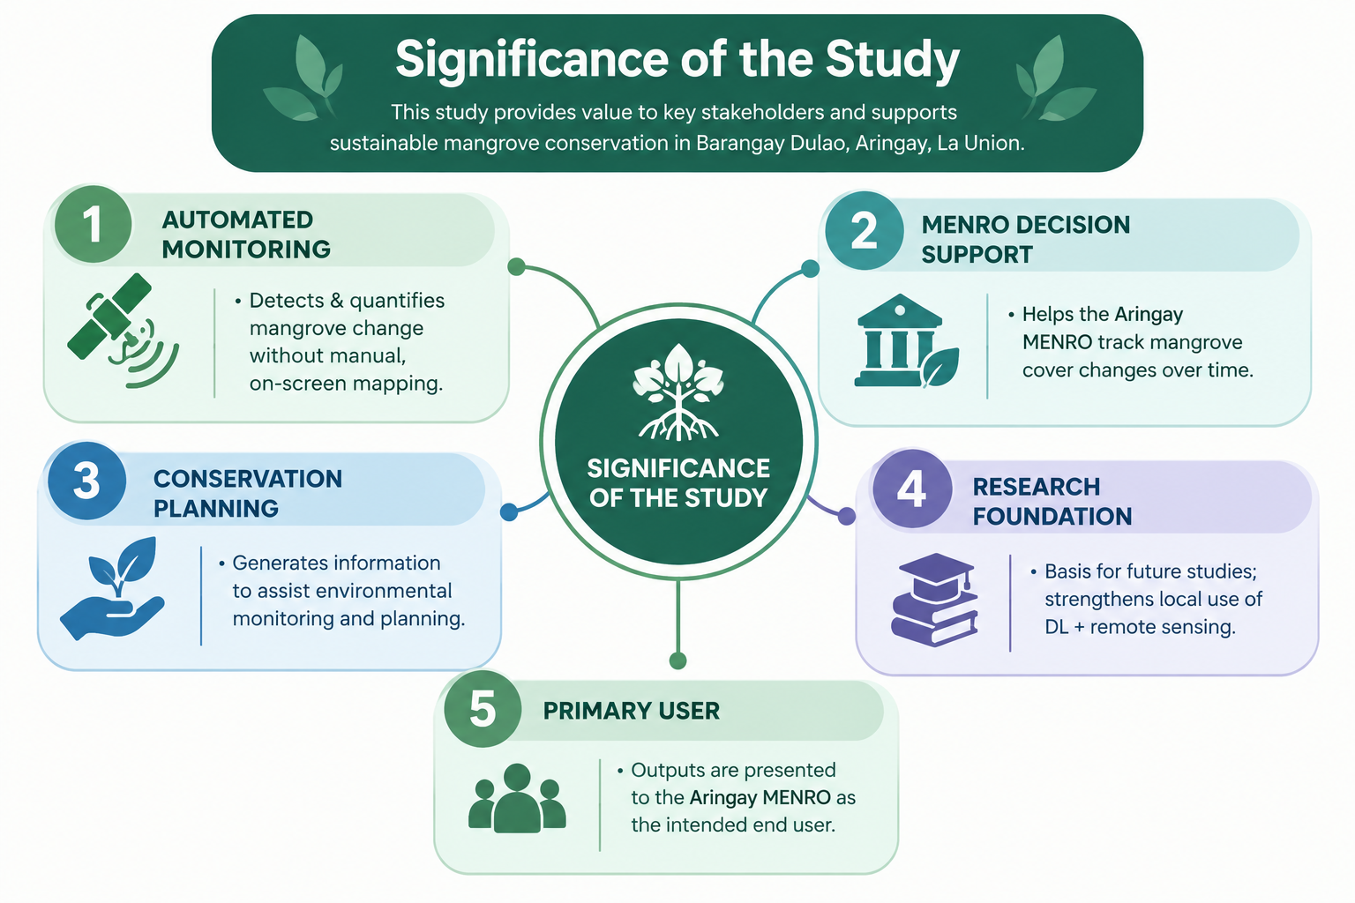
IMPACT
Significance of the Study
▸ Basis for future studies; strengthens local use of DL + remote sensing.
Notes:
This study contributes an automated monitoring capability that detects and quantifies mangrove cover change without manual, on-screen digitization. It directly supports the Aringay MENRO's decision-making by enabling systematic tracking of mangrove cover changes over time. Because the dataset and model are localized to Barangay Dulao, the resulting spatial information captures barangay-scale detail that national and global databases cannot resolve. Beyond its immediate application, this study establishes a reusable local framework and dataset that can serve as a foundation for future research applying deep learning and remote sensing to coastal resource management in the region."

Slide 6
OBJECTIVES
Statement of Objectives
General objective: To develop an image processing system that automatically detects and quantifies mangrove cover change over time in Aringay, La Union, using satellite imagery and deep learning–based segmentation.
SPECIFIC OBJECTIVES
1
Collect a localized mangrove dataset
2
Train the mangrove gain-and-loss detection model using U-Net
Evaluate model performance in terms of F1-score, Intersection over Union (IoU), and mean Average Precision (mAP)
3
Notes:
Our general objective is to develop an image processing system that automatically detects and quantifies mangrove cover change over time in Aringay, La Union, using satellite imagery and deep learning-based segmentation. Specifically, this study aims to: one, collect a localized mangrove dataset; two, train the mangrove gain-and-loss detection model using the U-Net architecture; and three, evaluate model performance in terms of F1-score, Intersection over Union, and mean Average Precision."

Slide 7
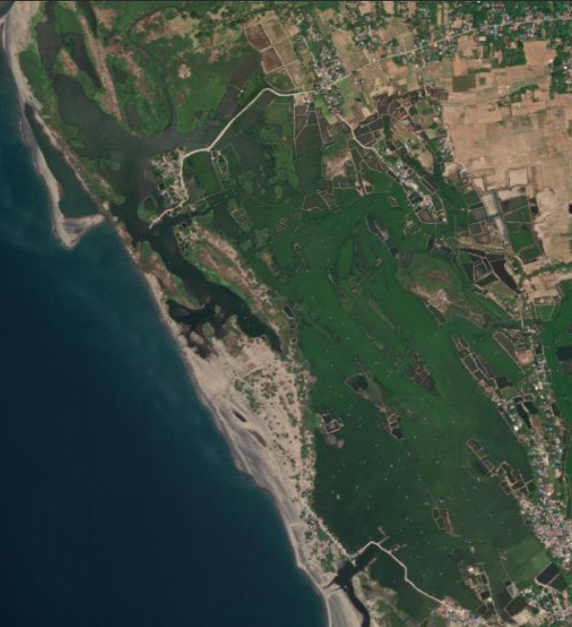
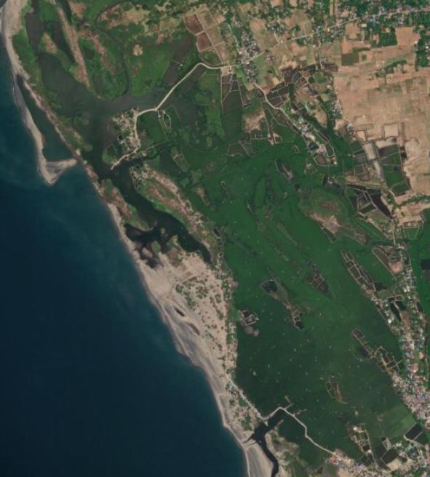
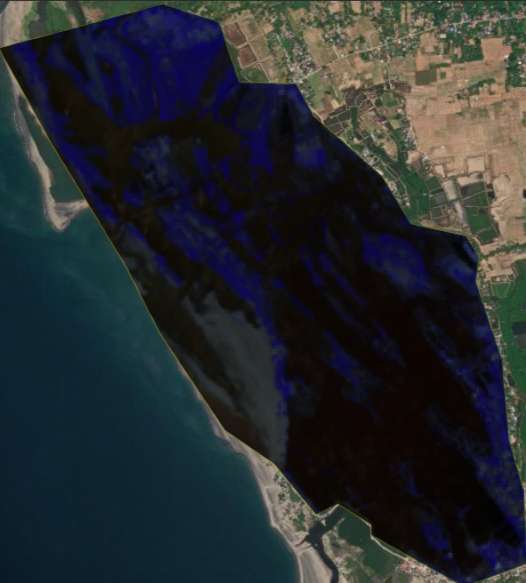

TIME and PLACE
SATELLITE IMAGE
2019
2024
Notes:
Here, we can see sample Sentinel-2 satellite imagery of Barangay Dulao for the years 2019 and 2024.
At first glance, the two images appear relatively similar, and the changes in mangrove cover are not immediately obvious through visual inspection alone.
This is one of the challenges of using conventional visual inspection. Some changes in vegetation may not be easily distinguished because satellite images contain information beyond what we can see through their true-color appearance.
However, when we use the different spectral bands and NDVI, we can better distinguish vegetation and identify differences that may not be easily visible in the true-color imagery.
To better visualize this, we will now look at these inputs one by one and see how each one reveals different information from the same area.”

Slide 8
COMPARISON
SATELLITE IMAGE
Notes:
“First, we have the 2019 image, followed by the 2024 image.
Now, we can apply the same visualization to the spectral inputs used in our study.
Here, we can start to see more differences between the two years. The purple or bluish areas may represent possible mangrove vegetation, while the darker areas may correspond to other land-cover features such as ponds, grass, or other surrounding areas.
When we compare 2019 and 2024, some areas appear to have differences in their vegetation patterns and coverage. However, these visual differences alone are not enough to accurately determine whether an area is actually mangrove or whether it represents mangrove gain or loss.
This is where our deep learning approach comes in. The spectral information will be used as input to the U-Net model to help identify mangrove and non-mangrove areas more systematically. The resulting maps can then be compared across the different years to identify possible areas of mangrove gain, loss, or stability.”

Slide 9
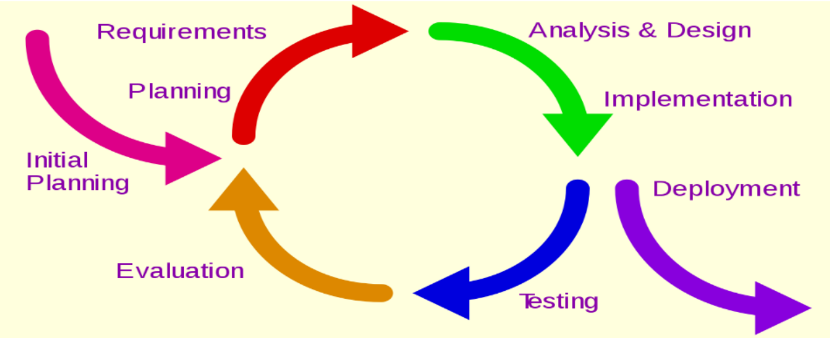
METHODOLOGY
Research Design
  Approach: Hybrid Experimental–Descriptive Research Design
  Framework: Iterative and Incremental Development (IID)
  Purpose: Guides development through repeated cycles of building, testing, and refinement (Larman & Basili, 2003; Ibrahim et al., 2020).
Notes:
For our methodology, we employ a hybrid experimental-descriptive research design. The experimental phase covers dataset preparation using Sentinel-2 imagery and reference masks, training our U-Net model for pixel-level binary segmentation, and evaluating overall accuracy using standard metrics like IoU, F1-score, and mAP. Once the model is finalized, we transition to the descriptive phase. Here, we generate and compare annual mangrove maps from 2019 to 2024 to report total area, stability, gains, and losses over time. To maintain strict methodological consistency across all six years, model refinements are restricted entirely to the development phase—meaning the model configuration and classification thresholds are completely locked before multi-temporal application. "Finally, mapped changes are classified as probable land-cover shifts, not confirmed ecological causes. Because factors like high tides or erosion can alter image data, we only claim definitive causes when backed by local records or ground-truth evidence."

Slide 10
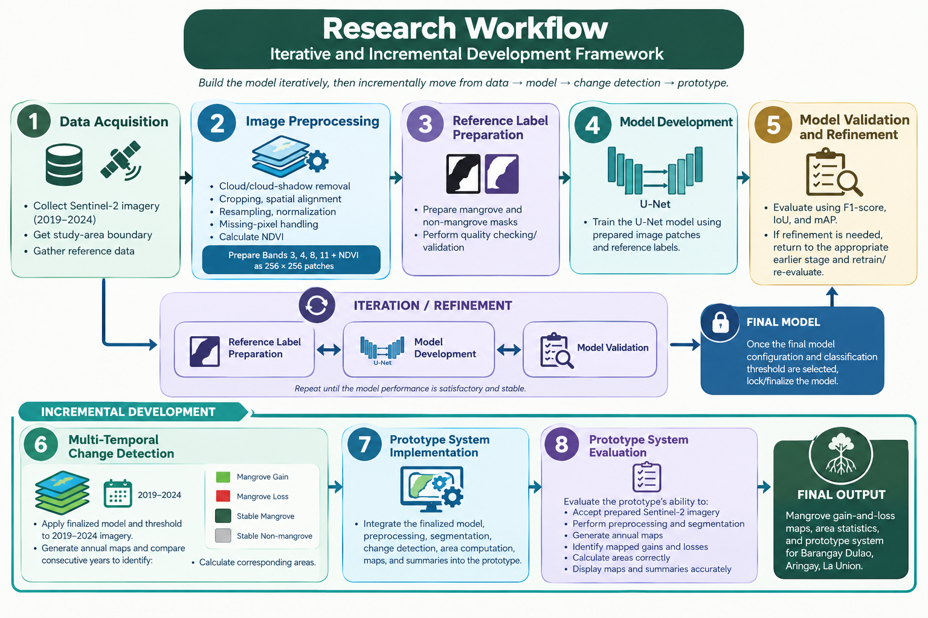
METHODOLOGY
Research Workflow — Iterative & Incremental Development
Incremental: data → model → change detection → working prototype
Iterative: labels → Phase 3 ·
preprocessing → Phase 2 ·
training parameters → Phase 4
Notes:
"Our development process follows the Iterative and Incremental Development framework (Larman & Basili, 2003; Ibrahim et al., 2020). The principal iteration loop occurs among Phases 3 through 5 — dataset labeling, model training, and model validation — and repeats until validation metrics stop improving relative to our baseline. The iterative component specifically governs label correction in Phase 3, preprocessing adjustments in Phase 2, and training-parameter refinement in Phase 4, while the incremental component governs the progressive build-out of the full system: from data preparation, to the trained model, to change detection, to the final working prototype."

Slide 11
MATERIALS & PROCEDURES
Dataset Collection & Preparation
PRIMARY DATA — SENTINEL-2 IMAGERY
PREPARATION
▸ Barangay Dulao mangrove area 2019–2024
▸ Bands: B3 Green, B4 Red, B8 NIR, B11, SWIR
▸ NDVI = (B8 − B4) / (B8 + B4) — explicit vegetation-health signal
▸ Selection: full coverage · minimal cloud · low shading
▸ Cloud/shadow removal · crop to boundary · grid alignment · normalization · missing-pixel handling
▸ B11 resampled 20 m → 10 m (bilinear) to unify the stack
▸ 256 × 256 patches · 5-channel input · pixel-aligned masks
Notes:
"Our primary dataset consists of Sentinel-2 multispectral imagery of Barangay Dulao's mangrove area, spanning 2019 to 2024. The input configuration comprises Bands 3, 4, 8, and 11 — green, red, near-infrared, and short-wave infrared, respectively — together with the derived Normalized Difference Vegetation Index, calculated as NDVI equals B8 minus B4, over B8 plus B4. Scene selection prioritizes full geographic coverage, minimal cloud cover, and low shading. Preprocessing includes cloud and cloud-shadow masking, boundary clipping, spatial grid alignment, normalization, and no-data handling. Since Band 11's native resolution is 20 meters versus the 10-meter resolution of Bands 3, 4, and 8, Band 11 is resampled using bilinear interpolation to produce a unified five-channel input stack, subsequently divided into 256-by-256 pixel patches. Reference labels are binary — one for mangrove, zero for non-mangrove — constructed from the Global Mangrove Watch, the 2023 Philippine Mangrove Map, and Aringay MENRO records, treated as guidance rather than assumed ground truth. To avoid a conflict of interest, since the researchers themselves prepare the initial labels, these labels are independently validated by the Aringay MENRO's core officers before the dataset is partitioned into an 80 percent training set and a 20 percent validation set."

Slide 12
MATERIALS & PROCEDURES
Dataset Collection & Preparation
PRIMARY DATA — SENTINEL-2 IMAGERY
PREPARATION
▸ Barangay Dulao mangrove area 2019–2024
▸ Bands: B3 Green, B4 Red, B8 NIR, B11, SWIR
▸ NDVI = (B8 − B4) / (B8 + B4) — explicit vegetation-health signal
▸ Selection: full coverage · minimal cloud · low shading
▸ Cloud/shadow removal · crop to boundary · grid alignment · normalization · missing-pixel handling
▸ B11 resampled 20 m → 10 m (bilinear) to unify the stack
▸ 256 × 256 patches · 5-channel input · pixel-aligned masks
Notes:
"Our primary dataset consists of Sentinel-2 multispectral imagery of Barangay Dulao's mangrove area, spanning 2019 to 2024. The input configuration comprises Bands 3, 4, 8, and 11 — green, red, near-infrared, and short-wave infrared, respectively — together with the derived Normalized Difference Vegetation Index, calculated as NDVI equals B8 minus B4, over B8 plus B4. Scene selection prioritizes full geographic coverage, minimal cloud cover, and low shading. Preprocessing includes cloud and cloud-shadow masking, boundary clipping, spatial grid alignment, normalization, and no-data handling. Since Band 11's native resolution is 20 meters versus the 10-meter resolution of Bands 3, 4, and 8, Band 11 is resampled using bilinear interpolation to produce a unified five-channel input stack, subsequently divided into 256-by-256 pixel patches. Reference labels are binary — one for mangrove, zero for non-mangrove — constructed from the Global Mangrove Watch, the 2023 Philippine Mangrove Map, and Aringay MENRO records, treated as guidance rather than assumed ground truth. To avoid a conflict of interest, since the researchers themselves prepare the initial labels, these labels are independently validated by the Aringay MENRO's core officers before the dataset is partitioned into an 80 percent training set and a 20 percent validation set."

Slide 13
MATERIALS & PROCEDURES
DATA LABELING & MENRO VALIDATION
BINARY MASK PREPARATION
INDEPENDENT MENRO VALIDATION
1
= MANGROVE
0
= NON-MANGROVE
The researchers who prepare the initial labels are the same people who train and evaluate the model.
Left unchecked, this is a conflict of interest — the model could simply be graded against its own creators' assumptions.
Every pixel in the reference mask is labeled using available mangrove datasets, local records, and high-resolution imagery — assigned a value of 1 if it is mangrove, or 0 if it is not.
Notes:
"Every pixel is labeled 1 for mangrove, 0 for non-mangrove, using available datasets, local records, and imagery — with extra care on fragmented stands, narrow strips, and mangrove-water boundaries.
Since we're the ones both labeling the data and training the model, that's a conflict of interest. To fix this, our labels will be independently validated by the Aringay MENRO's core officers, who are separate from our team and know the area firsthand."

Slide 14
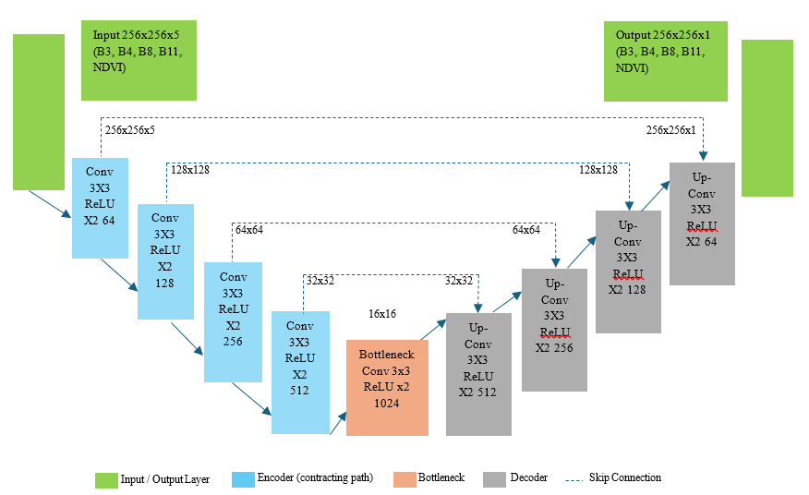
MODEL DEVELOPMENT
U-Net Architecture
WHY U-NET FITS THIS TASK
▸ Goal is pixel-level classification, not whole-image classification
▸ Skip connections preserve mangrove boundaries & small/fragmented patches
▸ Proven in comparable settings; lower data & compute than transformers (Ronneberger et al., 2015)
TRAINING CONFIGURATION
▸ Adam optimizer · learning rate 0.001 · binary cross-entropy loss
▸ Batch size, epochs, augmentation, class-imbalance handling, stopping criteria recorded
▸ Training vs. validation loss monitored for overfitting/underfitting
Notes:
This diagram illustrates the U-Net convolutional neural network architecture used in our study.
U-Net uses the encoder-decoder architecture and skip connections and is design to classify images at the pixel level
This architecture is appropriate to our study because we need to identify the specific pixel that represents mangrove areas rather than simply classifying an entire image
Our model receives an input image 256x256 pixel patch with 5 input channels.
This channels will provide satellite information that the model will use to distinguish mangrove and non-mangrove areas
According to Ronneberger et al. the encoder gradually decreases the spatial size of the image through repeated downsampling, while increasing the number of feature channels.
The image goes from 256x256 pixel patch down to 16x16. We can also see that the number of features channels are increasing from 64 to 1024. As the encoder compresses the image, it trades away fine spatial detail in exchange for learning increasingly abstract, higher-level patterns.
The bottleneck allows the model to process the deeper patterns that it has learned from the input. This is where the model holds its most abstract understanding of the image's content, right before the decoder begins reconstructing spatial detail.
The decoder does the opposite of the encoder it gradually increases the spatial size of the image through repeated upsampling, while decreasing the number of feature channels. This way the image will reconstruct and determine the location mangrove area.
Skip connection is very important because it transfer information from encoder directly to its corresponding decoder. This helps return fine spatial detail that would otherwise be lost during compression, which is especially useful for preserving mangrove boundaries and small, fragmented areas.
Output layer uses a sigmoid activation function to produce a 256x256x1 probability map, where each pixel will receives 0 and 1
"We train using the Adam optimizer with a learning rate of 0.001, and binary cross-entropy as our loss function, since this is standard for pixel-by-pixel binary classification. During training, we record parameters like batch size, epochs, augmentation, and class-imbalance handling for every iteration, so we know exactly what to adjust if a model underperforms. We also monitor training and validation loss together to catch overfitting or underfitting early, before we even reach formal evaluation with F1, IoU, and mAP."

Slide 15
MODEL EVALUATION
Model Validation and Refinement
F1-SCORE
IoU
mAP
2TP / (2TP + FP + FN)
TP / (TP + FP + FN)
AP = Σ (Rₙ − Rₙ₋₁) × Pₙ
What it measures?
What it measures?
What it measures?
Balance between correctly identified and missed mangrove pixels.
Overlap between predicted and reference mangrove areas.
Model performance across different classification thresholds.
Notes:
F1-score evaluates the harmonic balance between precision and recall, ensuring a balanced assessment that accounts for both false positives and false negatives.
Intersection over Union, or IoU, evaluates spatial overlap by measuring the ratio of intersection over union between the predicted mangrove boundaries and the reference ground-truth masks — this metric, together with F1-score, is consistently used in comparable mangrove segmentation studies, including Maung et al. (2024) and Auxtero & Villamor (2026).
Mean Average Precision, or mAP, evaluates model confidence across different classification thresholds by computing the area under the precision-recall curve, following our own study-specific threshold-sweep procedure. In our single-class segmentation setup, mAP reduces to the Average Precision of the mangrove class specifically.

Slide 16
MULTI-TEMPORAL ANALYSIS
Change Detection: Mangrove Gain & Loss
Locked model applied uniformly to all years → annual binary maps 2019–2024
2019–2020
2020–2021
2021–2022
2022–2023
2023–2024
Overall 2019–2024
Area statistics: 10 m grid → 1 pixel = 100 m²
TRANSITION CATEGORIES
EARLIER YEAR
LATER YEAR
Area(ha) = N x 100 m2 / 10,000 m2 /ha
Non-mangrove
Mangrove
Mapped mangrove gain
Mangrove
Non-mangrove
Mapped mangrove loss
Area(ha) = N / 100
Stable mangrove
Mangrove
Mangrove
Where N represent the number of classified pixel
Non-mangrove
Non-mangrove
Stable non-mangrove
Notes:
"After the model and threshold are locked, they are applied uniformly to preprocessed Sentinel-2 imagery for each observation year from 2019 to 2024, producing annual binary mangrove and non-mangrove maps. Consecutive-year pairs — 2019 to 2020 through 2023 to 2024 — are compared pixel-by-pixel to classify transitions into four categories: a pixel transitioning from non-mangrove to mangrove is classified as mapped mangrove gain; the reverse is mapped mangrove loss; and pixels retaining the same classification across both years are classified as stable mangrove or stable non-mangrove, respectively. Since the final classified imagery uses a 10-meter spatial grid, each pixel represents 100 square meters, so area in hectares is calculated as the pixel count N divided by 100. Because the same model configuration, five-channel input structure, preprocessing procedure, patch size, and classification threshold are applied consistently across every observation year, any observed temporal differences are attributable to actual land-cover change rather than methodological inconsistency."

Slide 17
MULTI-TEMPORAL ANALYSIS
Prototype Implementation & Evaluation
The Prototype Workflow
Preprocessing
>
Segmentation
>
Change Mapping
>
Reporting
What It Does
Functional Evaluation (Phase 8)
Accepts prepared Sentinel-2 imagery
Rather than another model-training or model-selection stage, this phase verifies the system works as intended — confirming each step above executes correctly, with area calculations independently re-verified from the classified pixel counts.
Executes preprocessing and segmentation automatically
Generates annual mangrove-cover maps
Identifies mapped gain and loss between years
Practical Tool Delivery
Calculates corresponding area in hectares
The completed prototype presents its outputs — maps, tables, and area statistics — directly to Aringay MENRO, delivering a practical, working tool rather than a theoretical model alone.
Displays maps, tables, and summary information to the user
Notes:
"Once the model is finalized, we integrate it into a working prototype covering four stages: preprocessing, segmentation, change mapping, and reporting. It automatically processes imagery, generates annual maps, identifies gain and loss, computes area in hectares, and displays the results.
Phase 8 is not more model training — it's a functional check, confirming the system runs correctly and that area calculations match the actual pixel counts. The end goal is a practical tool Aringay MENRO can actually use."

Slide 18
THANK YOU
Deep Learning-Based Detection of Mangrove Gain and Loss in Aringay La Union
Caluza · Boado · Meneses · Milana · Vejano | Adviser: Fernan H. Mendoza, DIT
DMMMSU – South La Union Campus · College of Computer Science

