Slide 1

Lecture 1 – Introduction Phan Quoc Huy huypq@uit.edu.vn
University of Information Technology
Department of Computer Engineering
PH002 - INTRODUCTION TO DIGITAL SYSTEMS
PH002 - Digital Logic Design
Phan Quốc Huy (huypq@uit.edu.vn)

Slide 2
Agenda
Overview
Digital vs. Analog
Digital hardware
Fundamental concepts
Types of chips
Development process
Achievements
PH002 - Digital Logic Design
Phan Quốc Huy (huypq@uit.edu.vn)

Slide 3
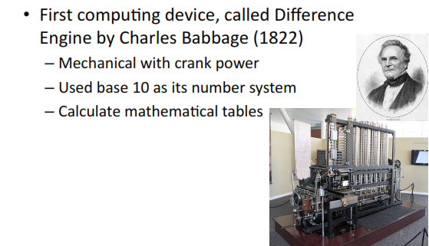
First machine
PH002 - Digital Logic Design
Phan Quốc Huy (huypq@uit.edu.vn)

Slide 4
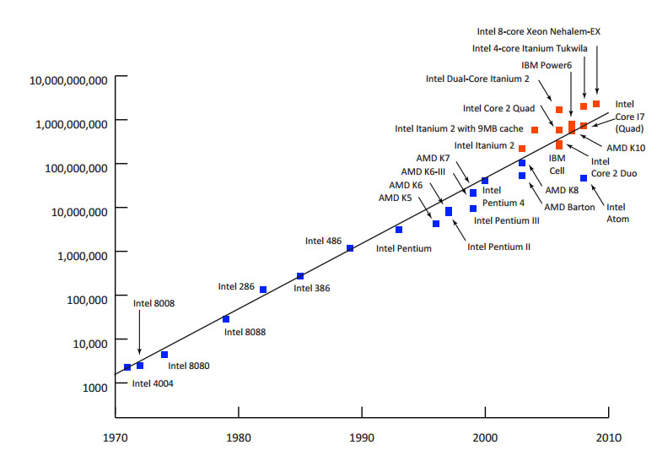
Where we are today?
CPU Transistor Counts 1971-2008 & Moore’s Law
from www.embedded.com
PH002 - Digital Logic Design
Phan Quốc Huy (huypq@uit.edu.vn)

Slide 5
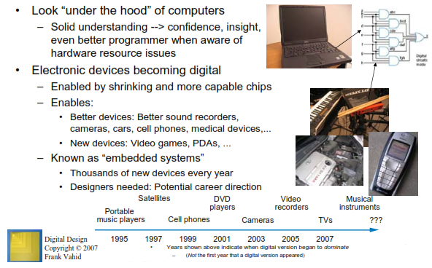
Why study digital design?
PH002 - Digital Logic Design
Phan Quốc Huy (huypq@uit.edu.vn)

Slide 6
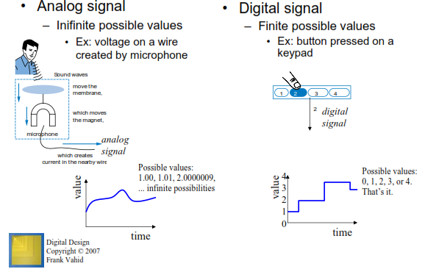
Analog vs. Digtial
PH002 - Digital Logic Design
Phan Quốc Huy (huypq@uit.edu.vn)

Slide 7
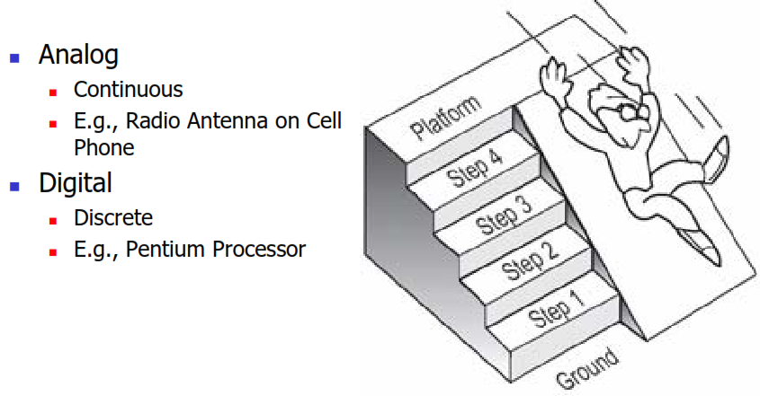
Analog vs. Digital
PH002 - Digital Logic Design
Phan Quốc Huy (huypq@uit.edu.vn)

Slide 8
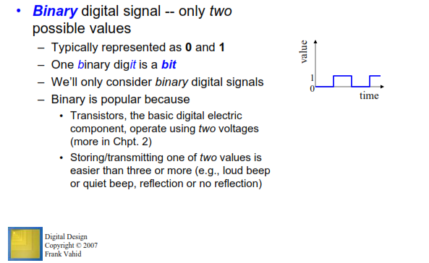
What does “Digital” mean?
PH002 - Digital Logic Design
Phan Quốc Huy (huypq@uit.edu.vn)

Slide 9
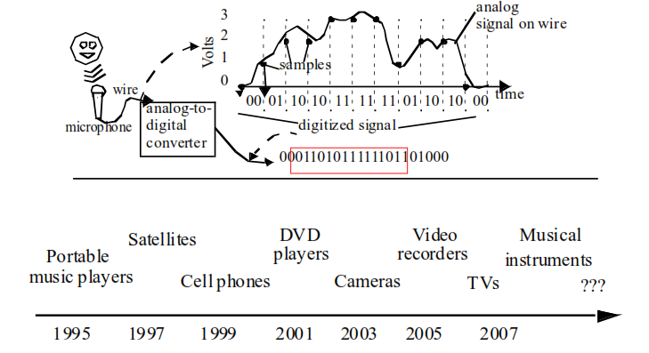
Analog to Digital
PH002 - Digital Logic Design
Phan Quốc Huy (huypq@uit.edu.vn)

Slide 10
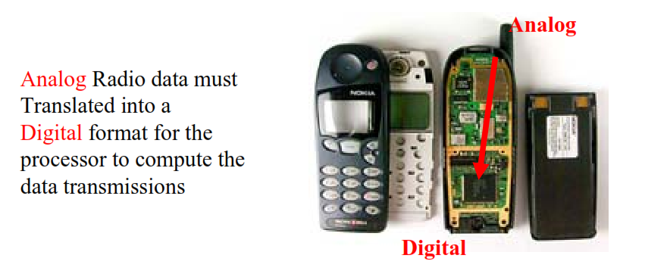
Analog to Digital
PH002 - Digital Logic Design
Phan Quốc Huy (huypq@uit.edu.vn)

Slide 11
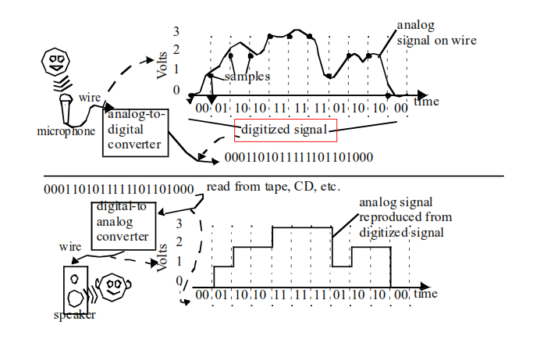
Digital to Analog
PH002 - Digital Logic Design
Phan Quốc Huy (huypq@uit.edu.vn)

Slide 12
Analog vs. Digital
Analog systems can generally handle higher power than digital systems.
Digital systems can process, store, and transmit data more efficiently but can only assign discrete values to each point.
PH002 - Digital Logic Design
Phan Quốc Huy (huypq@uit.edu.vn)

Slide 13
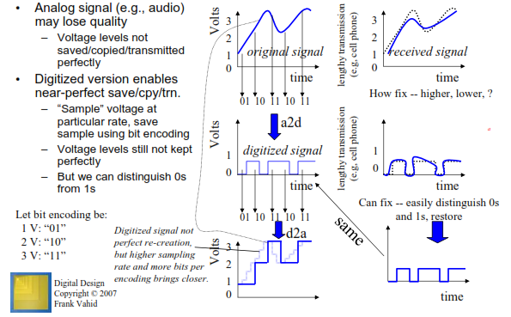
Example: Digitization Benefit
PH002 - Digital Logic Design
Phan Quốc Huy (huypq@uit.edu.vn)

Slide 14
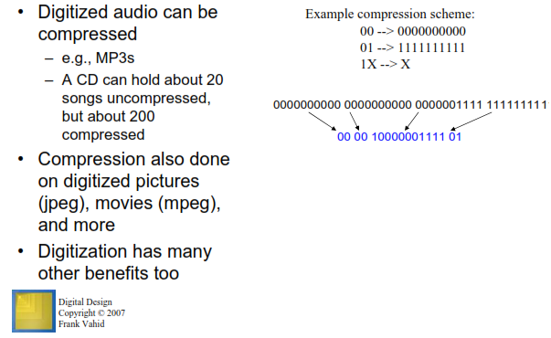
Example: Compression Benefit
PH002 - Digital Logic Design
Phan Quốc Huy (huypq@uit.edu.vn)

Slide 15
Digital Hardware
Logic circuits are used to build digital hardware e.g. digital computers, voice synthesizers, pocket calculators etc.
1960’s to 1970’s saw a revolution of digital hardware with capabilities:
smaller transistors
larger chip’s sizes.
More transistors/chip gives greater functionality, but requires more complexity in the design process.
PH002 - Digital Logic Design
Phan Quốc Huy (huypq@uit.edu.vn)

Slide 16
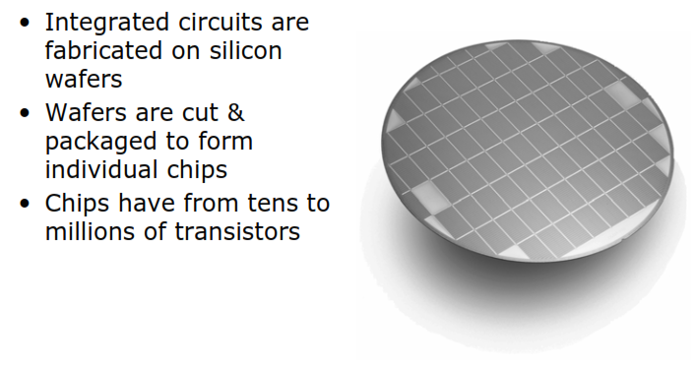
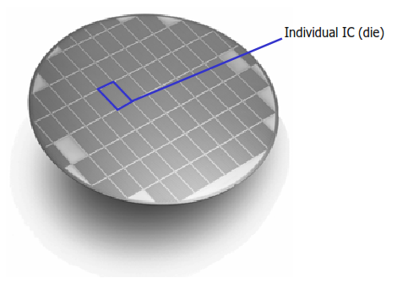
Digital Hardware
Silicon Wafer
PH002 - Digital Logic Design
Phan Quốc Huy (huypq@uit.edu.vn)

Slide 17
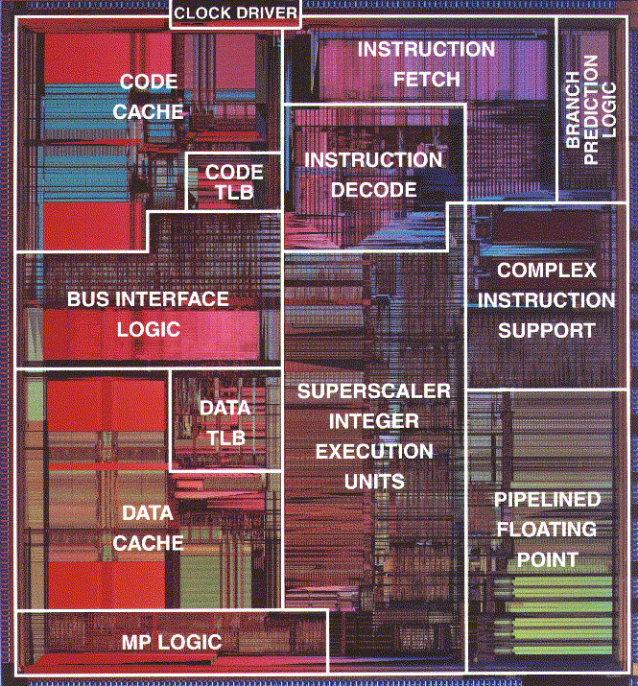
Digital Hardware
Pentium Processor
(Die Photo)
from www.codeine.org
PH002 - Digital Logic Design
Phan Quốc Huy (huypq@uit.edu.vn)

Slide 18
How complex is a digital design?
Complexity can, and generally does, surpass human capability
– 16 million transistors/cm² now
– 100 million transistors/cm² in 10 years (?)
• Provides motivation for computer-based design techniques
• Most engineering work is done with Computer-Aided Design (CAD) packages
PH002 - Digital Logic Design
Phan Quốc Huy (huypq@uit.edu.vn)

Slide 19
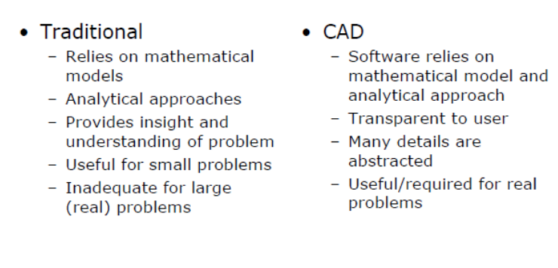
Two design approaches
PH002 - Digital Logic Design
Phan Quốc Huy (huypq@uit.edu.vn)

Slide 20
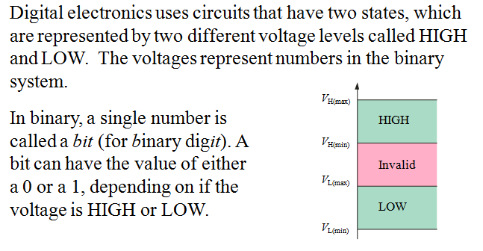
Features of Digital
States
PH002 - Digital Logic Design
Phan Quốc Huy (huypq@uit.edu.vn)

Slide 21
Pulses change between the LOW and HIGH levels. A positive going pulse is one that goes from a normally LOW logic level to a HIGH level and then back again. Digital waveforms are made up of a series of pulses.
Pulse and Waveform
PH002 - Digital Logic Design
Phan Quốc Huy (huypq@uit.edu.vn)

Slide 22
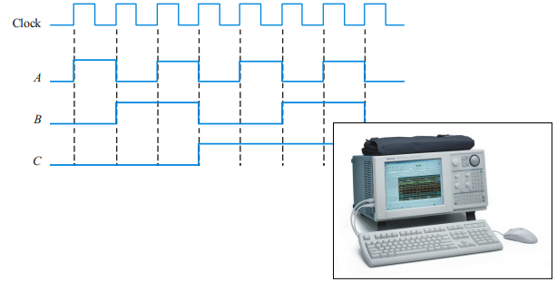
Timing Diagrams
A timing diagram is used to show the relationship between two or more digital waveforms
PH002 - Digital Logic Design
Phan Quốc Huy (huypq@uit.edu.vn)

Slide 23
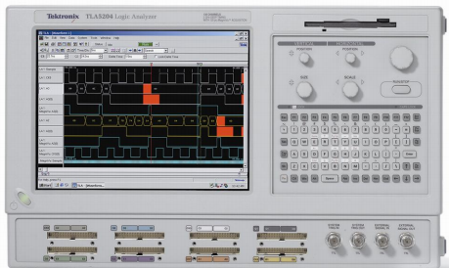
Test and Measurement Instruments
The logic analyzer can display multiple channels of digital information and show data waveforms in tabular form screen.
PH002 - Digital Logic Design
Phan Quốc Huy (huypq@uit.edu.vn)

Slide 24
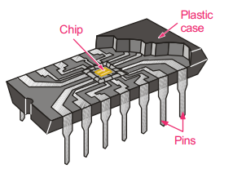
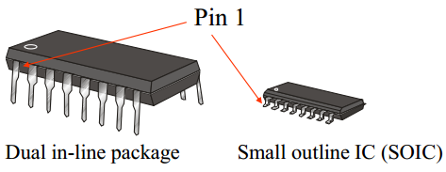
Types of chips
Standard chip
Contain a small amount of logic circuits
Perform simple functions
E.g. 7400 series devices, Integrated circuits (IC)
PH002 - Digital Logic Design
Phan Quốc Huy (huypq@uit.edu.vn)

Slide 25
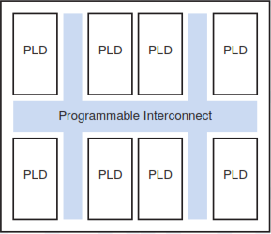
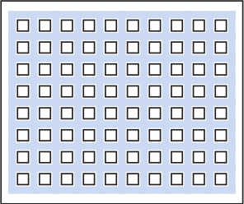
Types of chips
Programmable Logic Devices (PLDs)
A collection of gates with programmable interconnections
Specific function is configurable by designer/user
PLD is designed based on CAD Tools
Complex PLD
FPGA
PH002 - Digital Logic Design
Phan Quốc Huy (huypq@uit.edu.vn)

Slide 26
Types of chips
Custom-designed chips
optimized for some particular tasks
better performance
large volume, lots of logic circuits required
cost of products high
PH002 - Digital Logic Design
Phan Quốc Huy (huypq@uit.edu.vn)

Slide 27
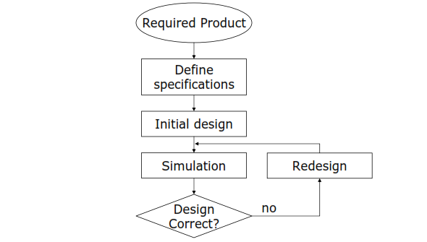
Development process (1)
PH002 - Digital Logic Design
Phan Quốc Huy (huypq@uit.edu.vn)

Slide 28
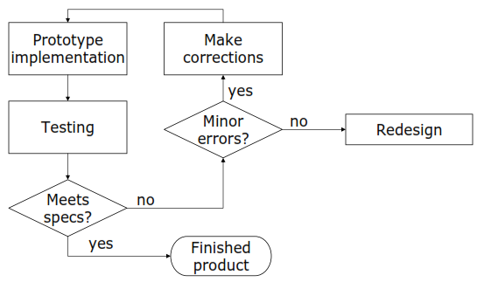
Development process (2)
PH002 - Digital Logic Design
Phan Quốc Huy (huypq@uit.edu.vn)

Slide 29
Achievements
Understanding of concepts, models, algorithms and processes in digital logic design
The ultimate goal is to build digital systems that solve problems for people
Logically, solving design problems skill
PH002 - Digital Logic Design
Phan Quốc Huy (huypq@uit.edu.vn)

Slide 30
ANY QUESTIONS ???
PH002 - Digital Logic Design
Phan Quốc Huy (huypq@uit.edu.vn)

