Slide 1
Number Representation in Digital Systems 05/03/2013
INTRODUCTION TO DIGITAL SYSTEMS

Slide 2
OUTLINE
1. Number systems
Decimal Number
Binary Number
Hexadecimal Number
Octal Number
2. Number systems conversion
3. Binary Operations
4. Signed numbers Representation
5. Other representations
Floating Point Number
BCD
ASCII

Slide 3
1. Number systems
Decimal Number
Binary Number
Hexadecimal Number
Octal Number

Slide 4
Number systems | Radix or base | Digits
Decimal | 10 | 0, 1, 2, 3, 4, 5, 6, 7, 8, 9
Binary | 2 | 0, 1
Octal | 8 | 0, 1, 2, 3, 4, 5, 6, 7
Hexa-decimal | 16 | 0, 1, 2, 3, 4, 5, 6, 7, 8, 9 A, B, C, D, E, F
Number systems

Slide 5
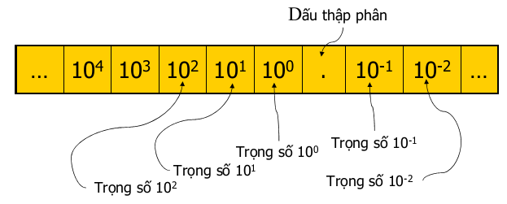
Decimal
Decimal point
weight
weight
weight
weight
weight

Slide 6
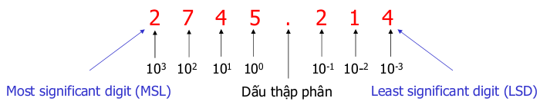
Decimal
Ex: analyze decimal number 2745.214₁₀
2745.214₁₀ =
2 * 10³ + 7 * 10² + 4 * 10¹ + 5 * 10⁰ +
2 * 10⁻¹ + 1 * 10⁻² + 4 * 10⁻³
Decimal point

Slide 7
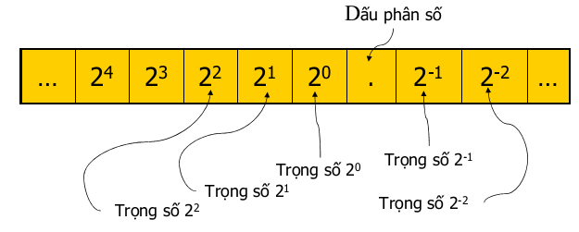
Binary
Binary point
weight
weight
weight
weight
weight

Slide 8
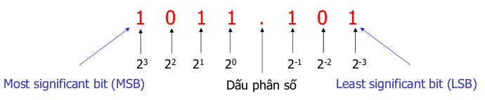
Binary
Ex: Analyze binary number 1011.101₂
1011.101₂ =
1 * 2³ + 0 * 2² + 1 * 2¹ + 1 * 2⁰ +
1 * 2⁻¹ + 0 * 2⁻² + 1 * 2⁻³ = 11.625₁₀
Binary point

Slide 9

Octal
Ex: Analyze octal number 372₈
372₈ =
3 * 8² + 7 * 8¹ + 2 * 8⁰ = 250₁₀

Slide 10

Hexadecimal
Ex: Analyze hex number 3BA₁₆
3BA₁₆ =
3 * 16² + 11 * 16¹ + 10 * 16⁰ = 954₁₀

Slide 11
Example
Một người chạy bộ chạy quanh hồ con rùa muốn sử dụng 10 ngón tay của mình để đếm số vòng chạy được. Người này có thể đếm bao nhiêu vòng một cách thuận tiện? Giải thích ngắn gọn câu trả lời của bạn.

Slide 12
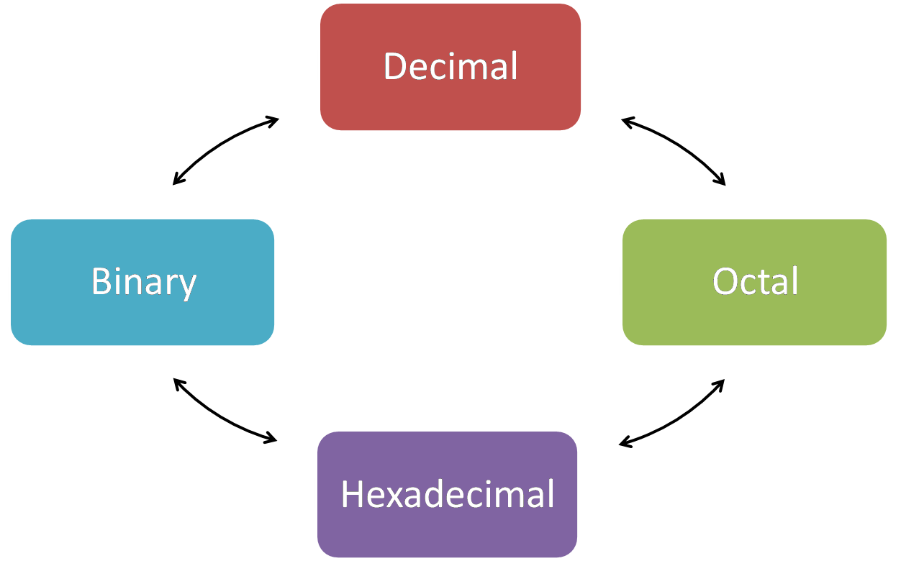
Number system conversion

Slide 13
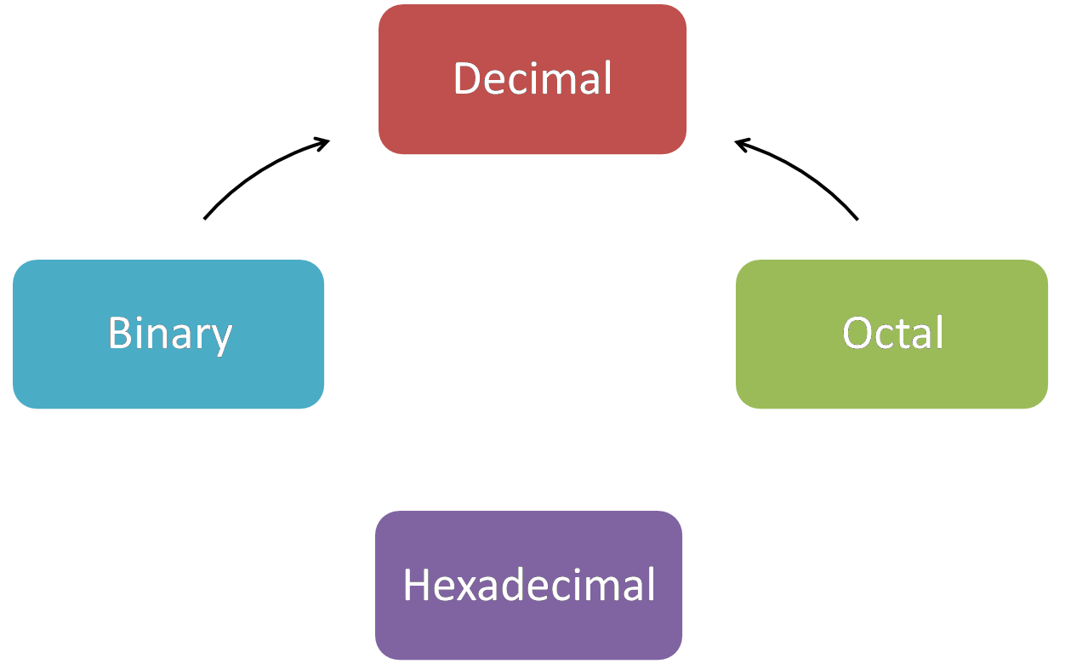
Convert to decimal
Multiply each digit with its weight

Slide 14
Example
Express 3702₈ in decimal
3702₈ = 2 * 8⁰ + 0 * 8¹ + 7 * 8² + 3 * 8³ = 1986₁₀
Express 1A2F₁₆ in decimal
1A2F₁₆ = 15 * 16⁰ + 2 * 16¹ + 10 * 16² + 1*16³ =6703₁₀

Slide 15
Decimal => Binary
Decimal
Binary
Divide by 2 and write down the remainder
Until a quotient of 0 is obtained
First remainder as LSB (Least significant bit)
Last remainder as MSB (Most significant bit)

Slide 16
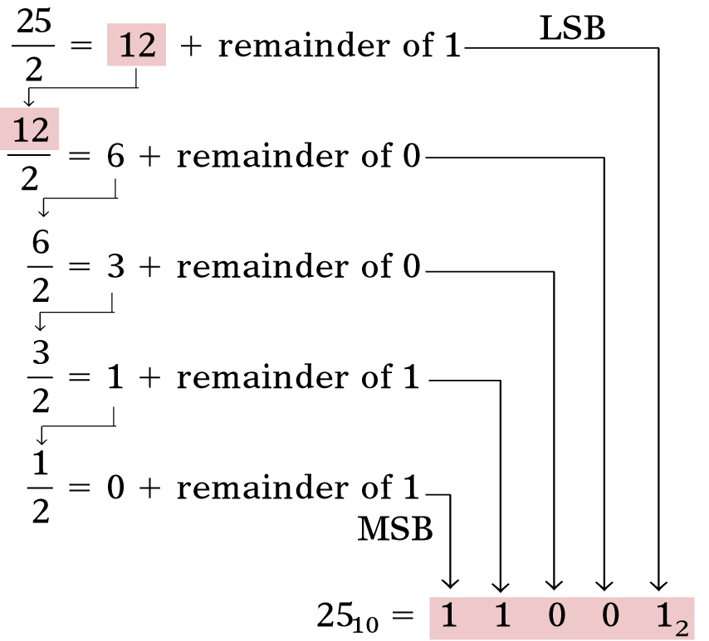
Example: 25₁₀ => binary

Slide 17
Decimal => Hexadecimal
Decimal
Hexadecimal
Divide by 16 and write down the remainder
Until a quotient of 0 is obtained
First remainder as LSD (Least significant digit)
Last remainder as MSB (Most significant digit)

Slide 18
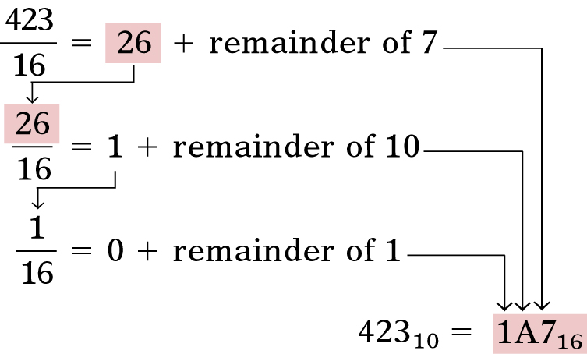
Example: 423₁₀ => hexadecimal

Slide 19
Decimal => Octal
Decimal
Octal
Divide by 8 and write down the remainder
Until a quotient of 0 is obtained
First remainder as LSD (Least significant digit)
Last remainder as MSB (Most significant digit)

Slide 20
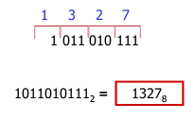
Octal => Binary
Octal
Binary
Individually convert each digit to its 3 bit binary
Ex:
Octal | 0 | 1 | 2 | 3 | 4 | 5 | 6 | 7
Binary | 000 | 001 | 010 | 011 | 100 | 101 | 110 | 111

Slide 21
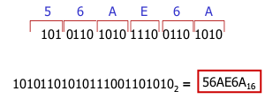
Hexadecimal => Binary
Hex | Bin
0 1 2 3 4 5 6 7 8 9 A B C D E F | 0000 0001 0010 0011 0100 0101 0110 0111 1000 1001 1010 1011 1100 1101 1110 1111
Hexadecimal
Binary
Individually convert each digit to its 4 bit binary
Ex:

Slide 22
Binary => Octal
Binary
Octal
Group 3 bits starting at LSB
Convert each group to 1 octal digit
Ex: 1011010111₂ => octal

Slide 23
Binary => Hexadecimal
Binary
Hexadecimal
Group 4 bits starting at LSB
Convert each group to 1 hexadecimal digit
Ex: 10101101010111001101010₂ => hexa

Slide 24
Octal <=> Hexadecimal
Binary
Octal
Hexadecimal
Convert via binary

Slide 25
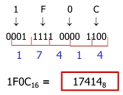
Example: 1F0C₁₆ => octal

Slide 26
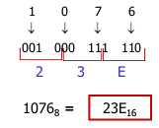
Example: 1076₈ => hexa

Slide 27
Example
Number system conversion practice
Decimal | Binary | Octal | Hexadecimal
35
 | 1101101
 |  | 712
 |  |  | 1AF

Slide 28
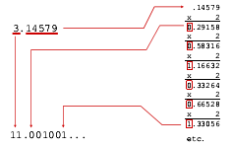
Fraction
Decimal => Binary

Slide 29
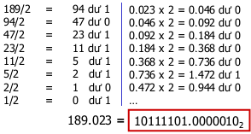
Example: 189.023₁₀ => binary

Slide 30
Example
Another number system conversion practice
Decimal | Binary | Octal | Hexadecimal
29.8
 | 110.1101
 |  | 3.07
 |  |  | C.82

Slide 31
Binary Operations
Addition
Multiplication
Subtraction

Slide 32
Binary Addition
2 1-bit binary numbers addition
A | B | A + B
0 0 1 1 | 0 1 0 1 | 0 1 1 10

Slide 33
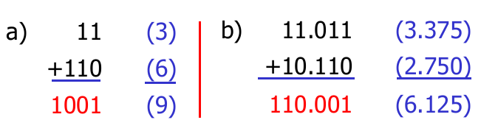
Binary Addition
2 unsigned binary numbers addition

Slide 34
Binary multiplication
2 1-bit binary numbers multiplication
A | B | A * B
0 0 1 1 | 0 1 0 1 | 0 0 0 1

Slide 35
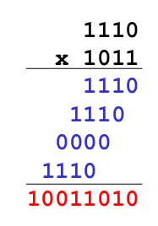
Binary multiplication
2 unsigned binary numbers multiplication

Slide 36
Binary Subtraction
The rules for binary subtraction are
0 - 0 = 0
1 - 1 = 0
1 - 0 = 1
10 - 1 = 1 with a borrow of 1
Ex: Subtract the binary number 00111 from 10101
10101 21
00111 7
0
1
1
1
0
=
14

Slide 37
Signed number representation
Signed Number Representation
1’s complement form
2’s complement form
2’s complement to binary
Operations in the 2’s complement system
Overflow

Slide 38
Signed Number Representation
Signed numbers are positive (+) or negative (-)
Some means to represent the sign
Use 1 additional bit to represent the sign (sign bit)
0: positive
1: negative
Sign bit is often the leftmost bit

Slide 39
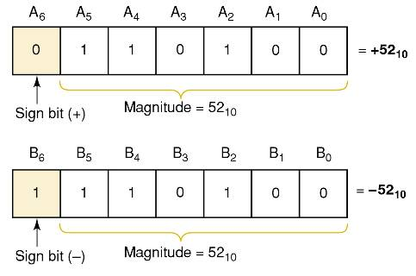
Signed Number Representation
Example: a 6 bit signed number

Slide 40
2’s complement
2’s complement is the most commonly way used to represent signed numbers
Binary
Ex:
0 1 0 0 1 0 0 1 0 0 (292₁₀)
Negate each bit
1’s complement
1 0 1 1 0 1 1 0 1 1 (-292₁₀)
+1
Add 1
2’s complement
1 0 1 1 0 1 1 1 0 0 (-292₁₀)

Slide 41
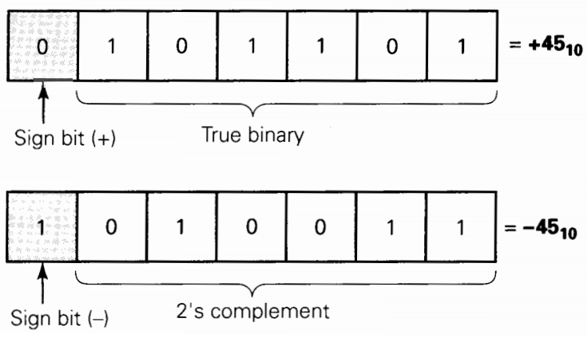
Representing signed numbers using 2’s complement

Slide 42

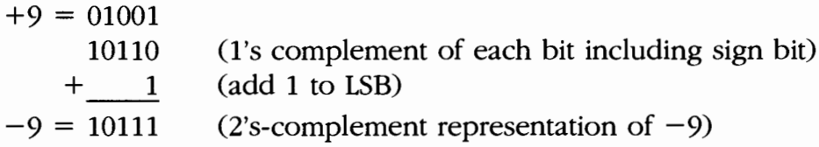
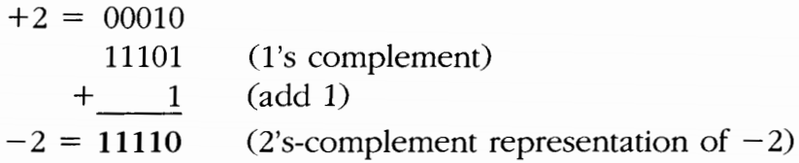
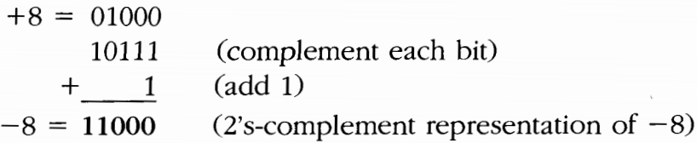
Example
Representing signed numbers using 2’s complement
+13
-9
-2
-8

Slide 43
Converting 2’s complement to binary
Binary
Ví dụ:
1 0 1 1 0
Negate each bit
Add 1
2’s complement
0 1 0 1 0
Negate each bit
Add 1
Binary
1 0 1 1 0

Slide 44
Addition in the 2’s complement system
Just like binary addition
Sign bit is operated on in the same manner as the magnitude bits
If a carry is generated in the last position, this carry is always disregarded
If the final result is negative, it is in 2’s complement form

Slide 45
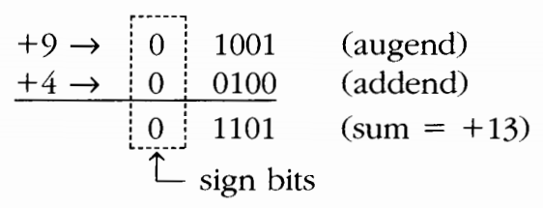
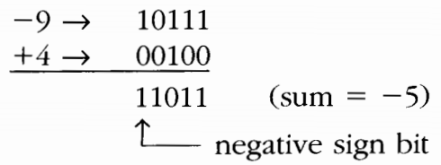
Example

Slide 46
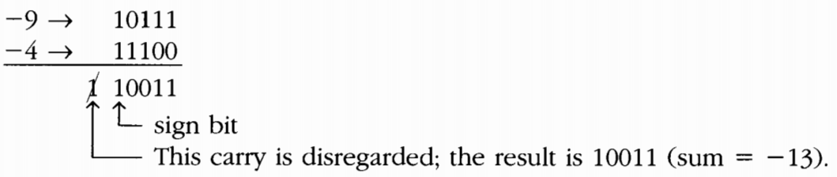
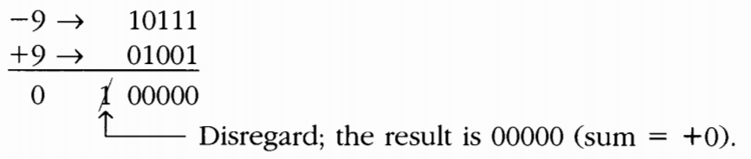
Example
+9 and -9 addition?

Slide 47
Subtraction in the 2’s complement system
In an example 4 + (–9), addition in the 2’s complement system is actually subtraction
Subtraction in the 2’s complement system
Take the 2’s complement of the subtrahend (including sign bit)
It is added to the minuend
The result of this addition represents the required difference

Slide 48

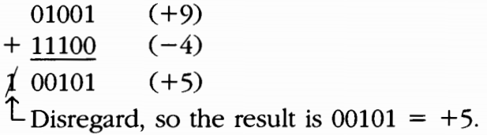
Example
9 – 4 =
9 + (– 4)
Take the 2’s complement
Add it to the minuend

Slide 49
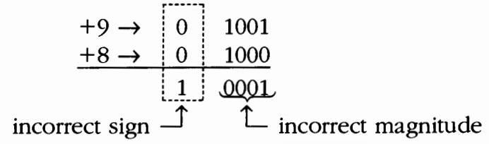
Arithmetic Overflow
Overflow occurs when the number of bits required for the answer is exceeded
n bit represents a number from -2^{n-1} to +2^{n-1}-1
Overflow always produces an incorrect result
=> A special circuit is used to detect any overflow condition

Slide 50
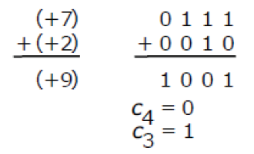
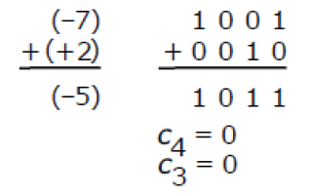
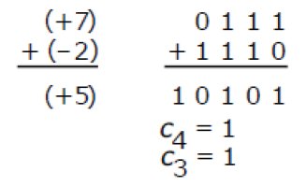
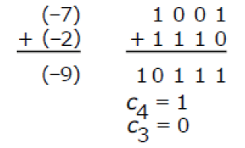
Overflow examples
4 bit numbers, 3 magnitude bit and 1 sign bit
O
O
Overflow never occurs if numbers have different signs

Slide 51
Other Codes
BCD
Floating point number
ASCII

Slide 52


BCD (Binary coded decimal)
Each digit of a decimal number is represented by its binary equivalent
Ex:
10₁₀ => BCD
847₁₀ => BCD
1
0
0001
0000

Slide 53
BCD vs. Binary
137₁₀ = 10001001₂ (Binary)
Decimal: 1 * 2⁷ + 1 * 2³ + 1 * 2⁰
137₁₀ = 0001 0011 0111 (BCD)
Decimal: 1 3 7
BCD uses more bit, yet the conversion is simpler

Slide 54
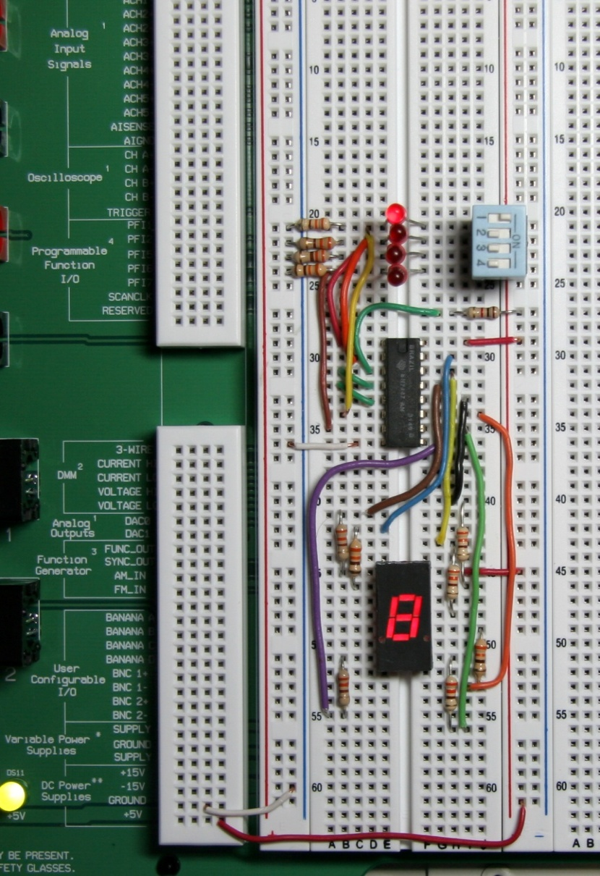
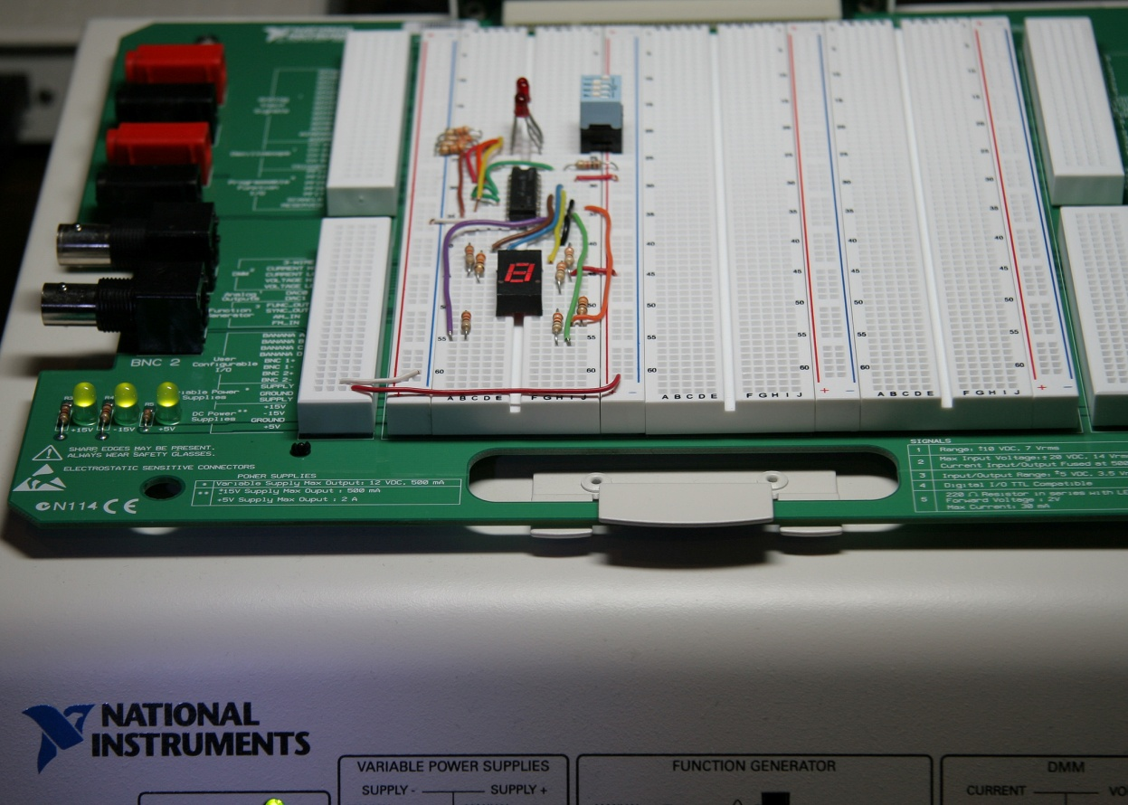
BCD
A lab experiment in which BCD is converted to decimal is shown.

Slide 55
Floating Point Number
Floating point notation is capable of representing very large or small numbers by using a form of scientific notation.
A 32-bit single precision number is illustrated.
S E (8 bits) F (23 bits)
Sign bit
Biased exponent (+127)
Magnitude with MSB dropped

Slide 56
Floating Point Number
Express the speed of light, c, in single precision floating point notation. (c = 0.2998 x 10⁹)
In binary, c = 0001 0001 1101 1110 1001 0101 1100 0000₂.
In scientific notation,
c = 1.001 1101 1110 1001 0101 1100 0000 x 2²⁸.
S = 0 because the number is positive.
E = 28 + 127 = 155₁₀ = 1001 1011₂.
F is the next 23 bits after the first 1 is dropped.
In floating point notation, c =
0 10011011 001 1101 1110 1001 0101 1100

Slide 57
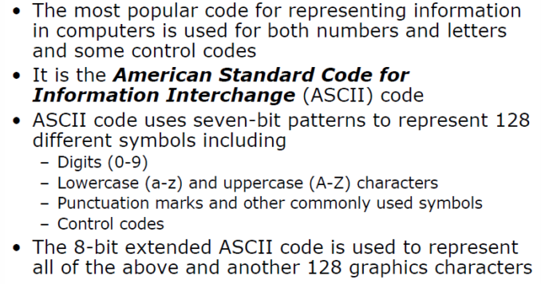
ASCII

Slide 58
Digital Key Terms
Byte
Floating-point number
Hexadecimal
Octal
BCD
A group of eight bits
A number representation based on scientific notation in which the number consists of an exponent and a mantissa.
A number system with a base of 16.
A number system with a base of 8.
Binary coded decimal; a digital code in which each of the decimal digits, 0 through 9, is represented by a group of four bits.
Alphanumeric
ASCII
Consisting of numerals, letters, and other characters
American Standard Code for Information Interchange; the most widely used alphanumeric code.

