Slide 1
Lecture 3 Introduction to Boolean Algebra and Logic Circuits
INTRODUCTION TO DIGITAL SYSTEMS

Slide 2
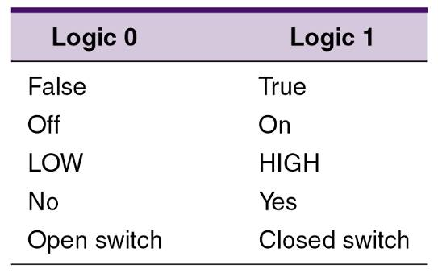
Boolean Algebra
Boolean Algebra allows only two values (two logic states): 0 and 1
Three basic logic operations:
OR, AND and NOT
Notes:
Năm 1854 Georges Boole, một triết gia đồng thời là nhà toán học người Anh cho xuất bản một tác phẩm về lý luận logic, nội dung của tác phẩm đặt ra những mệnh đề mà để trả lời người ta chỉ phải dùng một trong hai từ đúng (có, yes) hoặc sai (không, no).
Tập hợp các thuật toán dùng cho các mệnh đề này hình thành môn Đại số Boole. Đây là môn toán học dùng hệ thống số nhị phân mà ứng dụng của nó trong kỹ thuật chính là các mạch logic, nền tảng của kỹ thuật số.
Mạch số hoạt động trên mã nhị phân (0 hay 1 tương ứng với 1 mức điện áp cho trước)
=> dùng đại số Boolean làm công cụ cho việc thiết kế và phân tích hệ thống số
Chương này sẽ học về các cổng logic (thành phần cơ bản nhất của mạch logic), their operation, và biểu diễn hoạt động bằng đại số Boolean
How logic gates can be combined to produce logic circuits
How these logic circuits can be described and analyzed using Boolean algebra

Slide 3
Outline
AND, OR, NOT gates
Logic circuit => Algebraic expression
Algebraic expression => Circuit
NAND and NOR gates
Boolean Theorems

Slide 4
Basic logic gates

Slide 5
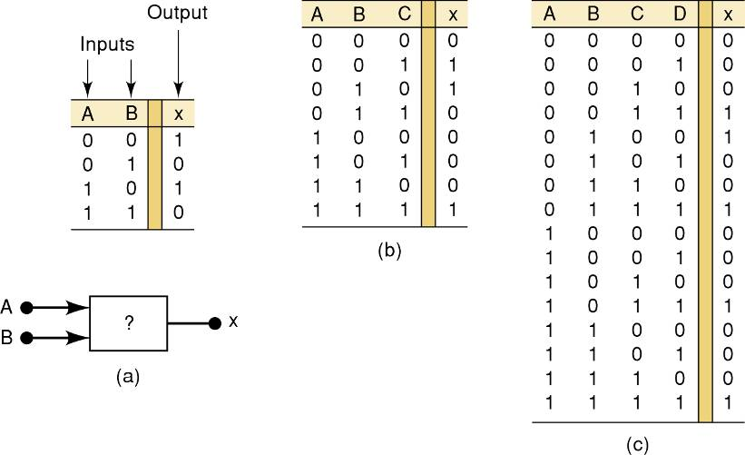
Truth table
A truth table describes the relationship between the input and output of a logic circuit
The number of entries corresponds to the number of inputs
A 2-input table would have 2² = 4 entries
A 3-input table would have 2³ = 8 entries
?
?
Notes:
Biểu diễn biến và hàm logic:
Biểu đồ Venn
Bảng sự thật
Bảng Karnaugh
Giản đồ thời gian

Slide 6
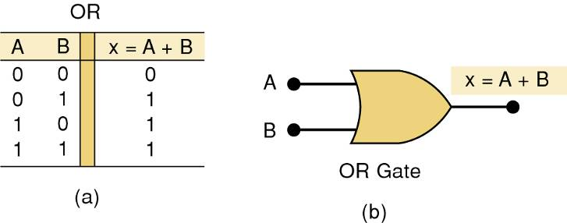
OR Gate
Boolean expression for the OR operation:
X = A + B — Read as “X equals A OR B”
Truth table/circuit symbol for a two input OR gate:
The + sign does not stand for ordinary addition—it stands for the OR operation

Slide 7
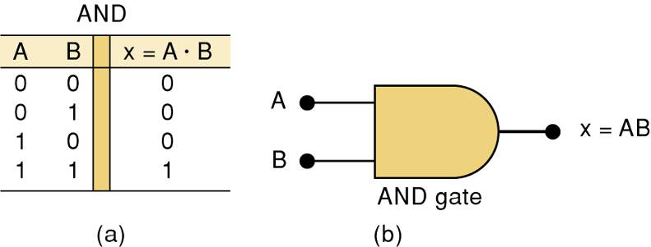
AND Gate
AND operation is similar to multiplication:
X = A • B — Read as “X equals A AND B”
Truth table/circuit symbol for a two input AND gate:
The • sign does not stand for ordinary multiplication—it stands for the AND operation.

Slide 8
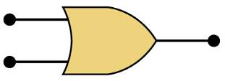
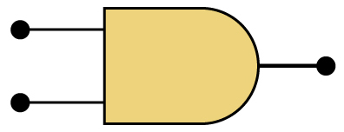
OR vs. AND
The OR symbol means the output will go HIGH when any input is HIGH
The AND symbol on a logic-circuit diagram tells you output will go HIGH only when all inputs are HIGH

Slide 9
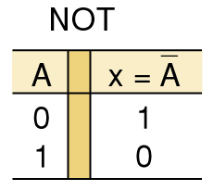
NOT Gate
The Boolean expression for the NOT operation:
X = A
— Read as:
“X equals NOT A”
“X equals the inverse of A”
“X equals the complement of A”
The overbar represents the NOT operation.
A' = A
Another indicator for inversion is the prime symbol (').
NOT Truth Table

Slide 10
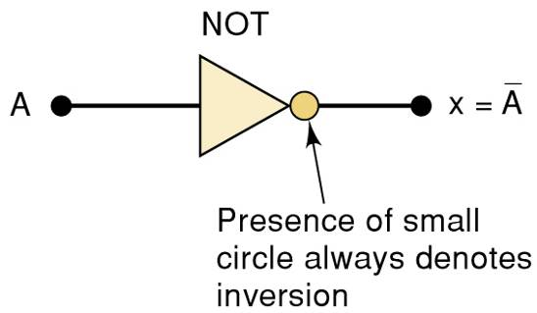
NOT Gate
A NOT circuit—commonly called an INVERTER
This circuit always has only a single input, and the output logic level is always opposite to the logic level of this input

Slide 11
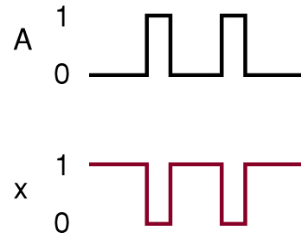
NOT Operation
The INVERTER inverts (complements) the input signal at all points on the waveform
Whenever the input = 0, output = 1, and vice versa

Slide 12
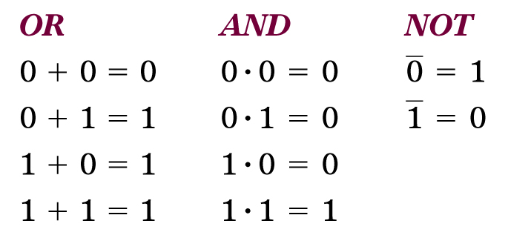
Basic logic gates
These three basic Boolean operations can describe any logic circuit

Slide 13
Logic circuit => Algebraic expression

Slide 14
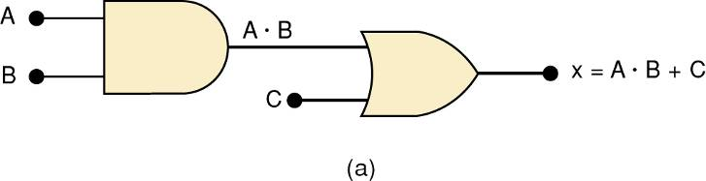
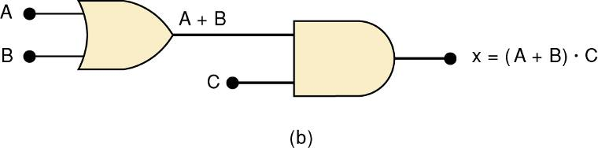
Describing Logic Circuits Algebraically
If an expression contains both AND and OR gates, the AND operation will be performed first
Unless there is a parenthesis in the expression

Slide 15
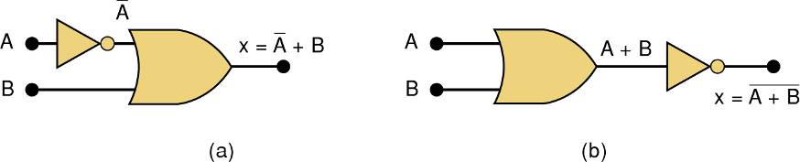
Describing Logic Circuits Algebraically
Whenever an INVERTER is present, output is equivalent to input, with a bar over it
Input A through an inverter equals A

Slide 16
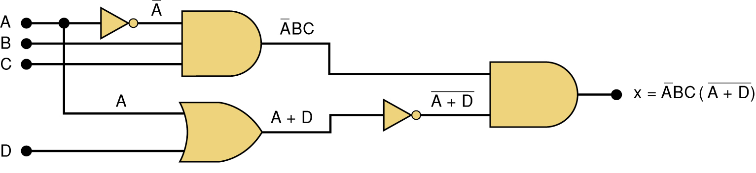
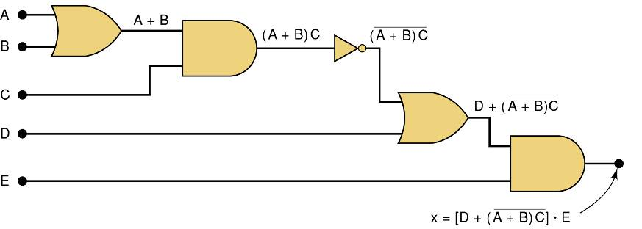
Further examples

Slide 17
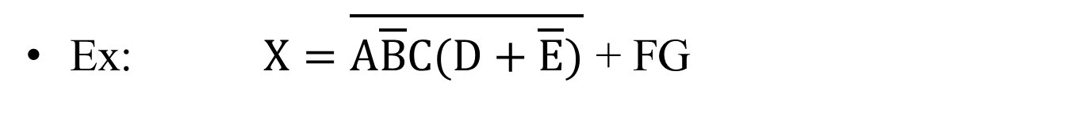
Evaluating Logic Circuit Outputs
Ex: $X=\overline{A\overline{B}C(D+\overline{E})}$ + FG
Rules for evaluating a Boolean expression:
Perform all inversions of single terms
Perform all operations within parenthesis
Perform AND operation before an OR operation unless parenthesis indicate otherwise
If an expression has a bar over it, perform operations inside the expression, and then invert the result

Slide 18
Evaluating Logic Circuit Outputs
The best way to analyze a circuit made up of multiple logic gates is to use a truth table
It allows you to analyze one gate or logic combination at a time
It allows you to easily double-check your work
When you are done, you have a table of tremendous benefit in troubleshooting the logic circuit

Slide 19
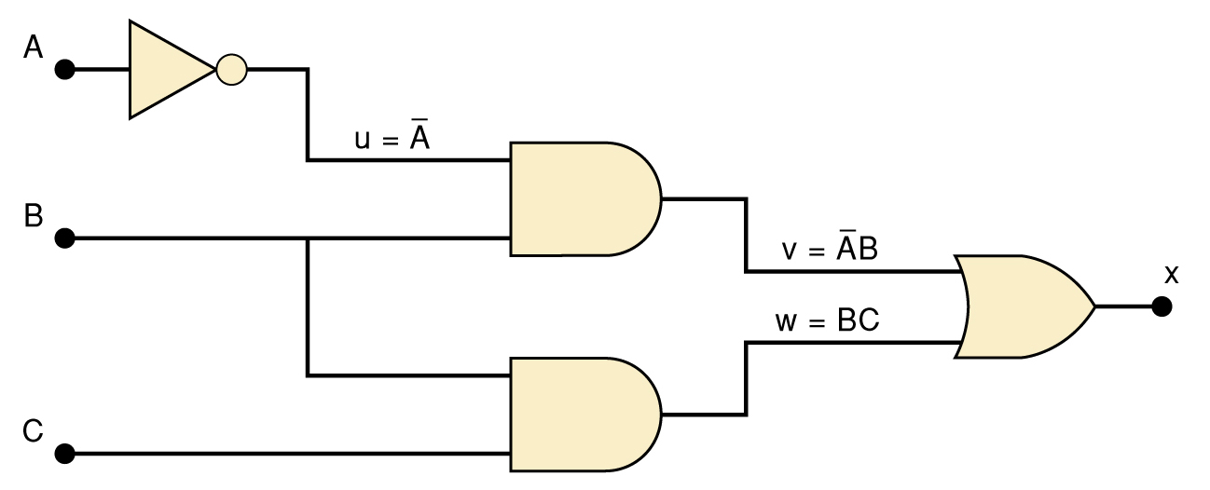
Evaluating Logic Circuit Outputs
Example: Evaluate outputs for this logic circuit

Slide 20
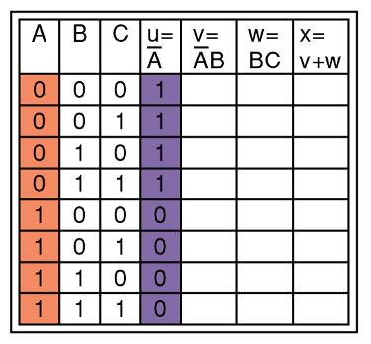

Evaluating Logic Circuit Outputs
Step 1: List all input combinations
Step 2: Create a column in the truth table for each intermediate signal (node)
Node u has been filled as the complement of A

Slide 21
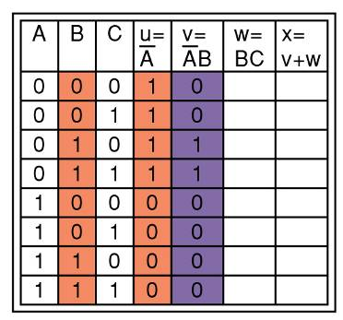
Evaluating Logic Circuit Outputs
Step 3: fill in the values for column v
v =AB — Node v should be HIGH when A (node u) is HIGH AND B is HIGH

Slide 22
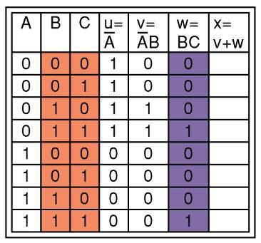
Evaluating Logic Circuit Outputs
Step 4: predict the values at node w which is the logical product of BC
This column is HIGH whenever B is HIGH AND C is HIGH

Slide 23
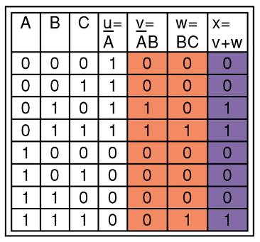
Evaluating Logic Circuit Outputs
Final step: logically combine columns v and w to predict the output x
Since x = v + w, the x output will be HIGH when v OR w is HIGH

Slide 24
Evaluating Logic Circuit Outputs
Ex: Evaluate outputs of the below circuit

Slide 25
Algebraic expression => Circuit

Slide 26
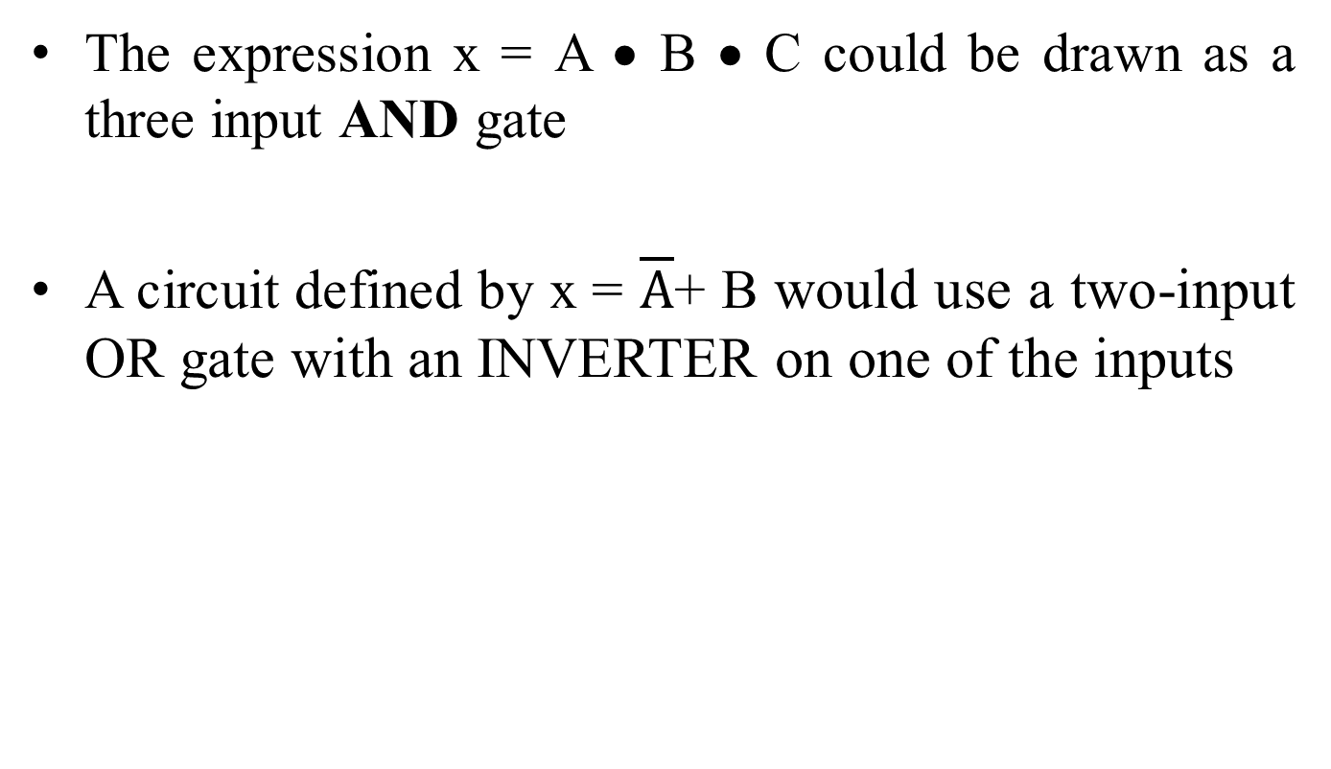
Implementing Circuits From Boolean Expressions
The expression x = A • B • C could be drawn as a three input AND gate
A circuit defined by x = $\overline{A}$+ B would use a two-input OR gate with an INVERTER on one of the inputs

Slide 27
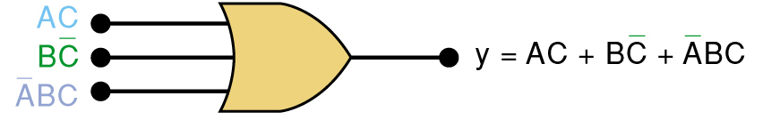

Example
Implement a circuit with output y = AC + B$\overline{C}$+ $\overline{A}$BC
Answer:
A circuit with output y = AC + B$\overline{C}$+ $\overline{A}$BC contains three terms which are ORed together
…and requires a three-input OR gate

Slide 28
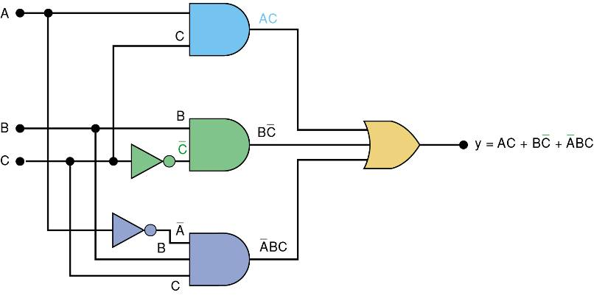
Implementing Circuits From Boolean Expressions
Each OR gate input is an AND product term
An AND gate with appropriate inputs can be used to generate each of these terms

Slide 29
NOR and NAND Gates

Slide 30
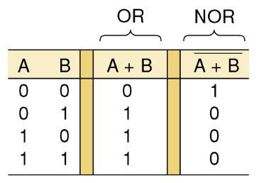
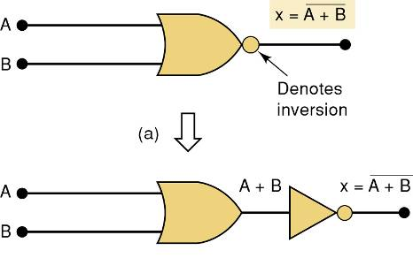

NOR Gate
NOR = NOT OR
X = $\overline{A+B}$

Slide 31
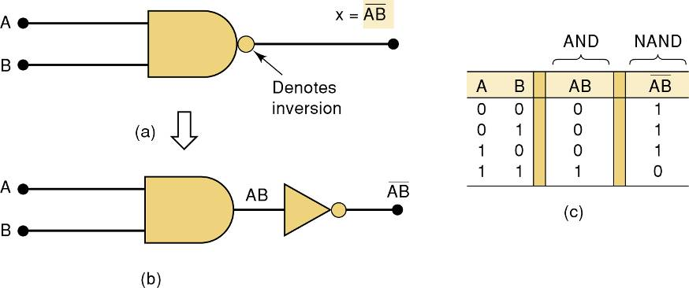

NAND Gate
NAND = NOT AND
X = $\overline{A \text{•} B}$

Slide 32
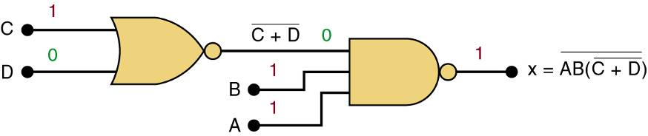

NAND/NOR Example
Implement logic circuit for X = $\overline{AB \text{•} (\overline{C \text{+}D})}$
Only use OR, AND, NOT gates
Only use NOR and NAND gates

Slide 33
Boolean Theorems

Slide 34
Boolean Algebra
Digital computers contain circuits that implement Boolean functions
The simpler that we can make a Boolean function, the smaller the circuit that will result
Simpler circuits are cheaper to build, consume less power, and run faster than complex circuits
There are a number of Boolean identities that help us to reduce our Boolean functions to their simplest form

Slide 35
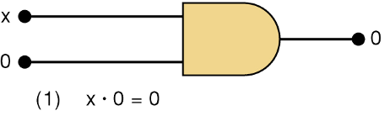
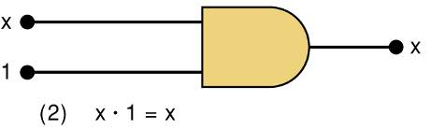
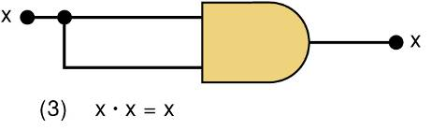
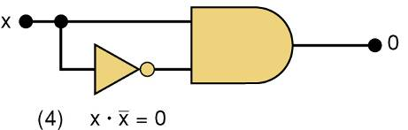
Boolean Theorems I
Theorem (1) states that if any variable is ANDed with 0, the result must be 0
Theorem (2) is also obvious by comparison with ordinary multiplication
Prove Theorem (3) by trying each case If x = 0, then 0 • 0 = 0
If x = 1, then 1 • 1 = 1
Thus, x • x = x
Theorem (4) can be proved in the same manner

Slide 36
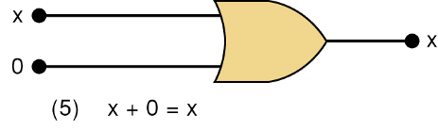
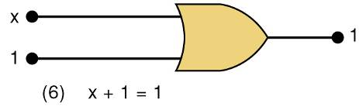
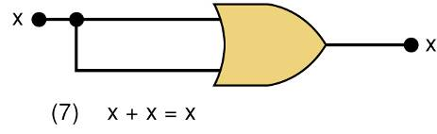
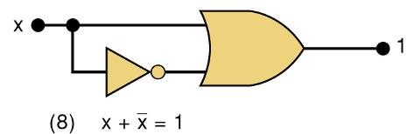
Boolean Theorems II
Theorem (5) is straightforward, as 0 added to anything does not affect value, either in regular addition or in OR addition
Theorem (6) states that if any variable is ORed with 1, the is always 1
Check values: 0 + 1 = 1 and 1 + 1 = 1
Theorem (7) can be proved by checking for both values of x: 0 + 0 = 0 and 1 + 1 = 1
Theorem (8) can be proved similarly

Slide 37
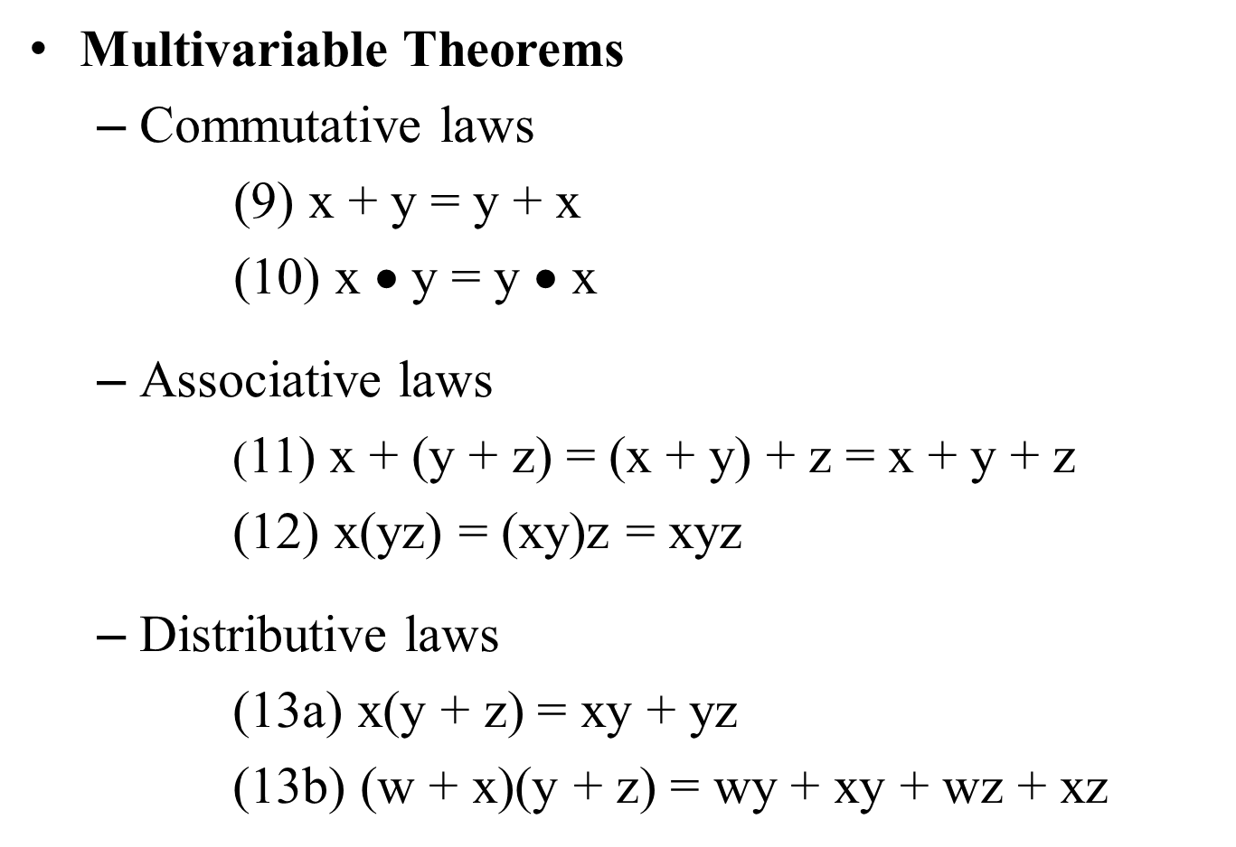
Boolean Theorems III
Multivariable Theorems
Commutative laws
(9) x + y = y + x
(10) x $\text{•}$ y = y $\text{•}$ x
Associative laws
(11) x + (y + z) = (x + y) + z = x + y + z
(12) x(yz) = (xy)z = xyz
Distributive laws
(13a) x(y + z) = xy + yz
(13b) (w + x)(y + z) = wy + xy + wz + xz

Slide 38
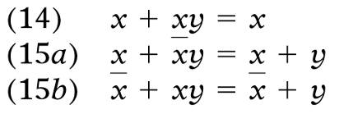
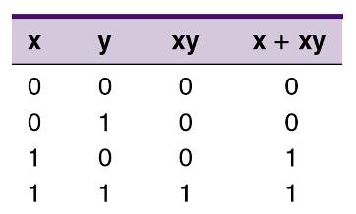

Boolean Theorems IV
Multivariable Theorems
Theorems (14) and (15) do not have counterparts in ordinary algebra. Each can be proved by trying all possible cases for x and y
Analysis table & factoring for Theorem (14)

Slide 39
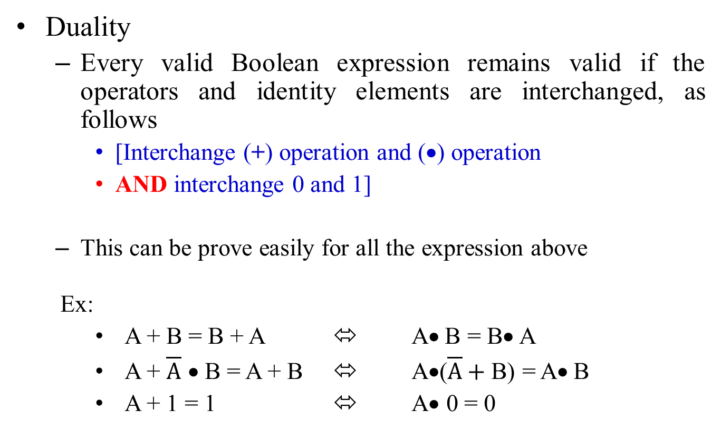
Boolean Theorems V
Duality
Every valid Boolean expression remains valid if the operators and identity elements are interchanged, as follows
[Interchange (+) operation and ($\text{•}$) operation
AND interchange 0 and 1]
This can be prove easily for all the expression above
Ex:
A + B = B + A ⬄ A$\text{•}$B = B$\text{•}$A
A + $\overline{A} \text{•}$B = A + B ⬄ A$\text{•}$($\overline{A}+$B) = A$\text{•}$B
A + 1 = 1 ⬄ A$\text{•}$ 0 = 0

Slide 40
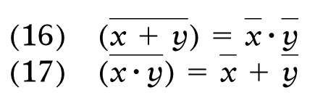
DeMorgan’s Theorems
DeMorgan’s theorems are extremely useful in simplifying expressions in which a product or sum of variables is inverted
Theorem (16) says inverting the OR sum of two variables is the same as inverting each variable individually, then ANDing the inverted variables.
Theorem (17) says inverting the AND product of two variables is the same as inverting each variable individually and then ORing them.
Each of DeMorgan’s theorems can readily be proven by checking for all possible combinations of x and y

Slide 41
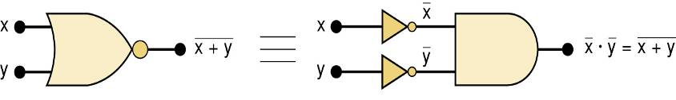
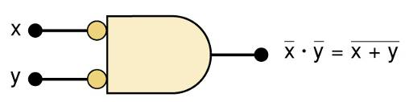
DeMorgan’s Theorems
Equivalent circuits implied by Theorem (16)
The alternative symbol for the NOR function

Slide 42
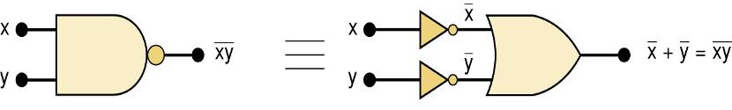
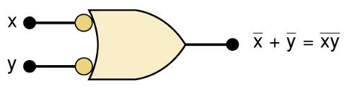
DeMorgan’s Theorems
Equivalent circuits implied by Theorem (17)
The alternative symbol for the NAND function

Slide 43

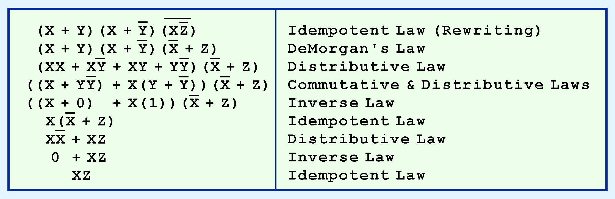
Example #1
Use Boolean theorems to simplify the function:

Slide 44

Example #2
Use DeMorgan theorem to simplify below expressions
$\overline{(M+\overline{N})(\overline{M}+N)}$
$\overline{(\overline{A}+\overline{C}+\overline{D})}$
How many transistors can be saved by using DeMorgan Theorem?

Slide 45

Example #3
Use the below boolean theorems
(7) x + x = x
(17) $\overline{(x \text{•} y)}$ = $\overline{x}\text{+} \overline{y}$
And only NAND gates to implement an INVERTER, OR AND AND gate

Slide 46

Universality of NAND Gates
How combinations of NANDs are used to create the three logic functions
It is possible to implement any logic expression using only NAND gates and no other type of gate

Slide 47

Example #4
Use the below boolean theorems
(7) x + x = x
(17) $\overline{(x \text{•} y)}$ = $\overline{x}\text{+} \overline{y}$
And only NOR gates to implement an INVERTER, OR AND AND gate

Slide 48

Universality of NOR Gates
How combinations of NORs are used to create the three logic functions
It is possible to implement any logic expression using only NOR gates and no other type of gate

Slide 49

Alternate Logic-Gate Representations
Meaning of two NAND gate symbols
Output is LOW when all inputs are HIGH
Active-HIGH
Output is HIGH when at least one input is LOW
Active-LOW

Slide 50

Alternate Logic-Gate Representations
To convert a standard symbol to an alternate:
Invert OR to AND or AND to OR
Invert each input and output in standard symbols
Add an inversion bubble where there are none
Remove bubbles where they exist

Slide 51
Digital Key Terms
Inverter
Truth table
Timing diagram
Boolean algebra
AND gate
A logic circuit that inverts or complements its inputs
A table showing the inputs and corresponding output(s) of a logic circuit
A diagram of waveforms showing the proper time relationship of all of the waveforms
The mathematics of logic circuits
A logic gate that produces a HIGH output only when all of its inputs are HIGH

Slide 52
Digital Key Terms
OR gate
NAND gate
NOR gate
Exclusive-OR gate
Exclusive-NOR gate
A logic gate that produces a HIGH output when one or more inputs are HIGH.
A logic gate that produces a LOW output only when all of its inputs are HIGH.
A logic gate that produces a LOW output when one or more inputs are HIGH.
A logic gate that produces a HIGH output only when its two inputs are at opposite levels.
A logic gate that produces a LOW output only when its two inputs are at opposite levels.

