Slide 1
Karnaugh Map & Cost Optimization
01/2013
Phan Quốc Huy

Slide 2
Content
Logic Circuit
Design a circuit
Karnaugh Map
DON’T CARE
Multilevel Optimization
XOR/ XNOR gates
Reading assignment:
Chapter 4: Section 4.3.4, 4.3.5, 4.3.6, 4.3.7, 4.3.8

Slide 3
1. Logic Circuit

Slide 4

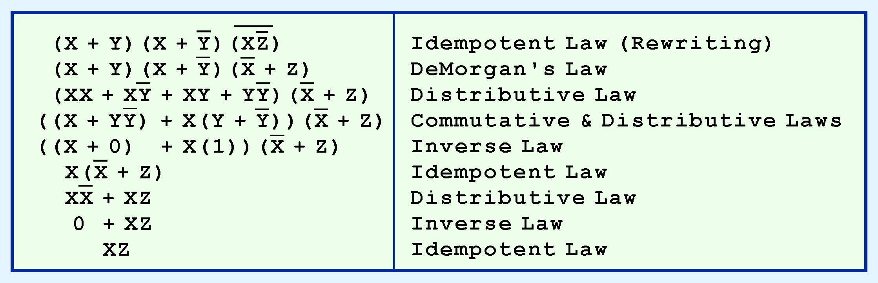
Example
Use Boolean theorems to simplify the function:

Slide 5
Canonical Forms
Through our example in simplifying Boolean expressions, there are numerous ways of stating the same Boolean expression
These “synonymous” forms are logically equivalent
Logically equivalent expressions have identical truth tables
In order to eliminate as much confusion as possible, designers express Boolean functions in standardized or canonical forms

Slide 6
Minterms
Minterms are AND terms with every variable present in either true or complemented form
Given that each binary variable may appear normal (e.g., x) or complemented (e.g., ), there are 2^{n} minterms for n variables
Ex: 2 variables (X and Y) produce 2 x 2 = 4 combinations:
(both normal)
(X normal, Y complemented)
(X complemented, Y normal)
(both complemented)
x
XY
X
Y
X
Y
X
Y

Slide 7
Maxterms
Maxterms are OR terms with every variable in true or complemented form
Given that each binary variable may appear normal (e.g., x) or complemented (e.g., x), there are 2^{n} maxterms for n variables.
Ex: 2 variables (X and Y) produce 2 x 2 = 4 combinations:
(both normal)
(x normal, y complemented)
(x complemented, y normal)
(both complemented)
X
+
Y
X
+
Y
X
+
Y
X
+
Y

Slide 8
Minterms & Maxterms for 2 variables
The minterm m_{i} should evaluate to 1 for each combination of x and y
The maxterm is the complement of the minterm
x | y | Index | Minterm | Maxterm
0 | 0 | 0 | m₀ = x y | M₀ = x + y
0 | 1 | 1 | m₁ = x y | M₁ = x + y
1 | 0 | 2 | m₂ = x y | M₂ = x + y
1 | 1 | 3 | m₃ = x y | M₃ = x + y

Slide 9
Minterms & Maxterms for 3 variables
x
y
z
Index
Minterm
Maxterm
0
0
0
0
m0 = x y z
M0 = x + y + z
0
0
1
1
m1 = x y z
M1 = x + y + z
0
1
0
2
m2 = x y z
M2 = x + y + z
0
1
1
3
m3 = x y z
M3 = x + y + z
1
0
0
4
m4 = x y z
M4 = x + y + z
1
0
1
5
m5 = x y z
M5 = x + y + z
1
1
0
6
m6 = x y z
M6 = x + y + z
1
1
1
7
m7 = x y z
M7 = x + y + z
Maxterm Mi is the complement of minterm mi
Mi = mi and mi = Mi

Slide 10
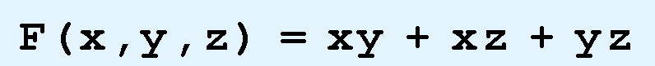
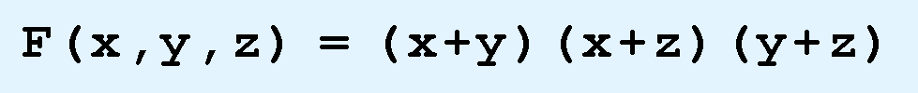
Canonical Forms for Boolean Expressions
Two canonical forms for Boolean expressions:
sum-of-products (SOP)
product-of-sums (POS)
SOP: ANDed variables are ORed together
For example:
POS: ORed variables are ANDed together
For example:

Slide 11
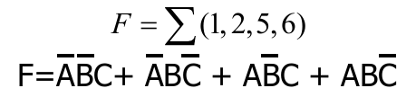
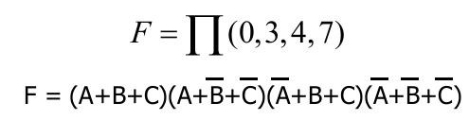
Canonical Forms for Boolean Expressions
# | A | B | C | F
0 | 0 | 0 | 0 | 0
1 | 0 | 0 | 1 | 1
2 | 0 | 1 | 0 | 1
3 | 0 | 1 | 1 | 0
4 | 1 | 0 | 0 | 0
5 | 1 | 0 | 1 | 1
6 | 1 | 1 | 0 | 1
7 | 1 | 1 | 1 | 0
SOP
POS

Slide 12
Canonical Forms for Boolean Expressions
Sum-of-Products | Product-of-Sums
AND terms ORed together | OR terms (sums) ANDed together
Only care value 1 | Only care value 0
X = 0: write down X’ | X = 0: write down X
X = 1: write down X | X = 1: write down X’

Slide 13
2. Design a logic circuit

Slide 14
Example
Design a logic circuit with
Three inputs
One output
Output is HIGH when the majority of input is HIGH

Slide 15
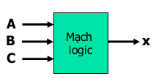
Logic circuit design procedures
Step 1: Construct a truth table
A | B | C | X
0 | 0 | 0 | 0
0 | 0 | 1 | 0
0 | 1 | 0 | 0
0 | 1 | 1 | 1
1 | 0 | 0 | 0
1 | 0 | 1 | 1
1 | 1 | 0 | 1
1 | 1 | 1 | 1
Logic Circuit

Slide 16
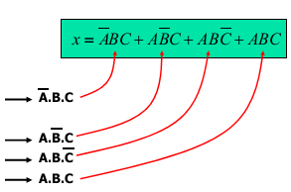
Logic circuit design procedures
Step 2: Converting truth table into logic expressions
A | B | C | X
0 | 0 | 0 | 0
0 | 0 | 1 | 0
0 | 1 | 0 | 0
0 | 1 | 1 | 1
1 | 0 | 0 | 0
1 | 0 | 1 | 1
1 | 1 | 0 | 1
1 | 1 | 1 | 1
SOP expression for the output:
AND terms for each case where output is 1

Slide 17
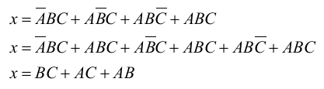
Logic circuit design procedures
Step 3: Algebraic simplification of logic expression

Slide 18
Limitations of Algebraic Simplification
Two problems of algebraic simplification
1. Not systematic
2. Difficult to check if a minimum solution is achieved
The Karnaugh map method overcomes these limitations
Typically for Boolean functions with =< 5 variables
Step 2 and step 3 can be done with Karnaugh Map, discussed in the next session

Slide 19
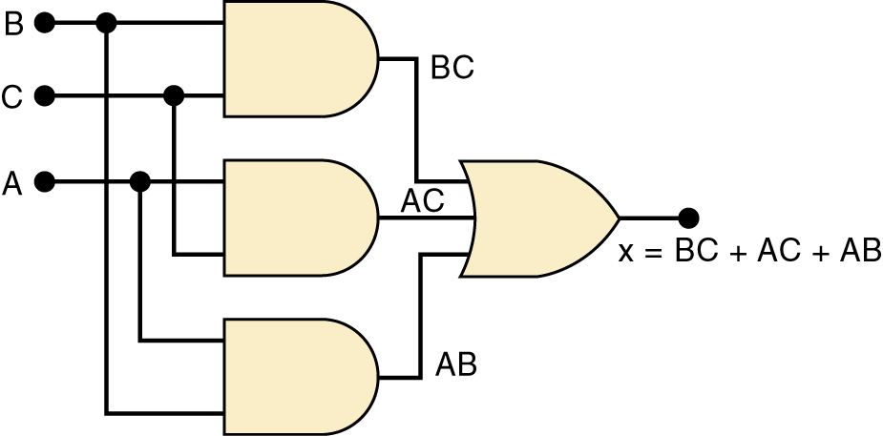
Logic circuit design procedures
Step 4: Draw a logic circuit for the final simplified logic expression
x = BC + AC + AB

Slide 20
3. Karnaugh Maps

Slide 21
Cost of Implementing a Logic Circuit
The cost of implementing a logic circuit is related to
the number of gates used and
with the number of inputs in each gate
A literal is a boolean variable or its complement

Slide 22
Cost of Implementing a Logic Circuit
The cost of a boolean equation represented in a sum-of-products form is given by:

Slide 23
Cost of a Logic Circuit - Examples
What is the cost of the following boolean equations?
f1(w,x,y,z) = wxy’z + wxyz’
f2(w,x,y,z) = w’ + x’ + yz + y’z’
g1(XYZ) = XY + X’Z + YZ
g2(XYZ) = XY + X’Z
h1(a,b) = ab
h2(a,b) = b’
C(f1) = 2+4+4 = 10
C(f2) = 4+0+0+2+2 = 8
C(g1) = 3+2+2+2 = 9
C(g2) = 2+2+2 = 6
C(h1) = 0+2 = 2
C(h2) = 0+0 = 0

Slide 24
Karnaugh Maps
M. Karnaugh, “The Map Method for Synthesis of Combinatorial Logic Circuits”, Transactions of the American Institute of Electrical Engineers, Communications and Electronics, Vol. 72, pp. 593-599, November 1953.
A Karnaugh Map is a graphical tool to assist on the minimization of logic equations
Similar to a truth table, a Karnaugh Map specifies a value for each combination of inputs

Slide 25
Karnaugh Maps
Karnaugh Map: a representation of the truth table by a matrix of squares (cells), where each square corresponds to a minterm (or a maxterm) of the logic function
For n-variable function, we need 2^n rows truth table and 2^n squares (cells)
To represent a logic function, the truth table values are copied into their corresponding cells

Slide 26
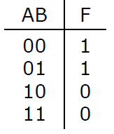
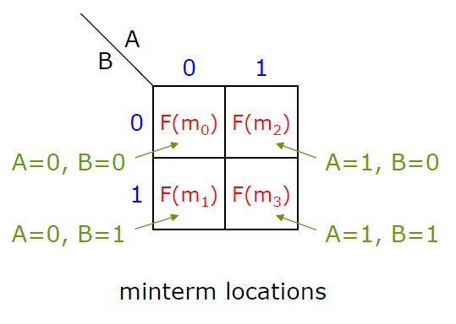
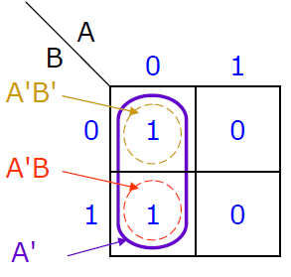
Two-variable Karnaugh map

Slide 27
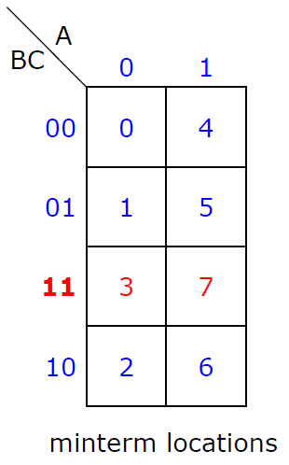
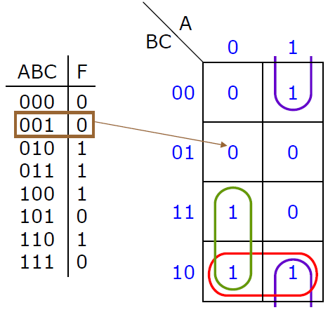
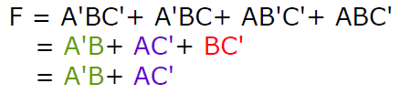
Three-variable Karnaugh map

Slide 28
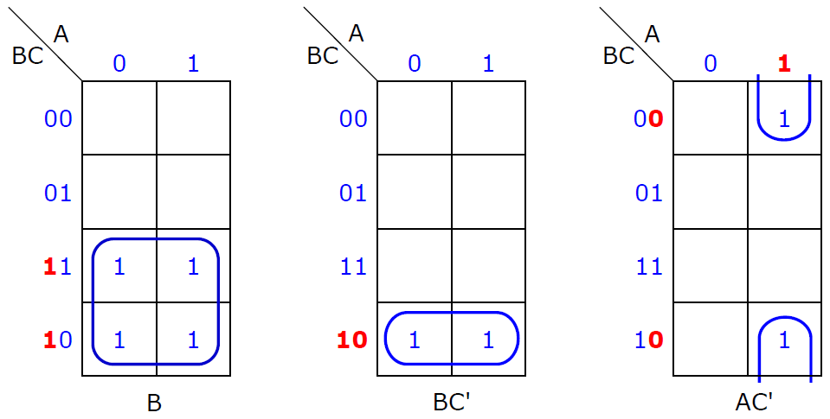
Three-variable Karnaugh map

Slide 29
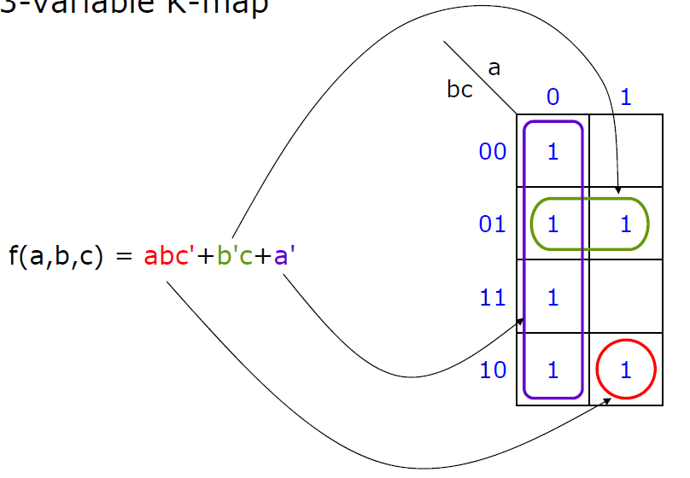
Three-variable Karnaugh map

Slide 30


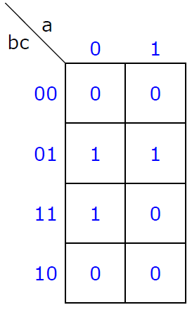
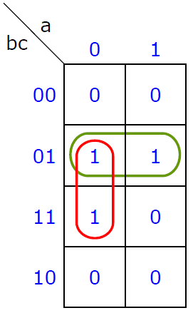
Three-variable Karnaugh map
Simplify

Slide 31


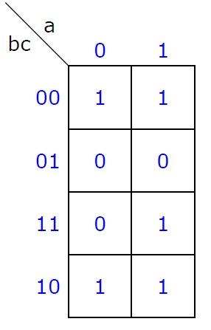
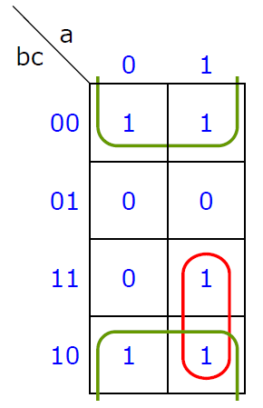
Three-variable Karnaugh map
Simplify

Slide 32
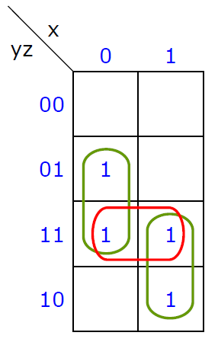
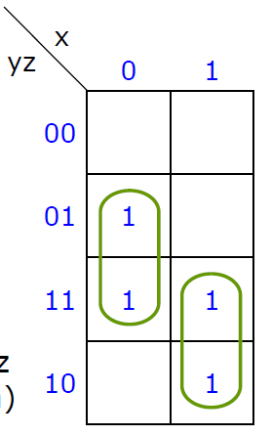
Three-variable Karnaugh map
Same

Slide 33
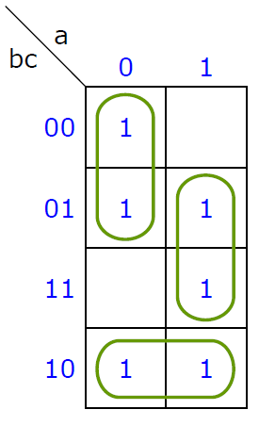
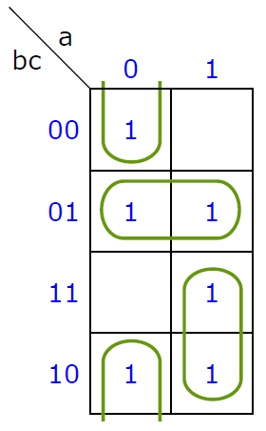

Three-variable Karnaugh map
Same

Slide 34

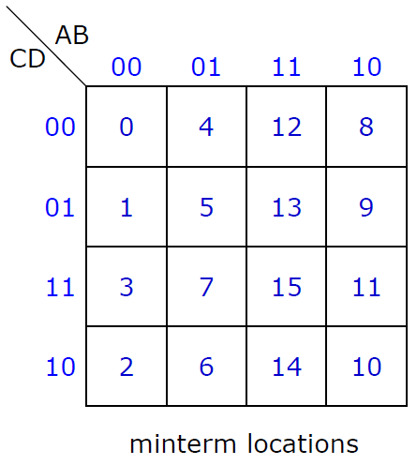
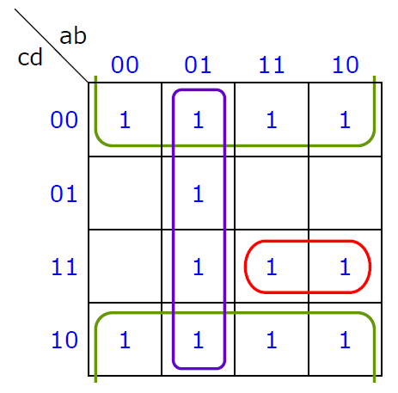
4-variable Karnaugh map
Simplify

Slide 35


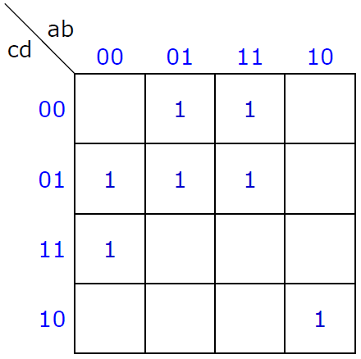
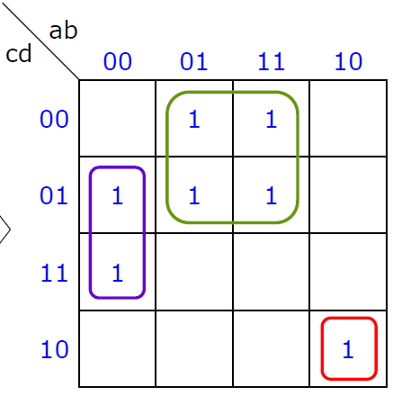
4-variable Karnaugh map
Simplify

Slide 36

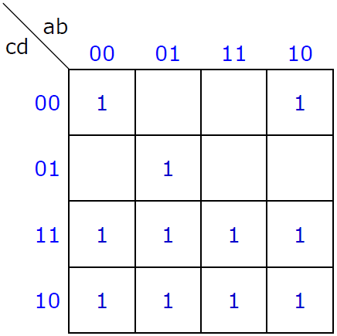
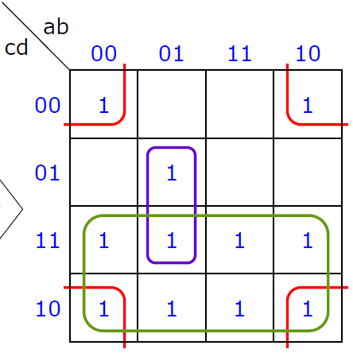
4-variable Karnaugh map
Simplify

Slide 37
Incompletely Specified Functions
N₁
A
N₂
w
x
B
F
y
C
z
Assumption: N₁ never produces the combinations
ABC = 001 and ABC = 110
Question: What value should F produce for the
combinations ABC = 001 and ABC = 110?
We don’t care!!!

Slide 38
Incompletely Specified Functions (Cont.)
How can we use the fact that we don’t care about the value produced by F when ABC = 001 or ABC = 110 to simplify the circuit N₂?
If we assume that F(0,0,1) = 0 and
F(1,1,0) = 0, we obtain the following equation
0
F(A,B,C) = A’B’C’ + A’BC’ + A’BC + ABC
= A’C’(B’ + B) + (A’ + A)BC
= A’C’·1 + 1·BC
0
= A’C’ + BC

Slide 39
Incompletely Specified Functions (Cont.)
However, if we assume that F(0,0,1)=1 and F(1,1,0)=1, we obtain instead the equation:
F(A,B,C) = A’B’C’ + A’B’C + A’BC’ + A’BC + ABC’ + ABC
= A’B’(C’ + C) + A’B(C’ + C) + AB(C’ + C)
= A’B’ ·1 + A’B ·1 + AB ·1
1
= A’B’ + A’B + AB
= A’B’ + A’B + A’B + AB
= A’(B’ + B) + (A’ + A)B
1
= A’·1 + 1·B
= A’ + B
Compare this with the other solution: F(A,B,C) = A’C’ + BC
Which one is cheaper to implement?

Slide 40

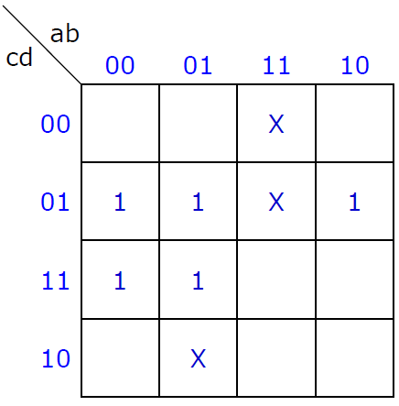
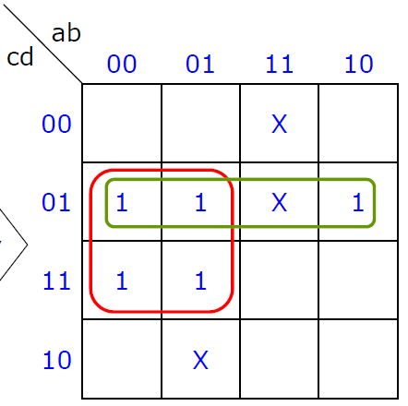
Incompletely Specified Functions (Cont.)
All the 1’s must be covered, but X’s are optional and are set to 1’s only if they will simplify the expression
Simplify

Slide 41


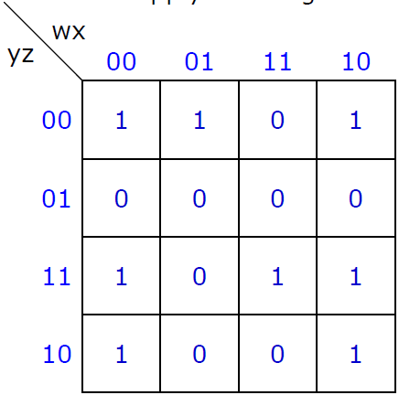
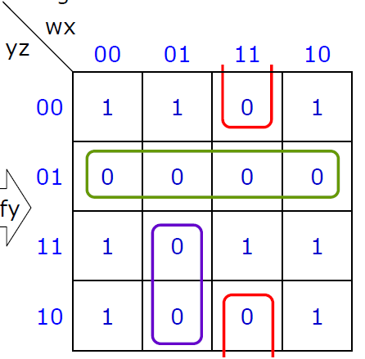
Simplify POS
Circle 0’s instead of 1’s
Apply De Morgan’s law converting SOP to POS
Simplify

Slide 42
Prime Implicants
Implicant: A product term of a function
Any single 1 or any group of 1’s on a K-map combined together forms a product term
Prime implicant: A maximal implicant
An implicant that cannot be combined with another term to eliminate a variable
All of the prime implicants of a function can be obtained from a K-map by expanding the 1’s as much as possible in every possible way

Slide 43
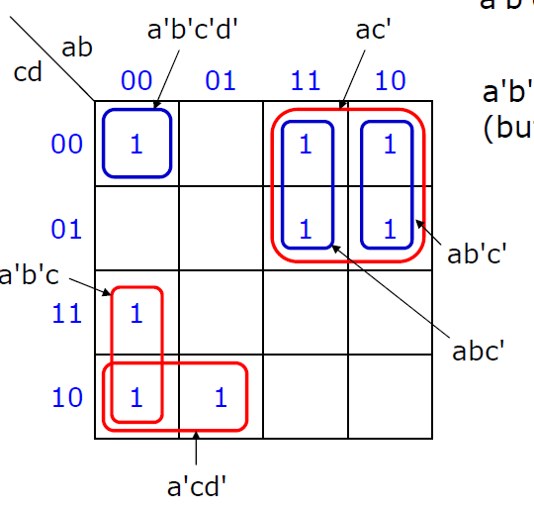
Example
a'b'c, a'cd', ac' are prime implicants
a'b'c'd', abc', ab'c' are implicants (but not prime implicants)

Slide 44
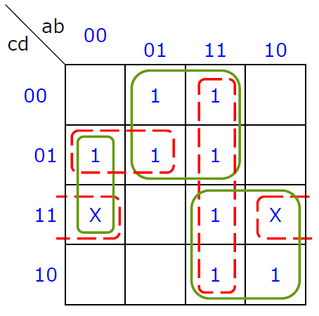
Minimum Expression using Essential Prime Implicants
Determine all prime implicants
In finding prime implicants, don’t cares are treated as 1’s. However, a prime implicant composed entirely of don’t cares can never be part of the minimum solution
Not all prime implicants are needed in forming the minimum SOP
Example
All prime implicants: a'b'd, bc', ac, a'c'd, ab, b'cd (composed entirely of don’t cares)
Minimum solution:
F = a'b'd+bc'+ac

Slide 45
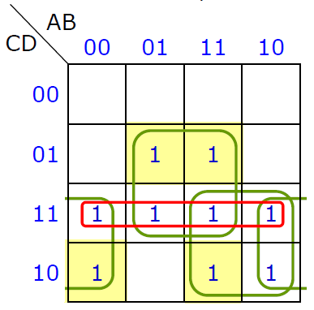
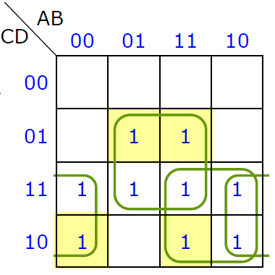


Minimum Expression using Essential Prime Implicants
Essential prime implicant (EPI): A prime implicant that covers some minterm not covered by any other prime implicant
EPIs already cover all 1’s
Minimum
SOP

Slide 46
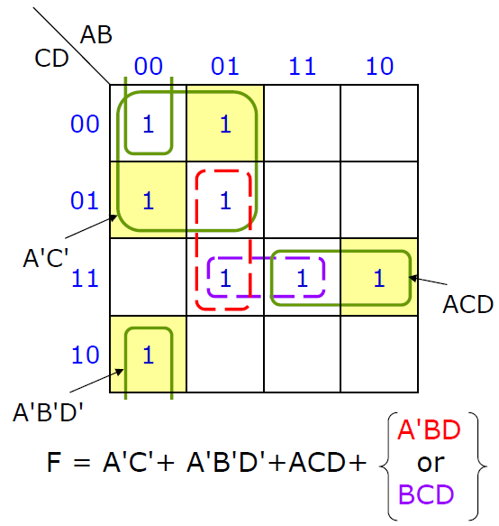
Minimum Expression using Essential Prime Implicants
1. Select all essential prime implicants
2. Find a minimum set of prime implicants which cover the minterms not covered by the essential prime implicants
There may be freedom left after all essential prime implicants are selected

Slide 47
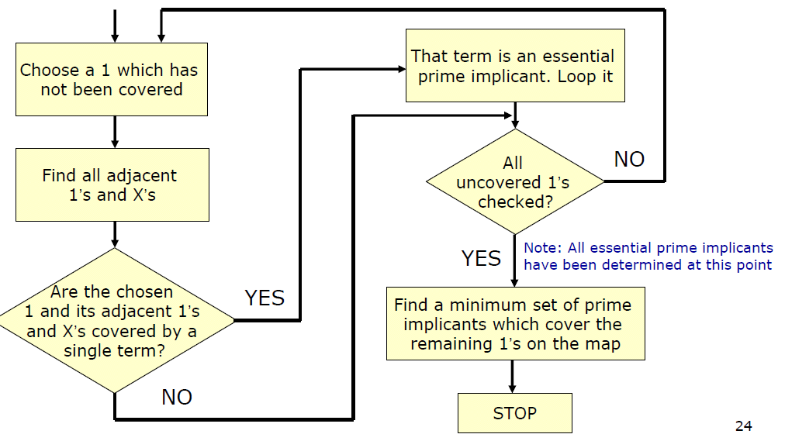
Minimum Expression using Essential Prime Implicants
Flowchart for determining a minimum SOP using K-map

Slide 48
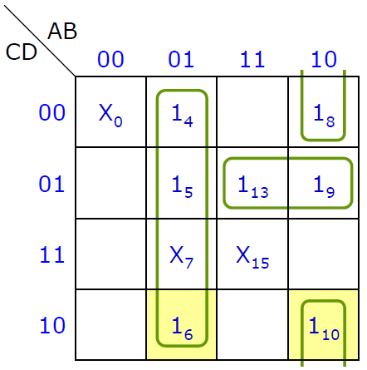
Example
Step 1: 1₄ checked
Step 2: 1₅ checked
Step 3: 1₆ checked
EPI => A'B selected
Step 4: 1₈ checked
Step 5: 1₉ checked
Step 6: 1₁₀ checked
EPI => AB'D' selected
Step 7: 1₁₃ checked
(up to this point all EPIs determined)
Step 8: AC'D selected to cover remaining 1’s

Slide 49
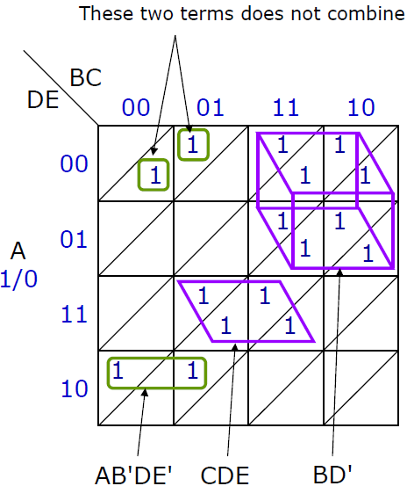
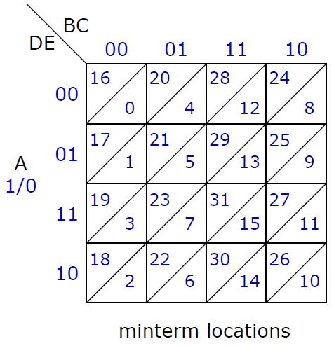
5-variable Karnaugh map

Slide 50
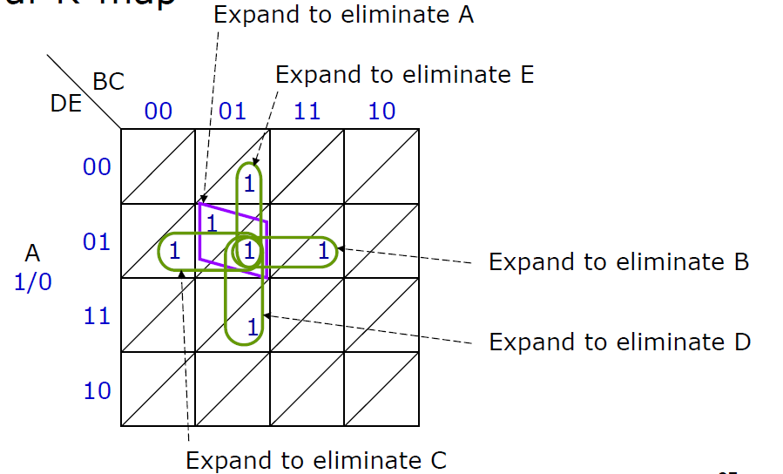
5-variable Karnaugh map

Slide 51
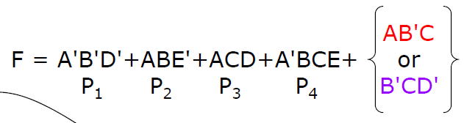
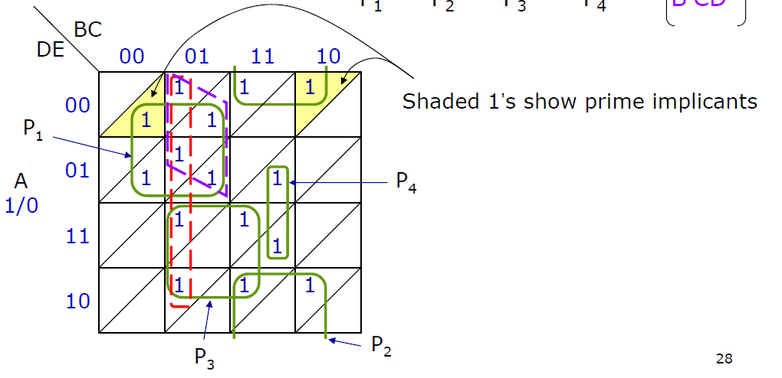
5-variable Karnaugh map

Slide 52
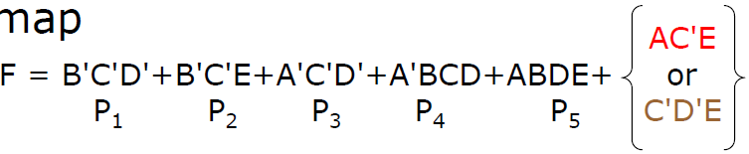
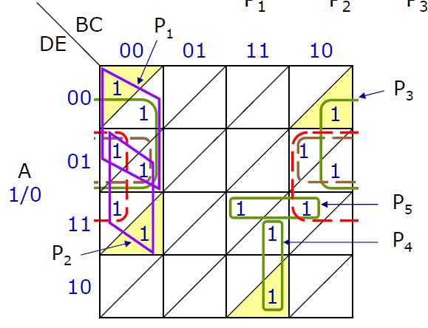
5-variable Karnaugh map

Slide 53
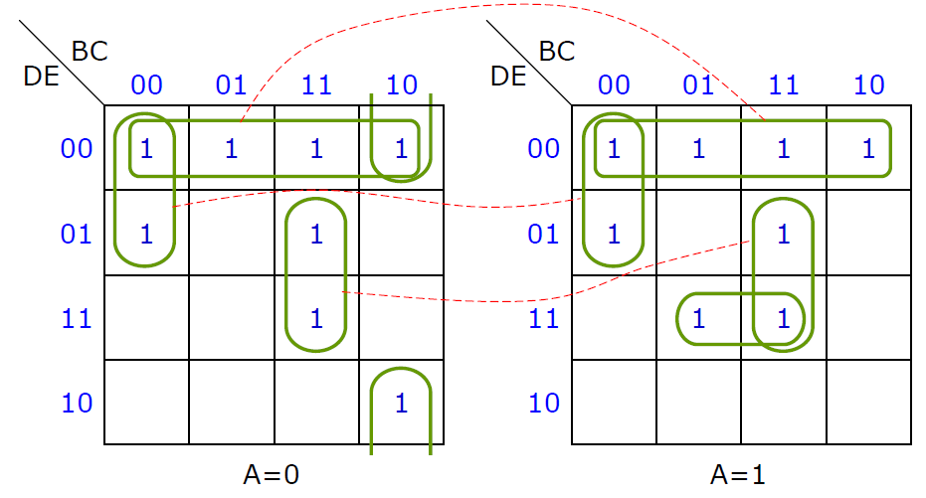
5-variable Karnaugh map
Other conventions

Slide 54
4. Multiple-Level Optimization

Slide 55
Multiple-Level Optimization
Multiple-level circuits are circuits that have more than two level (plus input and/or output inverters)
For a given function, multiple-level circuits can have reduced gate input cost compared to two-level (SOP and POS) circuits
Multiple-level optimization is performed by applying transformations to circuits represented by equations while evaluating cost

Slide 56
Transformations
Factoring - finding a factored form from SOP or POS expression
Algebraic - No use of axioms specific to Boolean algebra such as complements
Boolean - Uses axioms unique to Boolean algebra
Decomposition - expression of a function as a set of new functions

Slide 57
Transformations (continued)
Substitution of G into F - expression function F as a function of G and some or all of its original variables
Elimination - Inverse of substitution
Extraction - decomposition applied to multiple functions simultaneously

Slide 58




Factoring example
Function:
Factoring
Factoring again:
Factoring again:

Slide 59
Decomposition Examples
F = A’C’D’ + A’BC’ + ABC + ACD’ G = 16
The terms A’C’ + AC and B + D’ can be defined as new functions H and E
decomposing F = (A’C’ + AC)(B + D’):
F = H E, H = A’C’ + AC, E = B + D’ G = 10
This series of transformations has reduced G from 16 to 10
The resulting circuit has three levels plus input inverters

Slide 60



Substitution Example
Substitution of E into F
Returning to F just before the final factoring step
G=12
Defining , and substituting in F:
This substitution has resulted in the same cost as the decomposition
G=10

Slide 61



Elimination Example
Beginning with a new
set of functions:
G=10
Eliminating X and Y from Z :
G=10
“Flattening” (Converting to SOP expression):
G=12
This has increased the cost, but has provided an new SOP expression for two-level optimization

Slide 62

Elimination Example (cont’d)
Two-level Optimization
Result:
G=4
This example illustrates :
Optimization can begin with any set of equations, not just with minterms or a truth table
Increasing gate input count G temporarily during a series of transformations can result in a final solution with a smaller G

Slide 63



Extraction Example
Beginning with
two functions:
Finding a common factor and defining it as a function
We perform extraction by expressing E and H as the three functions
The reduced cost G results from the sharing of logic between the two output functions

Slide 64
Multi-level Optimization Summary
Transformations
Factoring - find a factored form from SOP or POS expression
Decomposition - express a function as a set of new functions
Substitution - express function F as a function of G and some or all of its original variables
Elimination - inverse of substitution
Extraction - decompose multiple functions simultaneously

Slide 65
5. XOR and XNOR gates

Slide 66


Exclusive OR and Exclusive NOR Circuits
The exclusive OR (XOR) produces a HIGH output whenever the two inputs are at opposite levels
Output expression:
x = AB + AB
XOR Gate Symbol

Slide 67



Exclusive OR and Exclusive NOR Circuits
The exclusive NOR (XOR) produces a HIGH output whenever the two inputs are at the same level
XOR and XNOR outputs are opposite
Output expression
XNOR Gate Symbol
x = AB + AB

Slide 68


Example
Design a circuit to detect equality of two-bit binary numbers

Slide 69


Exclusive OR and Exclusive NOR Circuits
How an XNOR gate may be used to simplify circuit implementation

Slide 70


Parity Generator and Checker
XOR and XNOR gates are useful in circuits for parity generation and checking

Slide 71
Any question?

