Slide 1
Combinational Circuits II
01/2013
Phan Quoc Huy

Slide 2
Content
5.5 Decoder/Encoder
5.6 Multiplexer/ Demultiplexer
5.7 Parity Generator/ Checker
5.8 Comparator

Slide 3
Reading Assignments
5.5 Chapter 5 (section 5.4, 5.5)
5.6 Chapter 5 (section 5.7)
5.7 Chapter 5 (section 5.8)
5.8 Chapter 5 (section 5.9)

Slide 4
5.5 Decoder/ Encoder

Slide 5
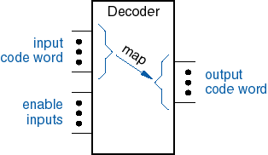
Decoder
Multiple-input/multiple-output device
Inputs (n) are less than outputs (m)
Converts input code words into output code words
One-to-One mapping:
Each input code produces only one output code
Input codes:
Binary Code
Your Code!
Output Codes
1-out-of-m code
Gray Code
BCD Code
enable inputs

Slide 6
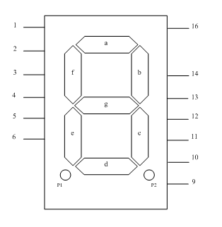
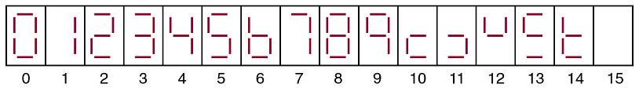
Display Decoders
Seven segment display for decimal digits
Design the decoder:
Input: BCD
Output: Seven segment display
How many inputs?
SOP?

Slide 7
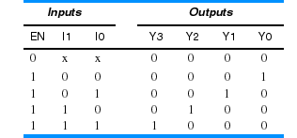
Binary Decoders
n-to- 2^{n} decoder: n inputs and 2^{n} outputs
Input code: n bit Binary Code
Output code: 1-out-of- 2^{n} , One output is asserted for each input code
Example: n=2, 2-to-4 decoder
Note “x” (don’t care input notation)

Slide 8
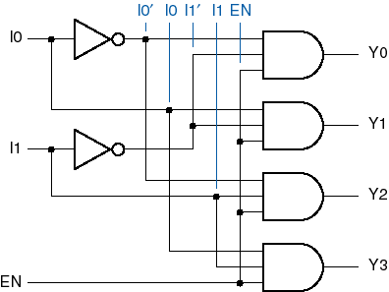
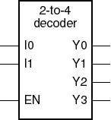
Binary 2-to-4 decoder

Slide 9
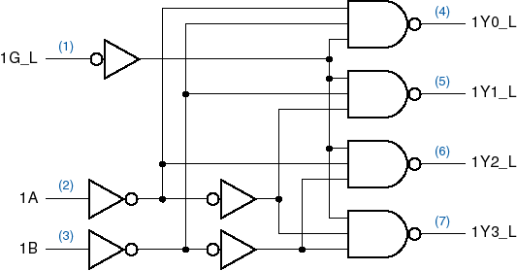
MSI Binary 2-to-4 decoder: 74x139
Input buffering (less load)
NAND gates (faster)

Slide 10
74x139 : Logic Symbol -Truth Table
Active Low Enable, Active Low outputs
Truth Table Logic Symbol Inputs Outputs G_L B A Y3-L Y2-L Y1-L Y0_L 1 X X 1 1 1 1 0 0 0 1 1 1 0 0 0 1 1 1 0 1 0 1 0 1 0 1 1 0 1 1 0 1 1 1
1/2 74x139
G_L
Y0
Y0_L
G
Y1
Y1_L
A
A
Y2
Y2_L
B
B
Y3
Y3_L

Slide 11
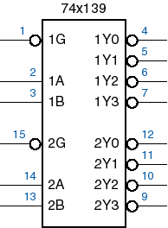
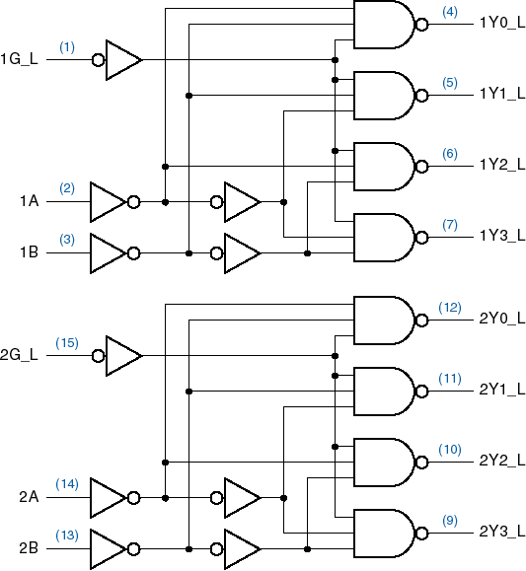
Complete 74x139 Decoder

Slide 12
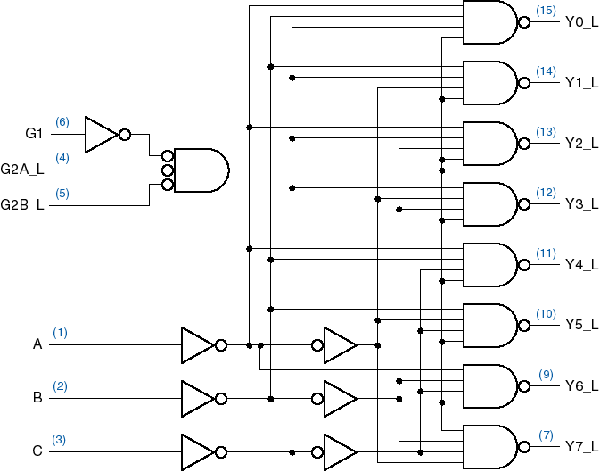
74x138: 3-to-8 Binary decoder

Slide 13
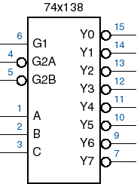
74x138: Logic Symbol

Slide 14
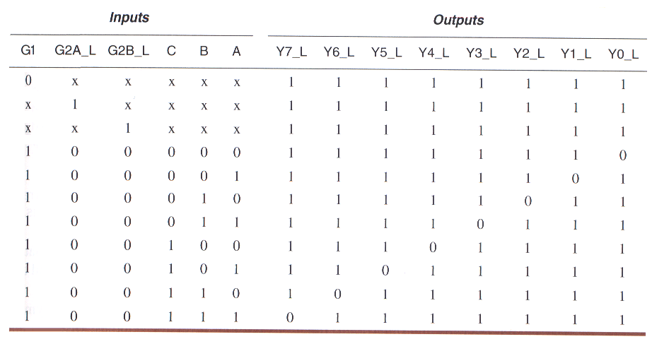
74x138: Truth Table

Slide 15
Decoders as logic function generators
Advantages:
Flexibility
Multiple-output Logic functions
Disadvantages:
Complexity: for large number of inputs
(5-variable Function with 3 minterms! F= AB’CD’E + A’BC’DE+A’BCDE’)

Slide 16
Implementing the Canonical Sum
The binary decoder generates all minterms of n-variable logic function
The canonical sum (sum of minterms) of a logic functions is obtained by adding all minterms of that function:
Match the order of input bits
Activate Enable inputs
Example :
+5V
74x138
Y0
G1
Y1
G2A
Y2
G2B
F
Y3
Z
A
Y4
Y
B
Y5
X
C
Y6
Y7

Slide 17
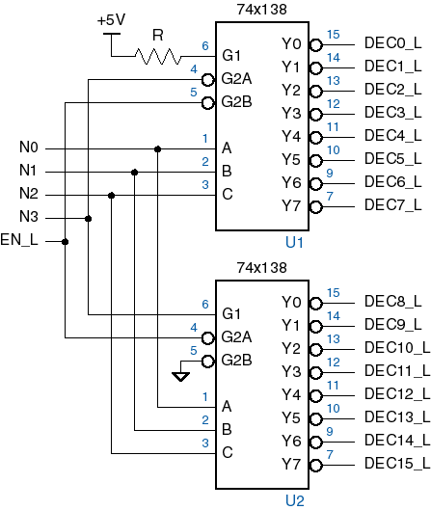
Decoder cascading
4-to-16 decoder

Slide 18
Decoder applications
Microprocessor memory systems
selecting different banks of memory
Microprocessor input/output systems
selecting different devices
Microprocessor instruction decoding
enabling different functional units
Memory chips
enabling different rows of memory depending on address
Lots of other applications

Slide 19
Encoders
Multiple-input/multiple-output device
Performs the inverse function of a Decoder
Outputs ( m ) are less than inputs ( n )
Converts input code words into output code words
input code
output code
ENCODER

Slide 20
Encoders vs. Decoders
Decoder
Encoder
Binary decoders/encoders
n-to-2^n
Input code : Binary Code
Output code :1-out-of-2^n
2^n-to-n encoder
Input code: 1-out-of-2^n
Output code: Binary Code

Slide 21
Binary Encoder
2^n-to-n encoder : 2^n inputs and n outputs
Input code: 1-out-of-2^n
Output code: Binary Code
Example: n=3, 8-to-3 encoder
Inputs Outputs
I0 I1 I2 I3 I4 I5 I6 I7 Y2 Y1 Y0 1 0 0 0 0 0 0 0 0 0 0 0 1 0 0 0 0 0 0 0 0 1 0 0 1 0 0 0 0 0 0 1 0 0 0 0 1 0 0 0 0 0 1 1 0 0 0 0 1 0 0 0 1 0 0 0 0 0 0 0 1 0 0 1 0 1 0 0 0 0 0 0 1 0 1 1 0 0 0 0 0 0 0 0 1 1 1 1
Binary encoder
I0
I1
I2
Y0
I3
Y1
I4
Y2
I5
I6
I7

Slide 22
8-to-3 encoder Implementation
Simplified implementation: Y0 = I1 + I3 + I5 + I7 Y1 = I2 + I3 + I6 + I7 Y2 = I4 + I5 + I6 + I7
Limitations:
I0 has no effect on the output
Only one input can be activated
Application:
Handling multiple devices requests. But, no simultaneous requests
Establishing priorities to solve the problem of multiple requests
I0
Y2
I1
I2
I3
Y1
I4
I5
I6
Y0
I7

Slide 23
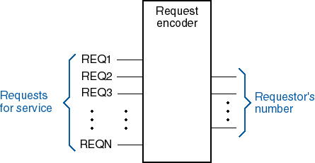
Need priority in most applications

Slide 24
Priority Encoder
Assign priorities to the inputs
When more than one input are asserted, the output generates the code of the input with the highest priority
Priority Encoder: H7=I7 (Highest Priority) H6=I6.I7’ H5=I5.I6’.I7’ H4=I4.I5’.I6’.I7’ H3=I3.I4’.I5’.I6’.I7’ H2=I2.I3’.I4’.I5’.I6’.I7’ H1=I1. I2’.I3’.I4’.I5’.I6’.I7’ H0=I0.I1’. I2’.I3’.I4’.I5’.I6’.I7’ IDLE= I0’.I1’. I2’.I3’.I4’.I5’.I6’.I7’
Encoder A0=Y0 = H1 + H3 + H5 + H7 A1=Y1 = H2 + H3 + H6 + H7 A2=Y2 = H4 + H5 + H6 + H7
Priority encoder
Priority Circuit
Binary encoder
I7
I7
H7
I7
I6
I6
H6
I6
I5
I5
H5
I5
Y2
A2
I4
I4
H4
I4
Y1
A1
I3
I3
H3
I3
Y0
A0
I2
I2
H2
I2
I1
I1
H1
I1
I0
I0
H0
I0
IDLE
IDLE

Slide 25
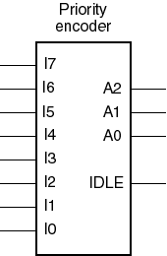
8-input priority encoder
I7 has the highest priority, I0 least
A2-A0 contain the number of the highest-priority asserted input if any
IDLE is asserted if no inputs are asserted

Slide 26
74x148 8-input priority encoder

Slide 27
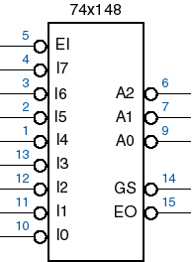
74x148 8-input priority encoder
Active-low I/O
Enable Input
“Got Something": Group Select
Enable Output

Slide 28
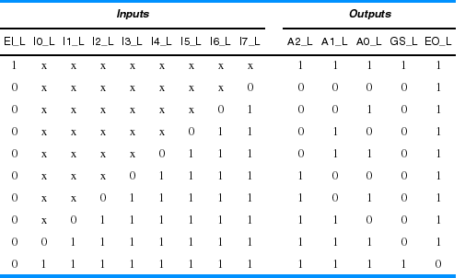
74x148 Truth Table

Slide 29
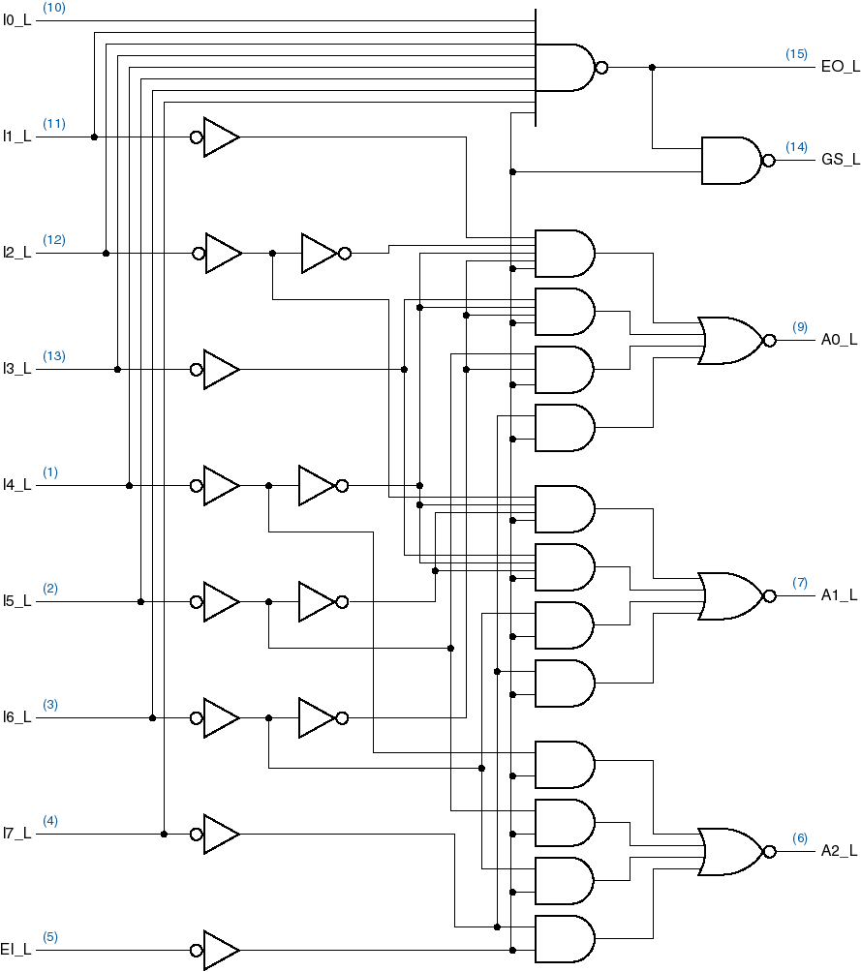
74x148 circuit

Slide 30
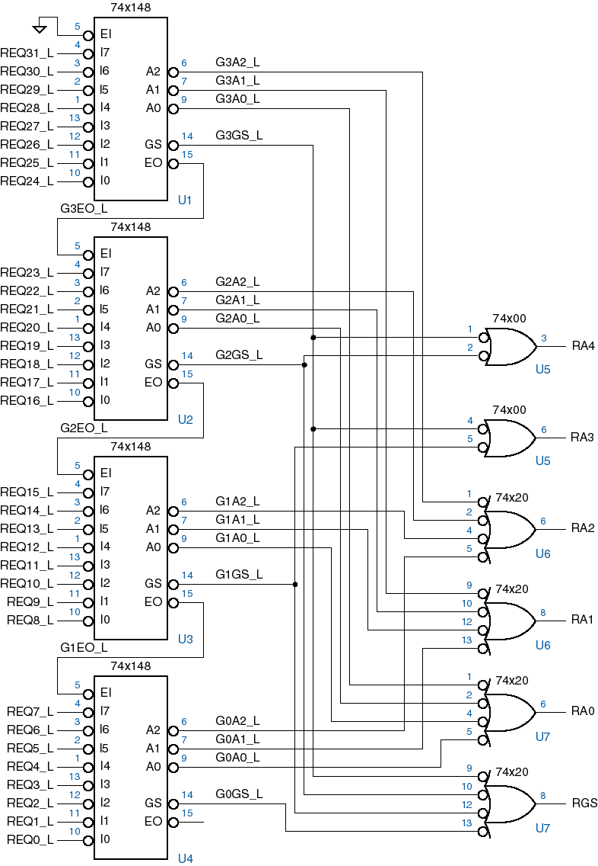
Cascading priority encoders
32-input priority encoder

Slide 31
5.6 Multiplexer/ Demultiplexer

Slide 32
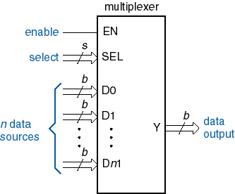
Multiplexers (Mux)
E.g. Put between Processor’s registers and ALU
A 16-bit processor where 3-bit field specifies one of 8 registers
The 3-bit field is connected to the select inputs of an 8-input, 16-bit Mux
Select one of n sources of data to transmit on a bus

Slide 33
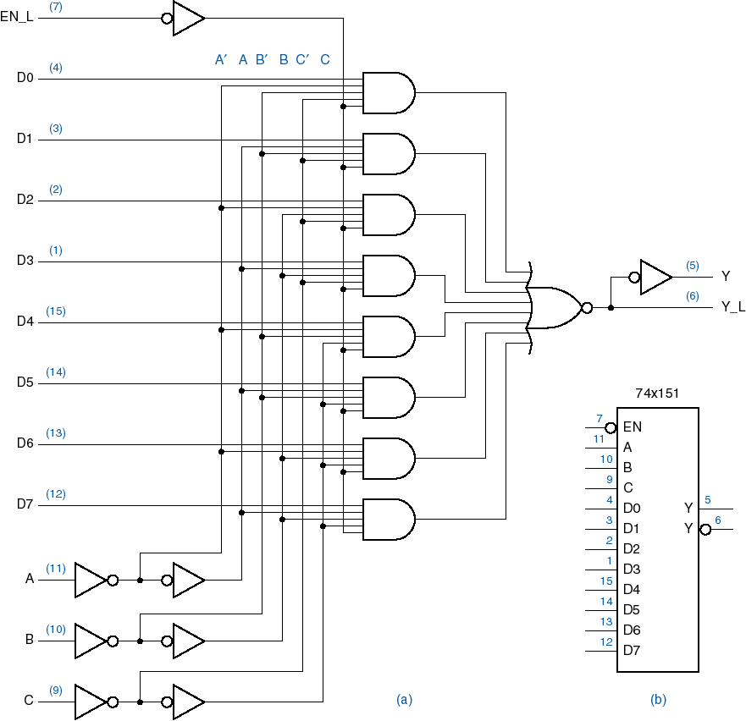
MSI: 74x151 8-input 1-bit multiplexer

Slide 34
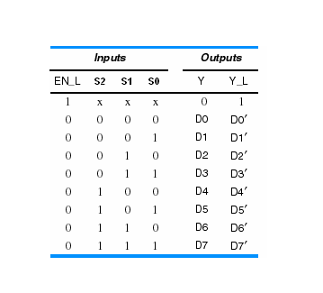
74x151 truth table

Slide 35
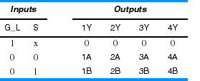
Other multiplexer varieties
2-input, 4-bit-wide
74x157
4-input, 2-bit-wide
74x153

Slide 36
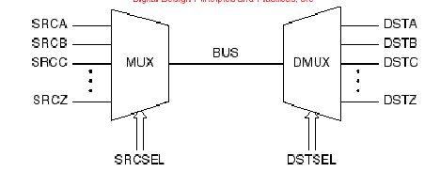
Demultiplexers same as decoders
A Mux is used to select one of n sources of data to transmit on a bus
A demultiplexer can be used to route the bus data to one of m destinations. Just the inverse of a mux
A binary decoder with an enable input can be used as a Demux. E.g. 74x139 can be used as a 2-bit, 4-output Demux

Slide 37
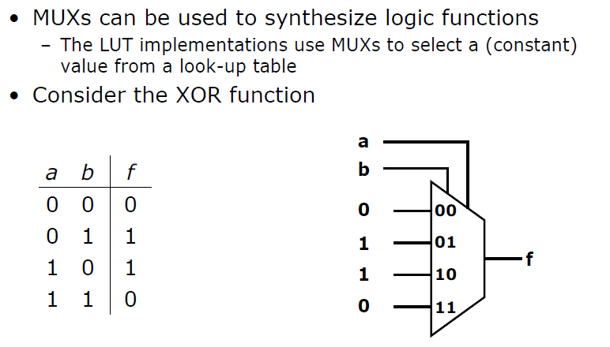
Logic functions using MUX

Slide 38
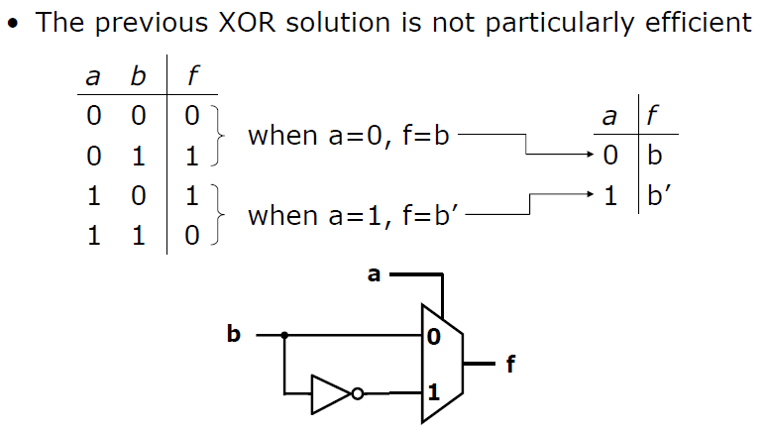
Logic functions using MUX

Slide 39
Logic functions using MUX
Example: Implement the following with a MUX and any additional logic gates
A | B | X
0 | 0 | 1
0 | 1 | 1
1 | 0 | 0
1 | 1 | 1

Slide 40
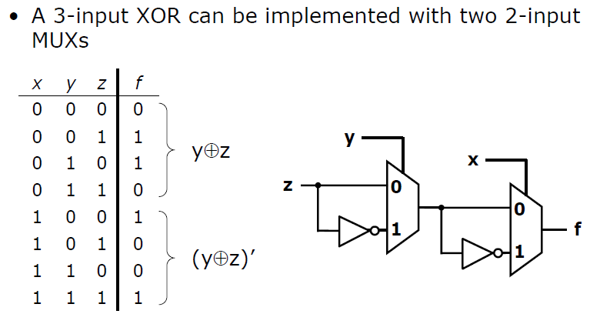
Logic functions using MUX
3 inputs XOR can be done with 2 2-to-1 MUX

Slide 41
Logic functions using MUX
Example: Implement the following with a MUX and any additional logic gates
A | B | C | X
0 | 0 | 0 | 1
0 | 0 | 1 | 1
0 | 1 | 0 | 0
0 | 1 | 1 | 1
1 | 0 | 0 | 1
1 | 0 | 1 | 0
1 | 1 | 0 | 0
1 | 1 | 1 | 1

Slide 42
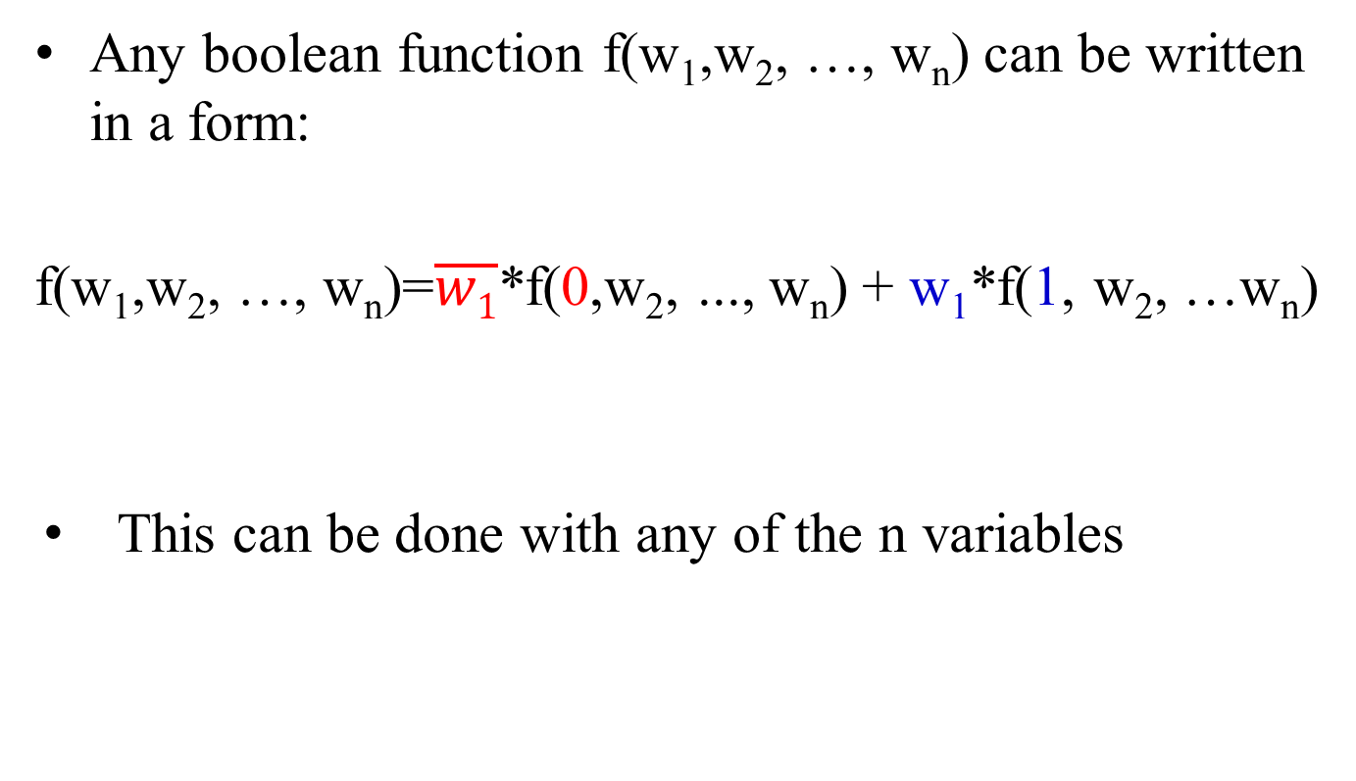
Shannon’s expression theorem
Any boolean function f(w₁,w₂, …, w_{n}) can be written in a form:
f(w₁,w₂, …, w_{n})=$\overline{w1}$*f(0,w₂, ..., w_{n}) + w₁*f(1, w₂, …w_{n})
This can be done with any of the n variables

Slide 43

Shannon’s expression theorem
Example 1:
f(w₁,w₂, w₃)= w₁w₂ + w₁w₃ + w₂w₃
Expanding this in terms of w₁:
f(w₁,w₂, w₃)= w₁(w₂ + w₃) + $\overline{w1}$(w₂w₃)
Wrong??
f when w₁=1
f when w₁=0

Slide 44
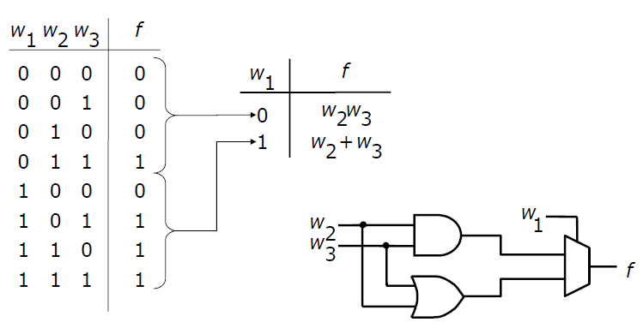
Shannon’s expression theorem

Slide 45
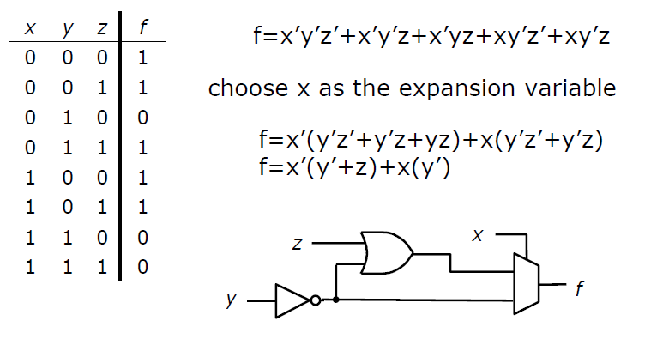
Shannon’s expression theorem
Example 2:
Choose x as the expansion variable

Slide 46
Shannon’s expression theorem
Example 3:
Choose z as the expansion variable

Slide 47
Example
Using 4-1 mux and essential logic gates to implement this function:
F (a, b, c, d) = SOP (1, 3, 5, 6, 8, 11, 15)
Requirement: c and d are control inputs of the 4-1 mux

Slide 48
5.7 Parity Generator/ Checker

Slide 49
Exclusive OR and Exclusive NOR Gates
XOR:
XNOR:
Truth Table : XOR X Y XOR XNOR 0 0 0 1 0 1 1 0 1 0 1 0 1 1 0 1 XNOR
X
F
Y
X
F
Y

Slide 50
XOR and XNOR Symbols
Equivalent Symbols of XOR gate
Equivalent Symbols of XNOR gate
For both XOR, XNOR: Any 2 signals (inputs or outputs) may be complemented without changing the resulting logic function

Slide 51
XOR Application: Parity Circuit
Odd Parity Circuit: The output is 1 if odd number of inputs are 1
Even Parity Circuit: The output is 1 if even number of inputs are 1
Example: 4-bit Parity Circuit
I0
I1
EVEN
I0
EVEN
I2
I1
ODD
ODD
I3
I2
Daisy-Chain Structure
I3
Tree structure
Input: 1101 Odd Parity output: 1 Even Parity output: 0

Slide 52
MSI Parity Circuit : 74x280

Slide 53
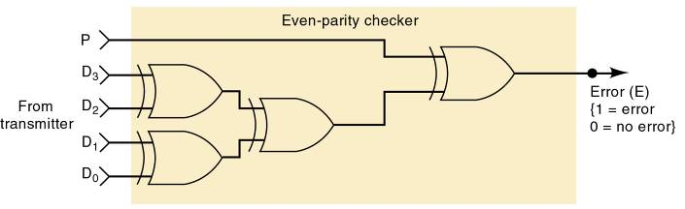
Parity checker

Slide 54
5.8 Comparator

Slide 55
Comparator
Comparator circuit compares two inputs
Produces 1 if they are equal
Produces 0 if they are not equal
Based on Exclusive-OR gate, returns 0 if the inputs are equal and 1 if they are unequal
A NOR gate decides whether to return 1 for equality or 0 for inequality

Slide 56
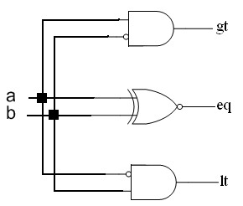
1 bit comparator
a | b | gt | eq | lt
0 | 0 | 0 | 1 | 0
0 | 1 | 0 | 0 | 1
1 | 0 | 1 | 0 | 0
1 | 1 | 0 | 1 | 0

Slide 57
4 bit comparator
eq

Slide 58
4 bit comparator
gt

Slide 59
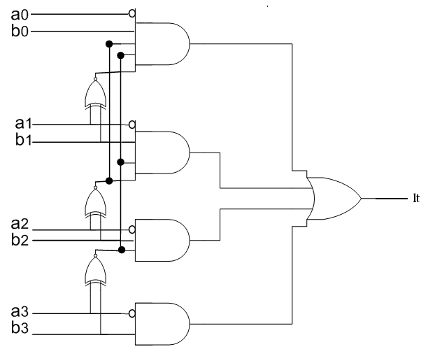
4 bit comparator

Slide 60
4 bit comparator
The 7485 is a standard comparator package with the following attributes:
if (A>B) lt=0, eq=0, gt=1
if (A<B) lt=1, eq=0, gt=0
if (A=B) lt=l, eq=e, gt=g
Note: The three l, e and g inputs are used when cascading

Slide 61
16 bit comparator
Cascading 4 7485 to construct a 16 bit comparator

Slide 62
16 bit comparator
This comparator will first compare the 4 most significant bits of the two inputs
in this first stage
‘a’ is less than ‘b’ if a’s 4 MSB are smaller
‘a’ is greater than ‘b’ if the 4 MSB are larger
If these 4 MSB of the two numbers turn out to be equal, the final result is from less significant bits comparison

Slide 63
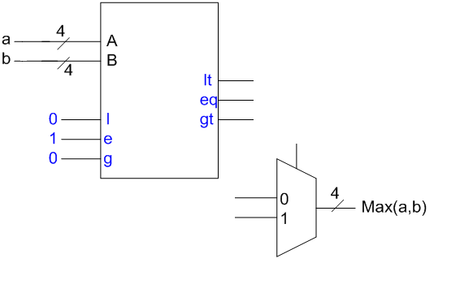
Example
Design a maximum, minimum finder of n 4 bit numbers using comparators and MUXs

Slide 64
Any question?

