Slide 1
Combinational Circuits I Arithmetic Circuits
01/2013
Phan Quốc Huy

Slide 2
Content
5.1 Ripple-Carry Adder
5.2 Carry-Look-Ahead Adder
5.3 Adder/ Subtrator
5.4 Arithmetic Logic Unit

Slide 3
Reading Assignments
Chapter 5 (section 5.10)

Slide 4
5.1 Ripple-Carry Adder

Slide 5
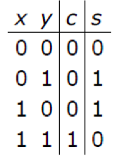
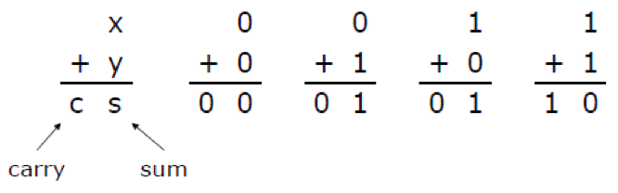
Binary Adder
4 cases when adding 2 1-bit numbers
This 1 bit adder with sum and carry out is called Half Adder (HA)

Slide 6
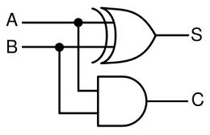
Half Adder
Circuit diagram

Slide 7
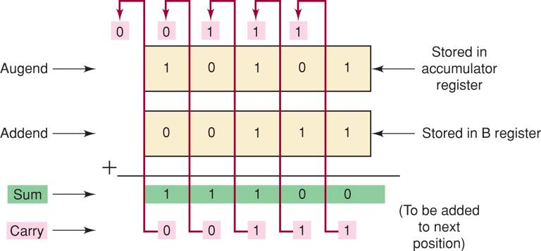
Parallel Binary Adder
Adding 2 or more bits numbers
Adding each pair of bit as usual
At pair #i, carry-in resulting from adding bit #i-1 may exist

Slide 8
Design a Full Adder
A Full Adder (FA)
3 inputs (2 inputs for 2 bits to be added, and 1 for carry-in)
2 output (1 for sum and 1 for carry-out)

Slide 9
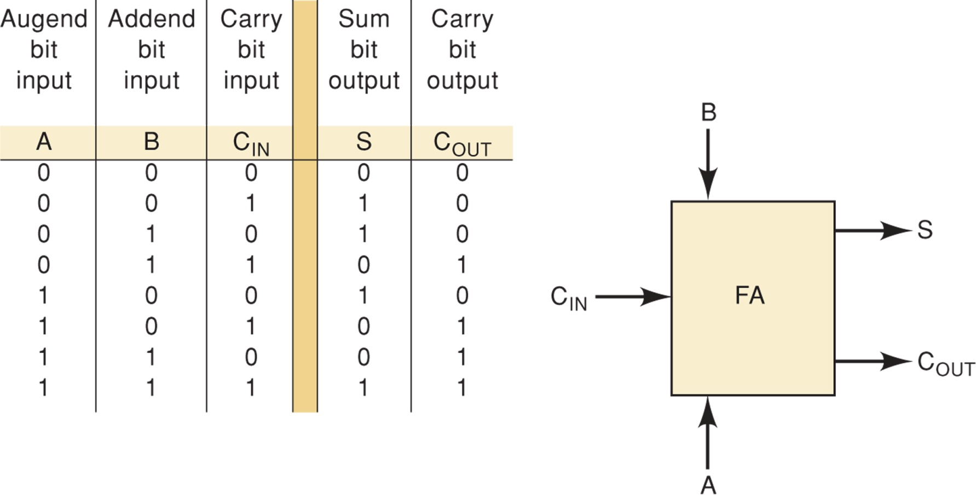
Design a Full Adder
Truth table

Slide 10
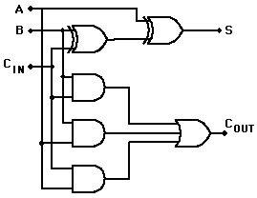
Design a Full Adder
Circuit diagram

Slide 11
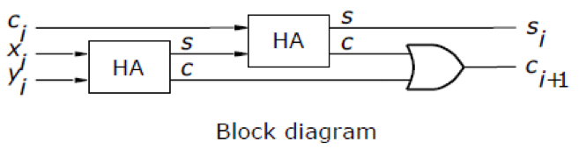
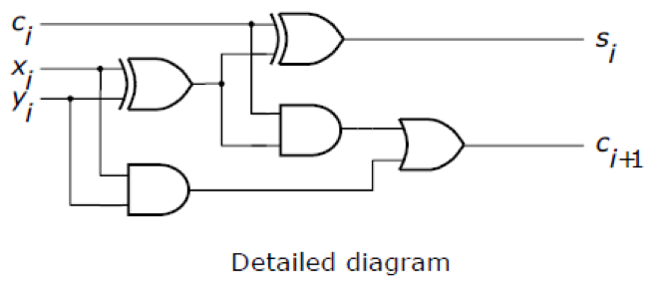
Design a Full Adder
Reusing HA

Slide 12
Carry Ripple Adder
Block diagram for a 4 bit adder using FAs

Slide 13
Carry Ripple Adder
FAs start adding bits from LSB to MSB
If carry is out at i^{th} bit, it will be added at i+1th bit
This setting is called carry-ripple adder
As carry is “ripple” from this FA to next FAs
speed is limited by carry propagation
The look-ahead carry scheme is commonly used in high speed devices to reduce the delay

Slide 14
5.2 Carry-Look-Ahead Adder

Slide 15
Performance
We are interested in the largest delay from the time the operands X and Y are presented as inputs until the time all bits of the sum S and the final carry-out, c_{n}, are valid
The delay for the carry-out in this circuit, Δt, is equal to two gate delays
Final result of an n-bit addition is valid after a delay of nΔt. This is 2n gate delays
each bit in the carry ripple adder is constructed as a FA

Slide 16
Performance
The speed of any circuit is limited by the longest delay along the paths through the circuit
The longest delay is called the critical-path-delay,
and the path that causes this delay is called the critical path

Slide 17
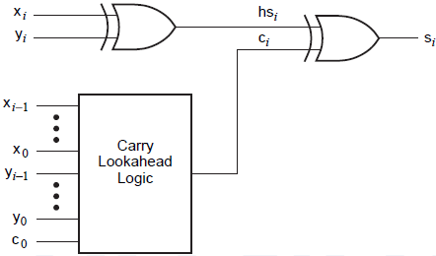
CLA
To reduce delay caused by the effect of carry propagation through the ripple-carry adder
evaluate quickly for each adder stage whether carry-in from the previous stage will have a value of 0 or 1
Target: reduce the critical-path-delay

Slide 18
CLA
Recall the carry-out function for stage I can be realized as
c_{i+1}= x_{i}y_{i} + x_{i}c_{i} + y_{i}c_{i} = x_{i}y_{i} + (x_{i} + y_{i})c_{i}
Let g_{i} = x_{i}y_{i} and p_{i} = x_{i} + y_{i} => c_{i+1}= g_{i} + p_{i}c_{i}
g_{i} = 1 when both x_{i} and y_{i} are 1, regardless of c_{i}
Stage i is guaranteed to generate a carryout, g is called generate function
p_{i} = 1 when x_{i} = 1 OR y_{i} = 1; carry-out = c_{i}
The effect is that carry-in of 1 is propagated through stage i, p is called propagate function

Slide 19
CLA
Generate an expression for the output carry of an n-bit adder
c_{n} =g_{n-1} + p_{n-1}c_{n-1}
and c_{n-1} =g_{n-2} + p_{n-2}c_{n-2}
c_{n}=g_{n-1} + p_{n-1}(g_{n-2} + p_{n-2}c_{n-2})
c_{n}=g_{n-1} + p_{n-1}g_{n-2} + p_{n-1}p_{n-2}c_{n-2}
The same expansion for other stages, ending with stage 0, gives
c_{n}=g_{n-1}+p_{n-1}g_{n-2}+p_{n-1}p_{n-2}g_{n-3}+…+p_{n-1}p_{n-2}….p₁g₀+p_{n-1}p_{n-2}….p₁p₀c₀

Slide 20
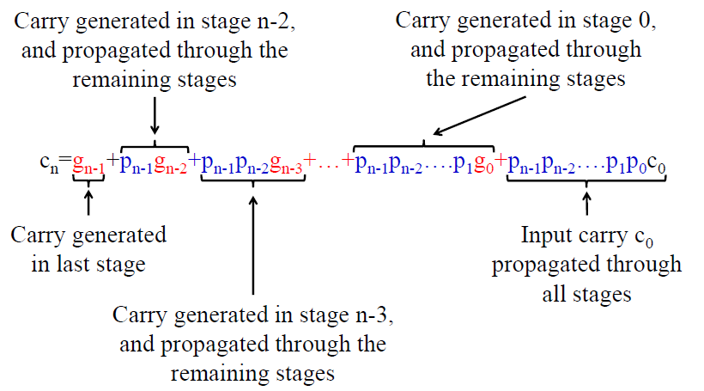
CLA

Slide 21
CLA
Example: 4-bit adder
C₁ = G₀ + P₀.C₀
C₂ = G₁ + P₁.G₀ + P₁.P₀.C₀ C₃ = G₂ + P₂.G₁ + P₂.P₁.G₀ + P₂.P₁.P₀.C₀ C₄ = G₃ + P₃.G₂ + P₃.P₂.G₁ + P₃P₂.P₁.G₀ + P₃P₂.P₁.P₀.C₀

Slide 22
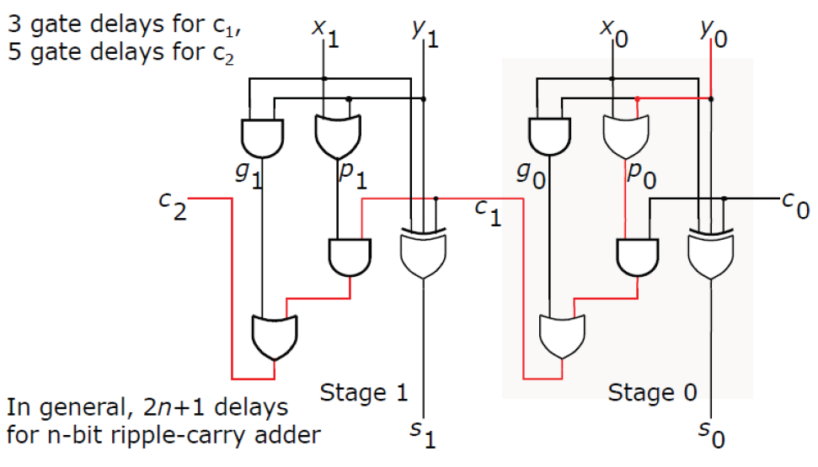
CLA critical path

Slide 23
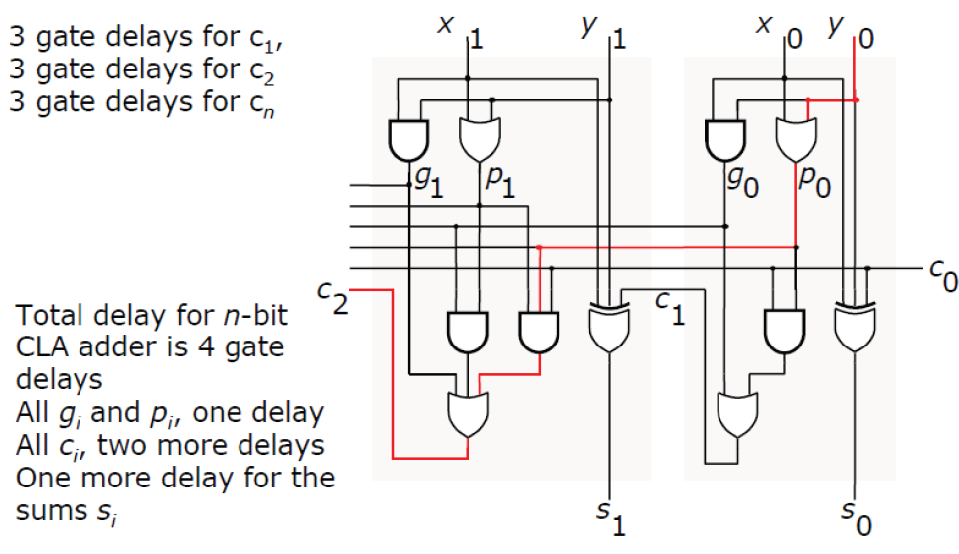
CLA critical path

Slide 24
Carry-lookahead limitations
The expression for carry in a CLA adder
c_{n}=g_{n-1}+p_{n-1}g_{n-2}+p_{n-1}p_{n-2}g_{n-3}+…+p_{n-1}p_{n-2}….p₁g₀+p_{n-1}p_{n-2}….p₁p₀c₀
obviously results in a fast solution (since it is only a 2 level AND-OR function)
The complexity of an n-bit CLA adder increases rapidly as n becomes large
To reduce this complexity, using hierarchical approach in designing large adders
Fan-in limitations may effectively limit the speed of a CLA adder
Devices with known fan-in limitations (such as an FPGA) often include dedicated circuitry for fast adders

Slide 25
5.3 Adder/ Subtractor

Slide 26
Full Subtractor = full adder, almost
X,Y are n-bit unsigned binary numbers
Addition: S = X + Y
Subtraction: D = X - Y = X + (-Y) = = X+ (Two’s Complement of Y) = X+ (One’s Complement of Y) + 1 = X+ Y’+ 1

Slide 27
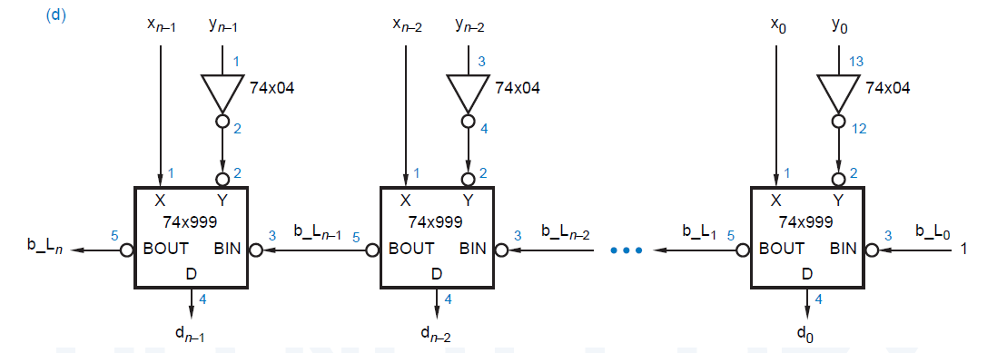
Using Adder as a Subtractor
Ripple Adder can be used as a Subtractor by inverting Y and setting the initial carry to 1
Ripple Subtractor

Slide 28
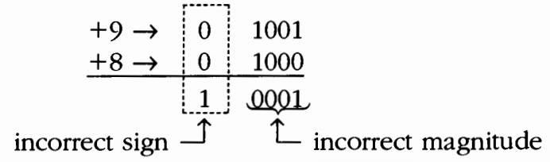
Arithmetic Overflow
If the answer exceeds the number of magnitude bits, an overflow results
n bit represent a number from -2^{n-1} to +2^{n-1}-1
Overflow always produces an incorrect result
=> A circuit to check if overflow results

Slide 29
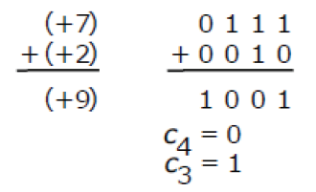
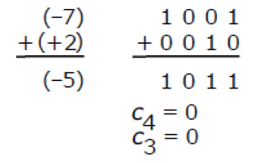
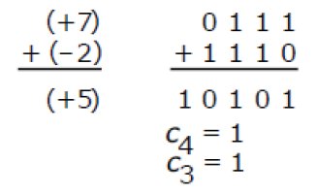
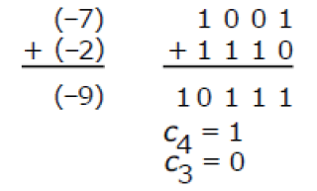
Arithmetic overflow example
4 bit number, 3 magnitude bit and 1 sign bit
O
O
Overflow never results when adding two opposite sign numbers

Slide 30
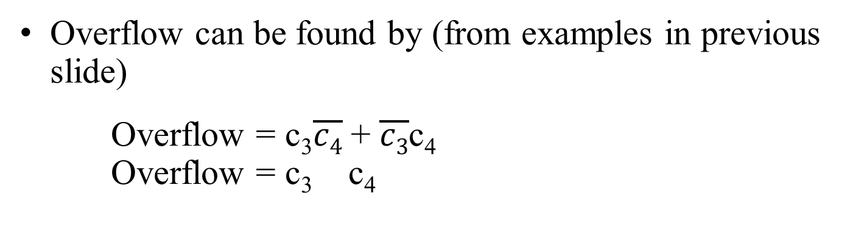
Arithmetic overflow
Overflow can be found by (from examples in previous slide)
Overflow = c₃$\overline{c4}$ + $\overline{c3}$c₄
Overflow = c₃ c₄
In case of n bit
Overflow = c_{n-1} c_{n}
Adder/ Subtractor can be expanded with an overflow checker with 1 XOR gate

Slide 31
Example
Design an adder/ subtractor circuit with two control inputs ADD and SUB
ADD = 1, circuit adds number in A and B registers
SUB = 1, circuit subtracts a number in A register from a number in B registers

Slide 32
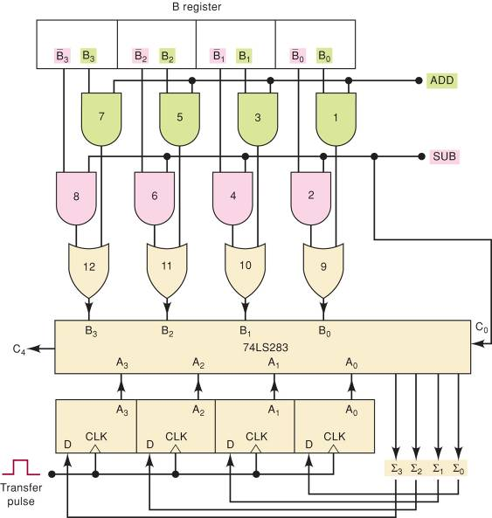
Example

Slide 33
5.4 Arithmetic Logic Unit (ALU)

Slide 34
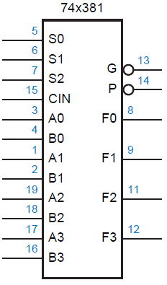
ALU
A combinational circuit that can perform several arithmetic and logical operations
Operation is specified by a set of function select inputs
Inputs
S2 | S1 | S0 | Function
0 | 0 | 0 | F = 0000
0 | 0 | 1 | F = B – A – 1 + Cin
0 | 1 | 0 | F = A – B – 1 + Cin
0 | 1 | 1 | F = A + B + Cin
1 | 0 | 0 | F = A B
1 | 0 | 1 | F = A + B
1 | 1 | 0 | F = A * B
1 | 1 | 1 | F = 1111

Slide 35
Any question?

