Slide 1
Latches and Flip-Flops
01/2013
Phan Quốc Huy

Slide 2
Content
6.1 SR Latch
6.2 D Latch
6.3 Flip-flops
Reading assignment:
Chapter 7 (section 7.1, 7.2)

Slide 3
Bistable Elements

Slide 4
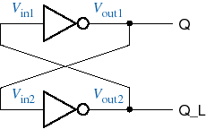
Bistable element
The simplest sequential circuit
Two states
One state variable, say, Q, two possible states
no way to control its state
LOW
HIGH
HIGH
LOW
HIGH
LOW
LOW
HIGH

Slide 5
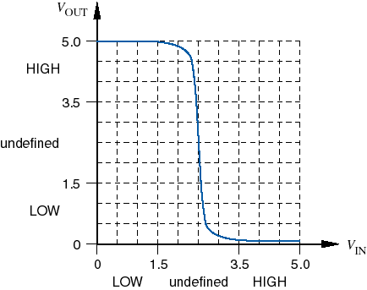
Analog analysis
Assume pure CMOS thresholds, 5V rail
Theoretical threshold center is 2.5 V
2.5 V
5.0 V
2.51 V
2.5 V
2.0 V
0.0 V
2.5 V
2.0 V
0.0 V
4.8 V
5.0 V
2.5 V

Slide 6
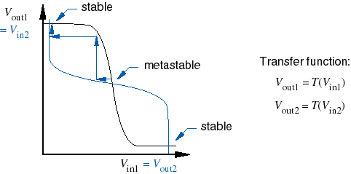
Metastability
Metastability is inherent in any bistable circuit
Two stable points, one metastable point

Slide 7
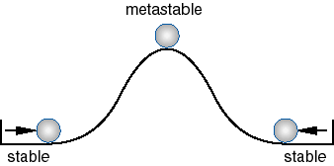
Another look at metastability

Slide 8
Why all the harping on metastability?
All real systems are subject to it
Problems are caused by “asynchronous inputs” that do not meet flip-flop setup and hold times
Severe in high-speed systems since clock periods are so short, “metastability resolution time” can be longer than one clock period
Many digital designers, products, and companies have been burned by this phenomenom

Slide 9
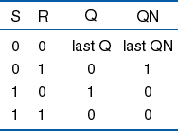
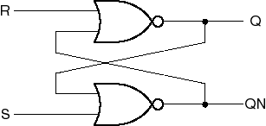
Back to the bistable….
How to control it?
Control inputs
S-R latch

Slide 10
Latches and Flip flops

Slide 11
The Set-Reset Latch
S
Q
S
Q
FF
R
Q’
Q’
R

Slide 12
The Set-Reset Latch
If S=0 and R=0, what are
the stable states for this
circuit?
P
0
Q
(i) Assume P=0;
1
S
0
P=0 and Q=1 is stable
R
0

Slide 13
The Set-Reset Latch
If S=0 and R=0, what are
the stable states for this
circuit?
P
1
Q
(i) Assume P=0;
0
S
0
P=0 and Q=1 is stable
R
0
(ii) Assume P=1;
P=1 and Q=0 is stable

Slide 14
The Set-Reset Latch
If the state is P=1 and Q=0,
and the input S changes to
1, what happens?
P
1
0
Q
The new stable state is
P=0 and Q=1
0
1
S
0
1
0
R
0
What happens if S changes
to zero now?
The state does not change!

Slide 15
The Set-Reset Latch
If the state is P=0 and Q=1,
and the input R is changed to
1, what happens?
P
0
1
Q
The new stable state is
P=1 and Q=0
1
0
S
0
R
0
1
0
What happens if S changes
to zero now?
The state does not change!

Slide 16
The Set-Reset Latch
Therefore:
if S changes to 1 for a short period of time,
the flip-flop goes to the state P=0, Q=1;
if R changes to 1 for a short period of time,
the flip-flop goes to the state P=1, Q=0;
We consider Q to be the output of the latch, therefore S is the “Set” input, and R is the “Reset” input.
What happens if R and S are 1 at the same time?

Slide 17
The Set-Reset Latch
Lets assume that P=0, Q=1
initially and then R and S
become 1.
P
The new stable state is
P=0 and Q=0
0
Q
1
0
S
0
1
R
0
1
But this is no longer a latch because
P is no longer a complement of Q!
S=1 and R=1 is not allowed

Slide 18
The Set-Reset Latch
S(t)
1
1
1
R(t)
X
X
S
Q
Q(t)
FF
R
Q’
Q(t+ε) = S(t) + Q(t)R’(t)

Slide 19
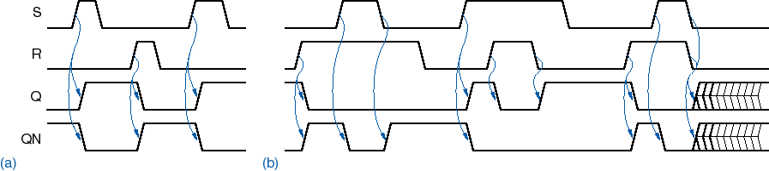
S-R latch operation
Metastability is possible if S and R are negated simultaneously.

Slide 20
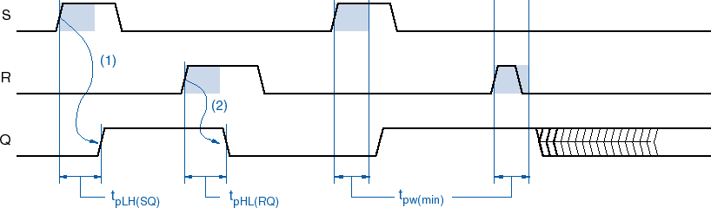
S-R latch timing parameters
Propagation delay
Minimum pulse width

Slide 21


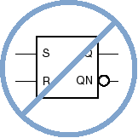

S-R latch symbols

Slide 22

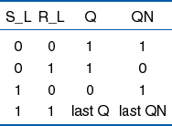
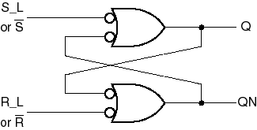
S-R latch using NAND gates

Slide 23
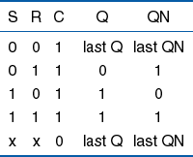
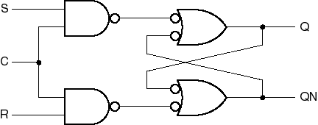
S-R latch with enable

Slide 24
Using an enable S-R latch to build a Trigger Latch
What happens if the
T input is at 1
for a longer time?
S’
T
The flip-flop oscillates
until T goes back to 0.
R’
Q
T
Q
FF
S’
T
δ
δ
R’’
Q’
δ
δ

Slide 25
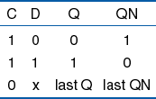
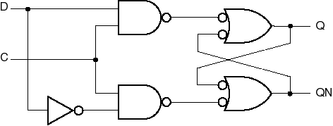
D latch

Slide 26
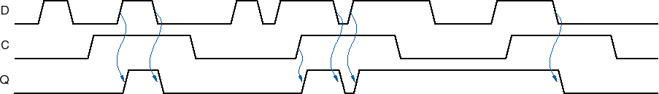
D-latch operation

Slide 27
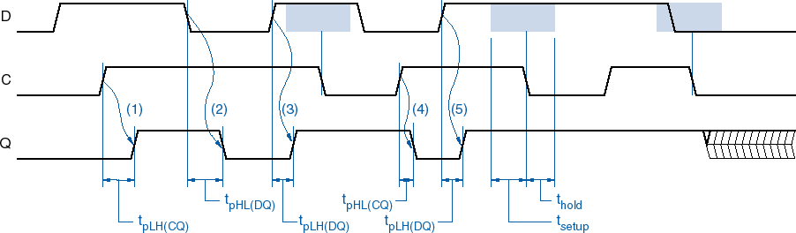
D-latch timing parameters
Propagation delay (from C or D)
Setup time (D before C edge)
Hold time (D after C edge)

Slide 28
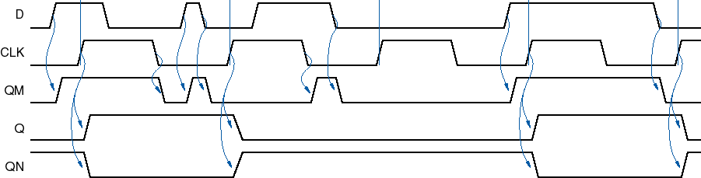
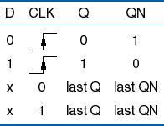
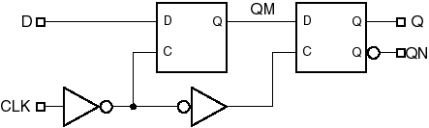
Edge-triggered D flip-flop behavior

Slide 29

Edge-triggered D flip-flop behavior

Slide 30
FF vs. Latch
Latches and flip-flops (FFs) are the basic building blocks of sequential circuits.
latch: bistable memory device with level sensitive triggering (no clock), watches all of its inputs continuously and changes its outputs, independent of a clocking signal.
flip-flop: bistable memory device with edge-triggering (with clock), samples its inputs, and changes its output only at times determined by a clocking signal.

Slide 31
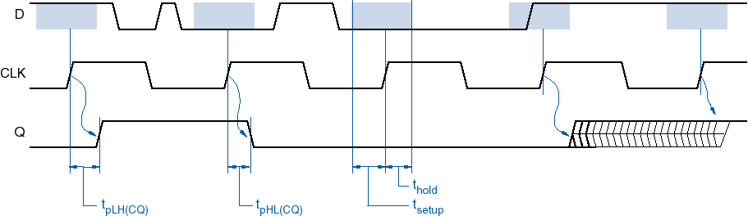
D flip-flop timing parameters
Propagation delay (from CLK)
Setup time (D before CLK)
Hold time (D after CLK)

Slide 32

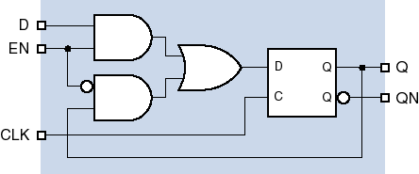

Other D flip-flop variations
Negative-edge triggered
Clock enable

Slide 33
D FF with asynchronous inputs
Force the D FF to a particular state independent of the CLK and D inputs
PR (Preset) and CLR (Clear)

Slide 34

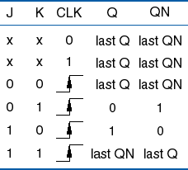
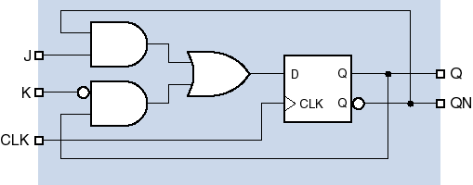
J-K flip-flop

Slide 35
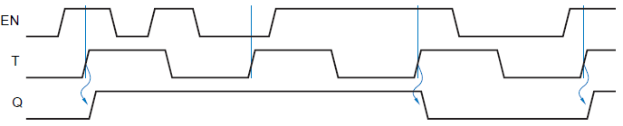

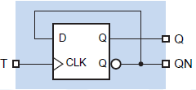
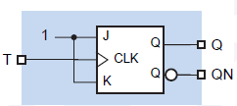
T (toggle) flip-flop
Change state on every stick of the lock
How to build a T FF using?
D FF
J-K FF

Slide 36
Notes
When power is applied, it is not possible to predict the starting state of a flip-flop’s output
If SET and RESET inputs are in their inactive state
To start a latch or FF in a particular state, it must be placed in that state by momentarily activating the SET or RESET input, at the start of operation
Often achieved by application of a pulse to the appropriate input

Slide 37
Any question?

