Slide 1
Counters
01/2013
Đỗ Đức Minh Quân

Slide 2
Content
Asynchronous counters
MOD number
Up/ Down counters
Propagation delay
Synchronous counters
Analyze synchronous counters
Design a synchronous counter
Registers

Slide 3
Asynchronous counters

Slide 4
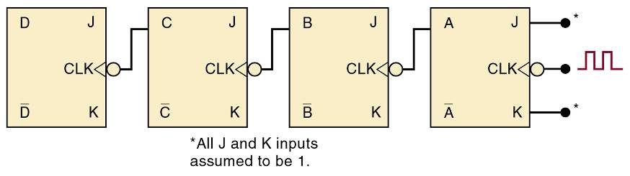
Asynchronous (Ripple) Counters
Review of four bit counter operation:
Clock is applied only CLK input to FF A
J & K are HIGH in all FFs
Output of FF A is CLK of FF B, etc
FF outputs D, C, B, and A, are a 4-bit binary number with D as the MSB

Slide 5
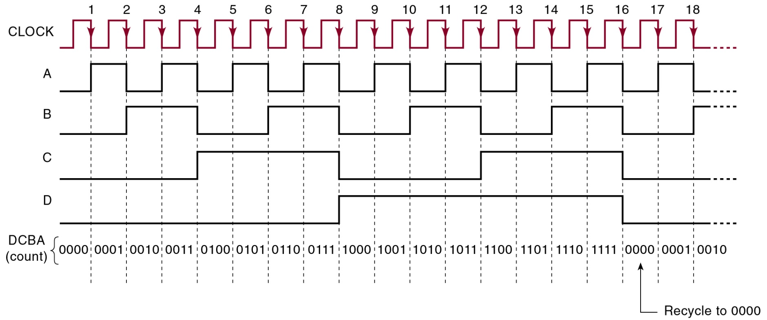
Asynchronous (Ripple) Counters
Review of four bit counter operation:
After the NGT of the 15th clock pulse, the counter FFs are recycled back to 0000
An asynchronous counter—state is not changed in exact synchronism with the clock

Slide 6
Example 1
Bộ asynchronous counter ở trên
Bắt đầu ở trạng thái 0000 và đưa clock pulses vào bộ đếm
Một khoảng thời gian sau đó, bỏ clock pulses ra và bộ đếm trên FF đang là 0011
Đã xuất hiện bao nhiêu clock pulses?
Bộ đếm đã lặp lại hay chưa?
=> Không đủ thông tin từ đề bài để xác định
=> 3, hay 19, hay 35 hay 51 xung, và tiếp tục

Slide 7
Asynchronous (Ripple) Counters MOD number
MOD number is equal to the number of states the counter goes through before recycling
Adding FFs will increase the MOD number

Slide 8
Asynchronous (Ripple) Counters MOD number
Frequency division – each FF will have an output frequency of 1/2 the input
Output frequency of the last counter FF will be clock frequency divided by MOD of the counter

Slide 9
Example 2
Cần bao nhiêu FF cho một bộ đếm dưới đây?
Bộ đếm được dùng để đếm số lượng sản phẩm trên 1 dây truyền tự động.
Kết hợp giữa photocell và light source để tạo ra 1 pulse mỗi khi có 1 sản phẩm chạy qua chúng
Bộ đếm phải có khả năng đếm được 1000 sp
Rất đơn giản là xác định giá trị N để 2^{N}>=1000
2⁹ = 512 => 9 FF không đủ
2¹⁰ = 1024 => phải cần 10 FF

Slide 10
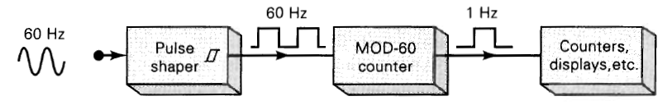
Example 3
Mạch tạo xung cho đồng hồ
Cần bao nhiêu FF cho MOD-60 counter?
Không có 2^{N} = 60 (N là số tự nhiên)
Số gần nhất 2⁶ = 64 => MOD-64 counter
Không có giải pháp cho counter này?

Slide 11
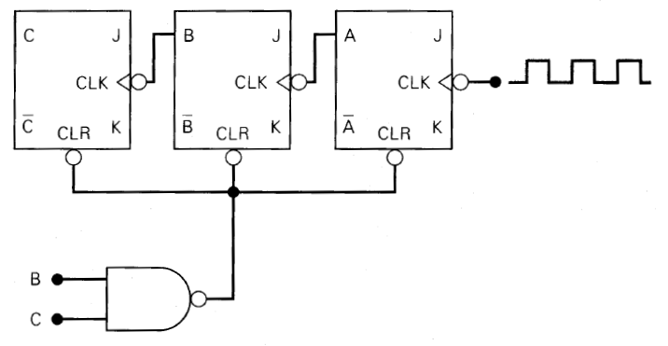
Counters with MOD Number <2^{N}
The basic asynchronous counter shown is limited to MOD numbers that are equal to 2^{N}
2^{N} is the maximum MOD number using N FFs
All J, K input are 1
MOD-6 counter by clearing MOD-8 counter when 110 occurs

Slide 12
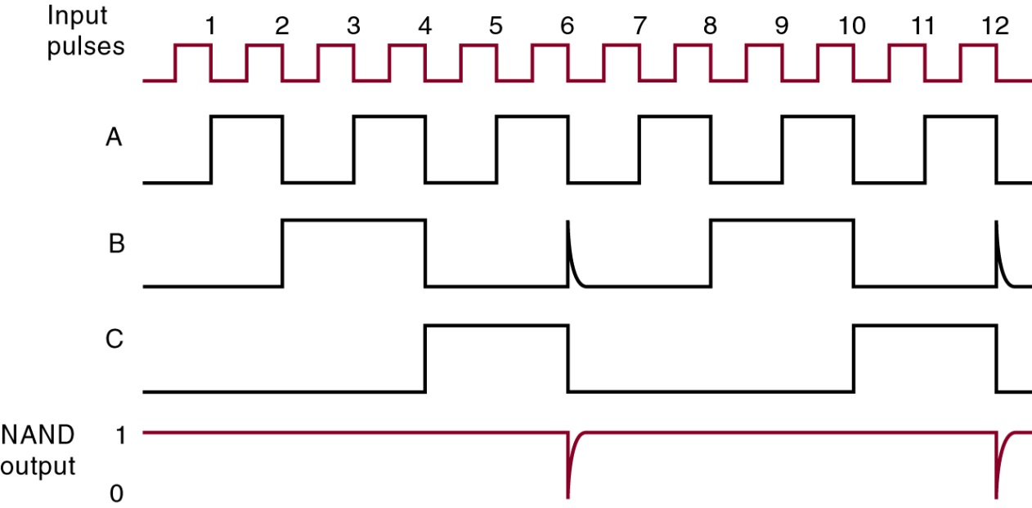
Counters with MOD Number <2^{N}
The basic asynchronous counter shown is limited to MOD numbers that are equal to 2^{N}
2^{N} is the maximum MOD number using N FFs
MOD-6 counter produced by clearing a MOD-8 counter when a count of six (110) occurs

Slide 13
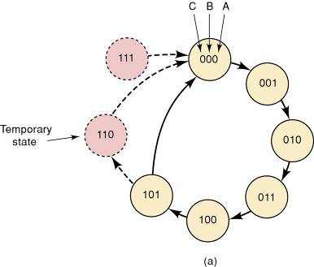
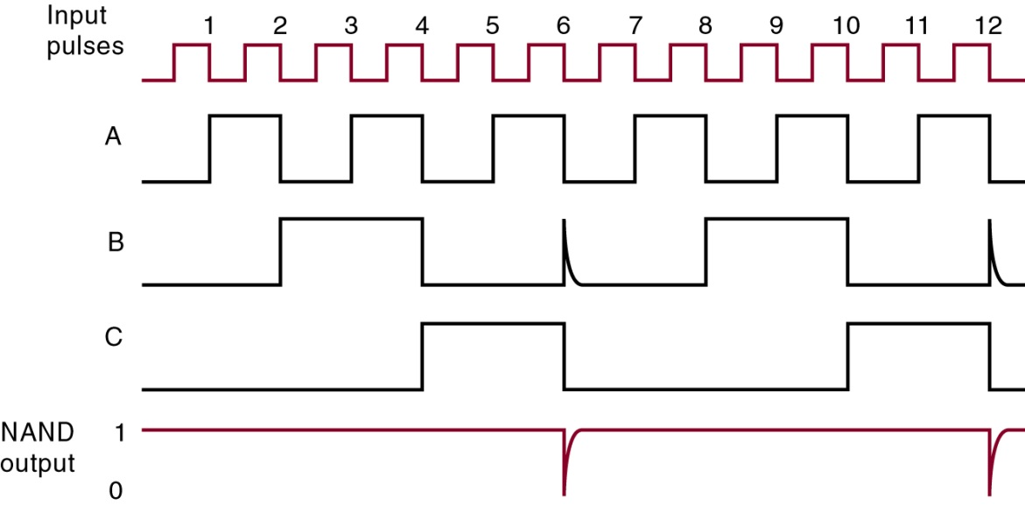
Counters with MOD Number <2^{N}
7-4 Counters with MOD Number <2^{N}
State transition diagram for the MOD-6 counter
Each circle represents one of the possible counter states
Arrows indicate how one state changes to another—in response to an input clock pulse
There is no arrow to the 111 state as the counter can never advance to that state
The 111 state can occur on power-up when the FFs come up in random states

Slide 14
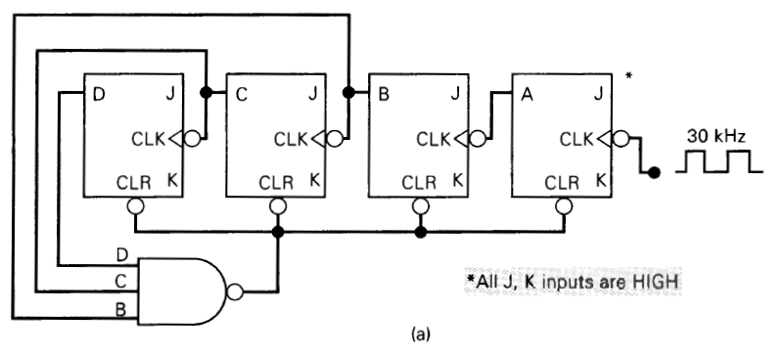
Example 4
Xác định MOD number của counter sau đây
Xác định tần số tại chân D
MOD-14
Freq_{D} = 30kHz/14 = 2.14 kHz

Slide 15
Construct a MOD-X counter
Find the smallest number of FFs such that 2^{N}>=X
Connect them as a counter
If 2N = X, don’t do step 2 and 3
Connect a NAND gate to asynchronous CLEAR inputs of all FFs
Determine which FFs will be in the HIGH state at a count = X, connect their outputs to the NAND inputs

Slide 16
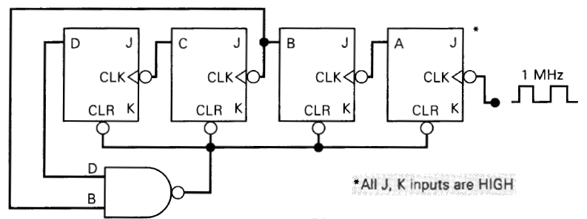
Example 5
Xây dựng MOD-10 counter (Decade counters)
Decade counter has 10 distinct states, no matter what the sequence
Counter counts in sequence from 0000 to 1001 is also called a BCD counter

Slide 17
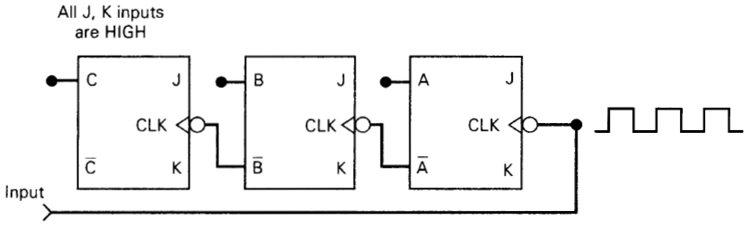
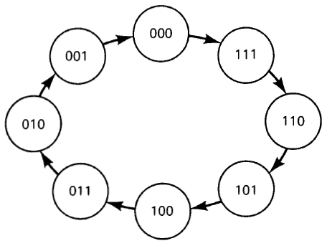
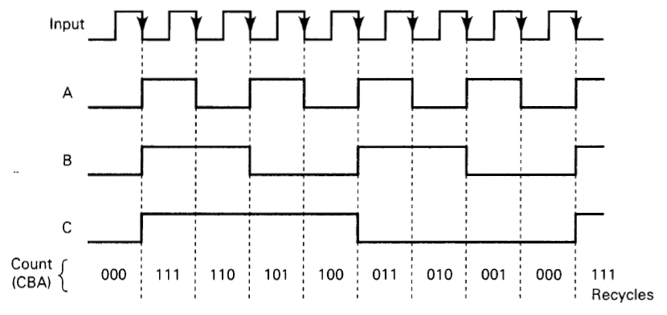
Asynchronous DOWN Counters
Asynchronous down counter is constructed in a similar manner to an up counter
It uses the inverted FF outputs to control the higher-order J, K inputs

Slide 18
Propagation Delay in Ripple Counters
Ripple counters are simple—requiring the fewest components to produce a given operation
Cumulative propagation delay can cause problems at high frequencies
If the period between input pulses is made longer than the total propagation delay of the counter, problems can be avoided
For proper operation: T_{clock} ≥ N x t_{pd}
Maximum frequency: F_{max}=1/N x t_{pd}

Slide 19
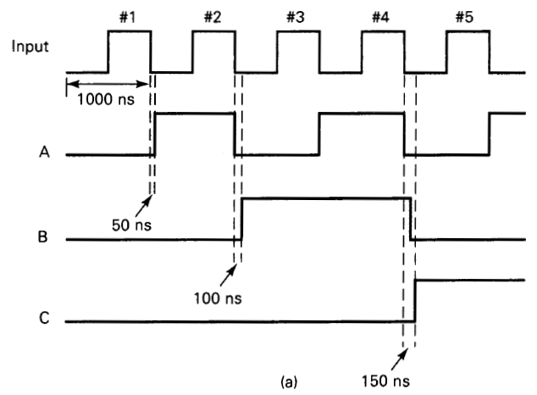
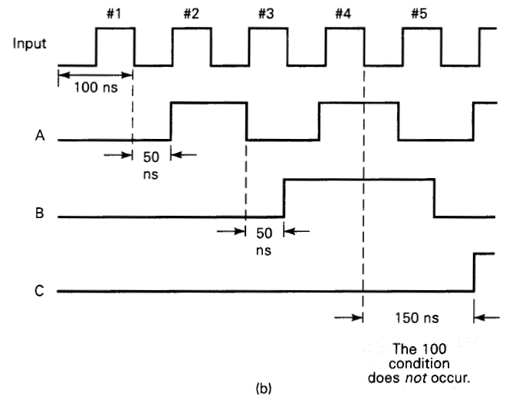
Propagation Delay in Ripple Counters
T=1000ns
t_{pd}=50ns
Counter operates properly
T=100ns
t_{pd}=50ns
Situation worsens

Slide 20
Propagation Delay in Ripple Counters
Asynchronous counters are not useful at very high frequencies—especially for counters with large numbers of bits
Due to their simplicity, they are useful for applications where frequency limitation is not critical

Slide 21
Synchronous counters

Slide 22
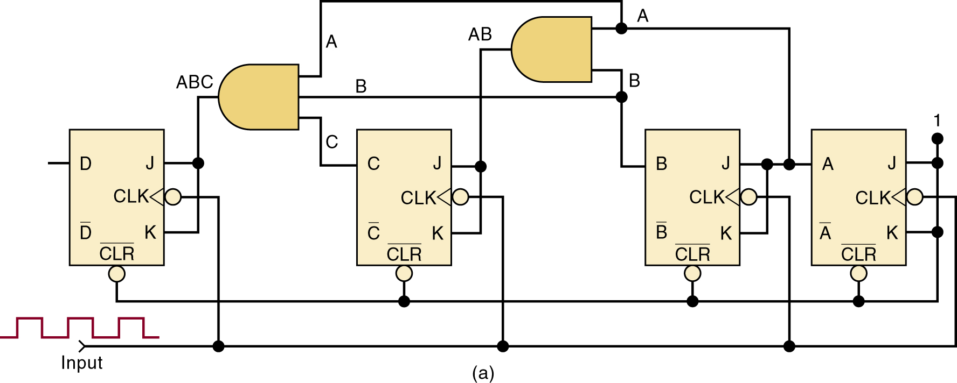
Synchronous (Parallel) Counters
In synchronous or parallel counters, all FFs are triggered simultaneously (in parallel) by the clock
Synchronous counters can operate at much higher frequencies than asynchronous counters

Slide 23
Synchronous (Parallel) Counters
Each FF has J & K inputs which are HIGH only when outputs of all lower-order FFs are HIGH
The total propagation delay will be the same for any number of FFs

Slide 24
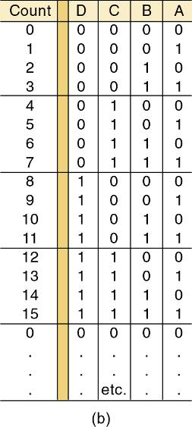
Synchronous (Parallel) Counters
For this circuit to count properly, on a given NGT of the clock, only those FF that are supposed to toggle on that NGT should have J = K = 1 when NGT occurs

Slide 25
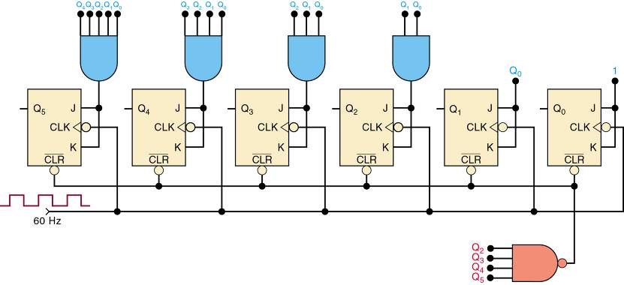
Counters with MOD Number <2^{N}
Mod-60 Counter

Slide 26
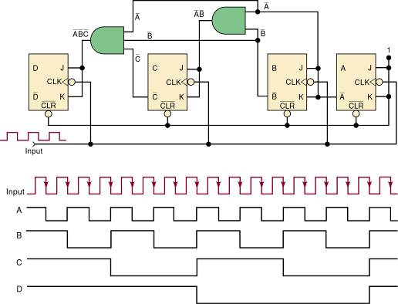
Synchronous Down and Up/Down Counters
A synchronous down counter is constructed in a similar manner to an up counter
It uses the inverted FF outputs to control the higher-order J, K inputs
Synchronous, MOD-16, down counter and output waveforms

Slide 27
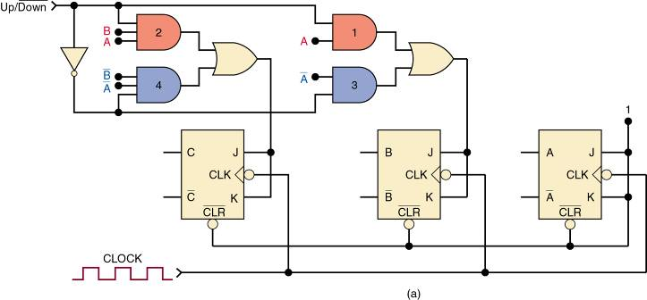
Synchronous Down and Up/Down Counters
In a parallel up/down counter, the control input controls the values fed to the J and K inputs of the successive FFs
The normal FF outputs or the inverted FF outputs

Slide 28
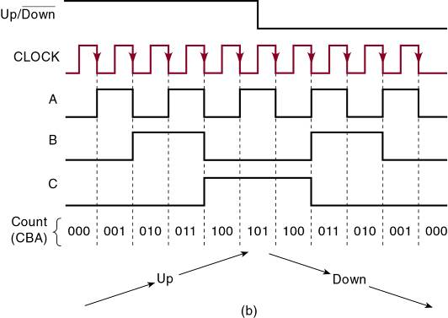
Synchronous Down and Up/Down Counters
For the first five clock pulses,
The counter counts up
Up/Down = 1
For the last five pulses,
The counter counts down
Up/Down = 0

Slide 29
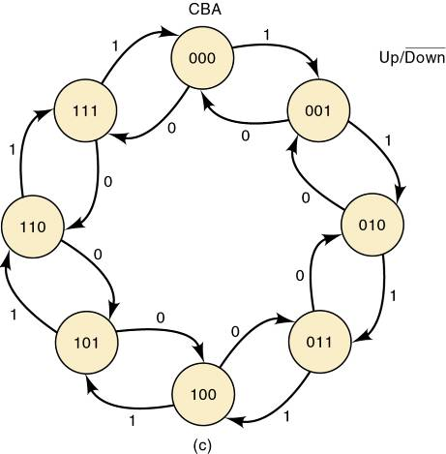
Synchronous Down and Up/Down Counters
Note that there are two arrows leaving each state’s bubble—a conditional transition
The next state for this counter is dependent upon the logic level applied to the control input

Slide 30
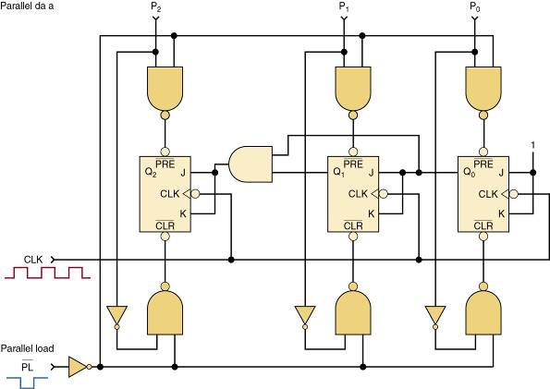
Presettable Counters
A presettable counter can be set to any desired starting point—synchronously or asynchronously
Preset is also called parallel loading the counter
Parallel data inputs
Synchronous counter with asynchronous parallel load

Slide 31
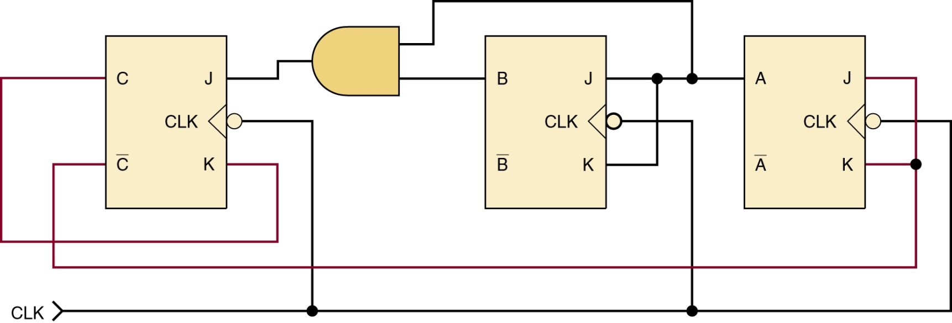
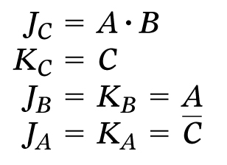
Analyzing Synchronous Counters
Synchronous counters can be custom-designed to generate any desired count sequence.
Synchronous up counter
Control input expressions

Slide 32
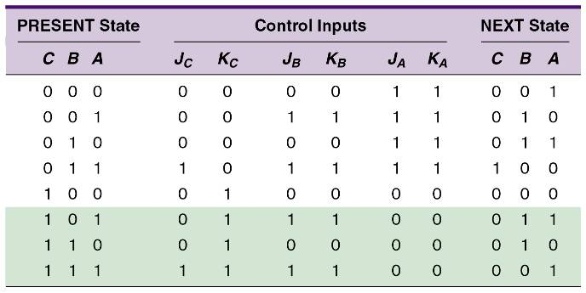
Analyzing Synchronous Counters
Analyze counter designs of this type by predicting FF control inputs for each state of the counter.
A PRESENT state/NEXT state table is very useful for this purpose

Slide 33
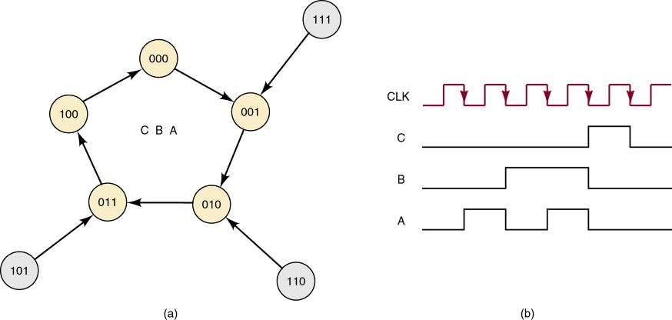
Analyzing Synchronous Counters
Synchronous up counter state transition diagram and waveform
Highlighted information
indicates this counter design is self-correcting

Slide 34
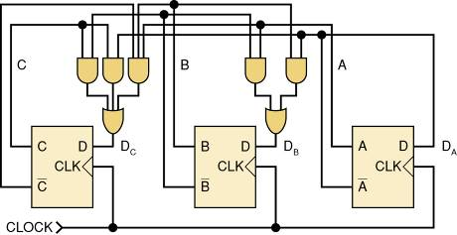
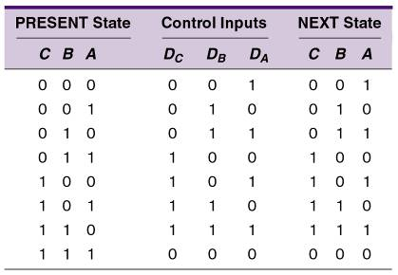
Analyzing Synchronous Counters
Synchronous counter built using D-type FFs
Control circuitry will typically be more complex than an equivalent JK-type counter,
The number of synchronous inputs to control is reduced by half

Slide 35
Synchronous Counter Design
Using J-K flip-flops in a synchronous counter configuration
Step 1: Determine the desired number of bits (FFs) and the desired counting sequence
Example: design a 3-bit counter that goes through the following sequence
C | B | A
0 | 0 | 0
0 | 0 | 1
0 | 1 | 0
0 | 1 | 1
1 | 0 | 0
0 | 0 | 0
etc.

Slide 36
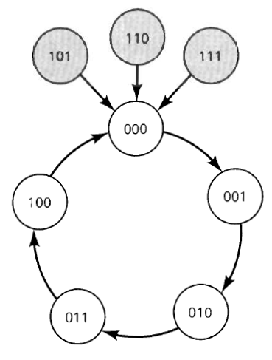
Synchronous Counter Design
Using J-K flip-flops in a synchronous counter configuration
Step 2: Draw the state transition diagram showing all possible states—including those not part of the desired counting sequence
For our example

Slide 37
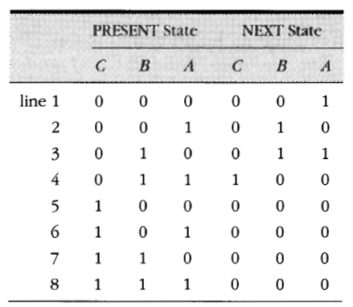
Synchronous Counter Design
Using J-K flip-flops in a synchronous counter configuration
Step 3: Use the state transition diagram to set up a table that lists all PRESENT states and their NEXT states
For our example, this
table looks like this

Slide 38
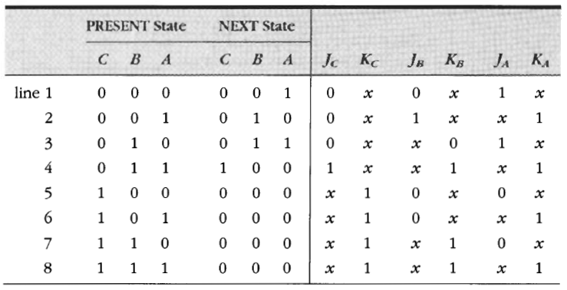
Synchronous Counter Design
Using J-K flip-flops in a synchronous counter configuration
Step 4: Add a column for each J and K input & indicate levels required to produce transition to the NEXT state

Slide 39
Synchronous Counter Design
Using J-K flip-flops in a synchronous counter configuration
Step 5: Design the logic circuits to generate levels required at each input, and implement the final expressions

Slide 40
Example 6
Đúng hay sai?
Các bước thiết kế bộ đếm đồng bộ ở trên có thể dùng để thiết kế chuỗi thứ tự sau: 0010, 0011, 0100, 0111, 1010, 1110, 0100, 1111, và lặp lại
Trả lời: Sai
Vì trạng thái 0100 xuất hiện nhiều hơn 1 lần trong chuỗi thứ tự trên.
Phương pháp thiết kế ở trên không thể xử lý trạng thái PRESENT của 0100 mà có 2 trạng thái NEXT khác nhau.

Slide 41
Registers

Slide 42
Register Data Transfer
Registers classification according to…
The way data can be entered into the register for storage
The way data are outputted from the register
Serial data flow through a register is generally called shifting—either to the left or to the right
Serial output data fed back to the input of the same register is called a data rotate
Parallel inputting is often described as a register load

Slide 43
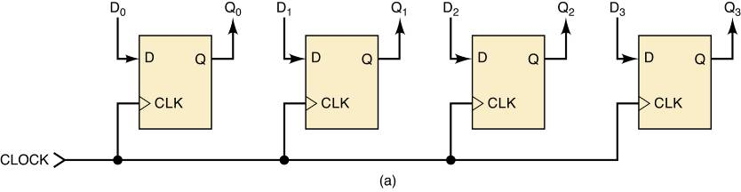
Register Data Transfer
Parallel in/parallel out (PIPO)
A group of flip-flops that can store multiple bits simultaneously and in which all bits of the stored binary value are directly available

Slide 44
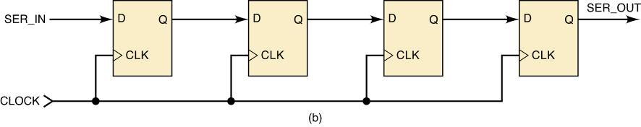
Register Data Transfer
Serial in/serial out (SISO)
Data loaded one bit at a time moves one bit at a time, with each clock pulse through the flip-flops toward the other end of the register, and exit one bit at a time in the same order as originally loaded

Slide 45
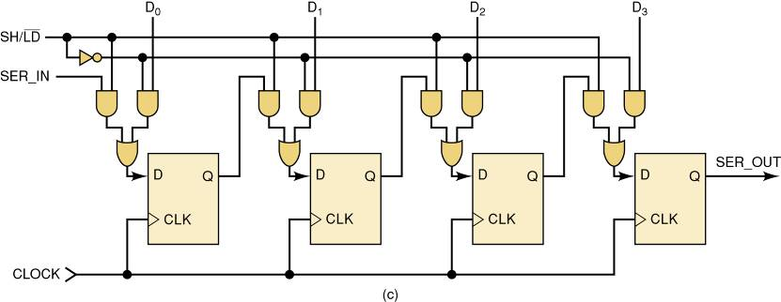
Register Data Transfer
8-bit parallel in/serial out (PISO)
Serial shifting is always synchronous, as the clock is required to ensure the input data moves only one bit at a time with each appropriate clocking edge

Slide 46
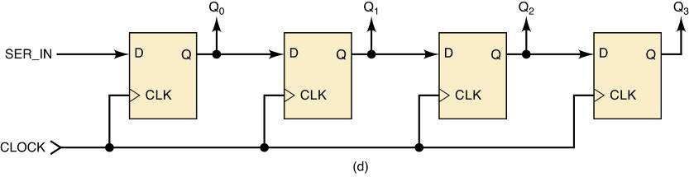
Register Data Transfer
8-bit serial in/parallel out (SIPO)

Slide 47
Shift Register Counters
Shift-register counters use feedback—the output of the last FF in the register is connected back to the first FF in some way

Slide 48
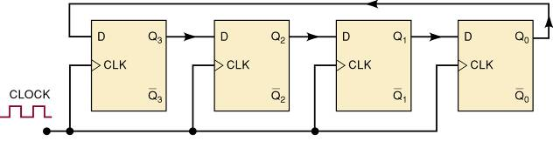
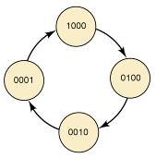
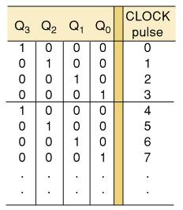
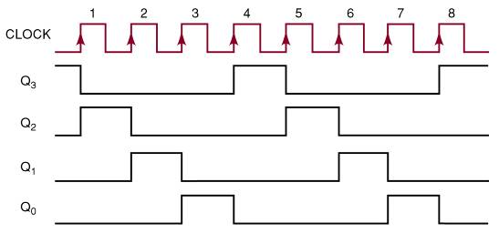
Shift Register Counters
A ring counter is a circulating shift register connected so the last FF shifts its value to the first.

Slide 49
Shift Register Counters
To operate properly, a ring counter must start off with only one FF in the 1 state and all the others in the 0 state.
As power-up starting states will be unpredictable, the counter is preset before clock pulses are applied.

Slide 50
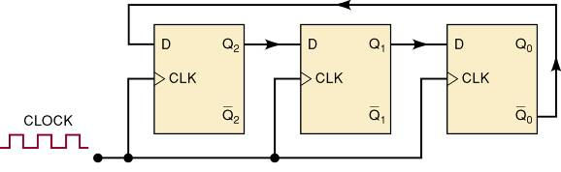
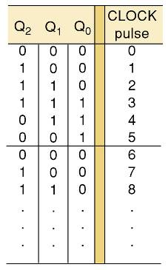
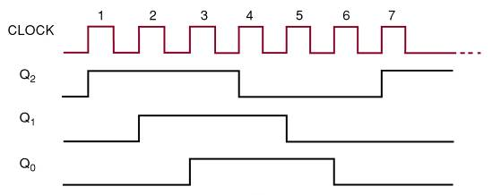
Shift Register Counters
In the Johnson or twisted-ring counter inverted output of the last FF is connected to the input of the first FF.

Slide 51
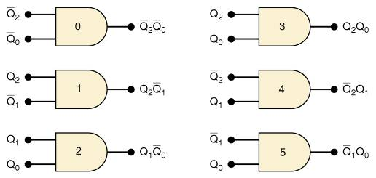
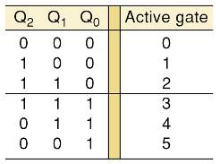
Shift Register Counters
For a given MOD number, a Johnson counter requires only half the FFs a ring counter requires.
It requires decoding gates—a ring counter does not.
A Johnson counter uses one logic gate to decode for each count.
Each gate requires only two inputs, regardless of the number of FFs in the counter.

Slide 52
Any question?

