Slide 1
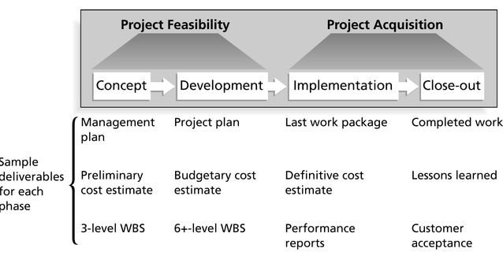
Project Life Cycle
Initiating > Planning > Execution > Controlling > Closing

Slide 2
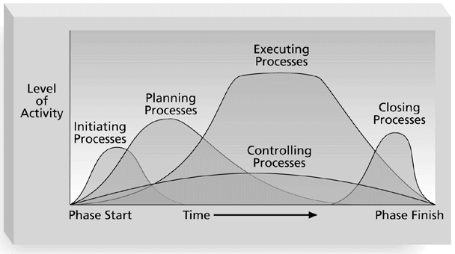
Project Phases Overlap in a Project

Slide 3
PM Methodologies
Management
Of Project
Evaluate and
Verify
Plan, Schedule
and Allocate
Control
Monitor
System Development
Problems
Solutions

Slide 4
Project Staffing
Good Project Manager Characteristics:
Strong Communications
Good Motivator
Good Leadership Skills
Self-Assured
Self-Motivated
Positive Mindsets

Slide 5
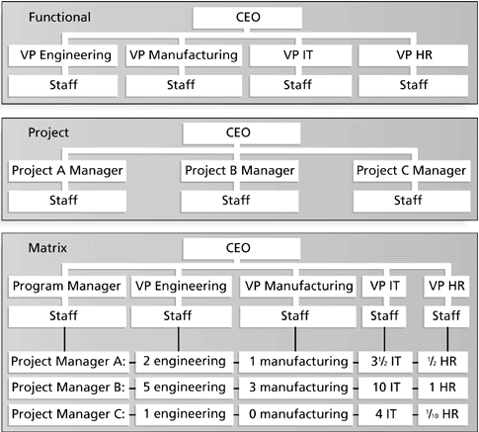
Organizational Structures

Slide 6
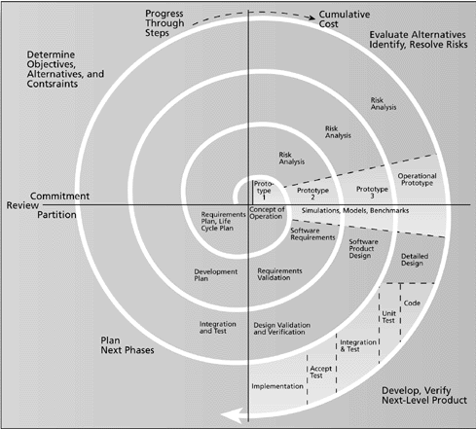
Spiral Model of SDLC

