Slide 1

NASH Dhabha & Bakes: Masala Mitra
Proposal: a voice-enabled RAG chatbot waiter
End-Semester Project · Review – I (Phase 1)
Presented by N Mailesh · CB.EN.U4ARE23025
25ARE471 Introduction to Generative AI · Guided by Prof. Rakesh Kumar
Notes:
Good morning. I'm N Mailesh. For my Introduction to Generative AI project, I'm proposing Masala Mitra: a voice-enabled, retrieval-augmented chatbot that works like a waiter for a restaurant called NASH Dhabha and Bakes. In this first review I'll cover the problem, my objectives, the planned design, how it maps to the course, and the prototype I've built so far.

Slide 2
Agenda
1
Course context and project fit
6
GenAI concepts and planned tools
2
Motivation and pain points
7
Knowledge-base design
3
Problem definition and objectives
8
Phase-1 prototype
4
Users and existing approaches
9
Planned evaluation
5
Proposed solution, AI-waiter plan, RAG architecture
10
Work plan, risks and course outcomes
Notes:
Here's the agenda. I'll start with how the project fits the course, then the motivation, problem and objectives. Next come the users and existing approaches, my proposed solution and its RAG architecture, the GenAI concepts and tools I plan to use, the knowledge-base design, and the phase-one prototype. I'll finish with the evaluation plan, work plan, risks and course-outcome mapping.

Slide 3


Course Context: Where This Project Fits
Unit 1
Introduction to GenAI Technology
Unit 2
GenAI Tools & Applications
Unit 3
Advances in GenAI
LLM operations: tokenisation, embeddings
Prompt engineering: role-task-output, few-shot
AI agents and agentic flow
Traditional AI vs generative AI
RAG: vector embeddings, semantic & similarity search
AI-augmented workflow: coding assistance
Responsible AI: bias, fairness, explainability
Text processing: Q&A, correction
LLMOps concepts
Guidelines on GenAI usage
Basics of fine-tuning
Human-AI interaction (HAX)
= topic applied in this project (from the 25ARE471 syllabus)
Notes:
The course has three units. This project applies most of them. From Unit 1: tokenisation and embeddings, and responsible AI. From Unit 2: prompt engineering, retrieval-augmented generation with vector similarity search, and question answering. From Unit 3: the AI-augmented coding workflow, LLM-ops style evaluation, and human-AI interaction. The ticks mark the topics I apply.

Slide 4




Motivation / Pain Points
At a busy dhaba, the menu has the answer, but nobody has time to explain it.
Waiters are stretched
Menus can't answer questions
At peak hours, guests wait just to ask a question or place an order.
Is it spicy? Veg? Dry or gravy? Under ₹250? A printed or QR menu can't tell you.
Special requests get lost
People ask in their own way
"Less oil, no onion" said at the table often never reaches the kitchen.
Hinglish, chat-speak and Indian spellings ("parota", "briyani") confuse simple bots.
Notes:
The motivation comes from everyday dhaba experience. Waiters are stretched at peak hours. A menu card can't answer simple questions like 'is it spicy' or 'is it dry or gravy'. Special requests often never reach the kitchen. And customers ask in their own way, with Hinglish, chat-speak and Indian spellings, which confuses simple chatbots.

Slide 5

Problem Definition / Objectives
PROBLEM
Build a waiter-like assistant that understands natural, mixed-language requests (text or voice), answers only from the restaurant's real menu, and handles the order from suggestion to kitchen, bill and payment.
OBJECTIVES
O1 · Understand: mood, diet, spice, dry/gravy, price, chat-speak
O2 · Ground: retrieve from a menu knowledge base; no invented dishes or prices
O3 · Voice: speech-to-text chat and voice notes for the chef
O4 · Complete the loop: cart → chef notes → kitchen → tracking → bill → payment → feedback
O5 · Evaluate: define metrics and test sets before building, measure in Phase 2
Notes:
The problem: build a waiter-like assistant that understands natural, mixed-language requests by text or voice, answers only from the real menu, and handles the whole order. My five objectives: understand requests, ground every answer in the menu, support voice, complete the full ordering loop, and define the evaluation up front so I can measure it in phase two.

Slide 6



Users & Scenarios
Customer
Chef / kitchen
Owner
Asks: "something spicy and veg under 250"
Speaks instead of typing
Wants live order status and the bill in one place
Needs every special request, clearly
Can play voice notes on the ticket
Sees dine-in table or takeaway
Fewer missed orders and requests
Feedback collected after every meal
Runs on a laptop; no paid AI needed
Notes:
There are three users. The customer wants to ask naturally, perhaps by voice, and follow the order in one place. The chef needs every special request clearly, including voice notes, on the ticket. The owner wants fewer missed orders, feedback after every meal, and something that runs without expensive AI services.

Slide 7
Existing Approaches & the Gap
Capability | Printed menu | QR menu | Generic chatbot | Masala Mitra (proposed)
Answers questions about dishes | ✗ | ✗ | ✓ | ✓
Answers only from the real menu | ✓ | ✓ | ✗ | ✓
Understands Hinglish & chat-speak | ✗ | ✗ | ~ | ✓
Voice input + voice chef notes | ✗ | ✗ | ~ | ✓
Order, kitchen, bill, payment in one flow | ✗ | ~ | ✗ | ✓
Mood-based suggestions | ✗ | ✗ | ~ | ✓
✓ yes ~ partly ✗ no
Notes:
Here's the gap. Printed and QR menus are accurate but can't answer questions. A generic chatbot can answer, but it isn't grounded in the restaurant's real menu, so it can invent dishes or prices. None of them combine voice, Hinglish understanding, chef notes and the full order flow. That combination is what Masala Mitra proposes.

Slide 8








Proposed Solution: Masala Mitra
Greets & asks your mood
Answers like a waiter
Voice chat
Voice chef notes
Suggests dishes that fit
From the real menu only (RAG)
Speech-to-text in the browser
Recorded and sent to the kitchen
Menu with filters
Kitchen display
Live order tracking
Bill & payment in chat
Veg / non-veg, search, sections
Every ticket with notes
Sent to chef → cooking → ready
GST bill, UPI / card / cash
Notes:
The proposed solution is Masala Mitra. It greets customers and asks their mood, then suggests dishes. It answers questions like a waiter, using only the real menu. It supports voice chat, and voice notes for the chef. The website adds a filterable menu and a kitchen display, and the chat itself tracks the order live and brings the bill and payment.

Slide 9
Planned AI-Waiter Interactions
Design rules
A
Greeting & general
B
Menu & food
C
Orders
Never invent ingredients, allergens, prices or order status
Not sure? Hand over to a staff member
English, Hindi and Tamil, by text or voice
Staff desk with requests and satisfaction
Hello, what can you do, where to sit
Today's special, spicy or sweet, price, Jain
Order, track, how long, change or cancel
D
Assistance
E
Needs & complaints
F
Payment & feedback
Call the waiter, water, chair, washroom
Allergies, no spicy, cold food, urgent help
UPI, bill, split bill, feedback
Phase 2: every group becomes a saved test set, with held-out questions
Notes:
Beyond menu questions, Masala Mitra is planned as a full AI waiter. It covers six groups of interactions: greetings, menu and food questions, orders, assistance like calling the waiter or asking for water, special needs and complaints like allergies, and payment and feedback. Two design rules guide it. It must never invent ingredients, allergens, prices or order status, and when it isn't sure, it hands over to a staff member. It will work in English, Hindi and Tamil, with a staff desk for requests and satisfaction.

Slide 10
Proposed RAG Architecture
1. Customer message
(text or voice)
2. Speech-to-text
(Web Speech API)
3. Normalise text
(tokens, spellings)
4. Understand intent
& constraints
8. Reply + dish cards
+ "Can I add it?"
7. Validate answer
(menu-only)
6. Generate reply
(LLM or rules)
5. Retrieve dishes
(knowledge base)
Plan: the LLM writes only from retrieved menu facts, and a validator checks every answer.
Notes:
This is the planned architecture. A message comes in as text or voice; voice is converted by speech-to-text. The text is normalised, then the intent and constraints are understood. The retriever finds matching dishes in the knowledge base. A language model, or a rule-based writer, generates the reply only from those dishes. A validator checks the answer before the customer sees it.

Slide 11





GenAI Concepts Applied (from the Syllabus)
Tokenisation
Vector representations
Split and normalise messages: stop-words, stemming, chat-speak mapping
TF-IDF vectors for dishes and house info (embedding-style)
Similarity search
RAG
Cosine similarity ranks dishes for each question
Generate answers only from retrieved menu context
Prompt engineering
Responsible AI
Role · Task · Output-format prompt with a JSON schema
Grounding, diet safety, honest "not on menu" replies
Notes:
These syllabus concepts are applied directly. Tokenisation splits and normalises each message. Vector representations: dishes and house info become TF-IDF vectors, and cosine similarity ranks them. That's the retrieval in RAG. Prompt engineering follows the Role, Task and Output-format pattern with a JSON schema, and responsible-AI principles guide grounding and diet safety.

Slide 12
Planned Tools & Tech Stack
Layer | Tool | Purpose | Cost
Retrieval | TF-IDF + structured dish facts (JavaScript) | Find the right dishes and house info | Free
Generation | Google Gemini (free tier) + rule-based writer | Write waiter replies from retrieved facts | Free tier
Speech | Web Speech API · MediaRecorder | Voice chat · voice chef notes | Free (browser)
Backend | Node.js + Express, JSON store | Sessions, orders, voice files, kitchen | Free
Frontend | HTML, CSS, vanilla JavaScript | Website, chat, menu, checkout | Free
Testing | Playwright (real browser) | Automated end-to-end evaluation | Free
Dev workflow | Claude Code (AI coding assistant) | Faster build, tests and fixes | —
Notes:
The stack is deliberately free. Retrieval uses TF-IDF and structured dish facts in JavaScript. Generation uses Google Gemini's free tier, with a rule-based writer as a fallback. Speech uses the browser's Web Speech API and MediaRecorder. The backend is Node.js and Express, the frontend is plain HTML, CSS and JavaScript, testing uses Playwright in a real browser, and I use Claude Code as an AI coding assistant.

Slide 13
Knowledge-Base Design
Menu sections (10)
Planned fields for each dish
Breads
Rice
Field | Example
Name · category · price | Paneer Butter Masala · Curries · ₹260
Veg / non-veg / egg | Veg
Spice level | Mild
Description | Paneer in a creamy tomato-butter gravy
Mood tags | comfort, rich, celebrate
(Phase 2) texture, main ingredient, pairing | gravy · paneer · Butter Naan
Gravies & Curries
Biryani
Starters
Juices & Lassi
Chai & Coffee
Desserts
Ice Cream & Kulfi
Bakes
Plus house-info pages: timings, payment, veg/non-veg kitchen, chef notes, spice, Jain & allergies, prep time, GST, about, ordering
Notes:
The knowledge base is the restaurant's own menu: ten sections from breads to bakes, plus house-information pages on timings, payment, the veg kitchen, chef notes, Jain food and GST. Each dish records its name, category, price, veg or non-veg, spice level, a description and mood tags. In phase two I plan to add texture, main ingredient and pairings, so it can answer like a real waiter.

Slide 14
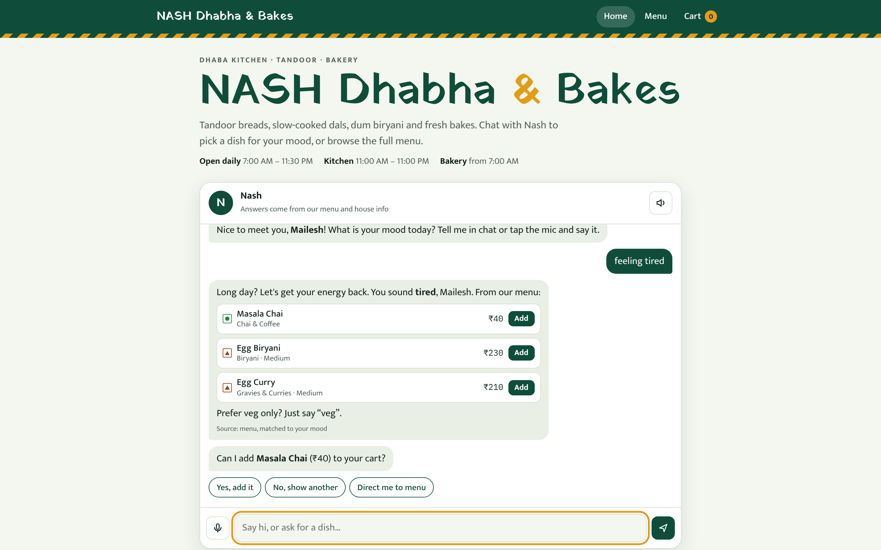
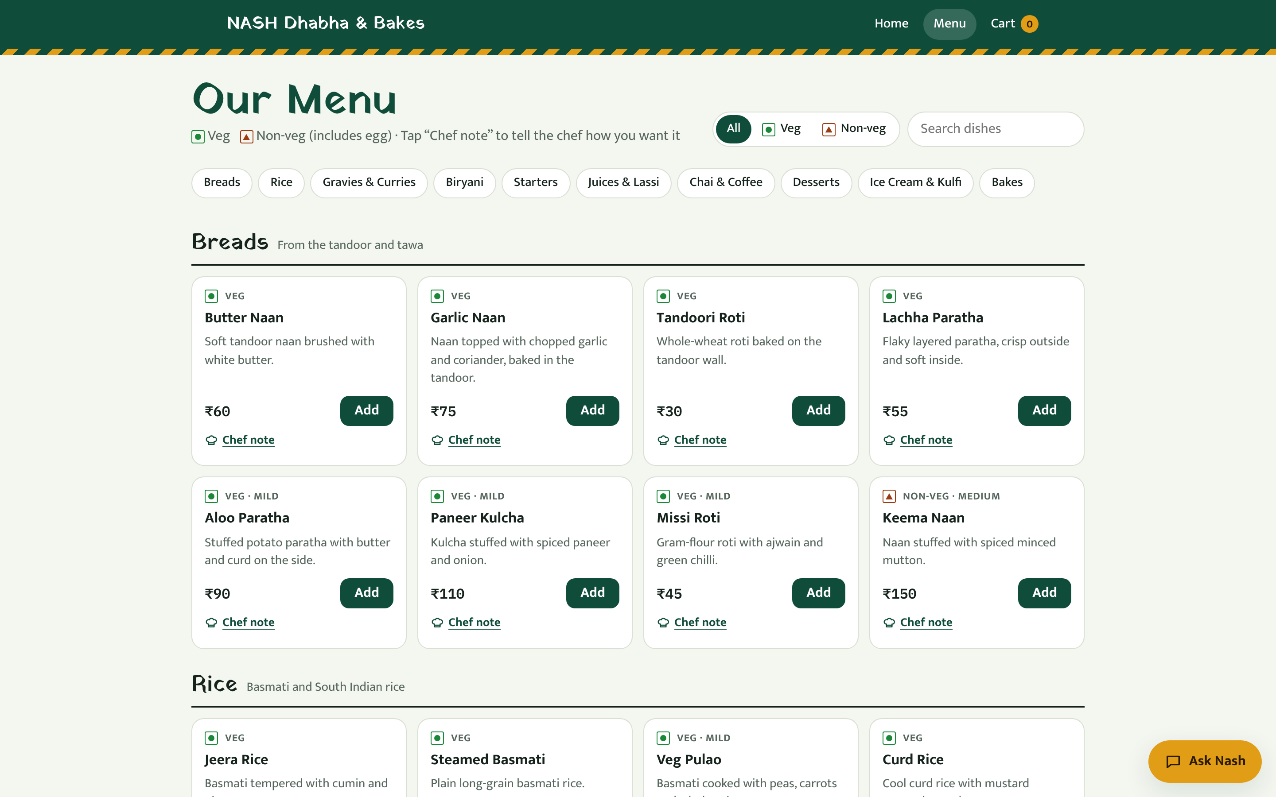
Phase-1 Prototype (Working Demo)
v1 menu: 78 dishes, veg / non-veg, chef notes
v1 home: chat greets, asks name and mood, suggests dishes
Already working in Phase 1
Greeting → name → mood → suggestions · cart · chef notes · checkout · order updates · bill · payment · feedback
Notes:
I already have a working phase-one prototype. The chat greets the customer, asks their name and mood, and suggests dishes from the menu. The menu has seventy-eight veg and non-veg dishes with chef notes, and the full flow works: cart, checkout, order updates, bill, payment and feedback. It's a single-file version that runs in the browser; phase two adds the backend, Gemini and much better understanding.

Slide 15
Planned Evaluation
Metric | How it will be measured | Target
Answer accuracy | Customer questions with rules checked against the menu | ≥ 90%
Generalisation | Held-out questions written after tuning, run once | ≥ 85%
Grounding | Count invented dishes / prices shown to customers | 0
Task completion | End-to-end scenarios: name → order → bill → feedback | 100% of steps
Robustness | Typos, Hinglish, XSS, prompt injection, server crash | No crash, safe output
Voice | Speech → text → action; notes reach the kitchen | All voice tests pass
Latency | Median reply time (engine and API) | < 1 s
Notes:
I'm defining the evaluation now, before building. Answer accuracy will be measured on customer questions, with each answer checked against the menu, targeting at least ninety percent. Generalisation uses held-out questions written after tuning. Grounding means zero invented dishes or prices. Task completion uses end-to-end scenarios, plus robustness checks, voice tests and latency under one second.

Slide 16
Work Plan: Phase 1 → Phase 2
1
2
3
4
5
6
Phase 1
Step 2
Step 3
Step 4
Step 5
Step 6
Prototype
Backend
Waiter brain
Voice
Gemini + guardrails
Evaluate & share
Single-file app, menu, mood chat, order flow
Express API, sessions, orders, kitchen display
Dish facts, request filters, chat-speak
Speech-to-text chat, voice chef notes
Grounded generation, validator, fallback
Test suites, report, LinkedIn video
Phase 1 is complete (dark). Steps 2–6 are planned for the final review.
Notes:
Here's the work plan. Phase one, the prototype, is done. Next I'll add the backend with sessions, orders and a kitchen display; then the waiter brain with dish facts and chat-speak understanding; then voice chat and voice chef notes; then Gemini with guardrails; and finally evaluation, the report and the LinkedIn video.

Slide 17




Risks & Mitigations
LLM invents dishes or prices
Microphone blocked or unsupported
Mitigation: Retrieve first; validate every answer; rule-based fallback
Mitigation: Clear message, typing always works, phone-recorder fallback
Hinglish, typos, chat-speak
No internet / API limits
Mitigation: Normalisation, spelling map, careful typo correction
Mitigation: Same engine runs offline in the browser; free-tier usage
Malicious input (XSS, injection)
Wrong diet advice
Mitigation: Escape all output; model never controls cart or payment
Mitigation: Explicit veg / non-veg / egg facts; never guess diet
Notes:
The main risks, and how I'll handle them. The language model might invent dishes, so I retrieve first and validate every answer. The microphone may be blocked, so typing always works and there's a fallback. Hinglish and typos need normalisation. If there's no internet, the engine runs offline. Malicious input is escaped, and diet facts are never guessed.

Slide 18
Mapping to Course Outcomes
Course outcome (25ARE471) | How this project will address it
CO1 · Understand generative AI and its tools | RAG with vector similarity search, an LLM (Gemini), speech-to-text and text-to-speech
CO2 · AI principles and ethics | Grounded answers, validation, diet safety, privacy, honesty when a dish isn't available
CO3 · Apply GenAI tools to applications | A working restaurant assistant: Q&A, recommendations, voice notes, order automation
CO4 · Advanced GenAI concepts | Human-AI interaction design, AI-assisted coding, continuous evaluation (LLMOps)
Notes:
Finally, the mapping to course outcomes. CO1 is covered through RAG, similarity search, an LLM, and speech technology. CO2, ethics, through grounded and validated answers and diet safety. CO3 is the working restaurant assistant itself. CO4 through human-AI interaction design, AI-assisted coding and continuous evaluation.

Slide 19
Thank You!
Questions and feedback welcome
N Mailesh · CB.EN.U4ARE23025
Notes:
Thank you. I'd welcome your questions and feedback on the plan before I move into phase two.

