Slide 1
Unity Game Project
Made by: Nashme Al-Hadid
Amir Sabbagh

Slide 2
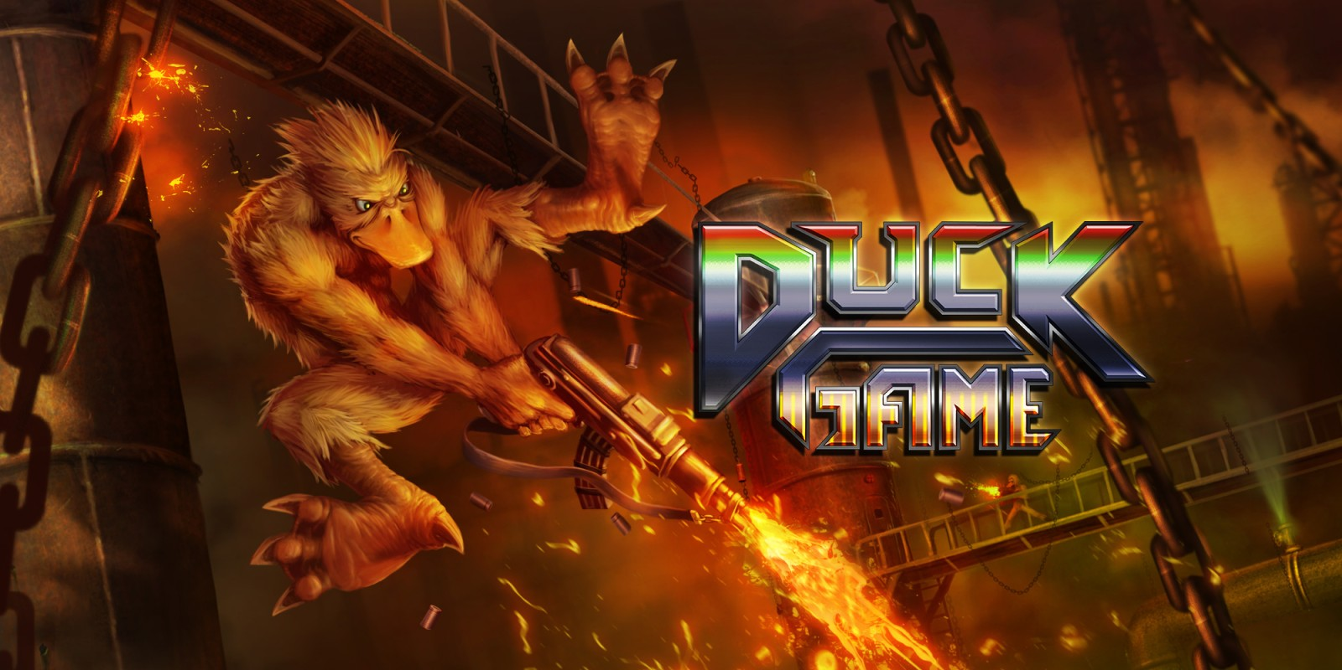
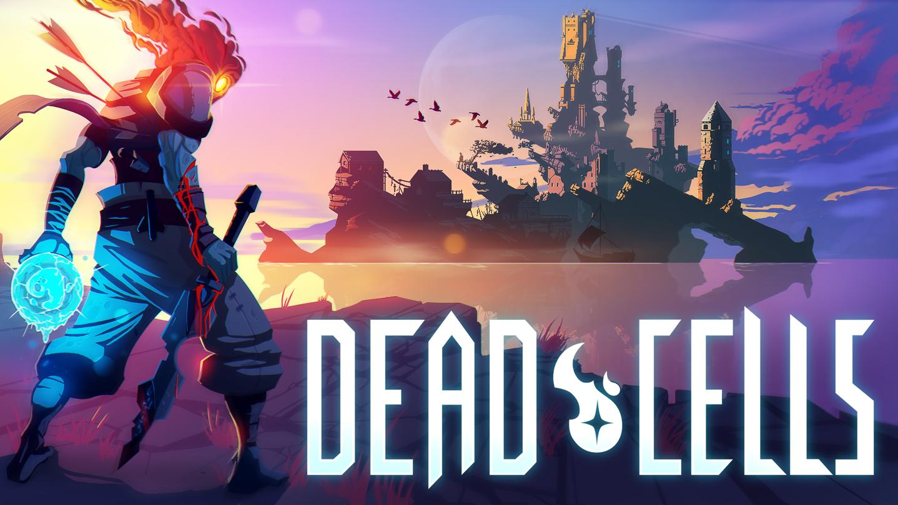
Introduction
The game is inspired by games such as Duck Game and Dead Cells.
The game will be a mixture of platforming and combat.

Slide 3
Core Gameplay
The game’s levels will be created using tile-mapping for more flexibility.
Multiple levels.
Multiple enemies.
Potions, such as health.
Well-crafted movement suitable for a platforming game.
Simplified UI suitable for a mobile phone touch-screen.

Slide 4
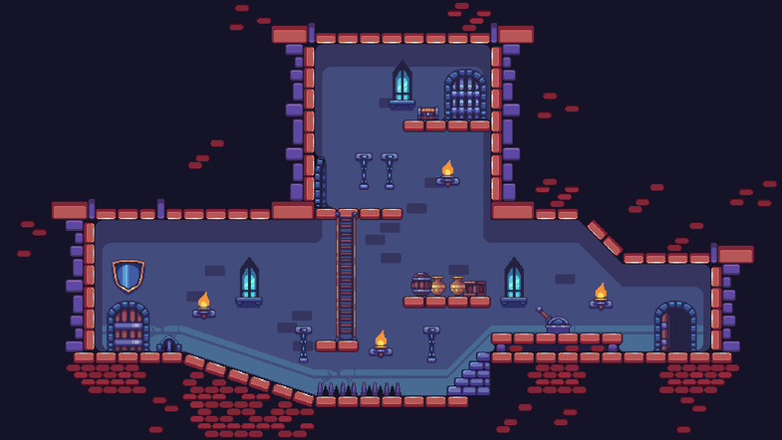


Slide 5
Possible Upcoming Features
Boss fight.
Deeper movement mechanics.
More levels.
Collectables.
Multiple weapons.
Teleportation

