Slide 1

WHO’S ON DECK?
with
TODD NORRIS
NSS DA9 COHORT

Slide 2

OBJECTIVES:
TO DETERMINE WHICH 2 US CITIES WOULD BE A GOOD CANDIDATE TO RECEIVE A NEW MLB TEAM IN THE NEXT EXPANSION
IT CANNOT HAVE A MLB TEAM ALREADY OR BE TOO CLOSE TO A CITY THAT HAS A MLB TEAM

Slide 3
DATA SOURCES:
CENSUS.GOV
CENSUSREPORTER.ORG
SPONSORPULSE.COM
STATISTA.COM
BASEBALL-REFERENCE.COM
ESPN

Slide 4
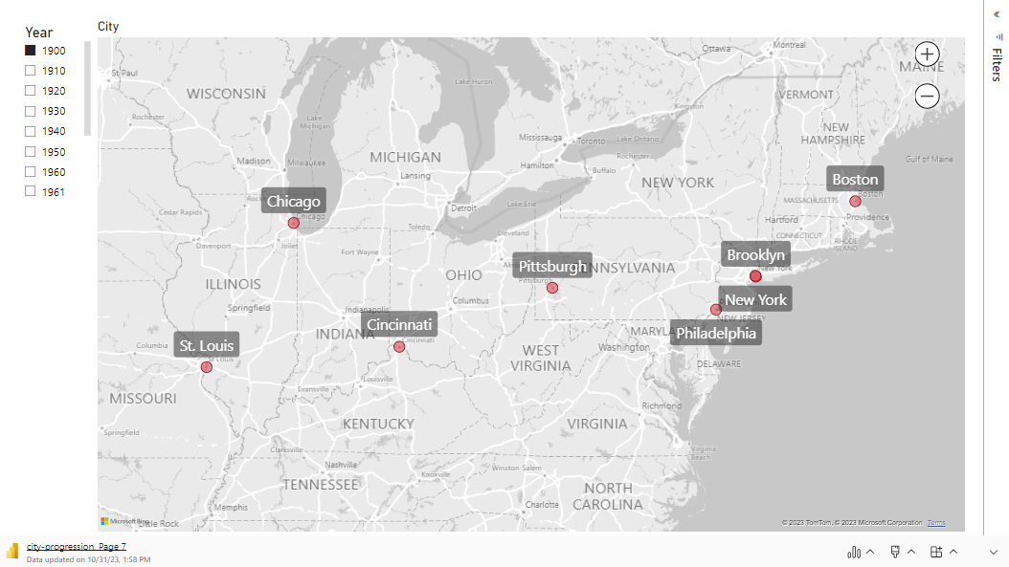

Slide 5
POTENTIAL CITIES:
AUSTIN, TX
CHARLOTTE, NC
EL PASO, TX
INDIANAPOLIS, IN
JACKSONVILLE, FL
LOUISVILLE, KY
NASHVILLE, TN
OKLAHOMA, OK
PORTLAND, OR
SAN ANTONIO, TX

Slide 6
CRITERIA:

Slide 7
CRITERIA:
CITY POPULATION BIG ENOUGH TO SUPPORT A NEW TEAM

Slide 8
CRITERIA:
CITY POPULATION BIG ENOUGH TO SUPPORT A NEW TEAM
LARGE ENOUGH MALE POPULATION (30-54 YEARS OLD)

Slide 9
CRITERIA:
CITY POPULATION BIG ENOUGH TO SUPPORT A NEW TEAM
LARGE ENOUGH MALE POPULATION (30-54 YEARS OLD)
EDUCATION LEVEL OF MALES AT LEAST 25 Y/O

Slide 10
CRITERIA:
CITY POPULATION BIG ENOUGH TO SUPPORT A NEW TEAM
LARGE ENOUGH MALE POPULATION (30-54 YEARS OLD)
EDUCATION LEVEL OF MALES AT LEAST 25 Y/O
HOUSEHOLDS INCOMES

Slide 11
CRITERIA:
CITY POPULATION BIG ENOUGH TO SUPPORT A NEW TEAM
LARGE ENOUGH MALE POPULATION (30-54 YEARS OLD)
EDUCATION LEVEL OF MALES AT LEAST 25 Y/O
HOUSEHOLDS INCOMES
ETHNICITY BREAKDOWN

Slide 12
SCORING:
COMPARING EACH CITY TO A “BENCHMARK” WITHIN EACH CRITERIA
EXCEEDING THE “BENCHMARK” EARNS A CITY A POINT
THE 2 CITIES WITH THE MOST POINTS “WIN”

Slide 13
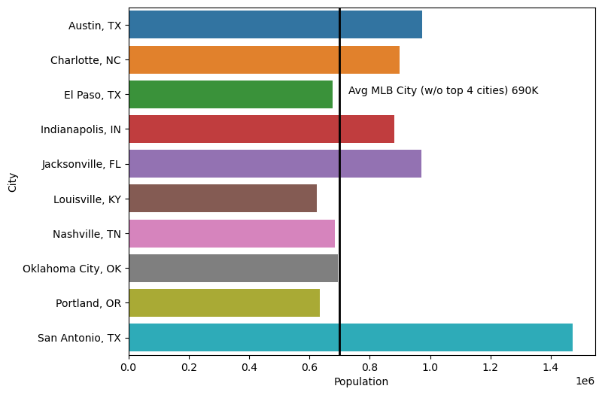
POPULATION (IN TERMS OF MILLIONS)

Slide 14
POPULATION (IN TERMS OF MILLIONS)
CITIES GETTING POINTS:
AUSTIN
CHARLOTTE
INDY
JACKSONVILLE
SAN ANTONIO

Slide 15
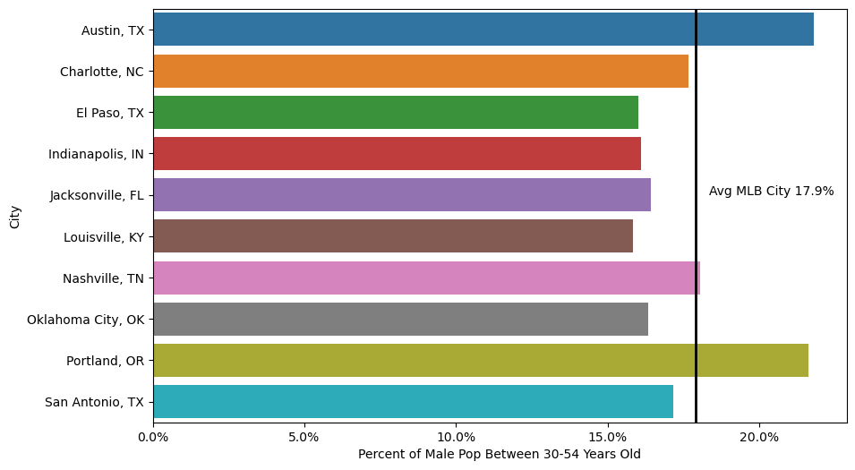
PERCENT OF MALE POPULATION BETWEEN 30-54 Y/O

Slide 16
PERCENT OF MALE POPULATION BETWEEN 30-54 Y/O
CITIES GETTING POINTS:
AUSTIN
NASHVILLE
PORTLAND

Slide 17
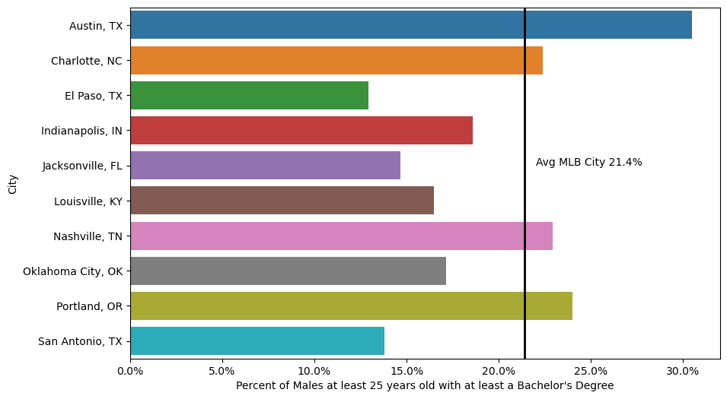
PERCENT OF MALES (>24 y/o) WITH A DEGREE

Slide 18
PERCENT OF MALES (>24 y/o) WITH A DEGREE
CITIES GETTING POINTS:
AUSTIN
CHARLOTTE
NASHVILLE
PORTLAND

Slide 19
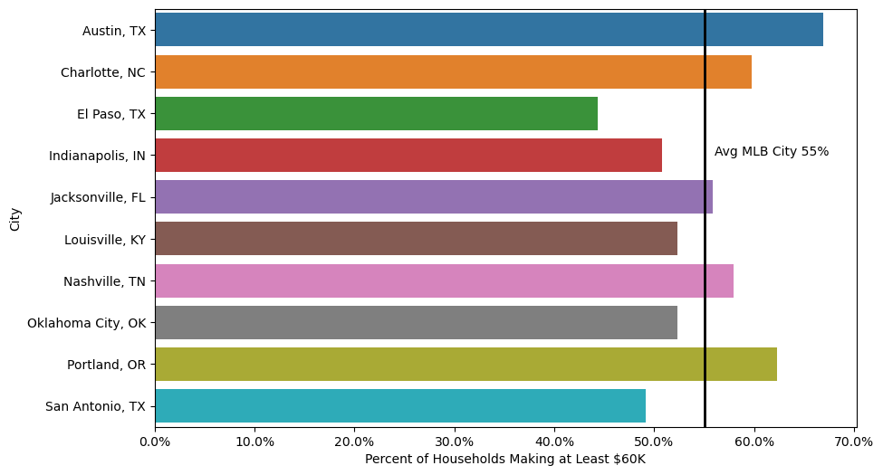
PERCENT OF HOUSEHOLDS MAKING AT LEAST $60K

Slide 20
PERCENT OF HOUSEHOLDS MAKING AT LEAST $60K
CITIES GETTING POINTS:
AUSTIN
CHARLOTTE
JACKSONVILLE
NASHVILLE
PORTLAND

Slide 21
ETHNICITY BREAKDOWNS COMPARED TO AVERAGE MLB CITY
CITY | CAUCASIAN
NASHVILLE | 69.83%
INDIANAPOLIS | 68.51%
PORTLAND | 65.84%
LOUISVILLE | 60.70%
OKLAHOMA CITY | 51.29%
JACKSONVILLE | 47.61%
AUSTIN | 46.75%
CHARLOTTE | 39.80%
AVG MLB CITY | 37.81%

Slide 22
ETHNICITY BREAKDOWNS COMPARED TO AVERAGE MLB CITY
CITY | AFR/AMERICAN
CHARLOTTE | 33.99%
JACKSONVILLE | 29.25%
AVG MLB CITY | 26.51%
CITY | CAUCASIAN
NASHVILLE | 69.83%
INDIANAPOLIS | 68.51%
PORTLAND | 65.84%
LOUISVILLE | 60.70%
OKLAHOMA CITY | 51.29%
JACKSONVILLE | 47.61%
AUSTIN | 46.75%
CHARLOTTE | 39.80%
AVG MLB CITY | 37.81%

Slide 23
ETHNICITY BREAKDOWNS COMPARED TO AVERAGE MLB CITY
CITY | AFR/AMERICAN
CHARLOTTE | 33.99%
JACKSONVILLE | 29.25%
AVG MLB CITY | 26.51%
CITY | CAUCASIAN
NASHVILLE | 69.83%
INDIANAPOLIS | 68.51%
PORTLAND | 65.84%
LOUISVILLE | 60.70%
OKLAHOMA CITY | 51.29%
JACKSONVILLE | 47.61%
AUSTIN | 46.75%
CHARLOTTE | 39.80%
AVG MLB CITY | 37.81%
CITY | HISPANIC
EL PASO | 81.54%
SAN ANTONIO | 65.80%
AUSTIN | 33.09%
AVG MLB CITY | 22.49%

Slide 24
ETHNICITY BREAKDOWNS COMPARED TO AVERAGE MLB CITY
CITY | AFR/AMERICAN
CHARLOTTE | 33.99%
JACKSONVILLE | 29.25%
AVG MLB CITY | 26.51%
CITY | CAUCASIAN
NASHVILLE | 69.83%
INDIANAPOLIS | 68.51%
PORTLAND | 65.84%
LOUISVILLE | 60.70%
OKLAHOMA CITY | 51.29%
JACKSONVILLE | 47.61%
AUSTIN | 46.75%
CHARLOTTE | 39.80%
AVG MLB CITY | 37.81%
CITY | HISPANIC
EL PASO | 81.54%
SAN ANTONIO | 65.80%
AUSTIN | 33.09%
AVG MLB CITY | 22.49%
CITY | OTHER
PORTLAND | 16.92%
OKLAHOMA CITY | 15.89%
AVG MLB CITY | 13.19%

Slide 25

SCORES

Slide 26


CITY
2
1
2
3
4
5
6
7
8
1
AUSTIN
X
CHARLOTTE
X
PORTLAND
X
JACKSONVILLE
X
NASHVILLE
X

Slide 27
WHY CHARLOTTE?
CHARLOTTE
POP OF 890K
250 MILES FROM ATL
PORTLAND
POP OF 640K
170 MILES FROM SEATTLE

Slide 28
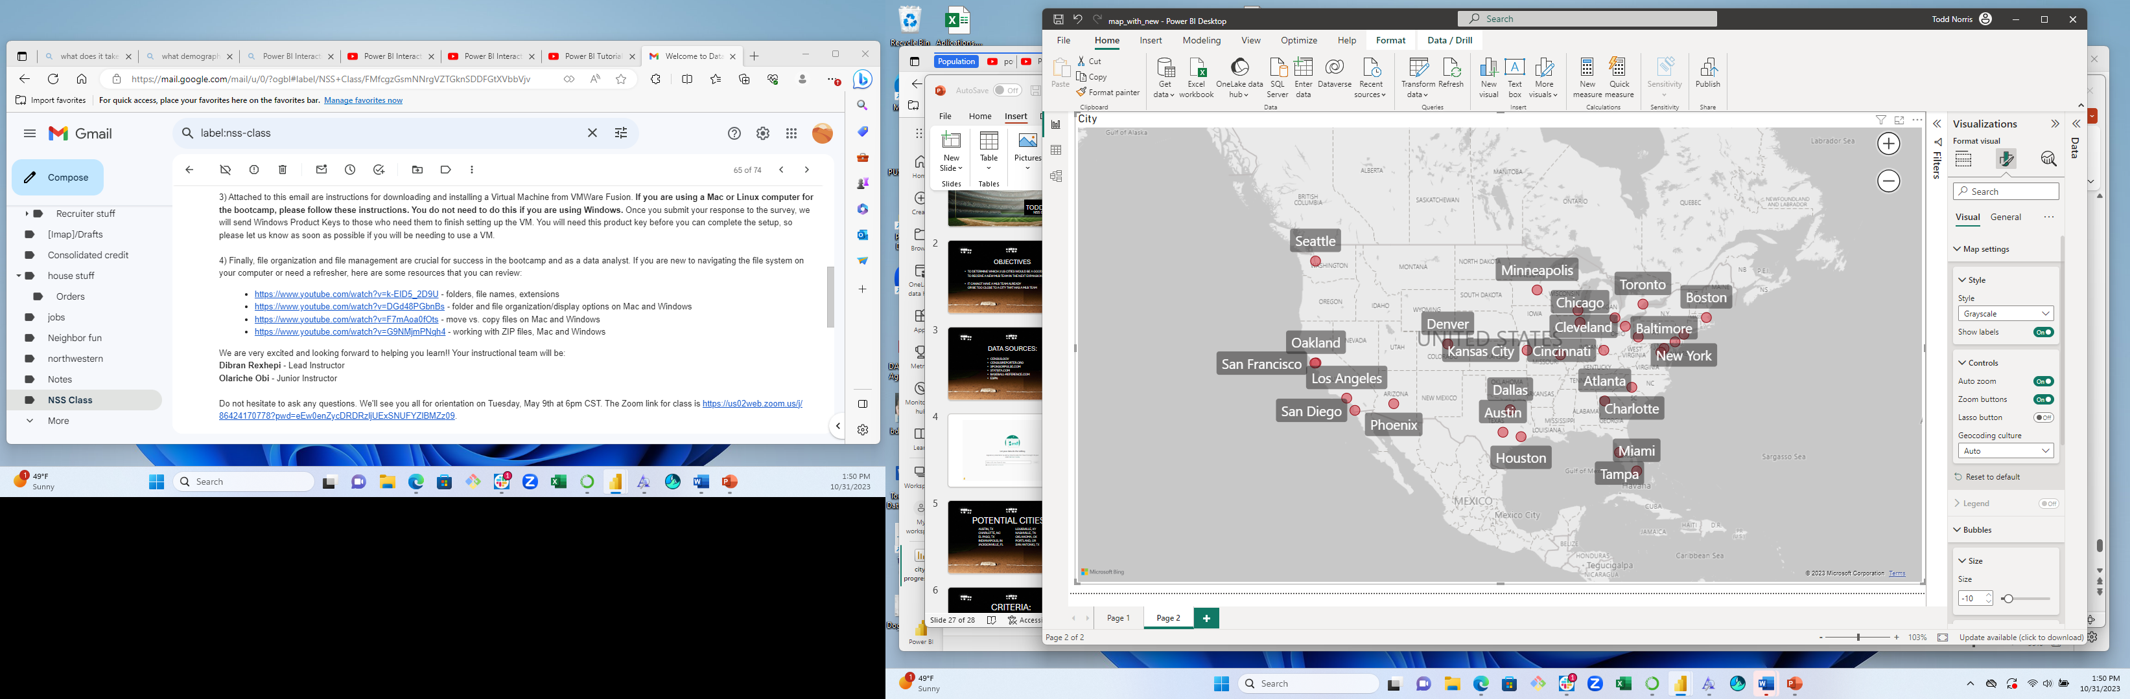

Slide 29
ANY QUESTIONS?

