Slide 1
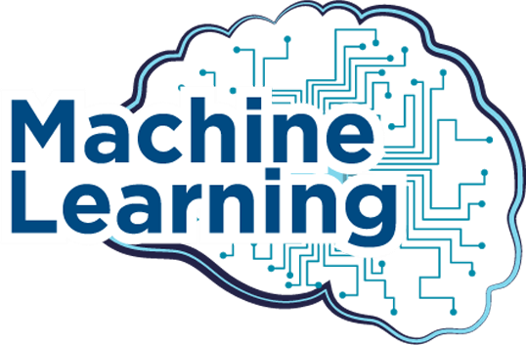

Slide 2
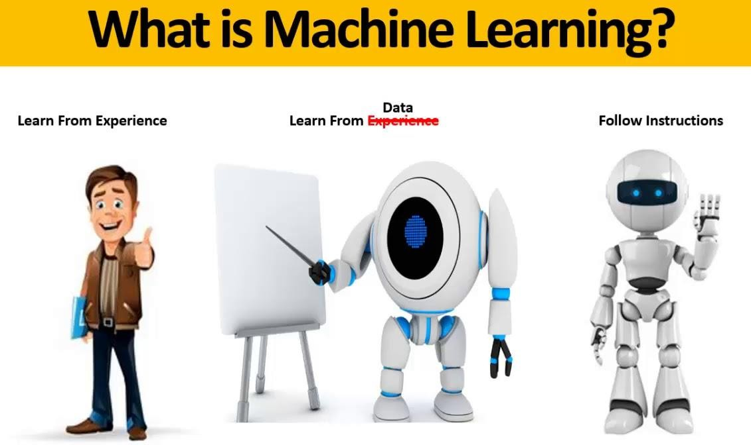



Slide 3

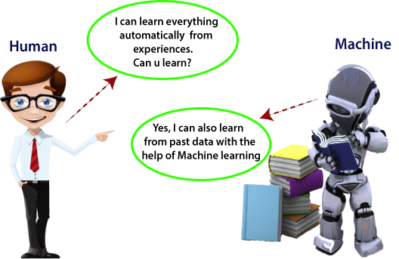

Slide 4



Slide 5
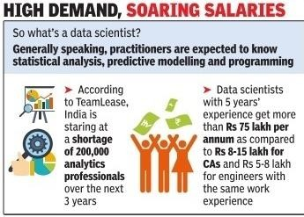


Slide 6
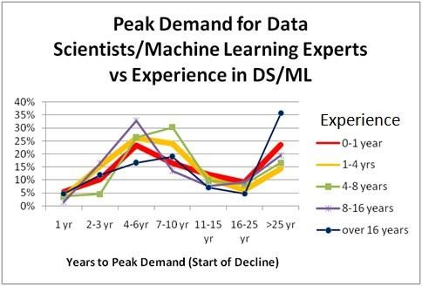


Slide 7



Slide 8

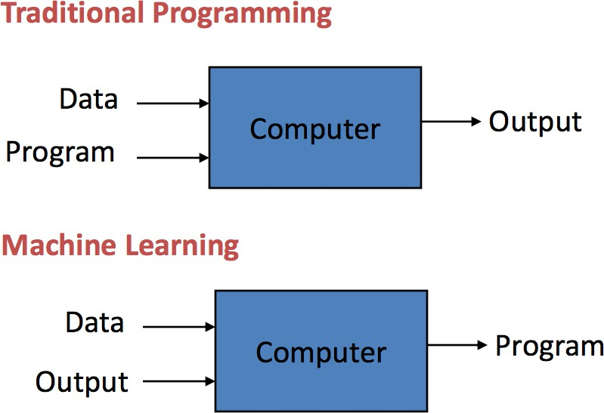

Slide 9

How Machine will Learn like Human Learning?

Slide 10


How does Machine Learning work

Slide 11

Machine Learning Engineer Responsibilities

Slide 12

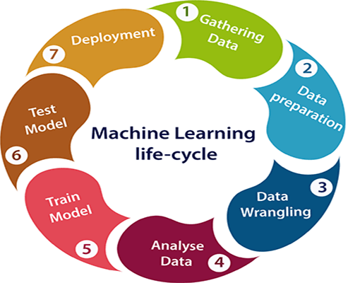
Machine Learning Life Cycle

Slide 13

Features of Machine Learning

Slide 14

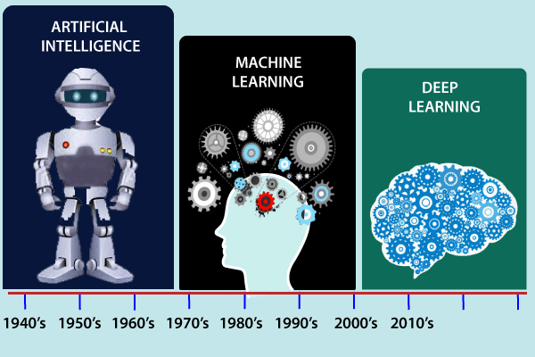
History of Machine Learning

Slide 15
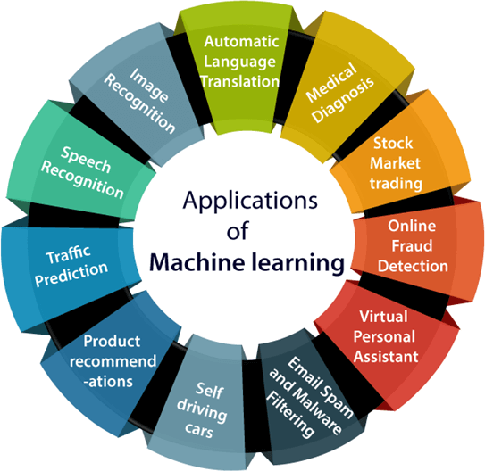
Applications of Machine learning

Slide 16
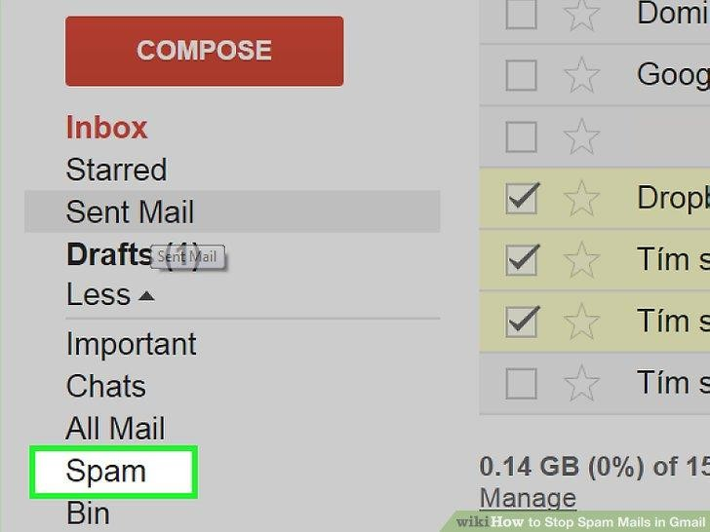


Slide 17

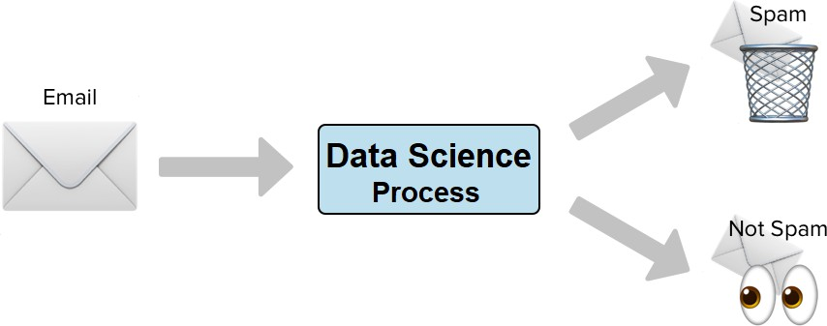

Slide 18

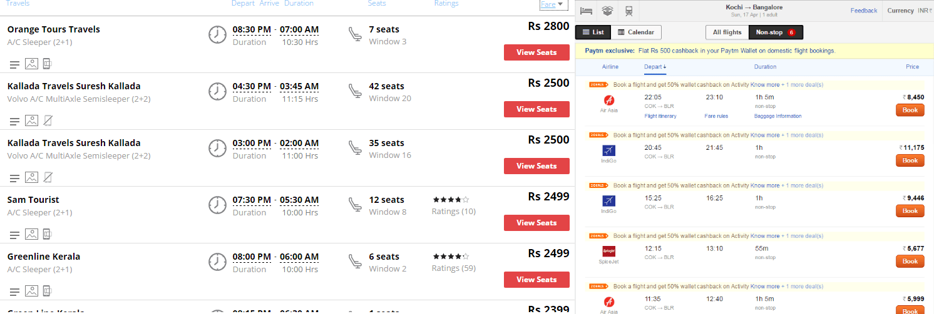

Slide 19
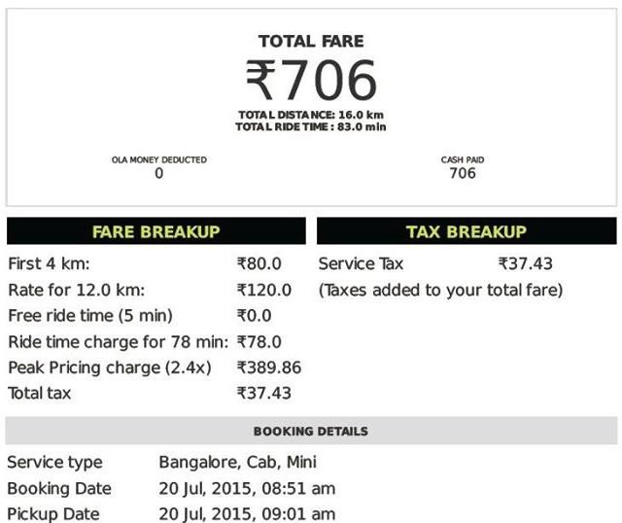


Slide 20
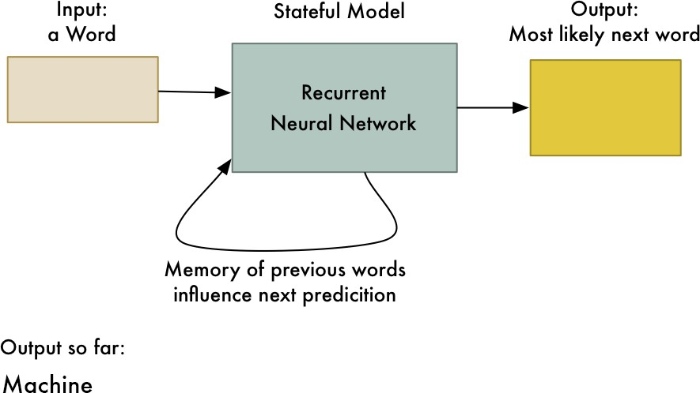

Slide 21


Slide 22
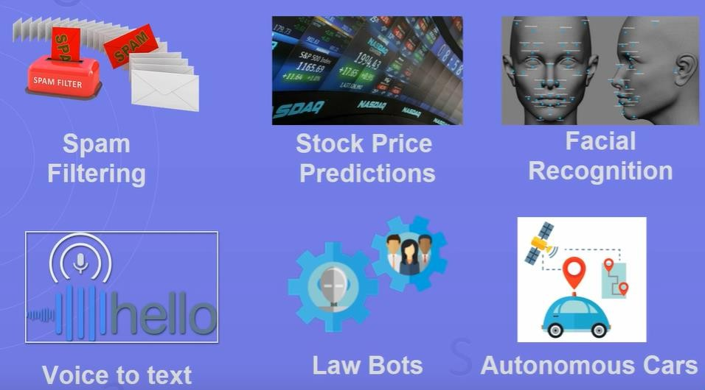

Slide 23
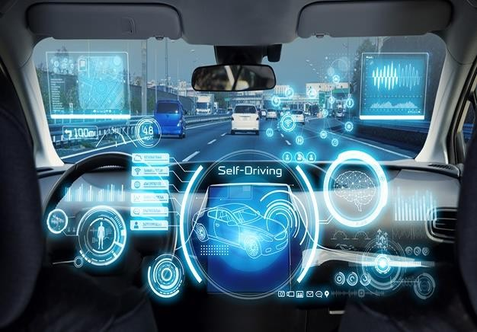

Slide 24
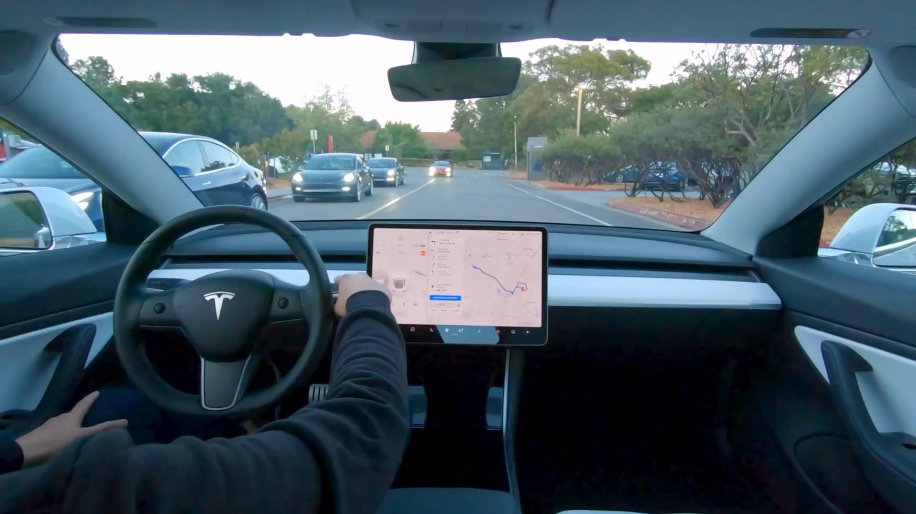

Slide 25


Slide 26


Slide 27

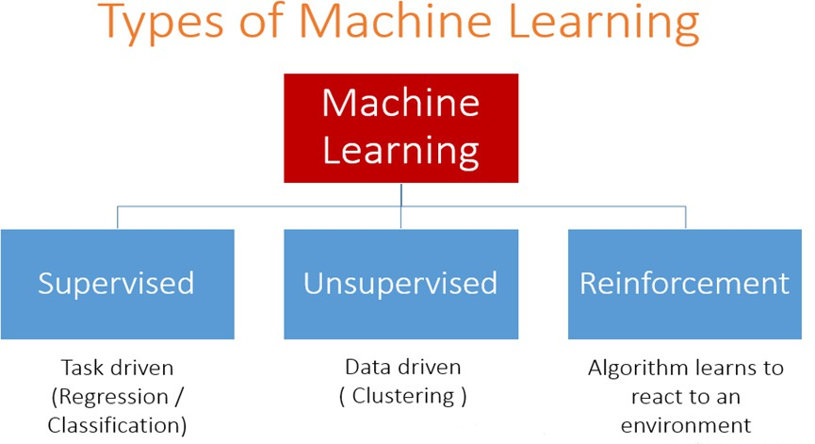

Slide 28

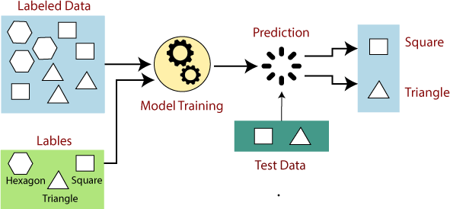
Supervised Machine Learning

Slide 29
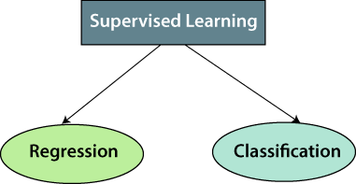
Types of Supervised Machine Learning Algorithms

Slide 30

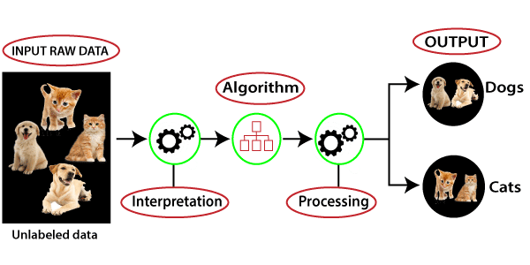
Unsupervised Machine Learning

Slide 31

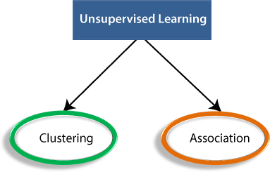
Types of Unsupervised Learning Algorithm

