Slide 1
Overloaded passenger detection and real-time tracking in Metrorail using deep learning

Slide 2
Input video
Apply YOLOV5
Passenger Classification
Bounding box with confidence
Assign Unique ID to each passenger
Find ROI to track the passenger using their ID
Count Passengers inside the ROI
No. of Passenger > Threshold
Fig. Realtime Overloaded passenger detection and tracking in Metro rail using deep learning
yes
no
Overloaded
Not Overloaded

Slide 3
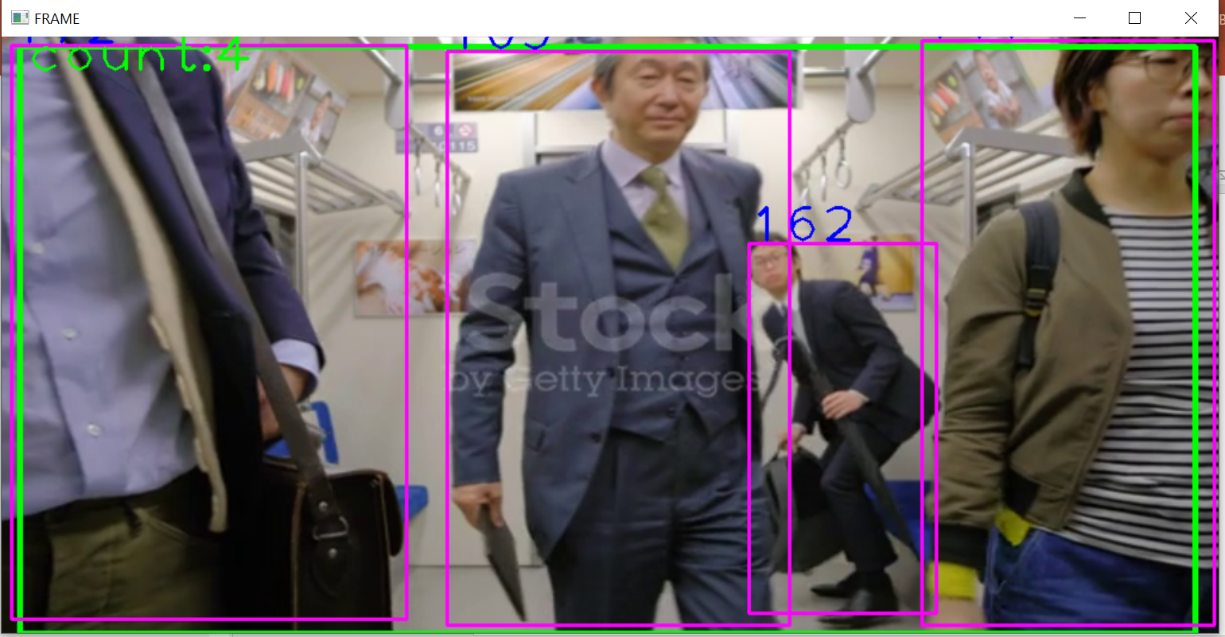
Output of YOLOV5 (fast and accurate)

Slide 4
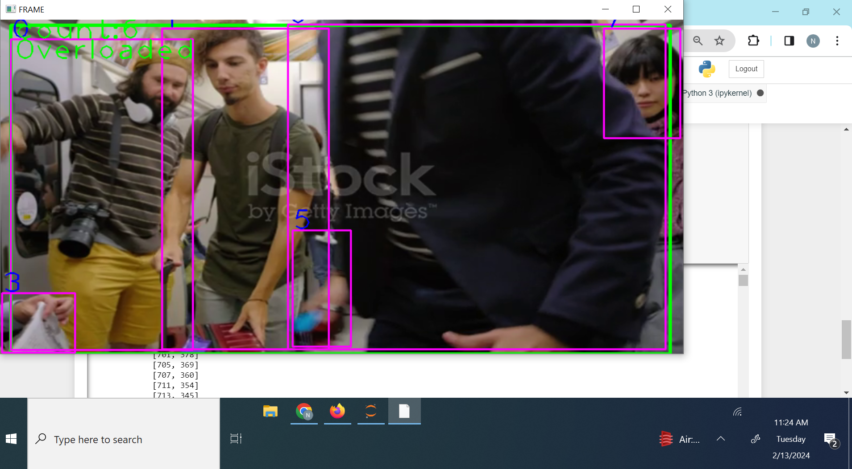
Output of YOLOV5

Slide 5
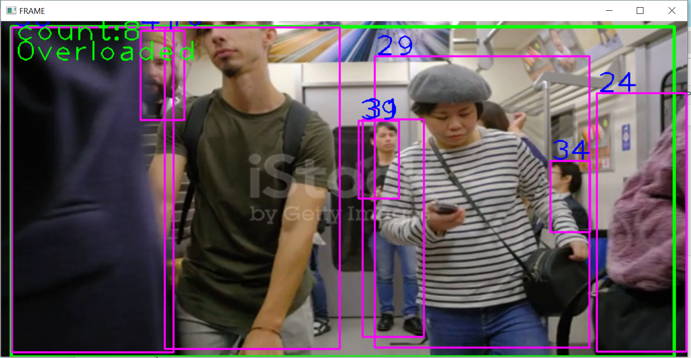
Output of YOLOV5

Slide 6
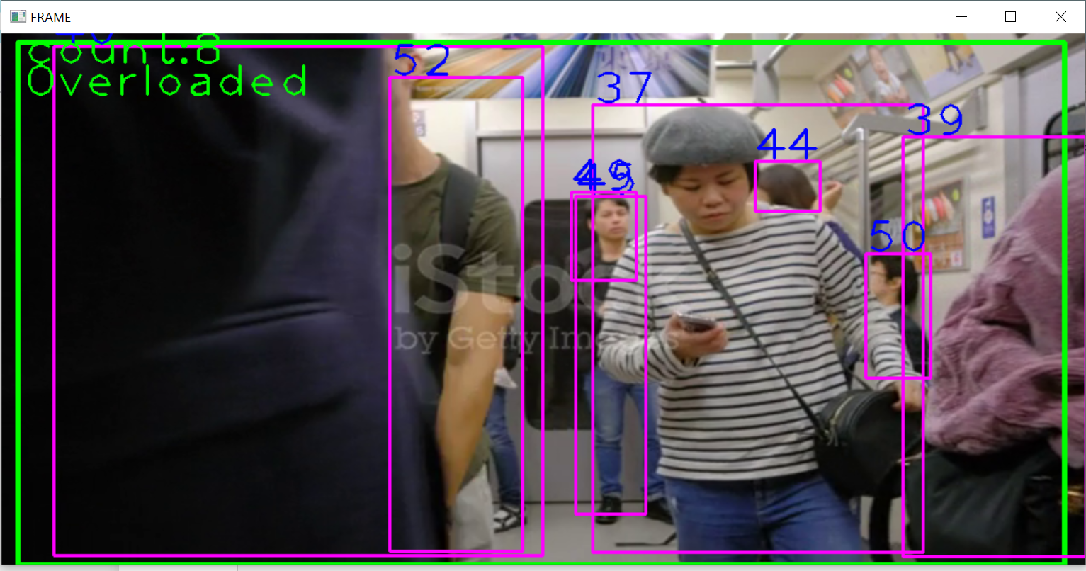
Output of Faster RCNN (more accurate but slow)

Slide 7
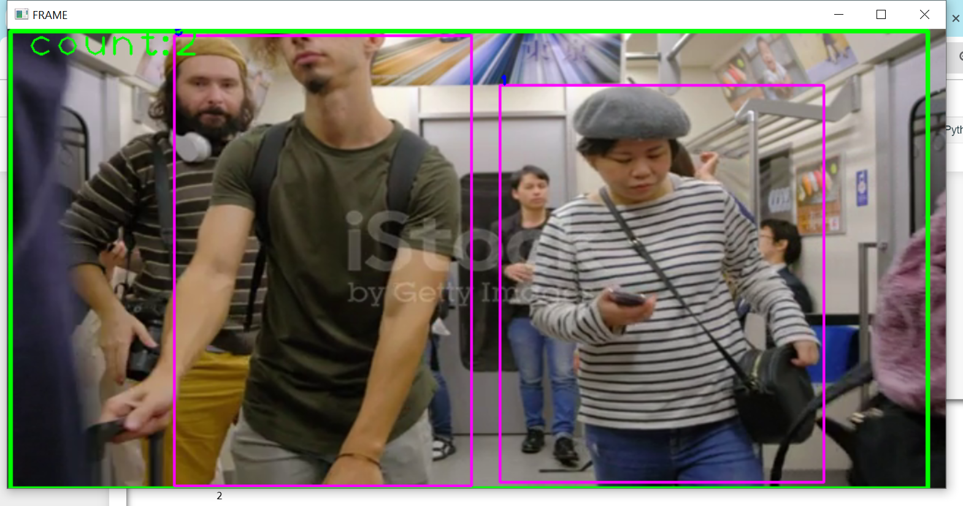
Output of SSD (very fast but less accurate)

Slide 8
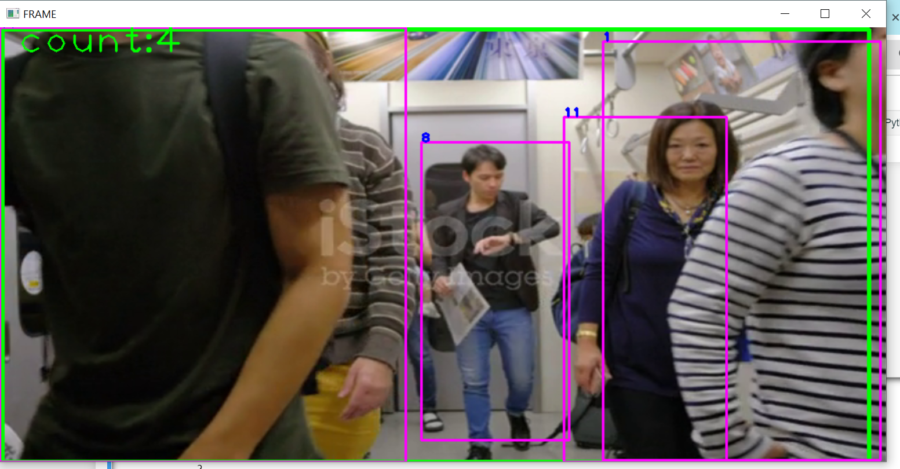
Output of SSD

Slide 9
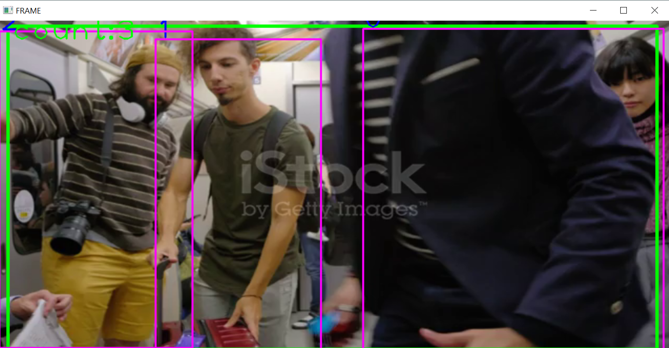
Output of RetinaNet (slow & accurate)

Slide 10
Comparison between YOLO and SSD
Accuracy: YOLO generally achieves higher accuracy compared to SSD, especially on small objects and in scenarios where objects are closely packed together. This is because YOLO divides the input image into a grid and predicts bounding boxes and class probabilities directly for each grid cell, allowing it to better capture small objects.
Speed: SSD is usually faster than YOLO, especially on GPU, because it doesn't need to perform grid-wise predictions like YOLO. Instead, it predicts bounding boxes at multiple scales and aspect ratios using a set of predefined anchor boxes. Both models are good in real-time applications.

Slide 11
Comparison between YOLO and FasterRCNN
Accuracy: YOLO tends to have slightly lower accuracy compared to Faster R-CNN, especially on small objects and in scenarios where objects are closely packed together and real time data. Faster R-CNN generally achieves higher accuracy compared to YOLO, especially on small objects and in complex scenes, due to its two-stage architecture.
Speed: YOLO is faster than Faster R-CNN, especially during inference, because it directly predicts bounding boxes and class probabilities for each grid cell. Faster R-CNN is slower than YOLO, particularly during inference, because it involves two stages: region proposal generation and bounding box refinement. It is more accurate but slower than YOLO and SSD.

Slide 12
Comparison between YOLO and RetinaNet
Accuracy vs. Speed:
YOLO is known for its speed and real-time performance. It sacrifices some accuracy for speed, making it suitable for applications where real-time inference is critical, such as video surveillance and autonomous driving.
RetinaNet achieves higher accuracy compared to YOLO, especially for small objects, but it is generally slower due to its two-stage detection process. It is often used in applications where accuracy is prioritized over speed, such as medical imaging and satellite imagery analysis.

Slide 13
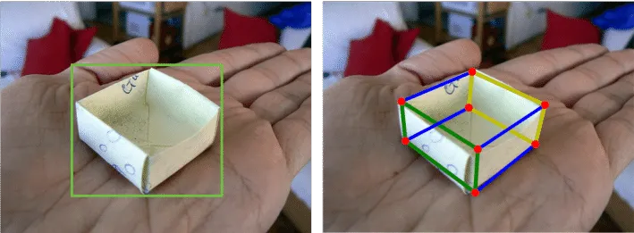
Limitations
Limitations of camera coverage: This can be overcome by the transition from the 2D bounding box to the 3D bounding box.

