Slide 1
Jquery

Slide 2
What is Jquery ?
jQuery is a fast and concise JavaScript Library created by John Resig in 2006 with a nice motto: Write less, do more. jQuery simplifies HTML document traversing, event handling, animating, and Ajax interactions for rapid web development

Slide 3
Installation
LocalInstallation Go to the https://jquery.com/download/ to download the latest version available. • Now, insert downloaded jquery-2.1.3.min.js file in a directory of your website, e.g. /jquery.
e.g
<script type="text/javascript" src="/jquery/jquery-2.1.3.min.js"></script>
<script type="text/javascript">
$(document).ready(function(){
document.write("Hello, World!");
});
</script>
CDNBasedVersion You can include jQuery library into your HTML code directly from Content Delivery Network (CDN). Google and Microsoft provides content deliver for the latest version. We are using Google CDN version of the library throughout this tutorial.
e.g
<script type="text/javascript"
src="http://ajax.googleapis.com/ajax/libs/jquery/2.1.3/jquery.min.js">
</script>

Slide 4
How to Call a jQuery Library Functions?
As almost everything, we do when using jQuery reads or manipulates the document object model (DOM), we need to make sure that we start adding events etc. as soon as the DOM is ready.
$(document).ready(function() {
// do stuff when DOM is ready
});

Slide 5
Better approach
/* Filename: custom.js */
$(document).ready(function() {
$("div").click(function() {
alert("Hello world!");
}); });
Now we can include custom.js file in our HTML file as follows:
<html>
<head>
<title>The jQuery Example</title>
<script type="text/javascript"
src="/jquery/jquery-1.3.2.min.js"></script>
<script type="text/javascript"
src="/jquery/custom.js"></script>
</head>
<body>
<div id="newdiv">
Click on this to see a dialogue box.
</div>
</body>
</html>
Important
// Import other library
// Import jQuery
$.noConflict();
jQuery(document).ready(function($) {
// Code that uses jQuery's $ can follow here.
});
// Code that uses other library's $ can follow here.

Slide 6
Objects
Objects
var emp = {
name: "Zara",
age: 10
};
// Getting object properties
emp.name // ==> Zara
emp.age // ==> 10
// Setting object properties
emp.name = "Daisy" // <== Daisy
emp.age = 20 // <== 20

Slide 7
Array
var x = [];
var y = [1, 2, 3, 4, 5];
var x = [1, 2, 3, 4, 5];
for (var i = 0; i < x.length; i++) {
// Do something with x[i]
}

Slide 8
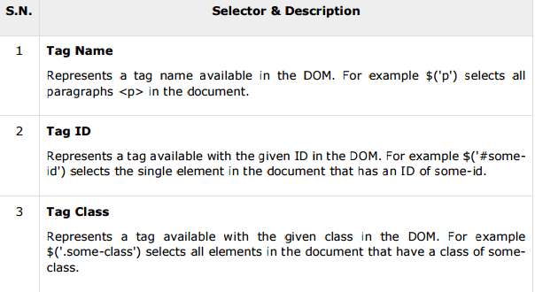
SELECTORS
The jQuery library harnesses the power of Cascading Style Sheets (CSS) selectors to let us quickly and easily access elements or groups of elements in the Document Object Model (DOM).
The factory function $() makes use of the following three building blocks while selecting elements in a given document:
The factory function $() is a synonym of jQuery() function. So in case you are using any other JavaScript library where $ sign is conflicting with some thing else then you can replace $ sign by jQuery name and you can use function jQuery() instead of $()

Slide 9
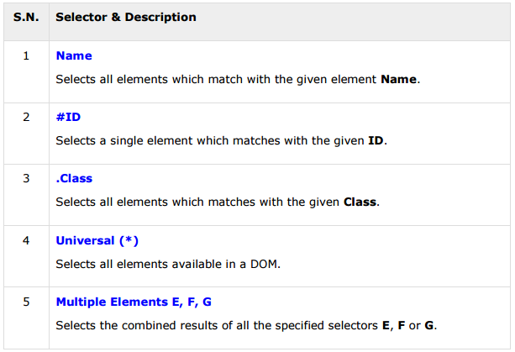
How to Use Selectors?
Example
$('p') − Selects all elements with a tag name of p in the document.
$('div') − Selects all elements with a tag name of div in the document

Slide 10
An Example
<html>
<head>
<title>The Selecter Example</title>
<script type="text/javascript"
src="http://ajax.googleapis.com/ajax/libs/jquery/2.1.3/jquery.min.js">
</script>
<script type="text/javascript" language="javascript">
$(document).ready(function() {
/* This would select all the divisions */
$("div").css("background-color", "yellow");
});
</script>
</head>
<body>
<div class="big" id="div1">
<p>This is first division of the DOM.</p>
</div>
<div class="medium" id="div2">
<p>This is second division of the DOM.</p>
</div>
<div class="small" id="div3">
<p>This is third division of the DOM</p>
</div>
</body>
</html>

Slide 11
Note It for reference
Example •
$('div, p') − selects all the elements matched by div or p.
$('p strong, .myclass') − selects all elements matched by strong that are descendants of an element matched by p as well as all elements that have a class of myclass.
$('p strong, #myid') − selects a single elements matched by strong that is descendant of an element matched by p as well as element whose id is myid.
$("li:not(.myclass)") Selects all elements matched by that do not have class="myclass".
$("a#specialID.specialClass") This selector matches links with an id of specialID and a class of specialClass.
$("p a.specialClass") This selector matches links with a class of specialClass declared within elements.
$("ul li:first") This selector gets only the first element of the .
$("li > ul") Selects all elements matched by that are children of an element matched by
$("strong + em") Selects all elements matched by that immediately follow a sibling element matched by .
$("p ~ ul") Selects all elements matched by that follow a sibling element matched by .
$(":empty") Selects all elements that have no children.
$("a[@rel]") Selects all elements matched by that have a rel attribute.
$("input[@name=myname]") Selects all elements matched by that have a name value exactly equal tomyname.
$("tr:odd") Selects all elements matched by that have an odd index value.

Slide 12
Apply Css Class The addClass( classes ) method
<html>
<head>
<title>the title</title>
<script type="text/javascript"
src="/jquery/jquery-1.3.2.min.js"></script>
<script type="text/javascript" language="javascript">
$(document).ready(function() {
$("em").addClass("selected");
$("#myid").addClass("highlight");
});
</script>
<style>
.selected { color:red; }
.highlight { background:yellow; }
</style>
</head>
<body>
<em title="Bold and Brave">This is first paragraph.</em>
<p id="myid">This is second paragraph.</p>
</body>
</html>

Slide 13
Important Methods
attr( properties ) Set a key/value object as properties to all matched elements.
attr( key, fn ) Set a single property to a computed value, on all matched elements.
removeAttr( name ) Remove an attribute from each of the matched elements.
hasClass( class ) Returns true if the specified class is present on at least one of the set of matched elements.
removeClass( class ) Removes all or the specified class(es) from the set of matched elements.
toggleClass( class ) Adds the specified class if it is not present, removes the specified class if it is present.
html( ) Get the html contents (innerHTML) of the first matched element.
html( val ) Set the html contents of every matched element.
text( ) Get the combined text contents of all matched elements.
text( val ) Set the text contents of all matched elements.
val( ) Get the input value of the first matched element.
val( val ) Set the value attribute of every matched element if it is called on <input> but if it is called on <select> with the passed <option> value then passed option would be selected, if it is called on check box or radio box then all the matching check box and radiobox would be checked.

