Slide 1
RoadRank
Final Demo
Driver Behavior FYP
Nasir Ahmad — G00419630
Bachelor of Engineering (Honours) in Software and Electronic Engineering · Atlantic Technological University · 2025/2026

Slide 2
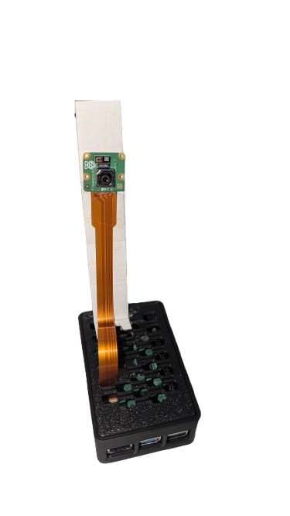
Recap
What RoadRank is
An edge-based driver monitoring system that detects unsafe driving in real time and gamifies safer driving through a leaderboard.
Semester 1 - Research and models
Trained the behaviour classifier (VGGNet, AlexNet, ResNet) and the Siamese facial verification model in Google Colab and Jupyter.

Slide 3
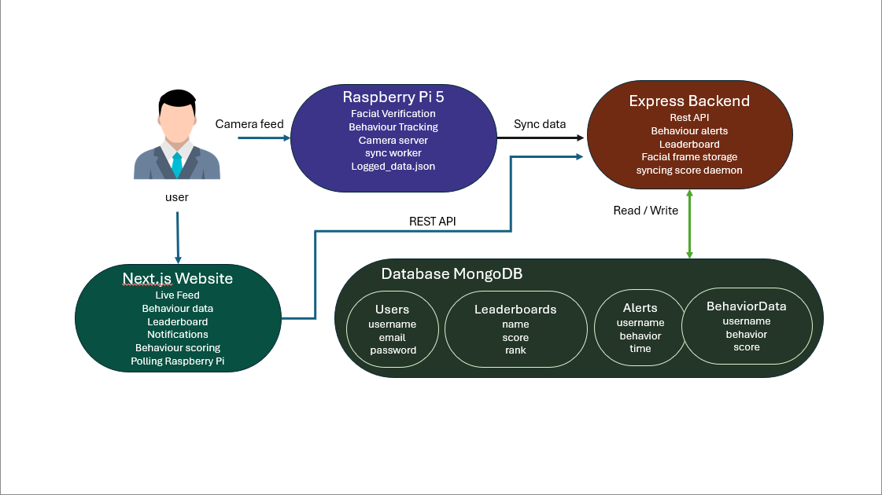
Architecture Diagram

Slide 4
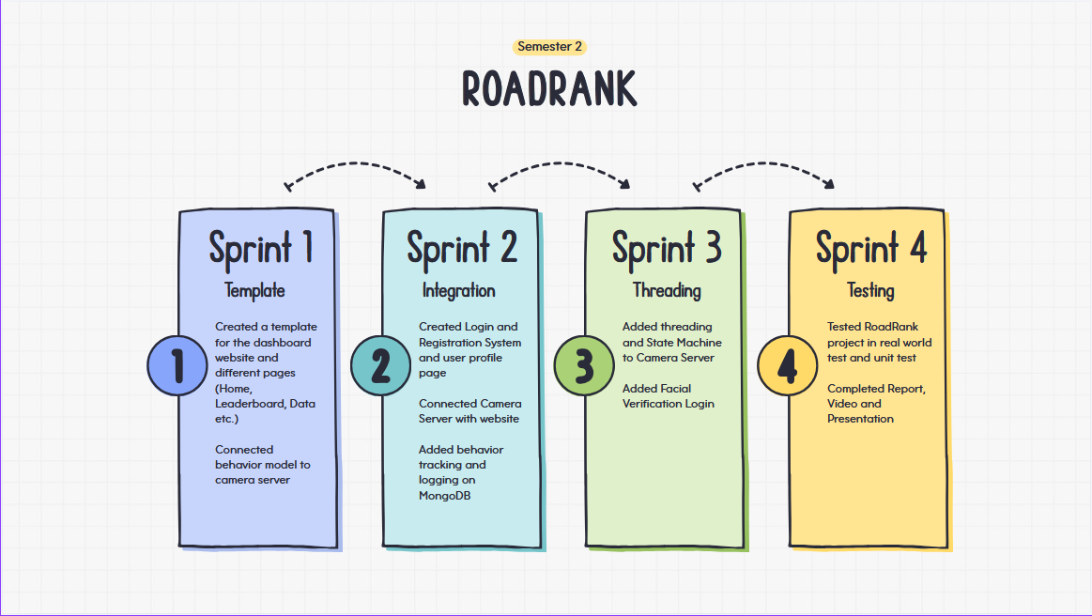
Timeline

Slide 5
1
unverified
Initial state. The first captured frame triggers start_verify, and the machine moves to verifying.
Camera Server
State machine
& Threading
2
verifying
Each frame is preprocessed and compared against the user's stored faces using the Siamese L1 model. On match -> verify_success.
3
verified
Behaviour classification runs on every other frame. A 5-frame agreement buffer debounces noisy predictions before logging.
Why a single-worker, slot-based handoff?
Capture loop overwrites a single pending frame and signals an event. The worker drains it, runs the model, repeats. Stale frames are dropped, threads never accumulate, the Pi stays responsive.

Slide 6
Facial Verification
Frame in
Preprocess
Embedding
L1 distance
Match?
Pi Camera Module 3
Resize 100x100
Normalise 0–1
Twin tower
4096-d vector
Compare to
stored faces
>50% agreement
-> verified
Up to 50 reference frames
Scoped by expected user
Thresholds
ffmpeg pulls 1 frame every 0.33s from the user's setup video, capped at 50, into application_data/verification_images/<user>/.
When a username is supplied, the Pi only compares against that user's folder verification falls from seconds to a fraction of a second.
0.5 per-frame and 0.5 aggregate match thresholds tuned for real-world lighting on the Pi camera, not lab conditions.

Slide 7
Per-event scoring
Safe
+10
5-frame agreement
An event is only logged when the last 5 predictions all agree, and only if the label is new. Cuts noise drastically: a one-second commitment gate.
Turn
+5
Behaviour
classification
& debouncing
Other
-2
Talking
-5
Texting
-10
Throughput on the Pi 5
~10 fps capture, classification on every other frame (~5 Hz inference) - best-effort alert posted to Express on a background thread so dangerous behaviours surface immediately.

Slide 8
Web Stack
Express API - Node.js - Mongoose
Next.js 14 - React - Pages
POST /register
bcrypt-hashed passwords, 10 salt rounds
POST /facial-setup
multer upload -> ffmpeg fps=3, max 50 frames per user
POST /login
bcrypt.compare; on success the Pi is told via /set-user
POST /api/alerts - GET/DELETE /api/alerts/:user
real-time channel for dangerous-behaviour notifications
GET /api/behavior-log - GET /api/leaderboard
history + global ranking, both queried from the dashboard
Live Feed
polls /frame at 10 Hz, /status every 3 s, behaviour pill colour-coded
Behaviour Dashboard
inline SVG score chart, summary cards, paginated event log
Leaderboard
medals for top 3, score-banded colours, current user highlighted
Notifications
5-second poll for fresh alerts, severity-coloured cards, clear-all
Auth - Login / Register / Facial Setup
dual login (password OR face), localStorage-persisted session

Slide 9
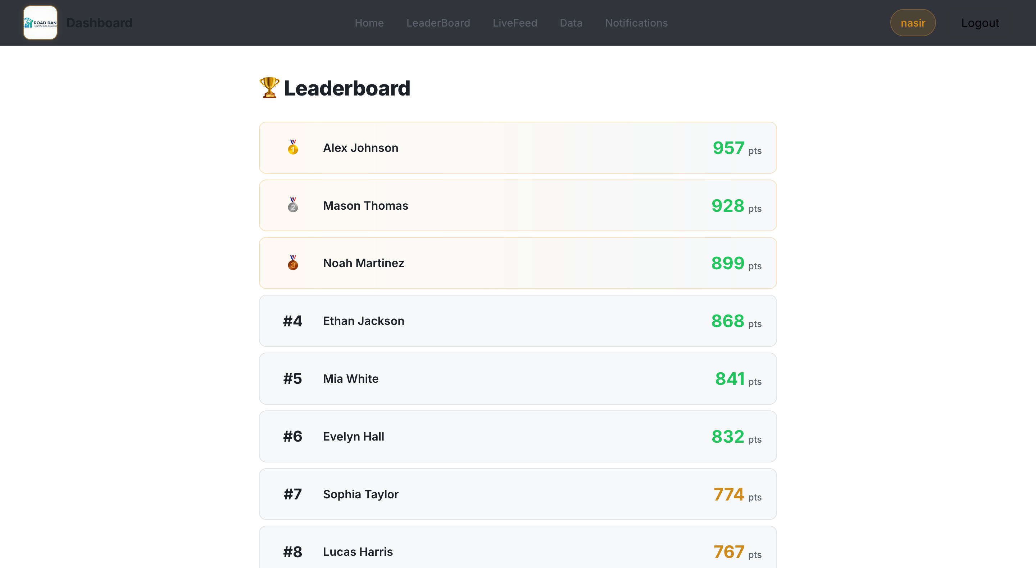
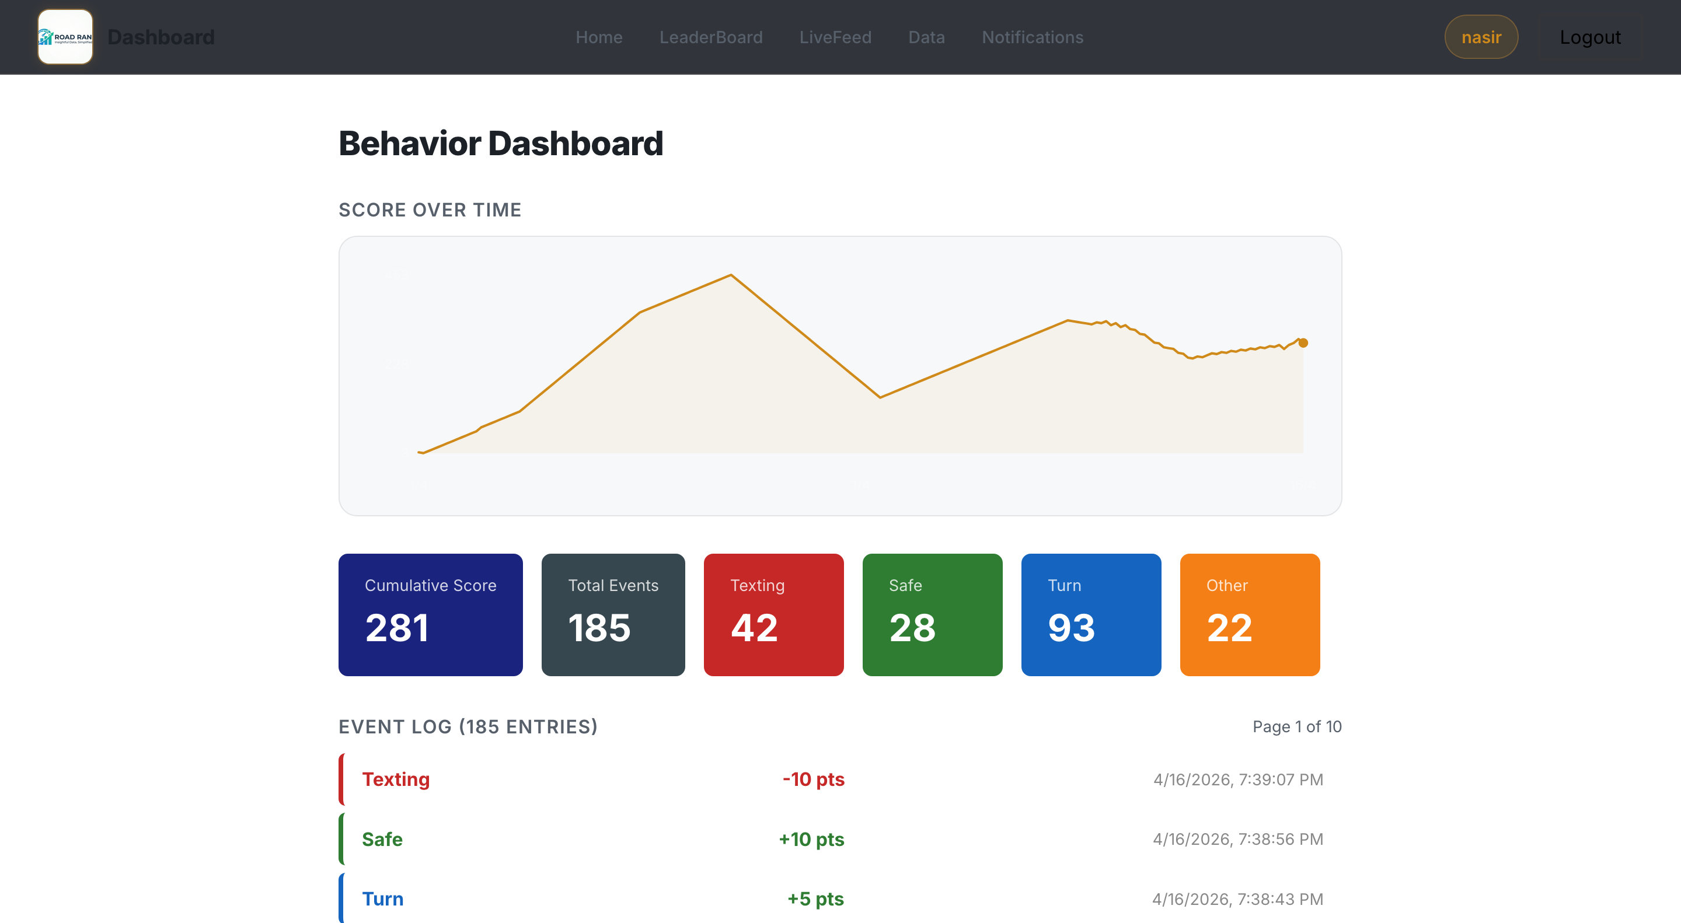
Bulk Write
Pi keeps a JSON log on disk, durable across crashes
sync_score.js mirrors entries into Mongo every 10 minutes
Leaderboard ranks recomputed in a single bulkWrite
Real-time alerts channel still fires immediately for the user-facing case
Score sync
& the
leaderboard
Per-Event syncing
Single point of failure, any Atlas hiccup drops driving data
Constant chatter from the Pi over an unreliable home network

Slide 10
Results & Evaluation
Behaviour classifier - held-out test accuracy
Facial verification - Siamese network
> 0.9
> 0.9
precision @ 0.5 threshold
recall @ 0.5 threshold
- 70/30 train/test split, 50 epochs, batch size 16
- Real-time verify() on the Pi 5 via picamera2 — verified / not verified overlay
User Testing
Performance Testing
Unit Tests (Playwright E2E)
- User registered a fresh account on the web app.
- Prometheus + NetData monitoring the Pi 5.
- Playwright drives a real headless Chromium against the app.
- Drove a 10-minute session - observed the final score.
- 30-minute run: camera server + sync_score.
- 33 tests across home.spec.js, auth.spec.js, leaderboard.spec.js.
- Surfaced UX improvements to the dashboard flow.
- Max CPU temperature reached 85 degC - throttling threshold.
- 33 / 33 pass - full suite runs in parallel in under 2 minutes.
- Risk: thermal throttling and possible crash under load.
- Auto-starts the Next.js dev server; HTML report via show-report.

Slide 11
Challenges
Real-time inference on a Pi
Naively spawning a thread per captured frame led to thread accumulation and growing latency. Fixed with a single worker, a one-slot pending-frame buffer, and an event-driven handoff, stale frames are dropped, the Pi stays under thermal limits.
Noisy frame-by-frame predictions
The classifier flipped between adjacent classes across consecutive frames, producing useless logs. Solved by requiring 5 consecutive predictions to agree before committing an event, gave a clean human-readable behaviour timeline.
Pi - dashboard recovery
Either side could go down independently. The dashboard now shows an offline card with the exact restart command, and the Pi state machine resets cleanly on /reset the system tolerates either component being restarted mid-session.

Slide 12
Set out to
Build a real-time driver monitoring system that uses computer vision to recognise the driver and classify driving behavior and makes safer driving rewarding through a leaderboard.
Conclusion
Delivered
An end-to-end working product: Pi-based camera server with a state machine, Express API, MongoDB-backed dashboard, dual-mode authentication, real-time alerts, persistent leaderboard.
Learned
How model choices show up in production: debouncing, throttling, scoped verification. What it takes to make an embedded device and a full web stack work together reliably over a flaky network.

Slide 13
Thank you for listening!
Video Demo:
https://youtu.be/GTDBRtyNb0g
GitHub:
https://github.com/Nasir-AhmadZ/Dashboard
https://github.com/Nasir-AhmadZ/FacialVerificationML
https://github.com/Nasir-AhmadZ/Driver-Analysis-ML-Model
Questions?
Supervisor: Ben Kinsella
Atlantic Technological University

